Slide 1

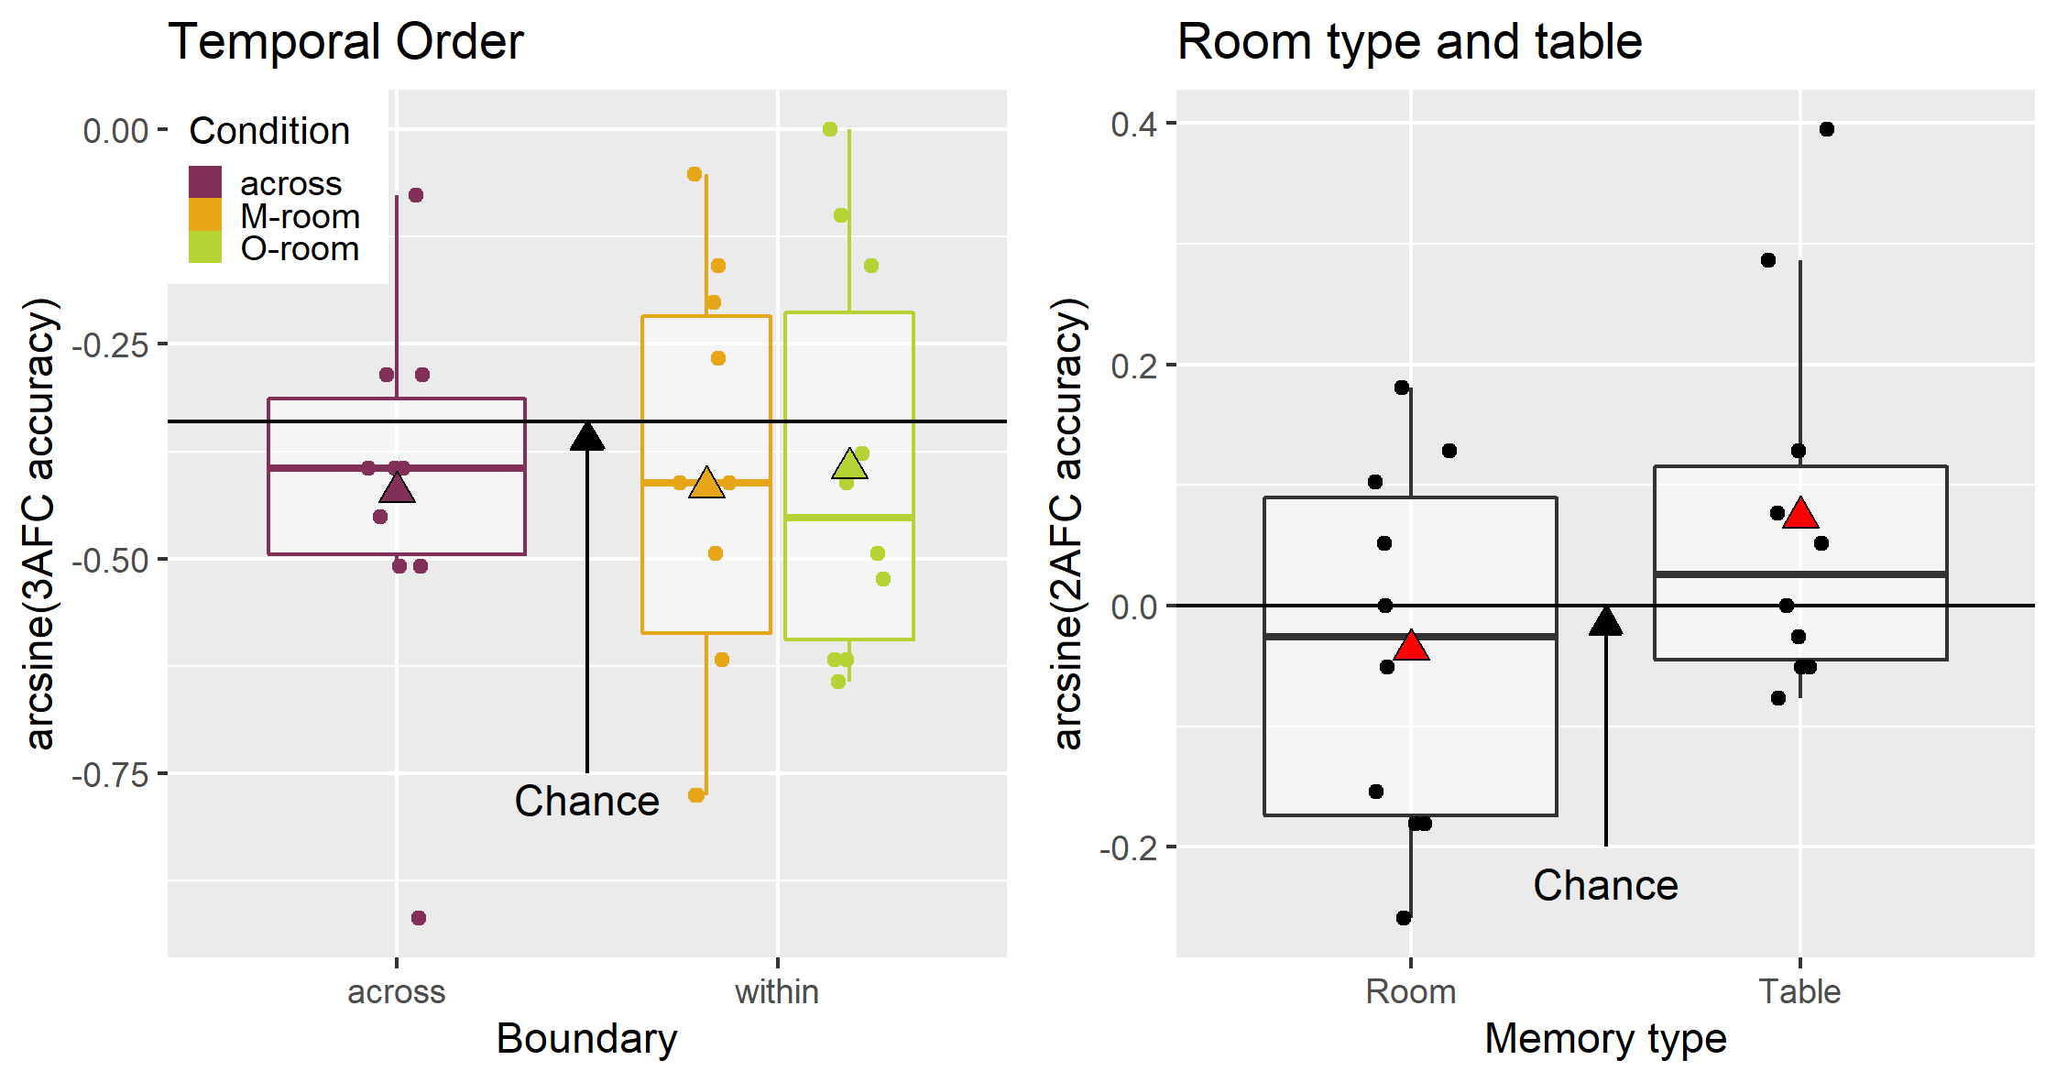
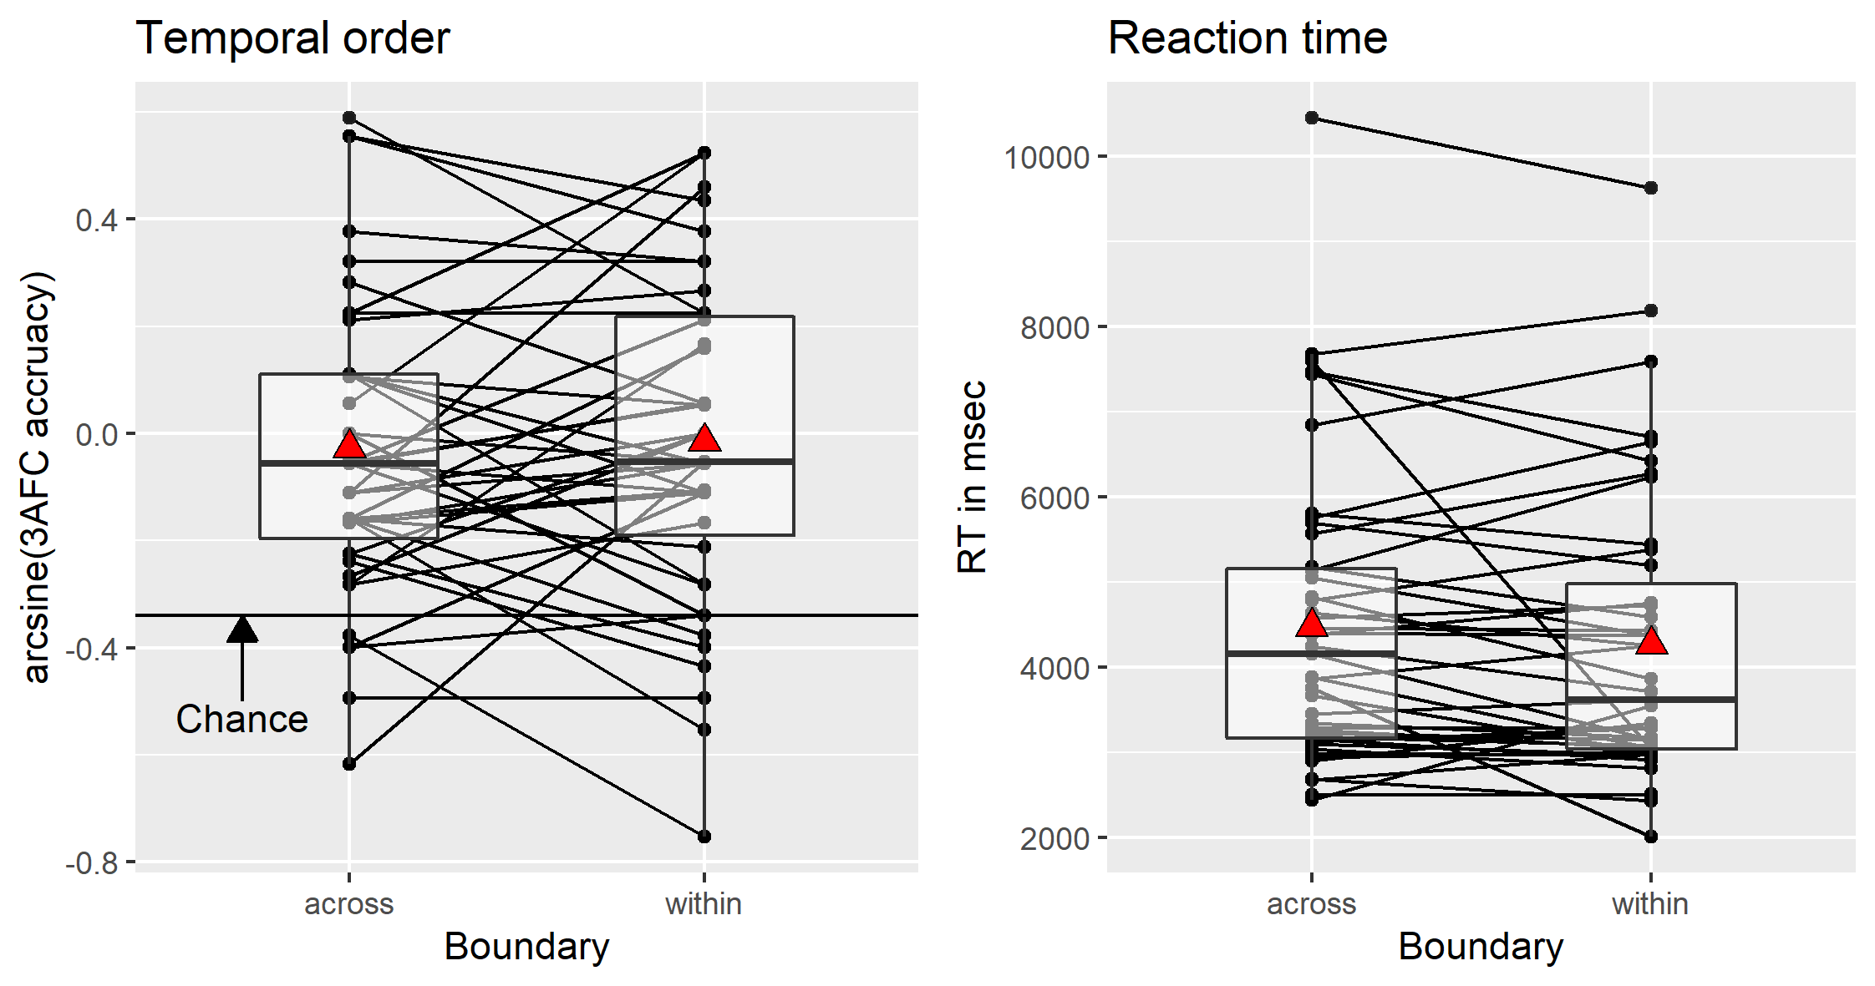
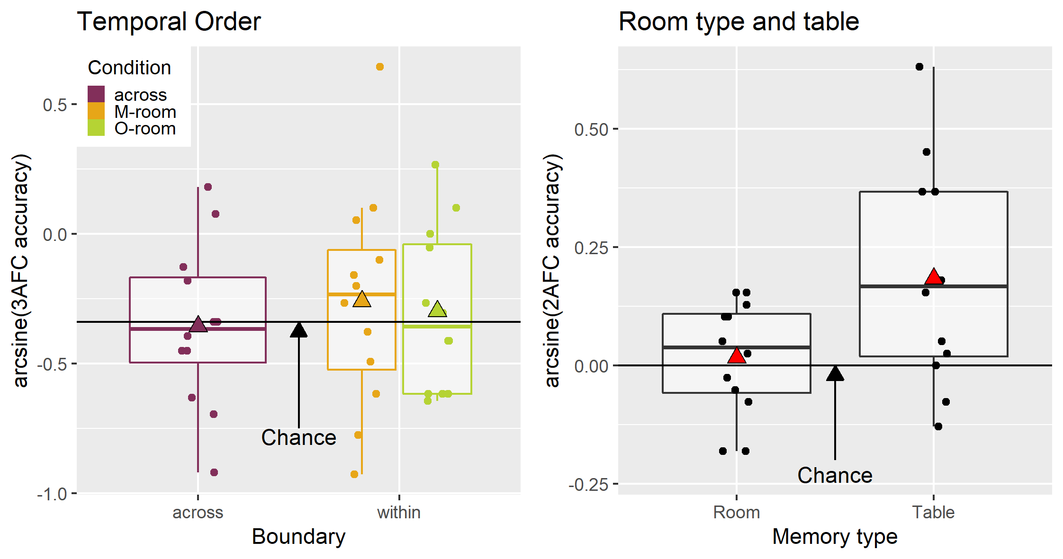
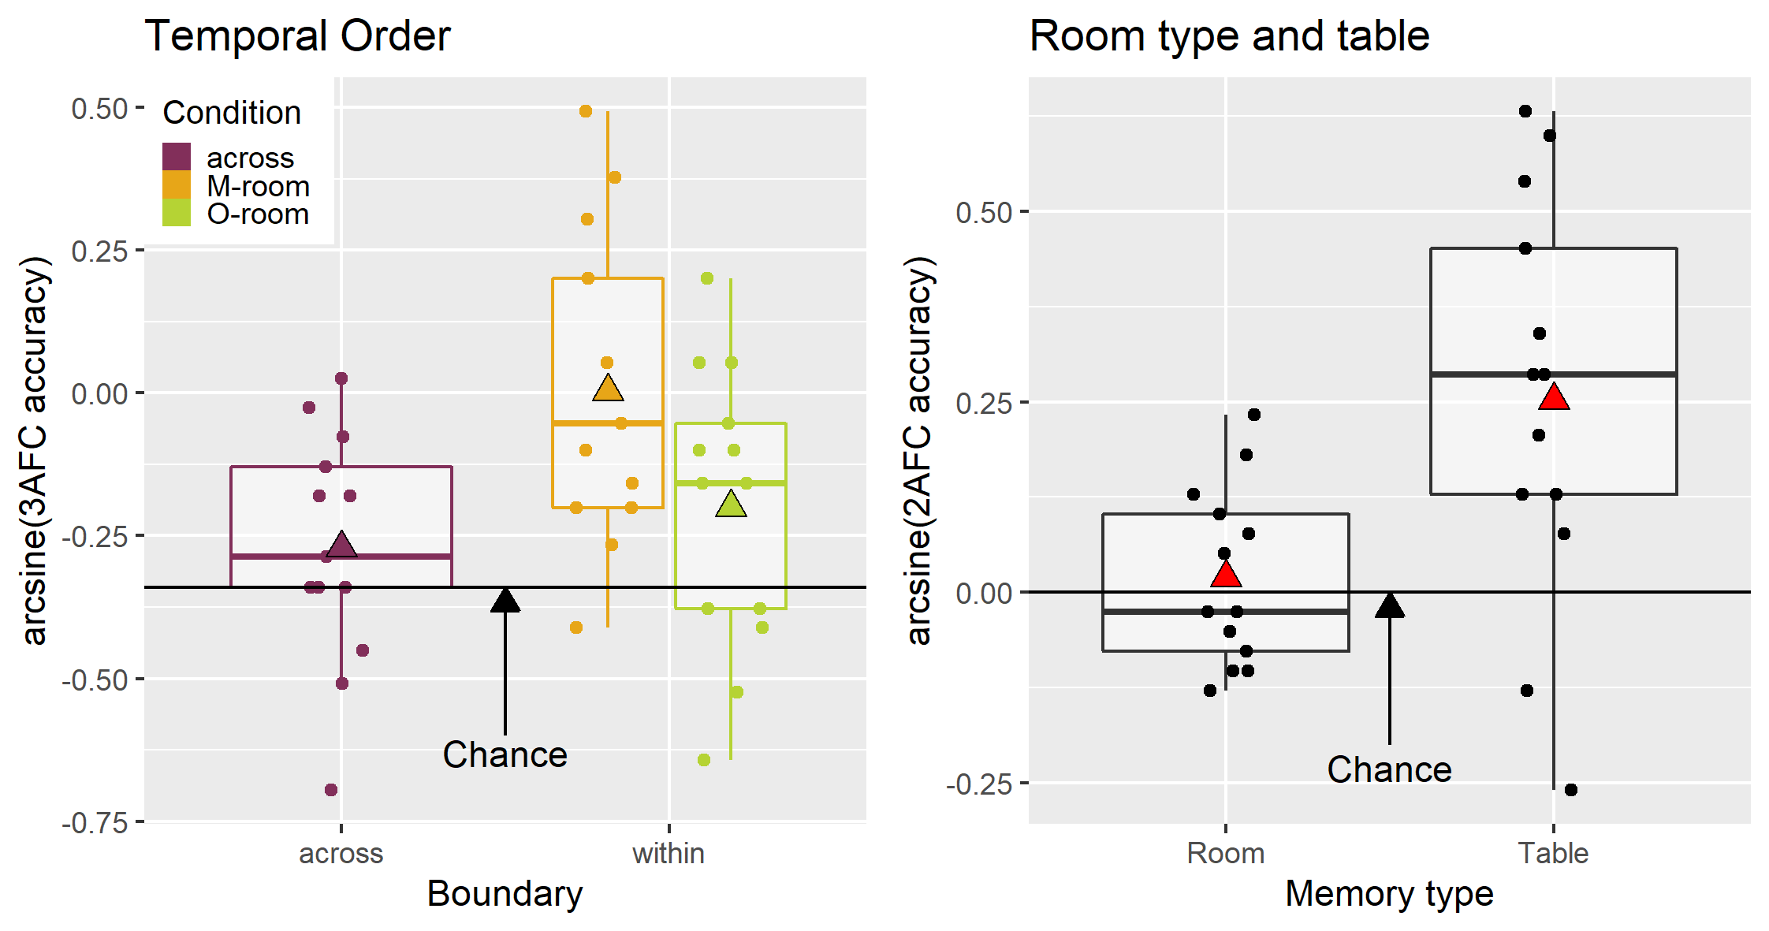
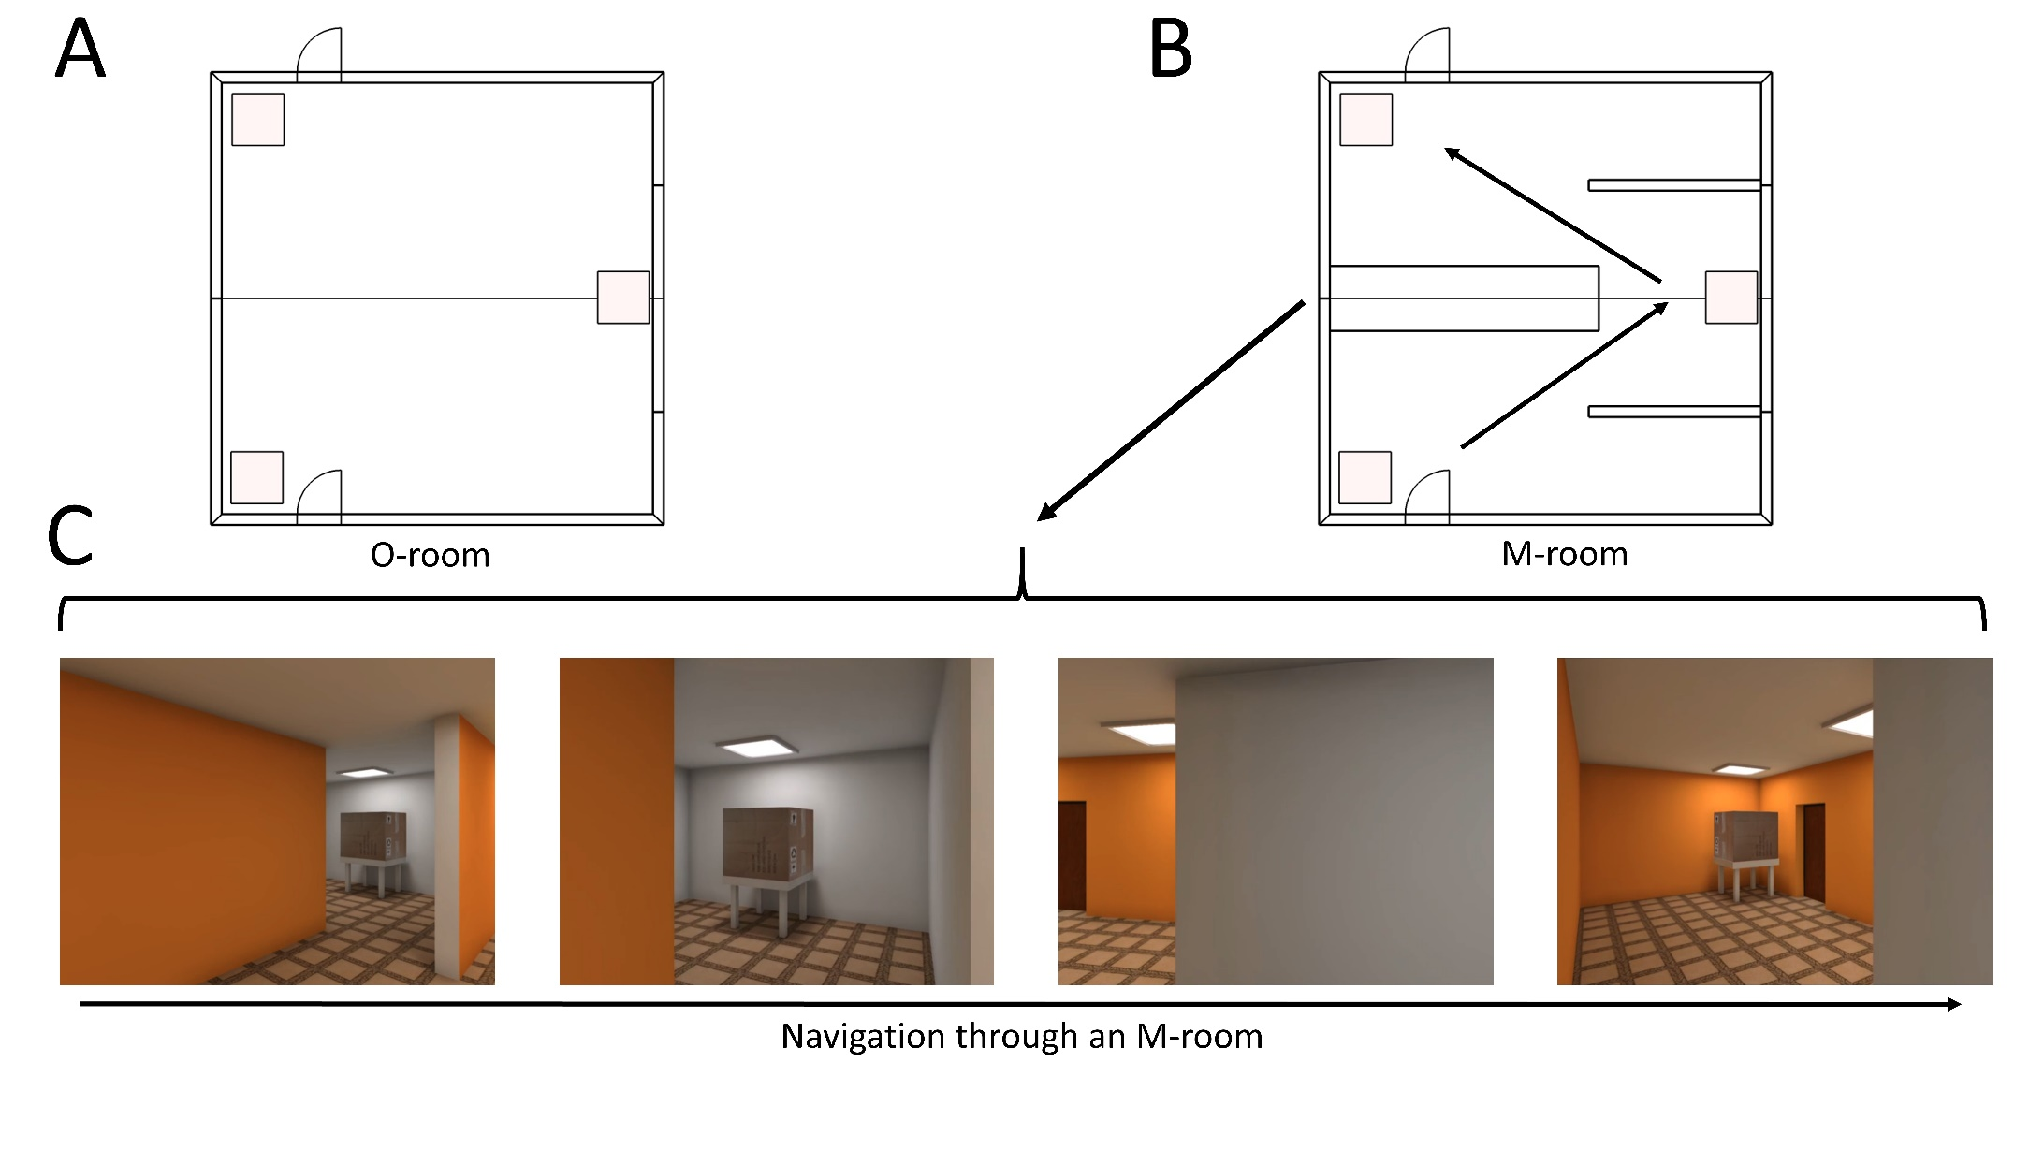
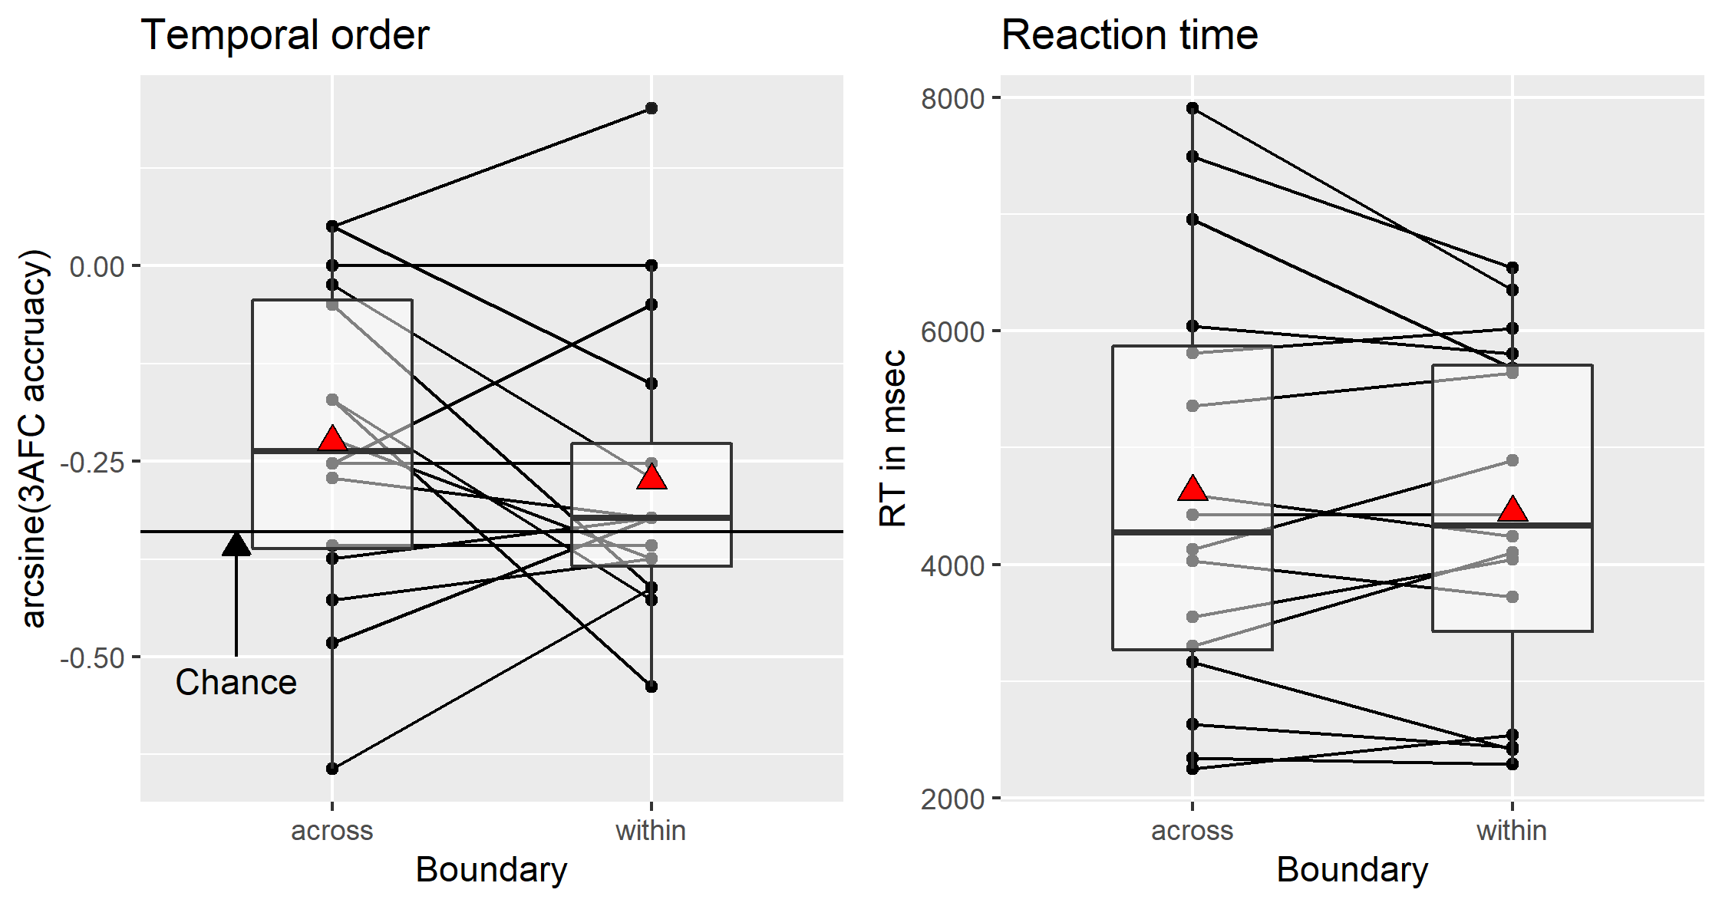
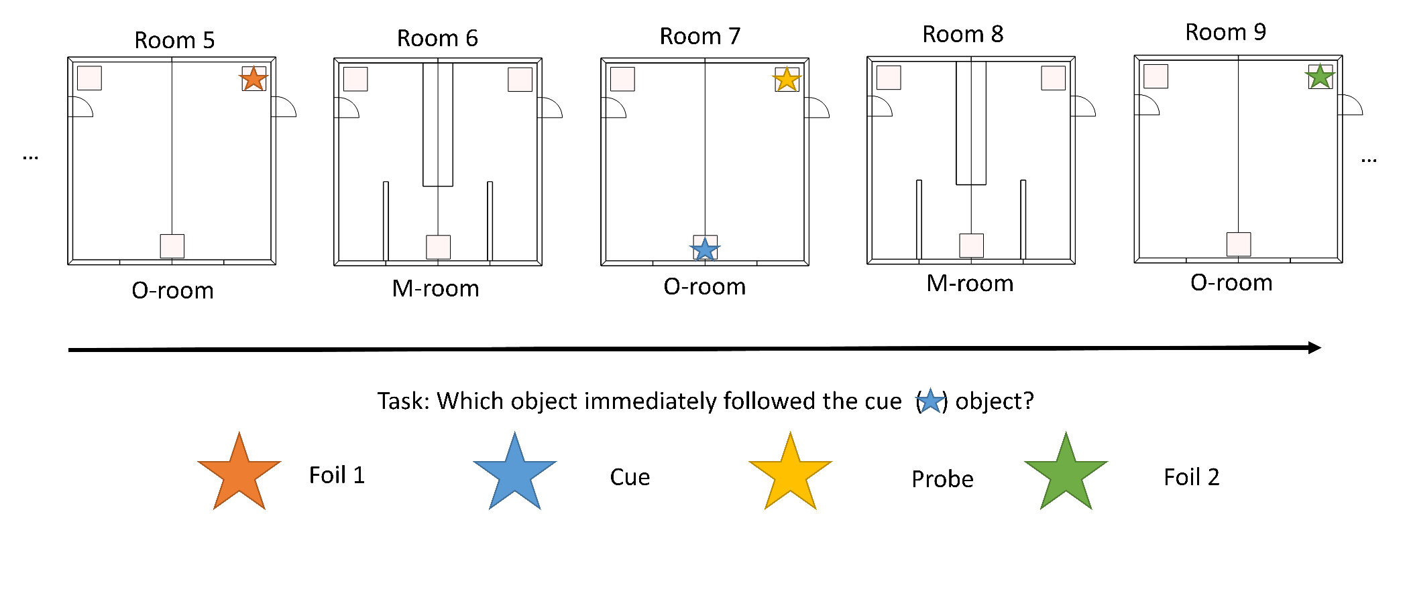
The role of perceptual change and prediction error in the spatial boundary effect on temporal order memory
Jörn Alexander Quent, Richard N. Henson & Aya Ben-Yakov,
MRC Cognition and Brain Sciences Unit, University of Cambridge
Follow me on twitter @J_A_Quent
Website: https://jaquent.me/
Introduction
Experiment 1 (Pilot)
Experiment 3
Event boundaries
As we experience the world through a continuous stream of sensory input, our brains are constantly trying to predict what comes next.
Prediction errors (PE) can result in “event boundaries”, which segment our memories for our experiences.
Walking into a new room is maybe the classic example of a boundary, and the temporal order effect demonstrates different temporal order memory across boundaries (Horner et al., 2016)¹.
However, walking between rooms also typically results in large perceptual changes (PC). We proposed an experiment to tease apart the contributions of PE and PC to the formation of event boundaries.
N = 46 (O-rooms only)
Rooms that are more unique.
Intentional memory task with 2 study-test cycles.
No boundary effect in memory performance or RT. BF₀₁= 4.72
Discussion
No boundary effect for Experiment 1 except for M-room in the last batch. In this experiment subjects saw both types of rooms
We collected a total N = 97.
Largely, unable to replicate the boundary effect (within > across).
Possible reasons for null effect:
Rooms too similar (always same layout).
Rooms are on a linear track.
Passive watching vs. active navigation.
General design
Experiment 2
Environment:
A video showing the rooms can be found here: https://vimeo.com/532276947
We designed the M-shape room allowing us manipulate PE & PC independently.
In the first step, we tried to replicate the memory boundary effect (within > across) that Horner et al. (2016)¹ found for M-room as we thought that O-rooms are similar to the rooms in Horner et al.
We ran three variants of the experiment using a similar design.
To replicate the original effect for O-rooms, we used a between subject design (M-rooms vs. O-rooms), which did not find.
N = 16 (O- rooms only)
No boundary effect in accuracy or RT for O-rooms. BF₀₁ = 7.14
Since memory performance was still quite bad, we ran a new experiment to see whether we could improve performance, in case the poor performance was the reason for the lack of an effect.
???
References
1 Horner, A. J., Bisby, J. A., Wang, A., Bogus, K., & Burgess, N. (2016). The role of spatial boundaries in shaping long-term event representations. Cognition, 154, 151–164. https://doi.org/10.1016/j.cognition.2016.05.013

