Slide 1


The role of perceptual change and prediction error in the spatial boundary effect on temporal order memory
Jörn Alexander Quent, Rik N. Henson & Aya Ben-Yakov

Slide 2
Background
As we experience the world through a continuous stream of sensory input, our brains are constantly trying to predict what comes next.
Prediction errors (PE) can result in “event boundaries”, which segment our memories for our experiences.
Walking into a new room is thought to trigger such a boundary, as evidenced by better temporal order memory for objects within the same room than for objects in different rooms, e.g. in a virtual environment (Horner et al., 2016).
However, walking between rooms also typically results in large perceptual changes (PC). We proposed an experiment to tease apart the contributions of PE and PC to the formation of event boundaries.

Slide 3
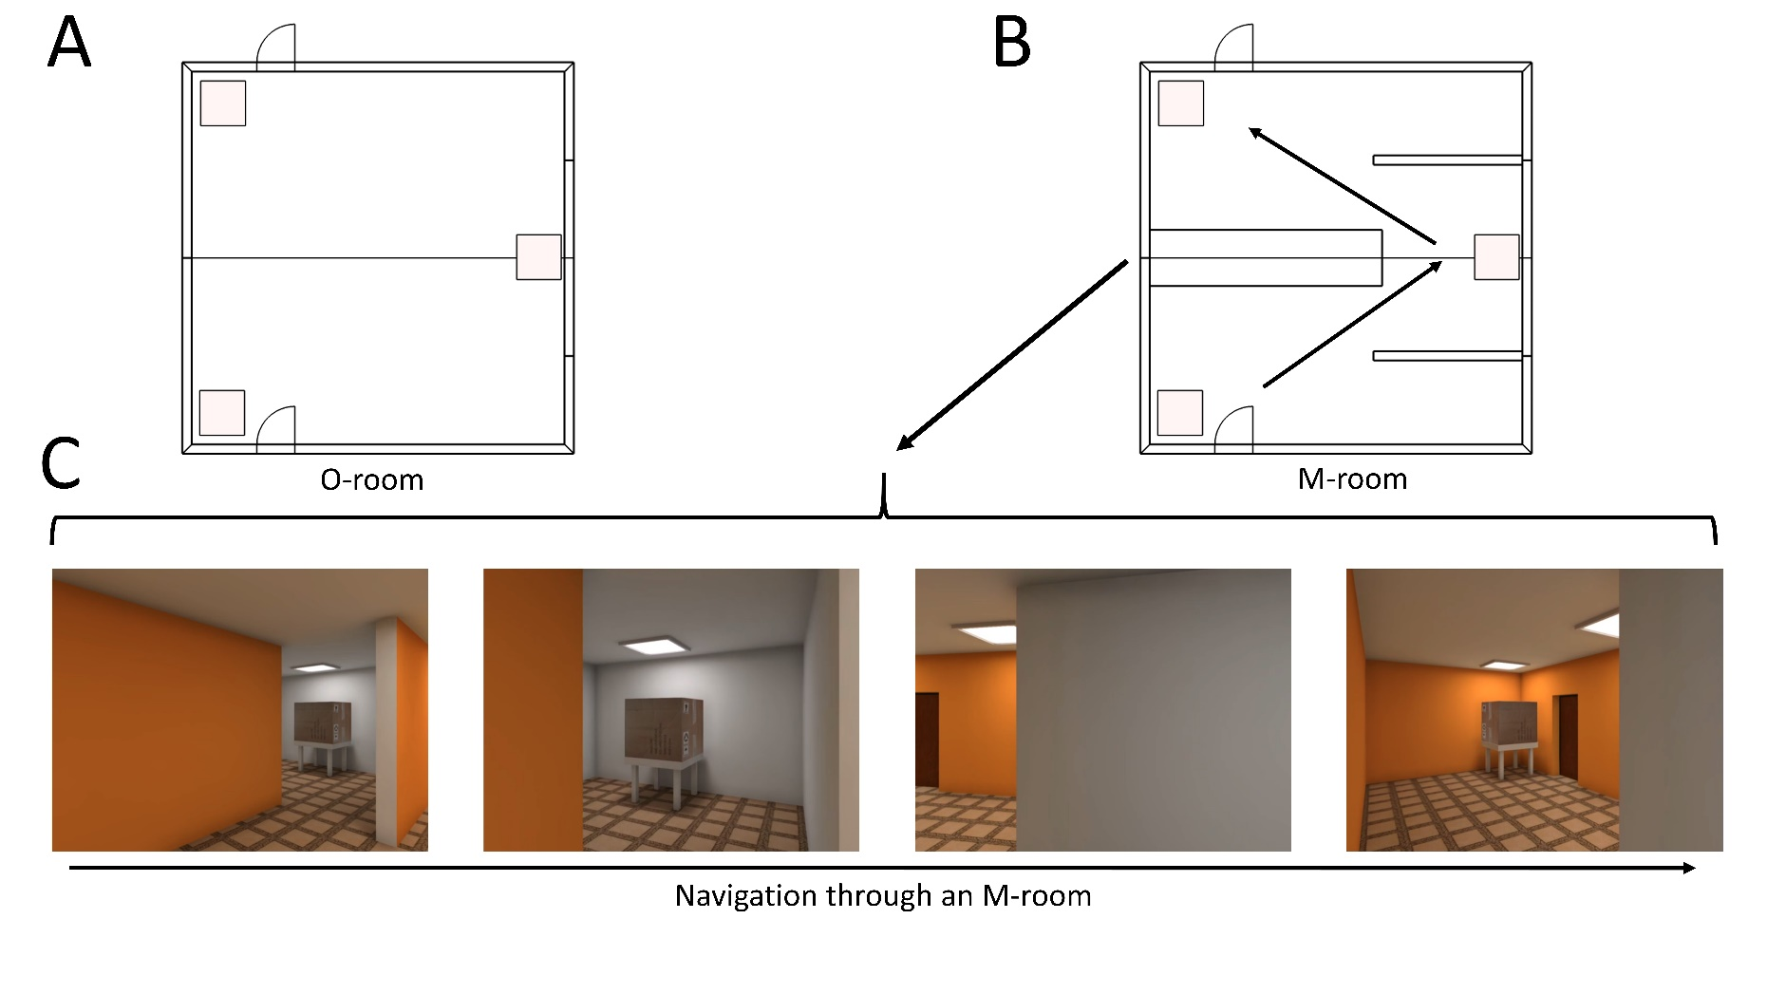
General design
A video showing the rooms can be found here: https://vimeo.com/532276947
Notes:
We designed an “M-room” (Panel B) for virtual environments. When traversing such a room, the viewer can only see one half of the room until they reach the middle section. This enables independent manipulation of PE and PC (Panel C): PC can be induced by changing the wall colours between the two halves of the room, and PE can be induced by presenting a cue indicating the colour of the second half, which is then violated.

Slide 4
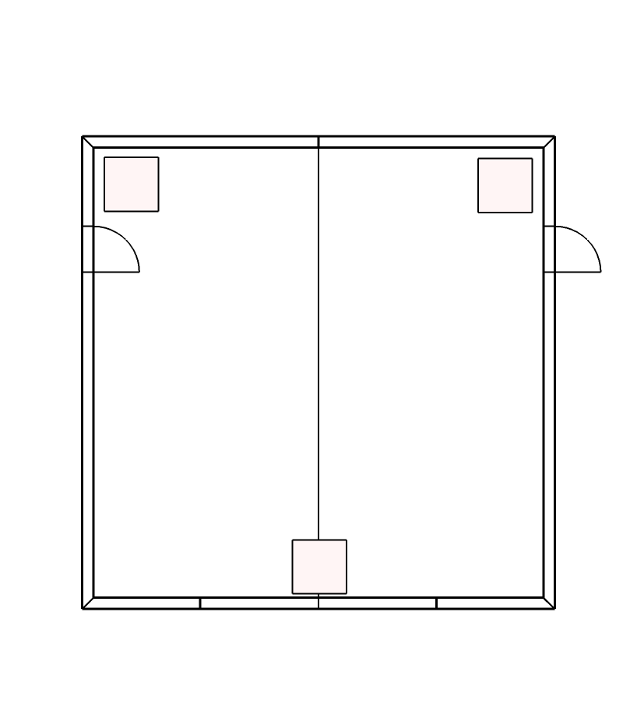
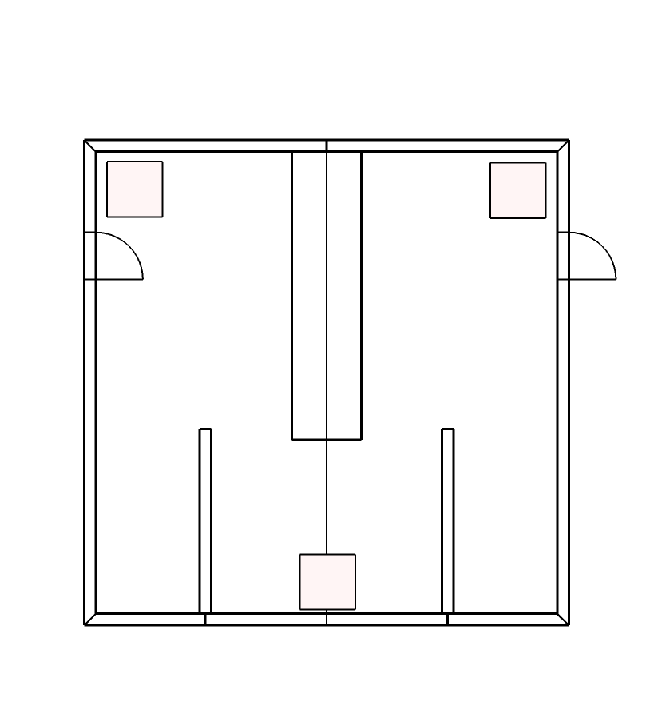
Experiment 1
Room 5
Room 6
Room 7
Room 8
Room 9
…
…
…
O-room
M-room
O-room
M-room
O-room
Task: Which object immediately followed the cue ( ) object?
Foil 1
Cue
Probe
Foil 2

Slide 5
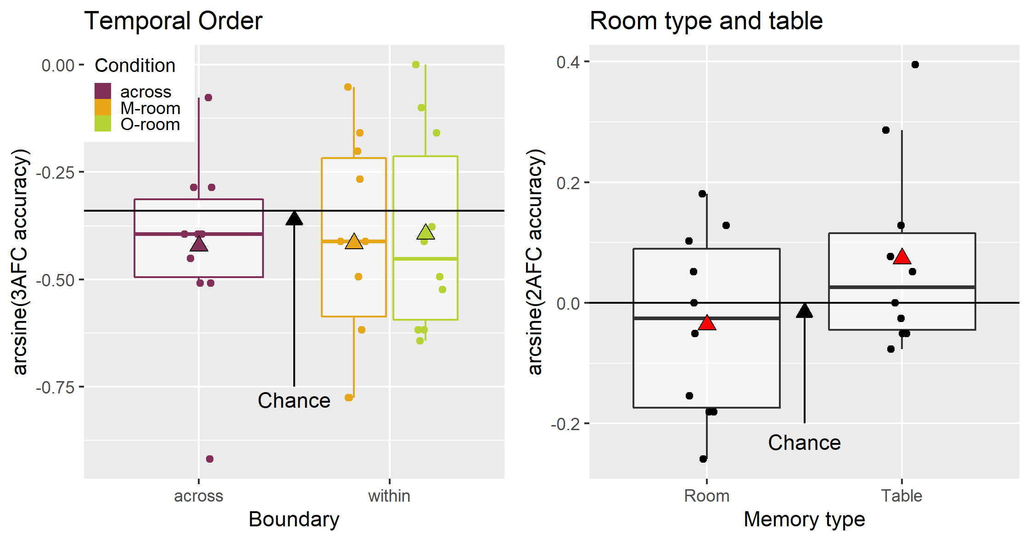
Experiment 1: Batch 1
N = 10
No boundary effect
Memory performance not above chance
Notes:
As can be inferred from above, there is considerable evidence that memory performance is not above change (BF01 = 6.75). The same is true for remembering in which room type a cue object was presented in (BF01 = 5.07). However, there is weak evidence that participants remembered on which table the object was presented (BF10 = 1.29).

Slide 6
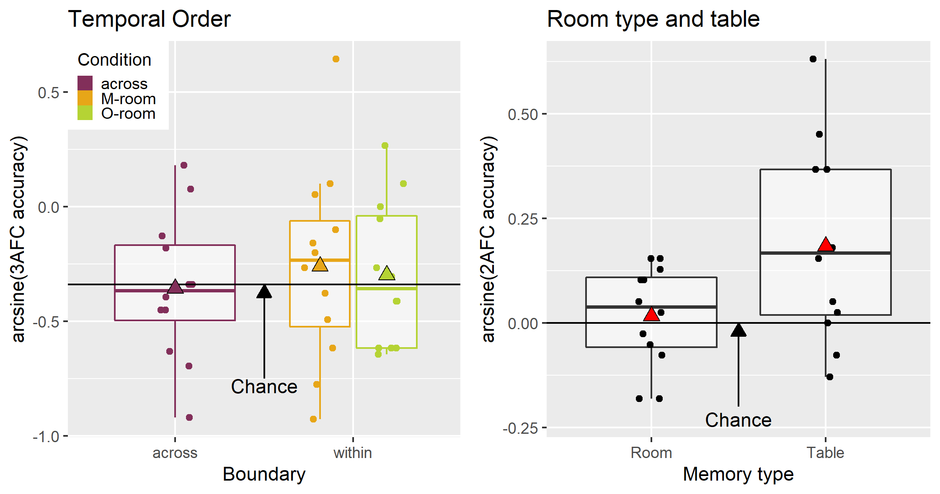
Experiment 1: Batch 2
More data with improved instructions
(N = 12)
No boundary effect
Memory performance not above chance
Above chance only for table question

Slide 7
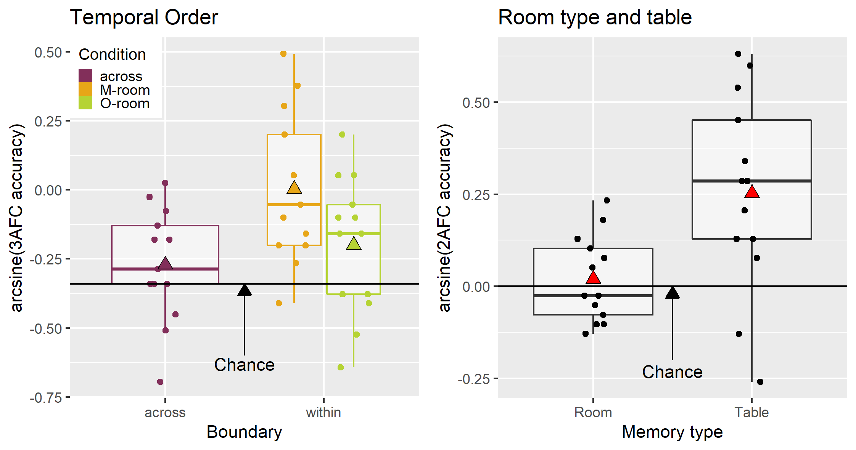
Experiment 1: Batch 3
Same foil (random) selection as in Horner et al. (2016; N = 13)
Memory above chance for temporal order and table question.
No boundary effect for O-rooms.
Boundary effect for M-shape.

Slide 8
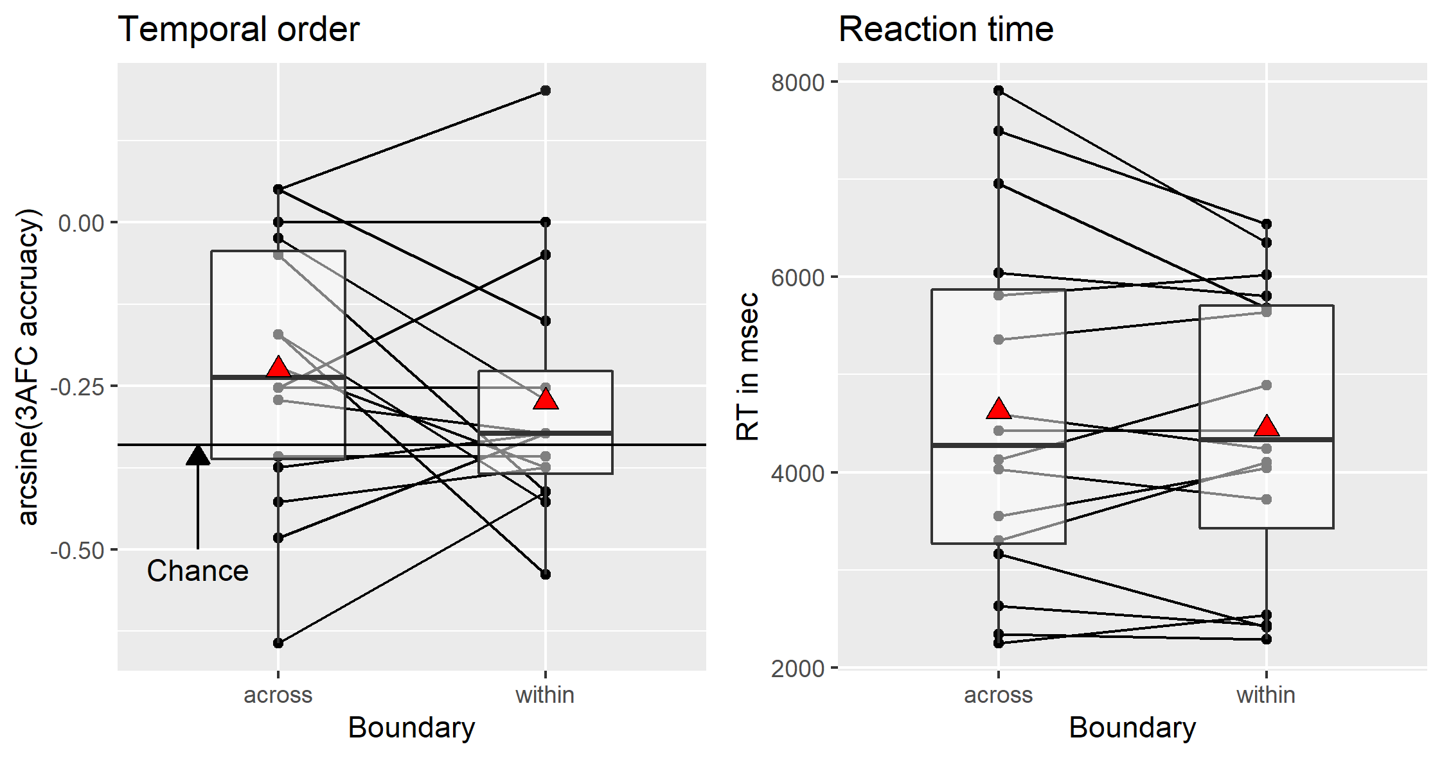
Experiment 2
Between subject design (M-rooms vs. O-rooms).
N = 16 (O-rooms only).
No boundary effect.
Notes:
BF01 =7.14 for memory boundary effect

Slide 9
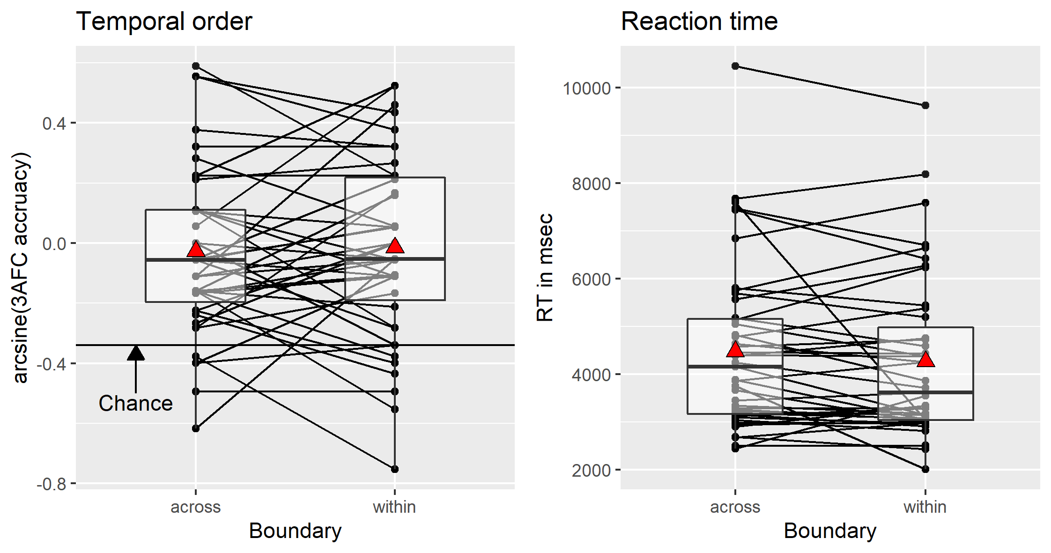
Experiment 3
N = 46 (O-rooms only)
Rooms that are more unique.
Intentional memory task
2 study test cycles.
No boundary effect.
Notes:
I analyse the data (N = 43) above with a paired and directed t-test. For accuracy the result is (BF_{01}) = 4.72 and for RT the result is (BF_{01}) = 1.09. So there is small evidence against an effect.

Slide 10
Discussion
We collected a total N = 97.
Largely, unable to replicate the boundary effect (within > across).
Possible reasons for null effect:
Rooms too similar (always same layout).
Rooms are on linear track.
Passive watching vs. active navigation
Effect not replicable or too weak.

