Slide 1
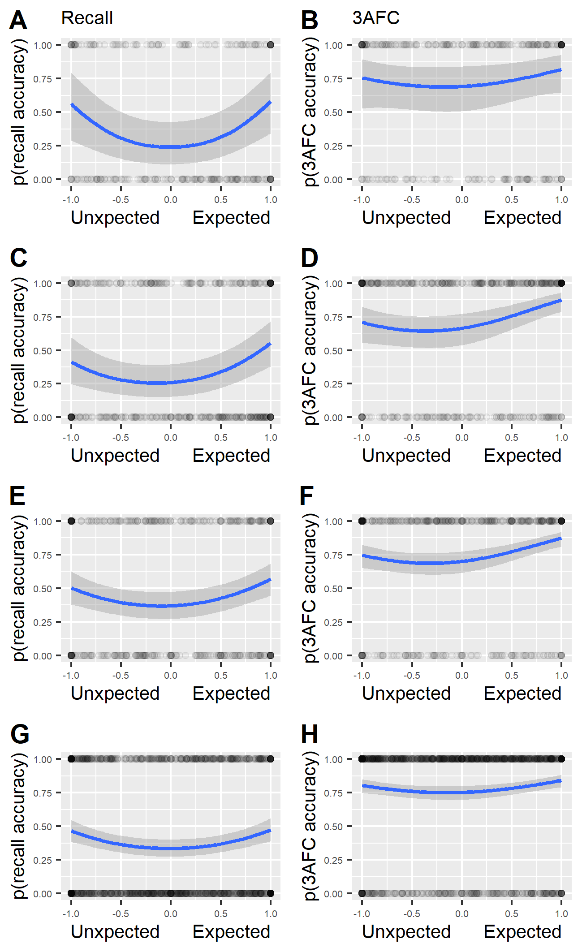
Pilot
Exp. 1
Exp. 2a
Exp. 2b

Slide 2
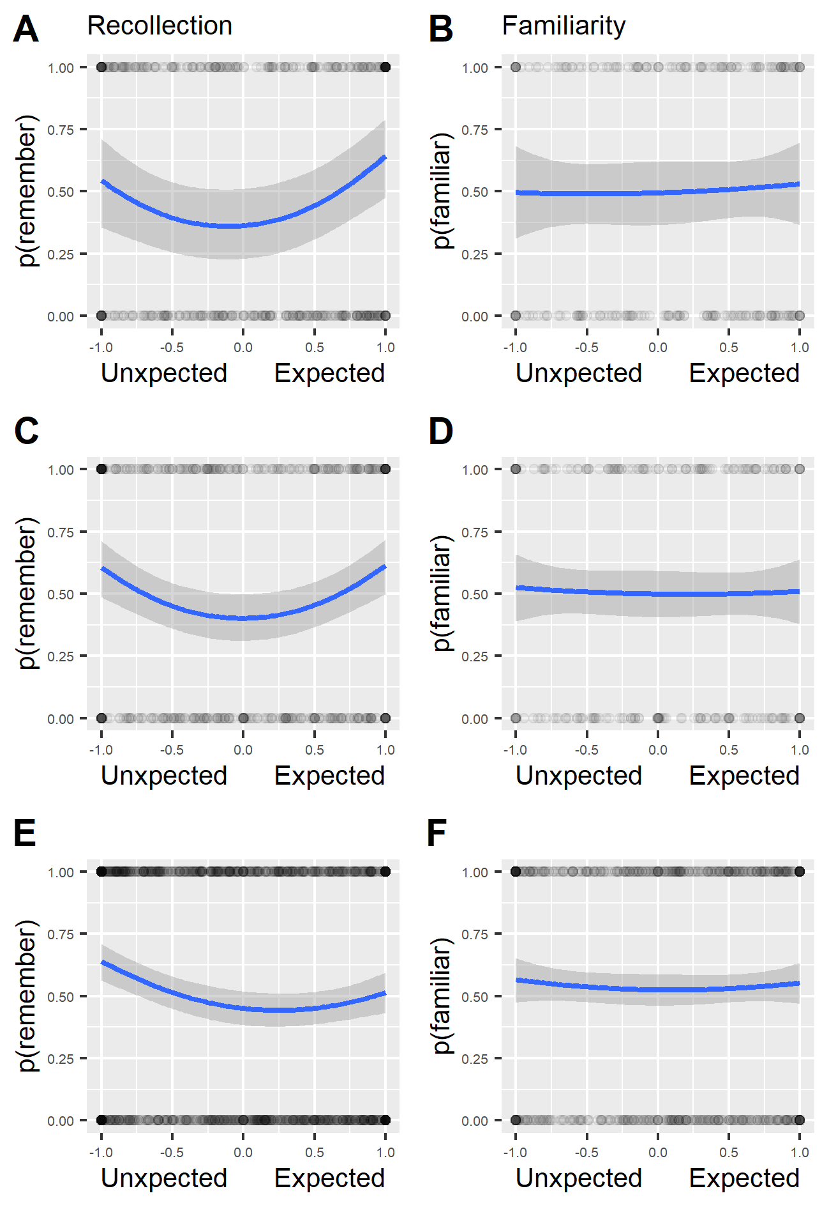
Exp. 1
Exp. 2a
Exp. 2b

