Slide 1
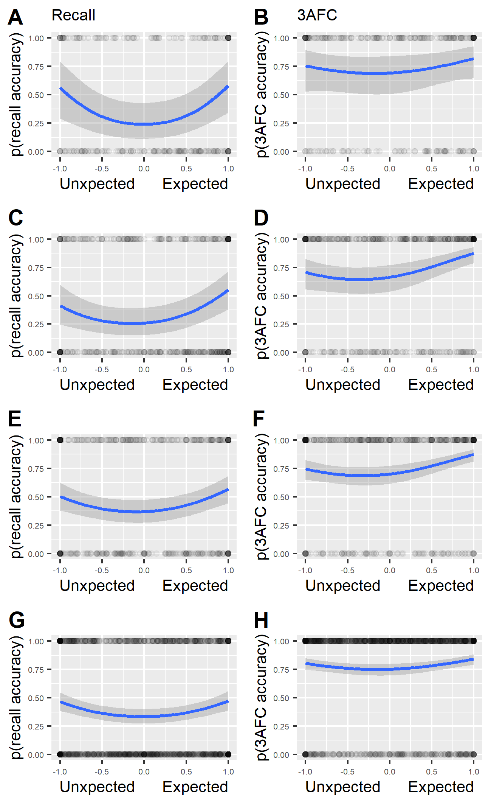
Pilot Experiment
Experiment 1
Experiment 2a
Experiment 2b

Slide 2
Pilot
Exp. 1
Exp. 2a
Exp. 2b

Slide 3
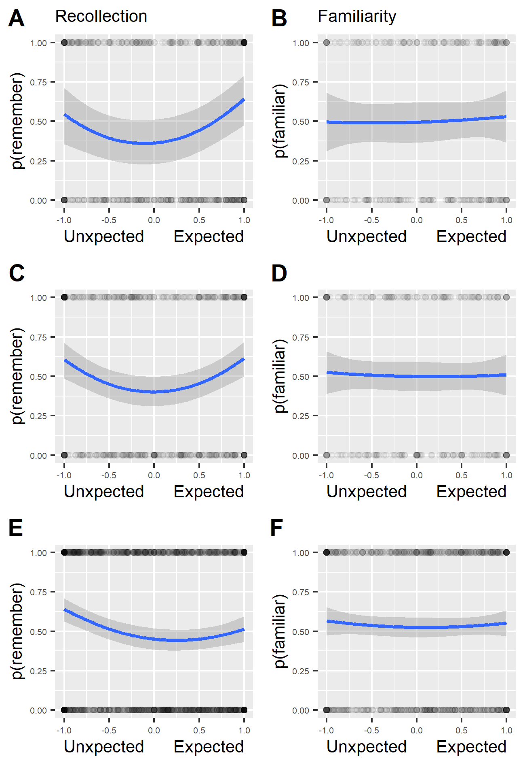
Exp. 1
Exp. 2a
Exp. 2b

Slide 4
Pilot Experiment
Experiment 1
Experiment 2a
Experiment 2b

Slide 5
Pilot Experiment
Experiment 1
Experiment 2a
Experiment 2b

Slide 6
Pilot Experiment
Experiment 1
Experiment 2a
Experiment 2b

Slide 7
Pilot
Exp. 1
Exp. 2a
Exp. 2b

