Slide 1
ARTISTA
By: JARRAY Fathia
July 2021

Slide 2
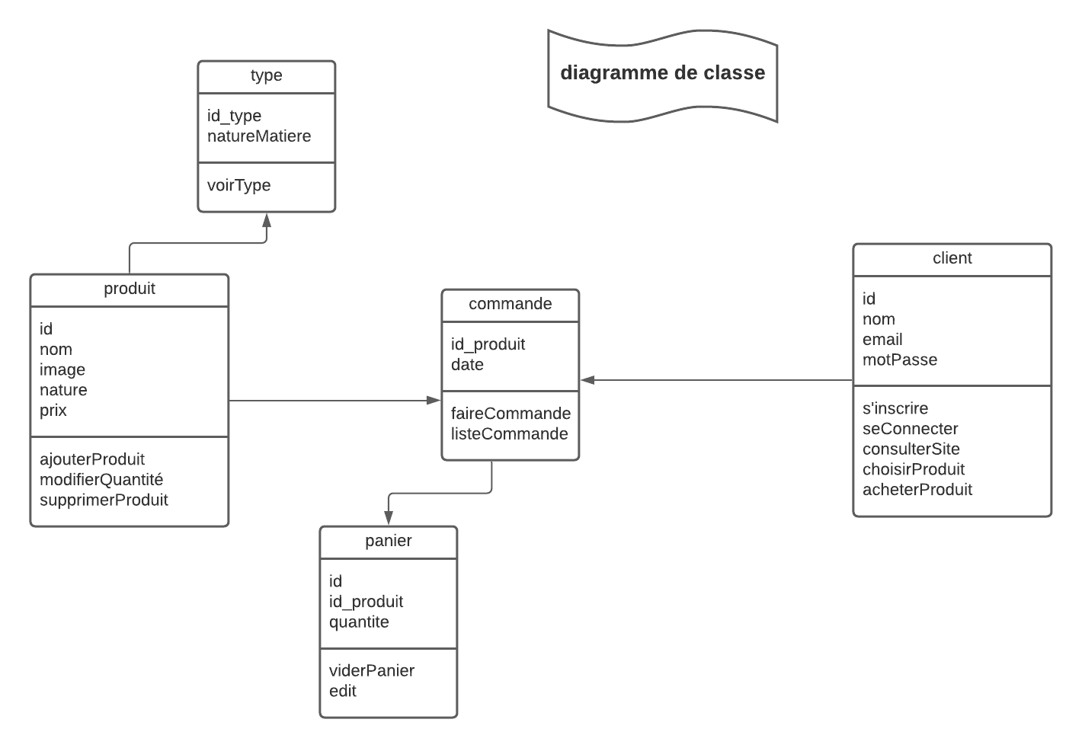
Classes diagram

Slide 3
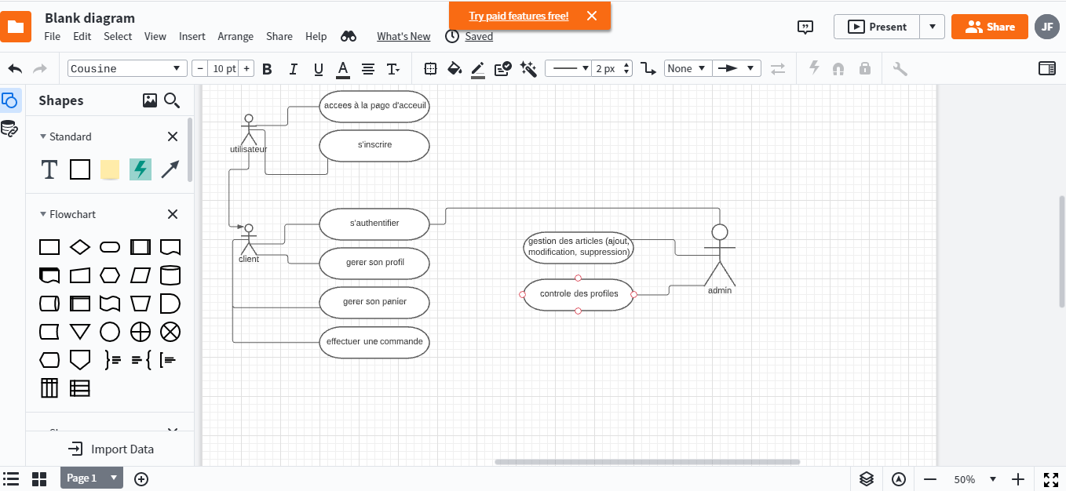
Use case diagram

