Slide 1
Introduction to databases
JARRAY Fathia

Slide 2
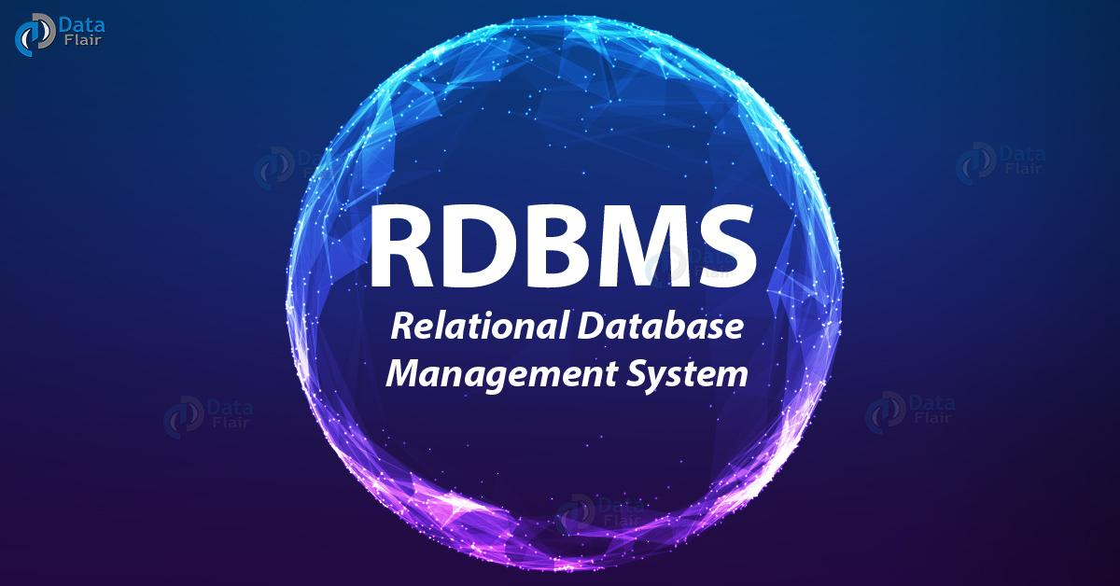
RDBMS
MySQL
SQL SERVER
PostgreSQL
1

Slide 3

What is MySQL?
MySQL has been the most popular open-source RDBMS since the site began tracking database popularity in 2012. It is a feature-rich product that powers many of the world’s largest websites and applications, including Twitter, Facebook, Netflix, and Spotify.
The main advantages of MySQL are that it is popular and easy to use, inexpensive, reliable and has a large community of developers who can help answer questions and they able to prioritize speed. More than that, MySQL comes installed with a script that helps you to improve the security of your database by setting the installation’s password security level.
Some of the disadvantages are that it has been known to suffer from poor performance when scaling. Since the MySQL project was acquired by Sun Microsystems in 2008, and later by Oracle Corporation in 2009, there have been complaints from users that the development process for the DBMS has slowed down significantly, as the community no longer has the agency to quickly react to problems and implement changes.
2

Slide 4

What is PostgreSQL?
PostgreSQL, also known as Postgres, bills itself as “the most advanced open-source relational database in the world”. It is an open source SQL database that is not controlled by any corporation. It is typically used for web application development.
Like MySQL, PostgreSQL have many advantages. According to the official PostgreSQL documentation, PostgreSQL supports 160 out of the 179 features required for full core SQL:2011 compliance, in addition to a long list of optional features. It is easy to use, open-source and community-driven, inexpensive, reliable and has a large community of developers. It also provides some additional features such as foreign key support without requiring complex configuration.
The main disadvantage of PostgreSQL is that it can be slower in performance than other databases such as MySQL. Although more widely used in recent years, PostgreSQL historically lagged behind MySQL in terms of popularity.
3

Slide 5
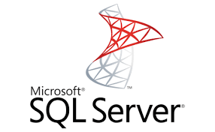
What is SQL SERVER ?
SQL Server is a relational database management system, or RDBMS, developed and marketed by Microsoft. Like Oracle DB, the code is close sourced.
SQL Server is used to create and maintain databases, to analyze the data through SQL Server Analysis Services (SSAS) and to generate reports through SQL Server Reporting Services (SSRS). More than that, it is used to carry out ETL operations through SQL Server Integration Services (SSIS).
Microsoft SQL Server is an excellent database management software for small to large businesses. But for more advanced databased applications and features, you will have to make a sizeable investment for higher versions of the software and you also need to increase your hard drive space.
4

Slide 6
A comparison between the three RDBMS
MySQL | PostgreSQL | SQL Server
Open-Source | Open-Source | Licensed
Owned by Oracle | Owned by PostgreSQL Global Development Groupe | Owned by Microsoft
Scalable buffer pool to pull cache | Scalable buffer pool to pull cache | Isolate processes as separate OS processes
Limited functionality regarding tables to deal with complex processes | More functionality regarding temporary tables (divide tables into local and global) Better with complex processes | More functionality regarding temporary tables (divide tables into local and global) Better with complex processes
Organizes index into clusters and tables (not very flexible search) | Rich automated functionality for index management | Flexible search
5

Slide 7
Thank you

