Slide 1


MVP PREDICTOR PROJECT
Group-14
Amarender Reddy Jakka, Pranav Tadepu, Harshini Pothireddy

Slide 2

INTRODUCTION
This project uses data-driven decision-making to identify the Most Valuable Player (MVP) in basketball by analyzing tournament data and employing complex queries and analytics.

Slide 3
RELATED WORK
Studies use metrics like player efficiency, true shooting percentage, and advanced machine learning models like random forests for MVP prediction.

Slide 4

METHODOLOGY OVERVIEW
The methodology involves preprocessing data, defining MVP scores based on player and team attributes, and analyzing the results through SQL queries.

Slide 5


TABLES
Key tables include:
mbb_teams
mbb_games_sr
mbb_players_games_sr
mbb_teams_games_sr with schemas focusing on game and player statistics.

Slide 6
SCHEMA FOR MBB_PLAYERS_GAMES_SR
Field Name | Type | Mode
game_id | VARCHAR | NULLABLE
player_id | VARCHAR | NULLABLE
team_id | VARCHAR | NULLABLE
full_name | VARCHAR | NULLABLE
points | INTEGER | NULLABLE
assists | INTEGER | NULLABLE
rebounds | INTEGER | NULLABLE
steals | INTEGER | NULLABLE
blocks | INTEGER | NULLABLE
turnovers | INTEGER | NULLABLE
personal_fouls | INTEGER | NULLABLE
tech_fouls | INTEGER | NULLABLE
minutes_int64 | INTEGER | NULLABLE

Slide 7
SCHEMA
mbb_teams
Field Name | Type | Mode
id | INTEGER | NULLABLE
name | VARCHAR | NULLABLE
mbb_games_sr
Field Name | Type | Mode
game_id | VARCHAR | NULLABLE
season | INTEGER | NULLABLE
tournament | STRING | NULLABLE
mbb_teams_games_sr
Field Name | Type | Mode
game_id | VARCHAR | NULLABLE
team_id | VARCHAR | NULLABLE
points | INTEGER | NULLABLE
assists | INTEGER | NULLABLE
team_rebounds | INTEGER | NULLABLE
steals | INTEGER | NULLABLE
blocks | INTEGER | NULLABLE
turnovers | INTEGER | NULLABLE
personal_fouls | INTEGER | NULLABLE
team_tech_fouls | INTEGER | NULLABLE

Slide 8
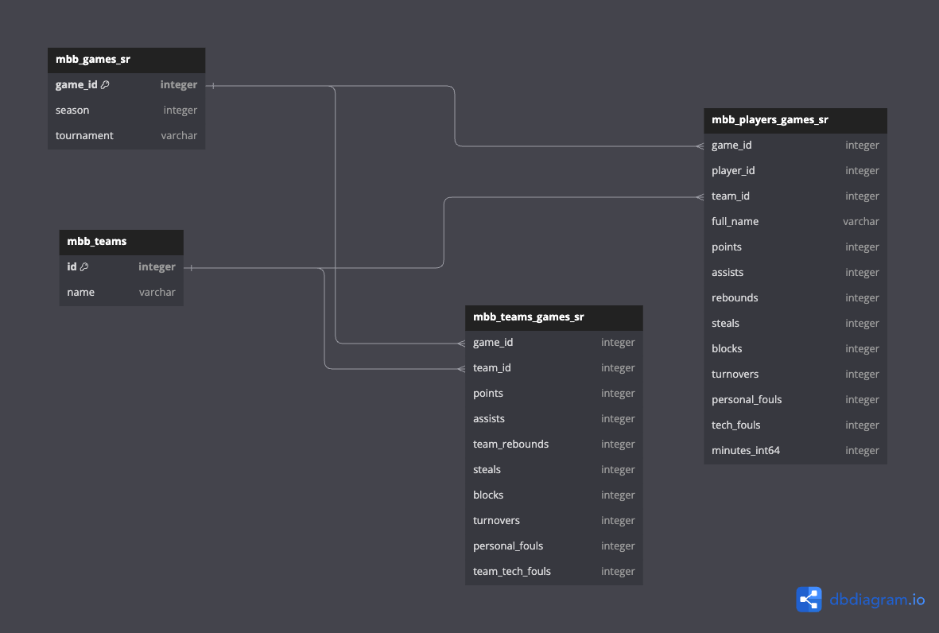
ER DIAGRAM
Entity-Relationship diagram is used to visualize the data structure.
Entity-Relationship diagram is used to visualize the data structure (not displayed here).

Slide 9
ALGORITHM DESCRIPTION
The MVP Score is calculated using weighted averages of player and team performance metrics, normalized by the number of games played.
mvp_score = player_score + team_contribution player_score = (w1×points + w2×assists + w3×rebounds + w4×steals + w5×blocks − w6×turnovers − w7×personal_fouls − w8×technical_fouls) / games_played team_contribution = (w9×team_points + w10×team_assists + w11×team_rebounds + w12×team_steals + w13×team_blocks − w14×team_turnovers − w15×team_personal_fouls − w16×team_technical_fouls) / games_played) Here, w1 to w8 and w9 to w16 are the cold start weights assigned to each player and team attribute respectively as shown below.

Slide 10

Attributes
Name | Definition/Importance | Cold Start Algorithm Weights
 |  | key | value
points | Points are crucial as they directly contribute to a player's offensive performance | w1 | 0.3
assists | Assists showcase a player's ability to create scoring opportunities for teammates | w2 | 0.2
rebounds | Rebounds demonstrate a player's effectiveness in both offense and defense | w3 | 0.2
steals | Steals indicate a player's defensive prowess and ability to create turnovers | w4 | 0.1
blocks | Blocks reflect a player's shot-blocking ability and defensive impact | w5 | 0.1
turnovers | Turnovers detract from a player's overall performance as they represent lost possessions | w6 | -0.1
personal_fouls | Personal fouls can limit a player's playing time and disrupt team defense | w7 | -0.1
technical_fouls | Technical fouls penalize a player and may lead to team disadvantage | w8 | -0.05
team_points | Total points scored by the team highlight overall offensive performance | w9 | 0.2
team_assists | Total team assists demonstrate teamwork and ball movement | w10 | 0.15
team_rebounds | Total team rebounds reflect dominance in securing possessions | w11 | 0.15
team_steals | Total team steals indicate defensive pressure and ability to force turnovers | w12 | 0.1
team_blocks | Total team blocks showcase defensive shot-blocking ability | w13 | 0.1
team_turnovers | Total team turnovers detract from overall team efficiency | w14 | -0.1
team_personal_fouls | Total team personal fouls can disrupt team defense and result in free throws for opponents | w15 | -0.1
team_technical_fouls | Total team technical fouls penalize the team and may lead to opponent advantages | w16 | -0.05

Slide 11
QUERY FOR TEAM SCORES
WITH team_scores AS ( SELECT tg.team_id, t.name, g.season, g.tournament, ( SUM(tg.points) * 0.2 + -- w9 for Team Points SUM(tg.assists) * 0.15 + -- w10 for Team Assists SUM(tg.team_rebounds) * 0.15 + -- w11 for Team Rebounds SUM(tg.steals) * 0.1 + -- w12 for Team Steals SUM(tg.blocks) * 0.1 - -- w13 for Team Blocks SUM(tg.turnovers) * -0.1 - -- w14 for Team Turnovers SUM(tg.personal_fouls) * -0.1 - -- w15 for Team Personal Fouls SUM(tg.team_tech_fouls) * -0.05 -- w16 for Team Technical Fouls ) / COUNT(DISTINCT tg.game_id) AS score FROM `bigquery-public-data.ncaa_basketball.mbb_teams` t INNER JOIN `bigquery-public-data.ncaa_basketball.mbb_teams_games_sr` tg ON tg.team_id = t.id INNER JOIN `bigquery-public-data.ncaa_basketball.mbb_games_sr` g ON tg.game_id = g.game_id WHERE g.season = 2016 AND g.tournament = 'NCAA' AND g.season is NOT NULL AND g.tournament is NOT NULL GROUP BY tg.team_id, t.name, g.season, g.tournament ),
SQL query to calculate team scores by aggregating team-level statistics and applying weights.

Slide 12
QUERY FOR PLAYER SCORES
player_scores AS ( SELECT pg.full_name, t.id as team_id, g.season, g.tournament, ( SUM(pg.points) * 0.3 + --w1 for points - 0.3 SUM(pg.assists) * 0.2+ --w2 for assists - 0.2 SUM(pg.rebounds) * 0.2 + --w3 for rebounds - 0.2 SUM(pg.steals) * 0.1 + --w4 for steals - 0.1 SUM(pg.blocks) * 0.2 + --w5 for blocks - 0.1 SUM(pg.turnovers) * -0.1+ --w6 for turnovers - (-0.1) SUM(pg.personal_fouls) * -0.1 + --w7 for personal_fouls - (-0.1) SUM(pg.tech_fouls) * -0.05 --w8 for technical_fouls - (-0.05) ) / COUNT(DISTINCT pg.game_id) AS score FROM `bigquery-public-data.ncaa_basketball.mbb_players_games_sr` pg INNER JOIN `bigquery-public-data.ncaa_basketball.mbb_teams` t ON pg.team_id = t.id INNER JOIN `bigquery-public-data.ncaa_basketball.mbb_games_sr` g ON pg.game_id = g.game_id WHERE g.season = 2016 AND g.tournament = 'NCAA' AND pg.minutes_int64 > 0 AND pg.game_id is NOT NULL AND t.id is NOT NULL AND g.season is NOT NULL AND g.tournament is NOT NULL GROUP BY pg.full_name, t.id, t.name, g.season, g.tournament )
SQL query to calculate player scores by aggregating individual performance metrics and applying weights.

Slide 13
AGGREGATED QUERY
SQL query to aggregate team and player scores to rank players based on the total score in order to find MVP.
SELECT RANK() OVER (ORDER BY ROUND(ps.score + ts.score,2) DESC) as rank, ps.full_name, ps.season, ps.tournament, ts.team_id AS team_id, ts.name AS team_name, ps.score AS player_contribution, ts.score AS team_contribution, ROUND(ps.score + ts.score,2) AS total_score, FROM player_scores ps INNER JOIN team_scores ts ON ps.team_id = ts.team_id ORDER BY total_score DESC LIMIT 50;

Slide 14
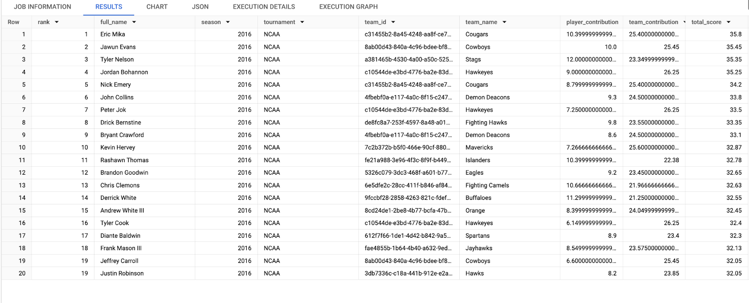
RESULTS AND FINDINGS
Summary of the key results and insights obtained from the MVP prediction analysis.

Slide 15
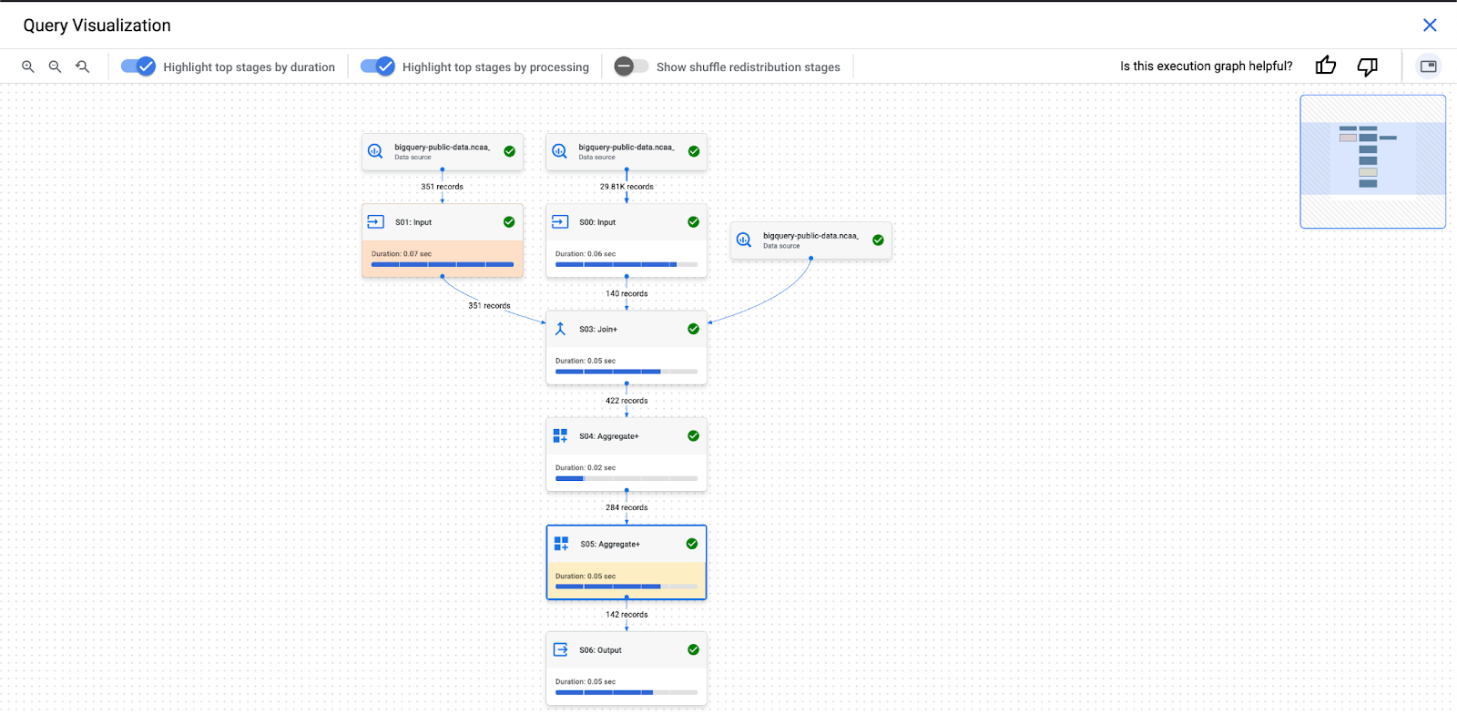
Optimization

Slide 16
LESSONS LEARNED
Data Exploration and Cleaning: One of the key lessons learned was the significance of thorough data exploration and cleaning. We realized that the quality of the dataset directly influenced the accuracy of our MVP predictions. Handling missing values, standardizing data formats, and removing outliers were critical steps in ensuring the reliability of our analysis.
Feature Engineering: Another important lesson was the importance of feature engineering in developing an effective prediction algorithm. By exploring player and team level features such we were able to capture more nuanced aspects of player and team performance.
Algorithm Design: Designing the MVP prediction algorithm required careful consideration of various factors such as the weighting of different performance metrics and normalization techniques. We learned that striking the right balance between individual player attributes and team-level statistics was crucial for accurately identifying MVP candidates.
Interpretability and Transparency: Throughout the project, we emphasized the importance of interpretability and transparency in our analysis. We learned that presenting the methodology, key findings, and recommendations in a clear and comprehensive manner was essential for facilitating understanding and decision-making among stakeholders.
Continuous Improvement: Finally, the project reinforced the importance of continuous improvement in data analytics projects. We recognized that the field of sports analytics is dynamic, with new data sources, techniques, and insights emerging over time.

