Slide 1
How Casual Riders and Annual Members use Cyclistic Bikes Differently
Motivate International Inc.
Annual 2019

Slide 2
Problem:
Why casual riders would buy a membership?
Solution:
Create a new Promotion or Activity Event and add BikePoint System on Application to be attention for casual riders and maintain memberships

Slide 3
Why: Quantity impact to be memberships
Analytic Goal
How: Identify what attention customer need to be membership

Slide 4
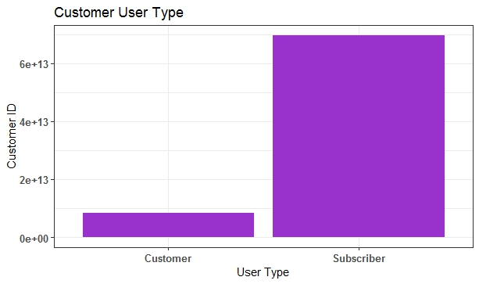
What is impact to be subscriber memberships and current Situation ?
From the data set we finds:
Almost user is a Subscriber (membership) about 88 % and we have a Customer (non-membership) 12 %
- About 72% is be Subscriber

Slide 5
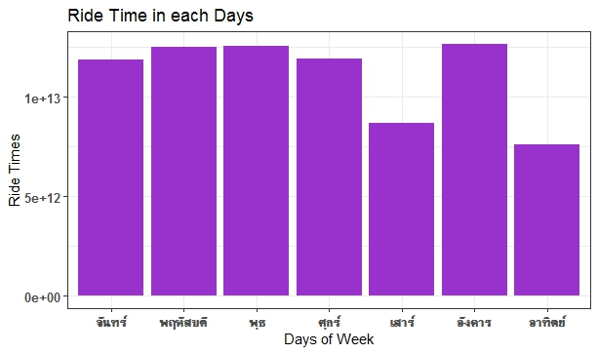
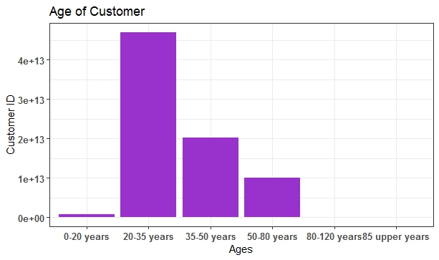
The Factor attention Customer need to be memberships
- In analysis process we find the most days of ride time on Tuesdays and the most customer age between 20-35 years old

Slide 6
Summaries
Analysis data is show almost customer is a membership of Cyclistic Bikes then use must to create a method to attention a new customer user bikes and become a memberships.
By :
1. Add a Bikepoint
- Get point when rent a bike or clear mission such rent 10 time or clear target duration
- Get rewards like a promotion or sale ticket
- New subscriber get a point
2. Create a Activity
- Create a campaign like save the world show benefit with collect data when use a bikes replace a combustion engine
**We use a analysis data to identify target age group and a location with history data

Slide 7
Thank You

