Slide 1
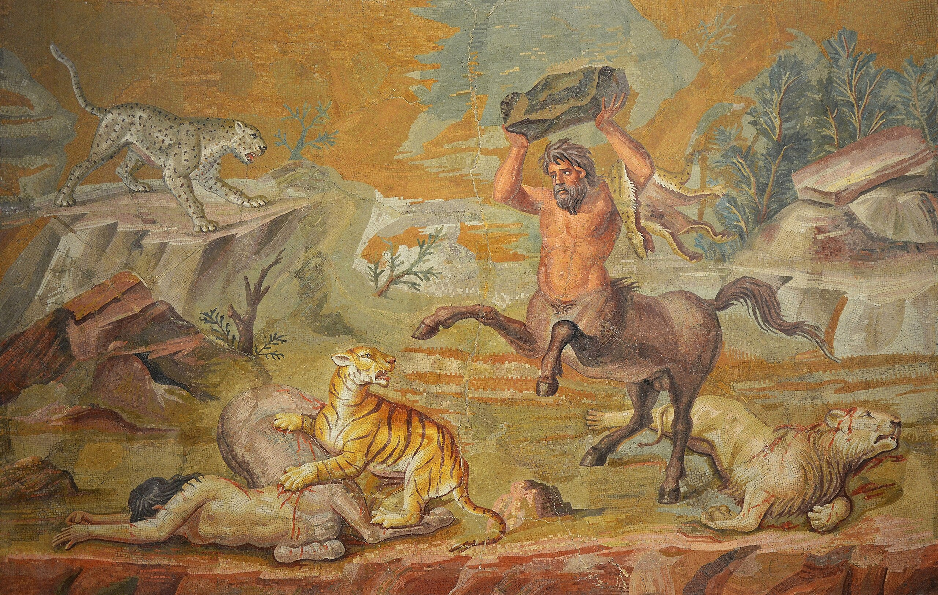
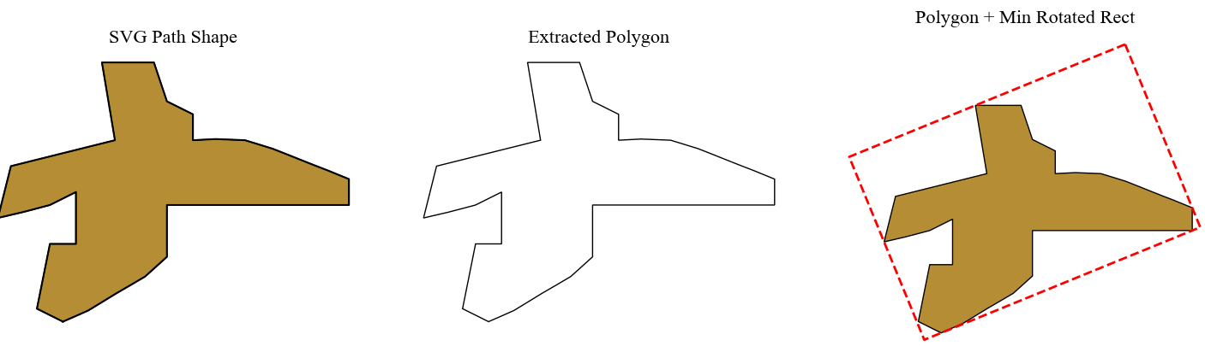

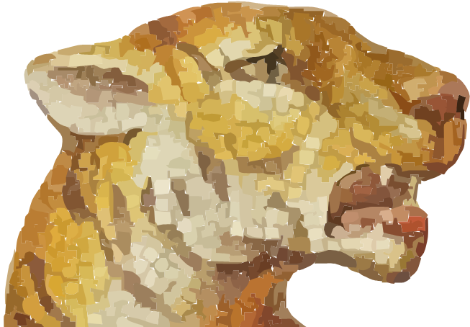

"bbox":
[[291,123][266,113]
[273,93][297,107]], "angle": -157.75,
"fill_colour": "#B48D35", "segment_id": 6
Segmentation
Vectorization
Image region

