Slide 1
CSA1484 – Compiler design for Deep Learning Models
CAPSTONE PROJECT ON
Compiler Design in the Era of Machine Learning and AI
PRESENTED BY :
JASMITHA REDDY(192210551)
ABHINAYA(192210199)
MADHURI(192211369)

Slide 2
COMPILER DESIGN IN THE ERA OF MACHINE LEARNING AND AI

Slide 3
ABSTRACT:
"Compiler Design in the Era of Machine Learning and AI" looks at how we can use new technology like machine learning and AI to improve the way we build compilers. It explores how these advanced techniques can help us make compilers faster, generate better code, and even translate languages more efficiently. This abstract also discusses the potential problems and possibilities that come with using machine learning and AI in this area, giving us a glimpse into where compiler design might be headed in the future.

Slide 4
INTRODUCTION:
Compiler design is the process of creating software tools that translate high-level programming languages into machine code that can be understood and executed by a computer.
The traditional stages of compilation:
Lexical analysis: This stage identifies and groups the basic building blocks of the code, like keywords and symbols.
Syntax analysis: It checks the structure of the code to ensure it follows the language's grammar rules and creates a hierarchical structure.
Semantic analysis: This part ensures that the code makes sense and is logically correct, catching errors that the previous stages might have missed.
Optimization: The compiler tries to make the code as efficient as possible by improving its performance.
Code generation: The final step involves converting the code into a form that the computer can understand and execute

Slide 5
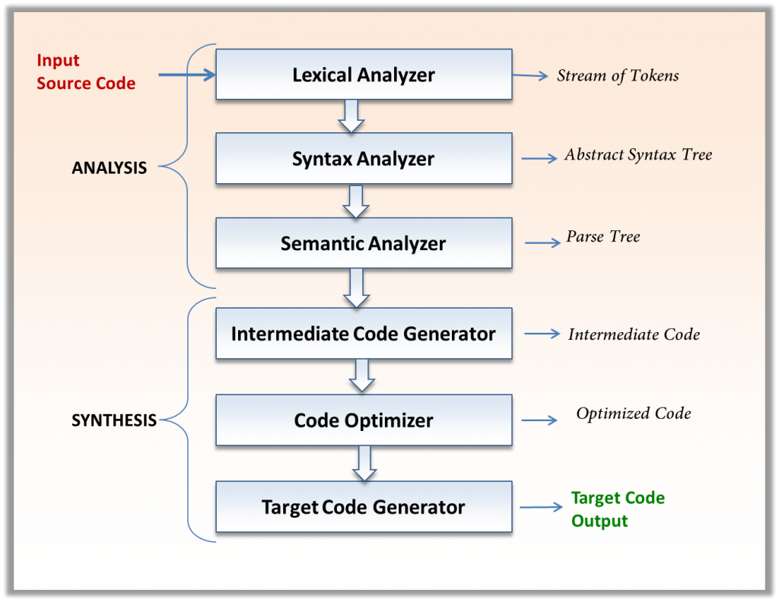

Slide 6
PROBLEM STATEMENT:
Address the challenges, such as the need for large datasets for training AI models and ensuring the reliability of AI-generated code.
Discuss future trends like AI-driven adaptive optimization, automated parallelization, and integration with development environments.
In the era of machine learning and AI, compiler design faces the critical challenge of optimizing code generation and execution for diverse and highly parallel hardware architectures, such as GPUs and TPUs, while integrating advanced AI-driven optimizations. This involves developing intelligent compilers that can leverage machine learning models to predict and optimize runtime performance, automate parallelization, and adapt to the dynamic nature of AI workloads.

Slide 7
Methodology Used for Validation and Evaluation:
Integrate machine learning models trained on annotated code datasets to enhance the accuracy and efficiency of tokenization. These models can learn to recognize complex patterns and contexts that traditional regular expressions may miss.
Use machine learning models to continuously improve the evaluation algorithm. These models can identify misclassifications and adjust the tokenization rules dynamically based on feedback and new data.
Define performance metrics to assess the efficiency and effectiveness of the lexical analysis process, including tokenization speed, memory usage, and tokenization accuracy.

Slide 8
Results of Validation and Evaluation:
Benefits of AI/ML in Compiler Design:
Improved Performance: AI/ML techniques can optimize compiler processes, leading to faster compilation times and more efficient code generation.
Enhanced Code Quality: Machine learning algorithms can help identify and fix code inefficiencies, leading to higher-quality output.
Automated Optimization: AI/ML can automate the process of code optimization, reducing manual effort and potentially uncovering optimizations that human developers might overlook.
Language Translation: AI can assist in improving the translation of code between different programming languages.

Slide 9
Results of Validation and Evaluation:
Impact of AI/ML in Compiler Design:
Performance Enhancement: AI/ML techniques can boost compiler performance, resulting in faster and more efficient code compilation.
Code Quality Improvement: By leveraging AI/ML, compilers can produce higher-quality code with optimized structures and improved efficiency.
Automation of Optimization: AI/ML facilitates the automation of code optimization, reducing manual effort and potentially uncovering optimizations that may be overlooked by traditional methods.
Language Translation and Interoperability: AI can play a role in enhancing the translation of code between different programming languages, thereby promoting better interoperability and code reuse.

Slide 10
Conclusion
The fusion of traditional compiler design with machine learning and AI technologies promises to significantly enhance compiler performance and improve code quality.
AI and ML integration can automate optimization, enhance language translation, and drive innovative advancements in compiler technology.
Embracing these technologies has the potential to transform the optimization and adaptation of programming languages for evolving computing needs, ushering in a new era of smarter and more efficient compilers.

Slide 11
THANK YOU

