Slide 1
Lumbar Spine MRI and MedGemma
DICOM, the lumbar spine, and evaluating MedGemma
AI in Healthcare · Unit III · Session 2
B.Tech AI, Third Year · Bennett University
Notes:
This lecture covers the concepts; Lab 9 is the hands-on part (loading the DICOM files, running the MedGemma experiments, scoring). Prerequisites: Python, NumPy, pandas; confusion-matrix metrics (sensitivity, specificity, PPV, NPV). No medical training assumed.

Slide 2
By the end of this lecture you can…
1
Describe the lumbar structures involved in stenosis, and the MRI view used to grade each RSNA condition
2
Explain how T1, T2 and STIR images differ, and what the sagittal, axial and coronal planes show
3
Explain how DICOM organises images (patient, study, series, instance), and tell identifiers from content
4
Use DICOM geometry tags to find an image's plane, physical size, and the patient's left and right
5
Explain how window/level changes what is visible, and what MedGemma actually receives
6
Score model labels against a reference and a baseline, and explain why one patient cannot establish performance
Prerequisites: Python, NumPy, pandas; sensitivity, specificity, PPV, NPV. Hands-on part: Lab 9.
Notes:
Read out the six objectives. Objectives 2–3 (sequences, planes, DICOM) and 6 (metrics, limits of one patient) are the core of this lecture.

Slide 3
Can a model grade this MRI?
The clinical workflow
The engineer's question
Low back pain, with pain running down one leg
Lumbar spine MRI: about a hundred images in three series
A radiologist finds each disc level and grades how narrow the spaces around the nerves are
The report helps the referring clinician decide what to do next
How would we find out whether a model can produce the same grades — and how could we be fooled?
Data one de-identified patient (RSNA 2024 lumbar spine dataset): 3 series, 96 DICOM files, 25 expert grades.
Notes:
A person with long-standing low back pain, and pain running down one leg, is referred for a lumbar spine MRI. The scanner produces about a hundred images in three series. A radiologist scrolls through them, finds each disc level, and grades how narrow the spaces around the nerves have become. The report helps the referring clinician decide what to do next.
The engineer's question is not only 'can a model do this?' but 'how would we find out, and how could we be fooled?'
All data in this lecture and Lab 9 is one de-identified patient from the RSNA 2024 Lumbar Spine Degenerative Classification dataset.

Slide 4
Discs, canal and the nerve exits
Side view (sagittal)
Disc level named after the two bones around it: L4/L5 sits between L4 and L5; five levels, L1/L2 to L5/S1
L1
spinal canal
L2
Spinal canal holds the thecal sac: cerebrospinal fluid (CSF) with nerve roots floating in it
L3
Lateral recess a gutter at the side of the canal (subarticular zone) that each exiting root passes
L4
disc L4/L5
L5
Neural foramen the window between vertebrae where the root leaves; normally cushioned by fat
S1
Stenosis means narrowing. It can squeeze a nerve root — but narrowing on an image does not prove it causes the pain.
Notes:
The lumbar spine has five vertebrae, L1 to L5, above the sacrum (top segment S1). A disc level is named after the two bones around it: L4/L5 is the disc between L4 and L5. Five levels: L1/L2 to L5/S1.
Behind the discs is the spinal canal, holding the thecal sac (a tube of cerebrospinal fluid, CSF, with nerve roots floating in it). At each level a pair of nerve roots leaves, one on each side, passing through the lateral recess (subarticular zone) and then the neural foramen, a window between vertebrae normally cushioned by fat.
Stenosis = narrowing, from bulging discs, enlarged facet joints and thickened ligamentum flavum. Narrowing on an image does not prove it causes symptoms: degeneration is common in people without pain.

Slide 5
Five conditions × five levels = 25 labels
Condition | Where the narrowing is | Sides | Series used to grade it
Spinal canal stenosis | Central canal | One (midline) | Sagittal “T2-like” (T2 or STIR)
Neural foraminal narrowing | Foramen | Left and right | Sagittal T1
Subarticular stenosis | Lateral recess | Left and right | Axial T2
25
3 classes
85.4%
labels per study: 5 condition columns × 5 levels
Normal/Mild · Moderate · Severe
of spinal canal grades are Normal/Mild: imbalanced
Reference standard our patient's labels are one expert's reading (training set, annotated once), not certain truth.
Notes:
The RSNA 2024 dataset: MRI studies from 2,697 patients at 8 institutions in 6 countries, graded by volunteer neuroradiologists and musculoskeletal radiologists (Richards et al., 2026).
Three places can narrow; two of them have a left and a right side, giving five condition columns. Each is graded at five levels: 25 labels per study. The 4-point scale (normal, mild, moderate, severe) was collapsed to three classes by merging normal and mild.
Classes are imbalanced: across all spinal canal grades, 85.4% Normal/Mild, 8.8% Moderate, 5.9% Severe.
Training-set studies were annotated once, by one radiologist per condition. Our patient is from the training set, so the labels are one expert's reading: a reference standard, not certain truth.

Slide 6
Clinical purpose vs computational task
Question | Answer for this lecture and Lab 9
Clinical purpose | Support consistent grading of lumbar stenosis in a radiology report
Not the purpose | Diagnosing the cause of pain, or deciding on treatment or surgery
Intended user | A radiologist who reviews every output
Decision time | After the scan is complete, before the report is signed
Computational task | 25 three-class classification problems per study
Three units — keep them apart
1
Study
one MRI visit
96
Slice
one 2D image (DICOM instance)
25
Label
one condition-level grade
Key idea the task is anatomical grading — far narrower than “diagnosing the cause of back pain”.
Notes:
Before choosing a model, separate the real-world purpose from the small, testable task given to software.
The radiologist grades anatomy; the clinician combines that with symptoms and examination. Our AI task is anatomical grading, far narrower than diagnosing the cause of back pain.
Keep three units apart: a study is one MRI visit; a slice (DICOM instance) is one 2D image; a label is one condition-level grade. This study has 96 slices but 25 labels.

Slide 7
Sequences: same anatomy, different contrast
Series = one pulse sequence in one plane: a stack of thin 2D slices.
Sequence | Fluid (CSF, healthy disc) | Fat | Used here for
T1-weighted | Dark | Bright | Neural foramina: bright fat around each root makes narrowing visible
T2-weighted | Bright | Intermediate to bright | Spinal canal and lateral recesses: bright CSF outlines the roots
STIR (short tau inversion recovery) | Bright | Suppressed (dark) | Fluid-sensitive; accepted as a “T2-like” sagittal series
Remember healthy discs hold water and look bright on T2; degenerated discs lose water and look darker.
MRI uses a magnetic field and radio-frequency pulses — no ionising radiation.
Notes:
MRI places the body in a strong magnetic field and sends radio-frequency pulses. Hydrogen nuclei, mostly in water and fat, respond and emit signals; different tissues relax at different rates, creating contrast. No ionising radiation.
A scan acquires a stack of thin 2D slices. One run of one pulse sequence in one orientation is a series.
Changing the pulse timing emphasises different tissue properties: the weighting. T1: fluid dark, fat bright — used for the foramina, where bright fat outlines the root. T2: fluid bright — CSF outlines the nerve roots in the canal and recesses. STIR (short tau inversion recovery): fluid bright, fat suppressed; accepted as a 'T2-like' sagittal series. Healthy discs contain water and look bright on T2; degenerated discs look darker.

Slide 8
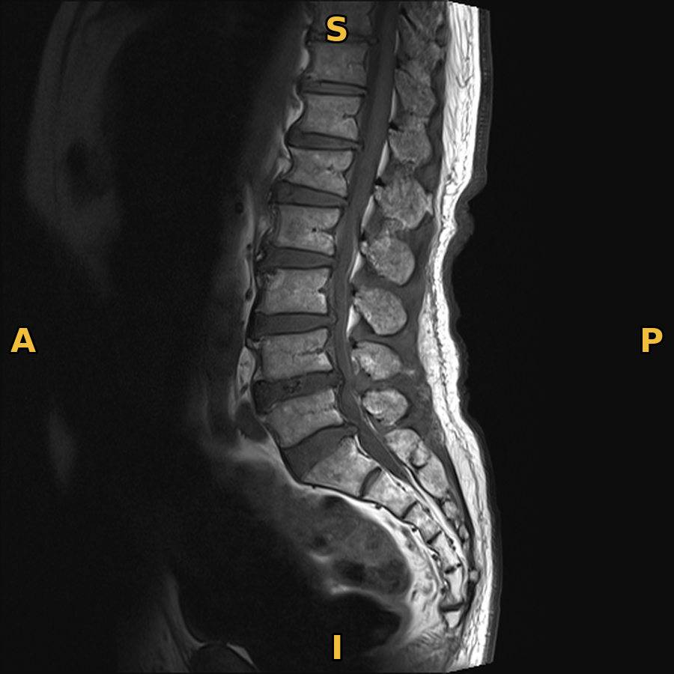
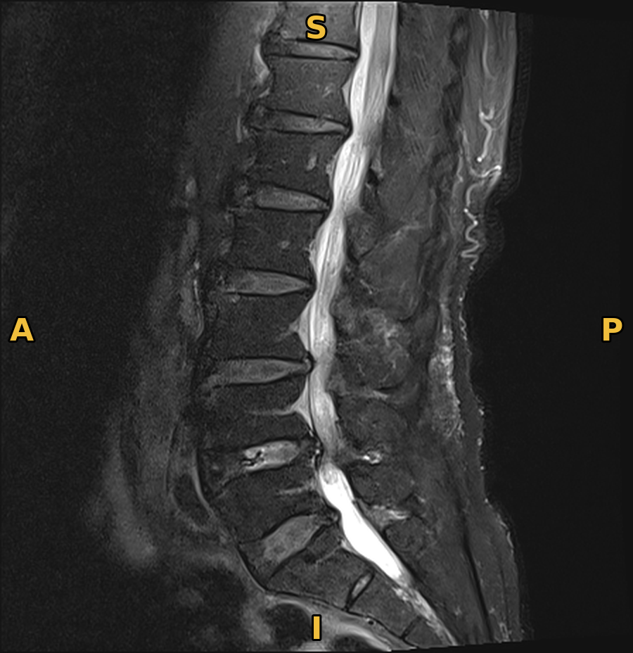
Same position, two weightings
CSF in the canal
dark on T1, bright on T2/STIR: it is fluid
Fat under the skin
bright on T1; dark on this T2/STIR series, consistent with fat suppression (STIR)
Sagittal T1 · instance 9 · field of view 350 mm
Sagittal T2/STIR · instance 9 · 240 × 247.5 mm
Letters from ImageOrientationPatient: S superior · I inferior · A anterior · P posterior
Notes:
Our patient, two sagittal series at almost the same left-right position near the midline (T1 instance 9, x ≈ 3.3 mm; T2/STIR instance 9, x ≈ 4 mm). Orientation letters come from ImageOrientationPatient: S superior, I inferior, A anterior, P posterior.
Point at the spinal canal behind the vertebral bodies: dark on T1, bright on the T2/STIR series, because CSF is fluid. Fat under the skin at the back is bright on T1; on this T2/STIR series it is dark, consistent with fat suppression as on STIR.
The fields of view differ (T1 about 350 mm, T2/STIR about 240 × 248 mm), so the T1 image shows more of the body. Grading uses the series that makes the structure visible: canal on the T2-like series, foramina on T1 (where bright fat outlines the root).

Slide 9
Planes: which way the body is sliced
Sagittal
Axial
Coronal
Side view — slices run left to right
Cross-section — slices run head to feet
Front view — parallel to the face
This study | Plane | Sequence
Sagittal T1 (18 slices) · Sagittal T2/STIR (18 slices) · Axial T2 (60 slices) | sagittal, axial | T1, T2, STIR
A series name such as “Sagittal T1” = plane + sequence. Sagittal is not a sequence; T2 is not a plane.
Notes:
Three planes. Sagittal: a side view, slicing from left to right. Axial: a cross-section, slicing from head to feet. Coronal: a front view. This study has two sagittal series (18 slices each) and one axial series (60 slices); no coronal series.
The diagrams show a person seen from the front; the line shows where one slice cuts. The coronal plane is parallel to the person's front, so it is drawn as the shaded body.

Slide 10
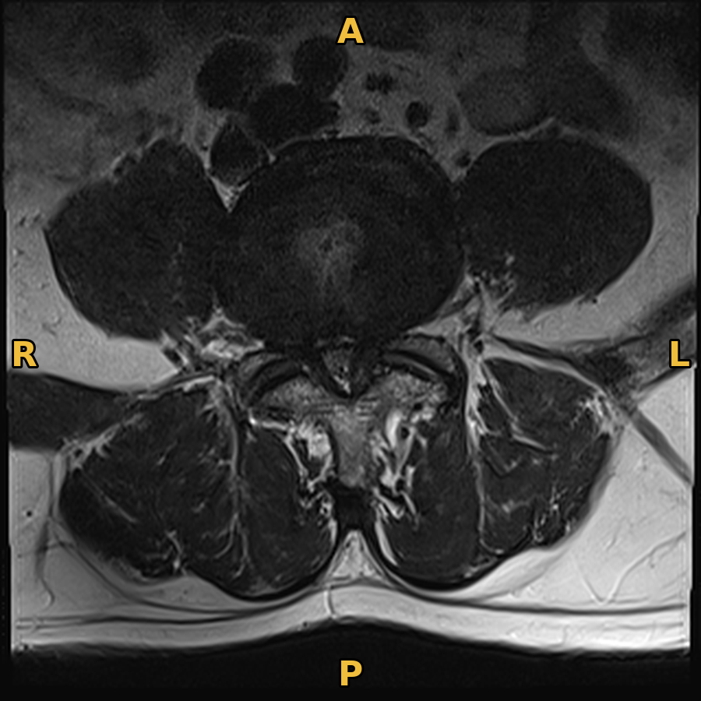
Our study in two planes
Sagittal
top = superior (S), left = anterior (A)
Axial
viewed from the feet: the patient's right (R) is on the screen's left
Sagittal T2/STIR · instance 9: side view
Axial T2 · instance 46 (L4/L5): cross-section
Orientation letters computed from ImageOrientationPatient (LPS)
Notes:
Left: the midline sagittal T2/STIR slice (instance 9) — a side view; top is superior, screen left is anterior. Right: axial T2 instance 46, the slice where the expert graded L4/L5 and the one whose header we read in the DICOM section — a cross-section viewed from the feet.
On the axial slice the patient's right (R) is on the screen's left: the radiological convention. The letters were computed from ImageOrientationPatient, not typed by hand. Point out the disc at the front (A), the bright CSF of the thecal sac behind it, and the facet joints and back muscles towards P.

Slide 11
MRI numbers have no fixed unit
CT
MRI
Pixel values in Hounsfield units: water = 0 by definition. The same tissue gives about the same number on any scanner.
No fixed scale. The same tissue can have very different values on different scanners, coils, or settings.
Why it matters for AI: a model trained at one hospital meets different intensity distributions at another — a form of dataset shift. Normalising each image helps, but does not remove differences in contrast, noise, or protocol.
Consequence no universal MRI display presets (unlike CT “bone” or “lung” windows) — see window/level later.
Notes:
CT pixel values are calibrated to Hounsfield units, where water is 0 by definition. MRI intensities have no fixed scale: the same tissue can have very different values on different scanners, coils, or settings.
This matters for AI. A model trained at one hospital can meet different intensity distributions at another — a form of dataset shift. Normalising each image helps, but does not remove differences in contrast, noise, or protocol.

Slide 12
DICOM: a header plus pixel data
DICOM = Digital Imaging and Communications in Medicine: the standard file format and network protocol for medical images. Scanners send DICOM objects to a PACS (picture archiving and communication system).
1 Header data elements: tag (group, element), keyword, value
2 Pixel data
Tag | Keyword | Value (axial T2, instance 46)
(0008,103E) | SeriesDescription | T2
(0020,0013) | InstanceNumber | 46
(0028,0030) | PixelSpacing | [0.5, 0.5]
(0028,0101) | BitsStored | 12
(0028,1050) | WindowCenter | 576
The image itself: a grid of integers, often 12–16 bits per pixel.
320 × 320
pixels, uint16, values 0–1,259 in this slice (12 bits stored)
Two parts every DICOM file = a header of data elements + the pixel data.
Notes:
DICOM = Digital Imaging and Communications in Medicine: the international standard for medical images. It defines both a file format and a network protocol. Scanners send DICOM objects to a PACS (picture archiving and communication system), where radiologists view them.
Every DICOM file has two parts: a header — a list of data elements, each with a tag (group, element), a keyword and a value — and the pixel data, the image itself, often 12–16 bits per pixel.
The example rows are real, from the header of one axial T2 slice (instance 46) of our study, read with pydicom in the lecture notebook. Its header has only 26 elements because the files were de-identified.

Slide 13
Patient → study → series → instance
DICOM identifier
In the RSNA files
Patient
the person
PatientID (0010,0020)
replaced by the study number
Study
one imaging visit
StudyInstanceUID (0020,000D)
study_id · top folder
Series
one sequence in one plane
SeriesInstanceUID (0020,000E)
series_id · sub-folder
Instance
one image (slice)
SOPInstanceUID (0008,0018)
InstanceNumber (0020,0013)
<instance_number>.dcm
Order by tags sort slices by InstanceNumber, not file name — as text, “10.dcm” comes before “2.dcm”.
Notes:
DICOM organises images in a hierarchy. Patient: the person (PatientID; in RSNA replaced by the study number). Study: one imaging visit (StudyInstanceUID; the study_id column and top folder). Series: one sequence in one plane (SeriesInstanceUID; series_id column and sub-folder). Instance: one image or slice (SOPInstanceUID and InstanceNumber; the file <instance_number>.dcm).
Order slices by the InstanceNumber tag (or position), not by file name: as text, '10.dcm' sorts before '2.dcm'.

Slide 14
Where identity can hide
UIDs tell a computer which object it is handling. They say nothing about anatomy or disease: identifiers are not content.
1
Header elements
2
Burned into the pixels
3
Outside the image
Names, birth dates, hospital numbers and other identifiers stored as data elements
Text drawn into the image itself; removing header tags does not remove it
Metadata in other files: our “Axial T2” description comes from the dataset's CSV
De-identification removes or replaces such data before research use. In our RSNA files many tags are absent (Modality, patient's name), PatientID is just the study number, and the header has only 26 elements.
Check all three a clean header does not make an image de-identified.
Notes:
A UID (unique identifier) tells a computer which object it is handling. It says nothing about anatomy or disease.
Personal information can sit in more than one place. Headers can hold names, birth dates, and hospital numbers. Text can even be 'burned into' the pixels — part of the image itself, so removing header tags does not remove it. Metadata can also live outside the image file: the fuller series description ('Axial T2') in our data comes from the dataset's CSV, not the header.
De-identification removes or replaces such data before research use. The RSNA contributing sites de-identified their data: many tags (Modality, patient's name) are absent, and PatientID is simply the study number.

Slide 15
DICOM compared with PNG and JPEG
Property | PNG / JPEG | DICOM
Typical bit depth | 8 bits (256 grey levels) | 12–16 bits (here 12 bits: 4,096 levels)
Metadata | Minimal | Rich: identifiers, acquisition settings, geometry
Physical scale | Pixels only | Millimetres via PixelSpacing and positions
Grouping | Single picture | Instance → series → study
Clinical use | Exports and teaching | Standard for clinical storage and exchange
Watch out DICOM → PNG drops bit depth, geometry and grouping: this happens before MedGemma sees a slice.
Notes:
PNG/JPEG typically store 8 bits (256 grey levels); DICOM 12–16 bits (our files: 12 bits, 4,096 levels). DICOM carries rich metadata — identifiers, acquisition settings, geometry — and physical scale in millimetres through PixelSpacing and positions; a PNG only knows pixels. DICOM groups instances into series and studies. DICOM is the clinical standard for storage and exchange; DICOM files can themselves use JPEG-family compression.

Slide 16
From pixels to millimetres and sides
Size
Axis | Increases towards
+x | the patient's left
+y | the patient's back (posterior)
+z | the patient's head (superior)
Which plane?
320 pixels × 0.5 mm
= 160 mm
field of view (axial T2), from PixelSpacing
row × column direction = slice normal. Largest component on z → axial; on x → sagittal.
LPS: left, posterior, superior
Radiological convention. An axial image is viewed as if from the patient's feet: the patient's left appears on the viewer's right. For our slice, the row direction ≈ (0.999, 0.03, −0.042): moving right on screen moves towards the patient's left. Swapping left and right is a classic and dangerous error.
Use the tags ImageOrientationPatient and ImagePositionPatient tell you where left, right, up and down are.
Notes:
Size: PixelSpacing gives the physical size of one pixel in mm. Our axial slice is 320 × 320 pixels at 0.5 mm, so the field of view is 320 × 0.5 = 160 mm on each side. SliceThickness is the slab captured by one slice; SpacingBetweenSlices is the distance between slice centres.
Direction: DICOM places every image in a 3D coordinate system attached to the patient, in mm (LPS): +x towards the patient's left, +y towards the back (posterior), +z towards the head (superior). ImagePositionPatient is the (x, y, z) of the top-left pixel; ImageOrientationPatient gives the row direction and the column direction. Their cross product is the slice normal; its largest component names the plane: along z = axial, along x = sagittal.
Radiological convention: an axial image is viewed from the feet, so the patient's left is on the viewer's right. Getting this wrong swaps left and right labels — a classic and dangerous error.
Notebook output for instance 46: row direction ≈ (0.999, 0.03, −0.042) → moving right on screen moves towards the patient's left; normal ≈ (0.048, −0.215, 0.975) → largest on z: axial.

Slide 17
Window/level: what you can see
display = 255 × ( clip(raw, L − W/2, L + W/2) − (L − W/2) ) ÷ W
L level: centre of the range of interest · W width: how wide it is · below the range → black, above → white
Worked example · axial T2, instance 46 · header suggests L = 576, W = 1235
Range shown
Raw value 600
Raw above 1193.5
−41.5 to 1193.5
≈ 132
white
576 ∓ 617.5
255 × (600 + 41.5) ÷ 1235: mid grey
differences between bright pixels are lost
No presets MRI has no fixed unit, so header values are only suggestions; a percentile window is a common alternative.
Notes:
A screen shows about 256 grey levels; a 12-bit image has up to 4,096. Window/level chooses which range of raw values to stretch across the screen. L, the level, is the centre of the range; W, the width, is how wide it is. Values below L − W/2 become black; values above L + W/2 become white.
Worked example: the header of instance 46 suggests L = 576, W = 1235. Displayed range: 576 − 617.5 = −41.5 to 576 + 617.5 = 1193.5. A raw value of 600 becomes 255 × (600 + 41.5) / 1235 ≈ 132, a mid grey. Every value above 1193.5 becomes pure white, so differences between those bright pixels are lost.
Narrow window: more contrast within a small range. Wide window: more of the range, less contrast. MRI has no universal presets; header values are suggestions from the scanner or technologist; a percentile window (e.g. 1st–99th percentile of the slice) is a common alternative.

Slide 18
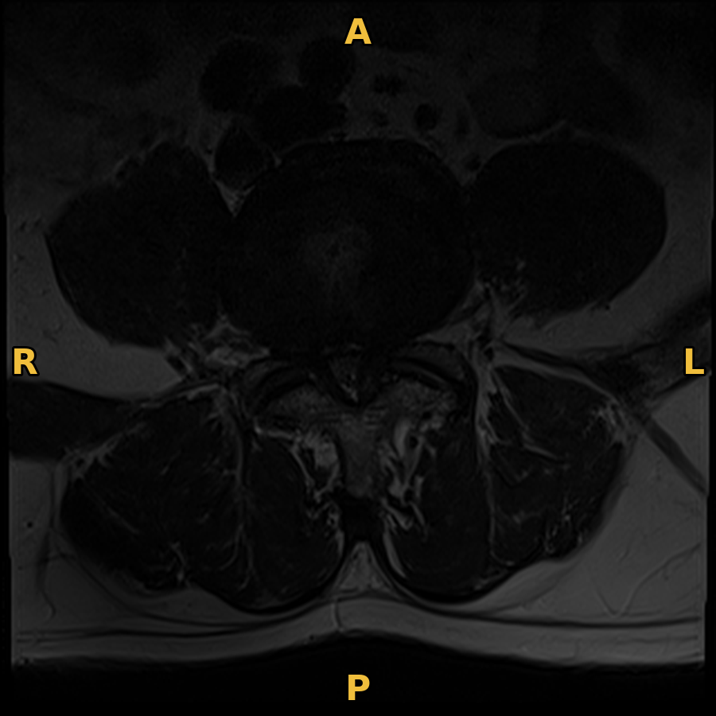
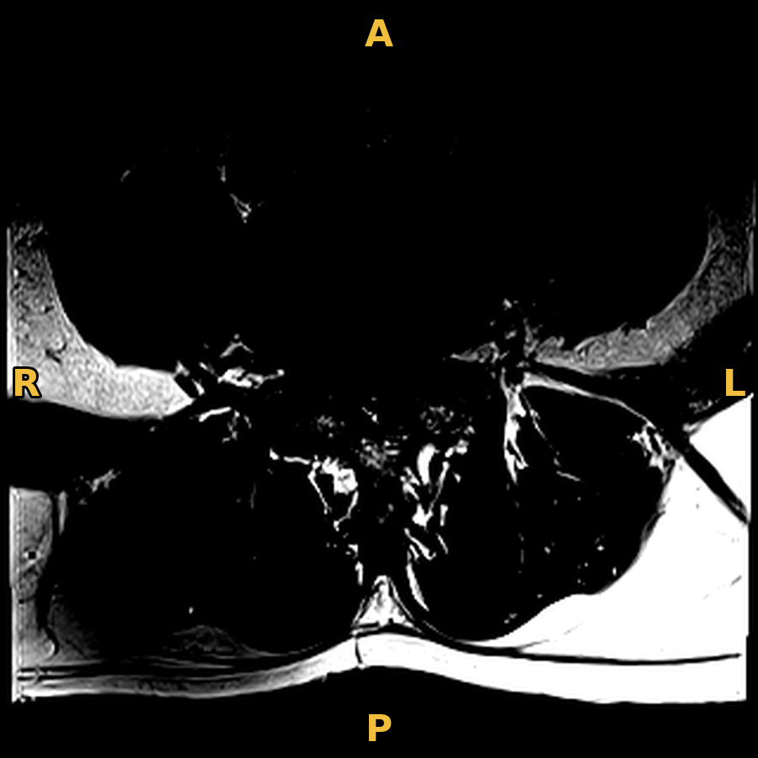
One slice, three windows
Full 12-bit range L = 2048, W = 4096
Header window L = 576, W = 1235
Narrow window L = 576, W = 300
Little contrast; nothing clipped
The scanner's suggestion
Strong contrast; much clipped to black or white
Same pixels the window decides what is visible — and the 8-bit PNG sent to a model inherits that choice.
Notes:
The same raw pixels of axial T2 instance 46, displayed three ways. Left: the full 12-bit range (L = 2048, W = 4096) — nothing is clipped, but this slice only uses values up to about 1,259, so it looks dark and flat. Middle: the header's suggested window (L = 576, W = 1235). Right: a narrow window (L = 576, W = 300) — strong contrast within a small range, but most pixels become pure black or white and detail is lost.
The left and right windows are teaching settings, not clinical presets. A 1st–99th percentile window for this slice gives L ≈ 499.5, W ≈ 999, close to the header window.
The PNG sent to MedGemma inherits whichever window was chosen.

Slide 19
What MedGemma actually receives
Window
12-bit → 8-bit: grey-level detail discarded
Save as PNG
one 2D slice; geometry and grouping lost
Model resizes
to 896 × 896 pixels → 256 image tokens
Radiologist
scrolls through every slice of three series, at full bit depth
Model in our setup
sees one compressed 2D picture per request
Keep the gap in mind when the model is wrong, it may simply not have been shown what the radiologist uses.
Notes:
To send a slice to MedGemma we: (1) apply a window, converting 12-bit to 8-bit and discarding grey-level detail; (2) save it as a PNG picture of one 2D slice; (3) let the model resize it — MedGemma's image encoder normalises images to 896 × 896 pixels and turns each image into 256 tokens (MedGemma model card).
A radiologist scrolls through every slice of three series at full bit depth. The model in our setup sees one compressed 2D picture per request. Keep that gap in mind when interpreting its answers.

Slide 20
Two ways to build imaging AI
 | Task-specific model | Foundation vision–language model
Example | A CNN trained on thousands of labelled lumbar MRIs (Kaggle competition) | MedGemma, prompted with an image and instructions
How it learns this task | Supervised training on this exact label set | Broad pretraining and medical adaptation; no training on our labels (zero-shot)
Output | Calibrated class probabilities for fixed labels | Free text, which we must parse into labels
Main strength | Usually stronger on its narrow task | Flexible; no task-specific training data
Main risk | Needs large labelled data; fails under dataset shift | Fluent but unsupported answers; format errors
Key idea a fluent free-text answer is not evidence: fix the output format and scoring rules first.
Notes:
Task-specific model: for example a CNN trained on thousands of labelled lumbar MRIs, as in the Kaggle competition. Learns this exact label set by supervised training; outputs calibrated class probabilities; usually stronger on its narrow task; needs large labelled data and fails under dataset shift.
Foundation vision–language model: MedGemma, prompted with an image and instructions. Broad pretraining and medical adaptation, no training on our labels (zero-shot). Outputs free text that we must parse. Flexible, needs no task-specific data; risks fluent but unsupported answers, format errors, and use on untested tasks.

Slide 21
Our setup is not the reported model
As reported
Our Lab 9 setup
MedGemma 1.5 4B: Gemma 3 language model + SigLIP-based image encoder
Adds support for 3D CT and MRI volumes
Model card: evaluated mainly on single-image tasks; not for direct clinical decisions
4-bit quantised GGUF (Q4_K_S) served locally by LM Studio — lower precision can change outputs
2D PNG slices through a chat API, not 3D volumes
One patient
“MedGemma has not been evaluated in use cases that involve comprehension of multiple images.”
MedGemma model card, checked 9 October 2026
So our results describe this setup on this patient — not MedGemma's published benchmark performance.
Notes:
MedGemma is a collection of Google models built on Gemma 3 with a SigLIP-based image encoder pretrained on de-identified medical data. MedGemma 1.5 4B (released 13 January 2026) adds support for 3D CT and MRI volumes.
The model card (checked 9 October 2026) says multimodal capabilities have been primarily evaluated on single-image tasks, that MedGemma has not been evaluated on comprehension of multiple images, and that outputs are not intended to directly inform clinical diagnosis or patient management.
Our Lab 9 responses come from medgemma-1.5-4b-it served by LM Studio as a 4-bit quantised GGUF file (Q4_K_S). Quantisation stores weights at lower precision to save memory and can change outputs. We send 2D PNG slices through a chat API, not 3D volumes prepared as the developers describe. Our results describe this setup on this patient; they do not measure MedGemma's 3D MRI capability or its published benchmark performance.

Slide 22
Four experiments, fixed in advance
ID | Experiment | Images sent | What it tests
E0 | Sanity check | One slice from each series, separately | Can it name modality, region and plane? (checkable from DICOM geometry)
E1 | Naive whole-study prompt | Middle slice of each series, in one request | All 25 grades at once from arbitrary slices
E2 | Expert-guided prompts | The slice where the expert placed each annotation | Best case: right slice, right view, narrow question
E3 | Stress tests | Repeated, blank, and mirrored images | Consistency, refusal without evidence, left/right
E2 is optimistic its slices came from the expert's annotations — part of the reference, which a deployed system lacks.
Notes:
These are the experiments run in Lab 9; the design and scoring rules are fixed before seeing results.
E0 sanity check: one slice from each series — can the model name modality, body region and plane? Checkable against DICOM geometry. E1 naive whole-study prompt: the middle slice of each series in one request, all 25 grades at once — how a first attempt often looks. E2 expert-guided: the slice where the expert placed each annotation, one condition per request — best-case input. E3 stress tests: repeated, blank and mirrored images — consistency, refusal without evidence, left/right reasoning.
Warning about E2: its slices are chosen with the expert's annotation coordinates, which are part of the reference standard. A deployed system would not have them. E2 is a best-case probe, not a usable pipeline, and its scores are optimistic.

Slide 23
How the answers are scored
Format compliance
Exact agreement
How many of the 25 labels came back as an allowed grade? “Cannot assess” counted separately; anything else invalid
Labels where the model grade equals the reference grade, out of all 25
High-grade detection
Baseline
Moderate or Severe = positive. Sensitivity, specificity, PPV and NPV on the labels the model graded
Always answer “Normal/Mild”, the most common class. The model must beat it to show it reads the image
Positive = Moderate or Severe (clinically relevant narrowing); Normal/Mild = negative.
Notes:
Format compliance: how many of the 25 labels came back as an allowed grade. 'Cannot assess' is allowed and counted separately; anything else is invalid.
Exact agreement: labels where the model grade equals the reference grade, out of all 25.
High-grade detection: treat Moderate or Severe as positive (clinically relevant narrowing), then compute sensitivity, specificity, PPV and NPV on the labels the model actually graded.
Baseline: always answer 'Normal/Mild', the most common class in the dataset. A model must beat this trivial rule to show it is reading the image.

Slide 24
Worked example: four metrics
Hypothetical model · 16 of 25 reference labels positive, 9 negative · model calls 10 positive, 8 of them truly positive
 | Reference positive | Reference negative | Total
Model positive | TP = 8 | FP = 2 | 10
Model negative | FN = 8 | TN = 7 | 15
Total | 16 | 9 | 25
Sensitivity TP ÷ (TP + FN) = 8 ÷ 16
50%
Specificity TN ÷ (TN + FP) = 7 ÷ 9
78%
PPV TP ÷ (TP + FP) = 8 ÷ 10
80%
Build it from the totals: FP = 10 − 8, FN = 16 − 8, TN = 9 − FP.
NPV TN ÷ (TN + FN) = 7 ÷ 15
47%
Sensitivity 50% half the narrowed sites were found; the other half are hidden among the “normal” answers.
Notes:
Hypothetical model, from the lecture notes. 16 of 25 reference labels are positive, 9 negative. The model calls 10 labels positive, of which 8 are truly positive.
So TP = 8, FP = 10 − 8 = 2, FN = 16 − 8 = 8, TN = 9 − 2 = 7.
Sensitivity = TP/(TP+FN) = 8/16 = 50%: half the narrowed sites were found. Specificity = TN/(TN+FP) = 7/9 = 78%. PPV = TP/(TP+FP) = 8/10 = 80%. NPV = TN/(TN+FN) = 7/15 = 47%.
Ask students to build the matrix from the sentence before revealing it: start from the totals (16 positive, 9 negative; 10 called positive).

Slide 25
What PPV and NPV tell the radiologist
The radiologist sees the model's answer, not the truth. Ask: “the model said X — how often is X right?”
PPV 80%
NPV 47%
When the model says “narrowed”, it is usually right: 8 of its 10 positive calls.
A “normal” answer is wrong more than half the time: 8 of its 15 negative calls are narrowed sites.
Why so low? Sensitivity is 50%: the 8 narrowed sites the model missed are hidden among its “normal” answers.
So a “normal” answer cannot rule out narrowing — the radiologist still has to read those images.
Notes:
The radiologist sees only the model's output, not the truth. PPV and NPV answer the question they face: 'the model said X — how likely is X to be right?'
PPV = 80%: when the model says 'narrowed', it is usually right (8 of 10). NPV = 47%: a 'normal' answer is wrong more than half the time (8 of 15 'normal' answers are narrowed sites; 1 − 0.47 = 53%).
So a 'normal' answer cannot rule out narrowing: the radiologist still has to read those images. The low NPV follows from the 50% sensitivity — the missed narrowed sites sit among the negatives.
With different numbers the wording changes: always state the value and read it from the user's side. For example, an NPV of 56% means a 'normal' answer is wrong almost half the time.

Slide 26
Why one patient cannot show performance
Not independent All 25 labels share one person's anatomy, one scanner, one image quality
A real evaluation would need
Hundreds of held-out studies, ideally from new sites
A test set with multiple annotators
Prespecified metrics and subgroup analysis
A study of how radiologists use the output
One annotator The reference is one expert's reading, not certain truth
Tiny variety One patient covers a tiny part of the ages, diseases, scanners and sites
No honest interval An interval treating the 25 labels as independent would be falsely narrow
And our setup: a quantised local model on 2D slices is not the reported model; E2 chose slices from the reference annotations.
One patient can describe behaviour and expose failure modes. It cannot establish clinical performance.
Notes:
The 25 labels are not independent: they share one person's anatomy, one scanner and one image quality. The reference is one annotator's reading. One patient covers a tiny part of the variety of ages, diseases, scanners and sites. A confidence interval computed as if the 25 labels were independent would be falsely narrow, so we do not report one.
Also remember the setup: a quantised local model on 2D slices is not the reported model; and E2's slice choice used the reference annotations, so its scores are optimistic.
A real evaluation would need hundreds of held-out studies, ideally from sites not used in development, a test set with multiple annotators, prespecified metrics, subgroup analysis, and a study of how radiologists actually use the output.

Slide 27
Key ideas
Idea | Key point
The task | Anatomical grading, not diagnosing pain; define user, unit of analysis and decision time first
Sequence vs plane | T1, T2, STIR are sequences; sagittal, axial, coronal are planes; a series = one of each
DICOM | Digital Imaging and Communications in Medicine: header (data elements) + pixel data
Identity | Can hide in the header, burned into pixels, or in metadata outside the image
Geometry | Order slices by tags, not file names; LPS tags tell left from right
Display | Window/level changes what is visible; the 8-bit PNG sent to a model inherits that choice
Evaluation | Fix scoring first; read PPV/NPV from the user's side; one patient cannot show performance
Next: Lab 9 — load the study, run the MedGemma experiments, score them
Notes:
Recap each row in one sentence. Then Lab 9: load the study, run E0–E3 from saved responses, score against the reference and the baseline.

Slide 28
Check your understanding
1
Why is “grading stenosis on MRI” a narrower task than “diagnosing the cause of back pain”?
2
Which series would you use to grade left foraminal narrowing at L4/L5, and why does T1 help?
3
A file is named 20.dcm. Which DICOM tag, not the file name, should decide its order?
4
A slice has ImageOrientationPatient = [0, 1, 0, 0, 0, −1]. What is its plane?
5
Why can't you reuse a CT “bone window” on MRI?
6
Give two reasons why MedGemma's published benchmarks do not predict its accuracy in Lab 9.
7
Why are the E2 results optimistic?
8
In the worked example NPV = 47%. What does that mean for a radiologist reading a “normal” answer?
Notes:
Answers: Q1 — the radiologist grades anatomy; the clinician combines it with symptoms and examination, and narrowing on images is common without pain. Q2 — sagittal T1; bright fat around the root makes foraminal narrowing visible. Q3 — InstanceNumber (or position). Q4 — normal = (0,1,0) × (0,0,−1) = (−1, 0, 0), along x: sagittal. Q5 — MRI has no fixed unit like Hounsfield units. Q6 — quantised local model and 2D slices instead of 3D volumes; one patient; one annotator. Q7 — E2 chose slices with the reference annotations. Q8 — a 'normal' answer is wrong 53% of the time, so it cannot rule out narrowing.

Slide 29
References
Richards TJ, Flanders AE, Colak E, et al. The RSNA Lumbar Degenerative Imaging Spine Classification (LumbarDISC) Dataset. Radiology: Artificial Intelligence 2026;8(2):e250480.
RSNA. RSNA 2024 Lumbar Spine Degenerative Classification (Kaggle competition, data and rules).
Google. MedGemma model card; Health AI Developer Foundations terms of use. Checked 9 October 2026.
NEMA. DICOM PS3.3, §C.7.6.2 Image Plane Module: image position, orientation and the patient coordinate system.
pydicom documentation: reading DICOM files in Python.
Brinjikji W, Luetmer PH, Comstock B, et al. Systematic literature review of imaging features of spinal degeneration in asymptomatic populations. AJNR 2015;36(4):811–816.
MRI images and header values: one de-identified study from the RSNA 2024 dataset, for use within this class only. Diagrams are schematic.
Notes:
Full references with links are in the lecture notebook, 'References and further reading'.

