Slide 1
WORKING WITH EXTERNAL FILES IN PYTHON
BY MR JASTIN MANYA

Slide 2
INTRODUCTION
OBJECTIVES
Types of external data files
Working with .csv, .JSON, SQL and XML.
Importing external data files.
Traversing through data in external files.
Changing data in external files.
CRUD functionality on external data files.

Slide 3
Make Effective Presentations
Using Awesome Backgrounds
Engage your Audience
Capture Audience Attention

Slide 4
Slide Title
Product A
Product B
Feature 1
Feature 2
Feature 3
Feature 1
Feature 2
Feature 3

Slide 5
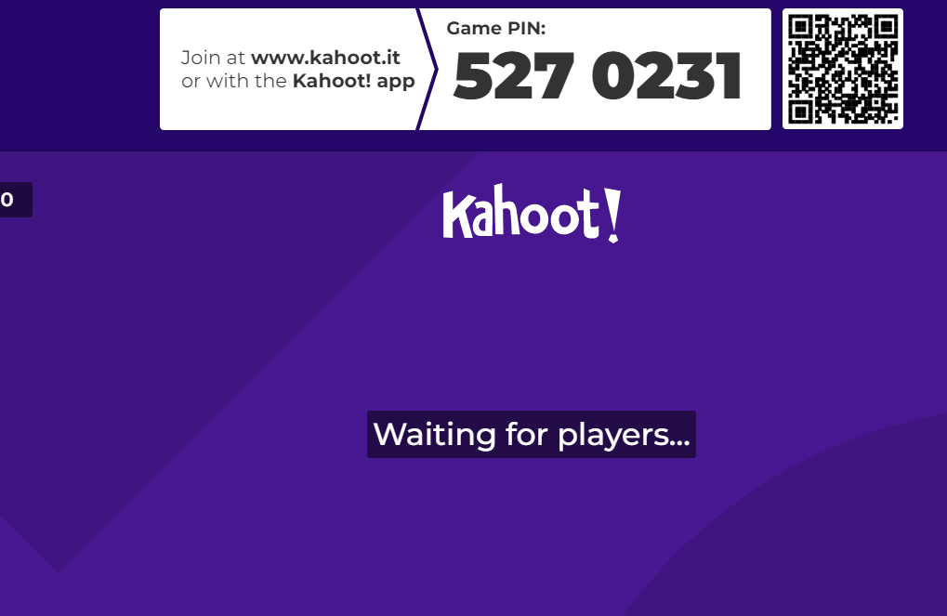
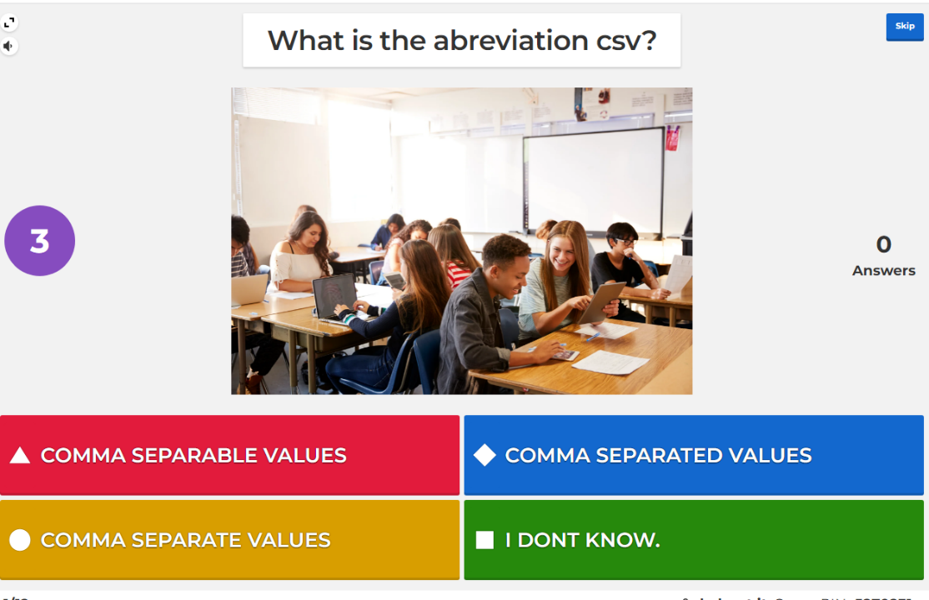
All Learning and no play makes Jack a dull boy

