Slide 1
Bluestock MF
Mutual Fund Analytics — India
ETL • Performance Metrics • Risk Signals • Investor Reporting
Bluestock MF • Mutual Fund Analytics Capstone
1

Slide 2
Project Objective
• Build a repeatable analytics workflow for Indian equity mutual fund schemes.
• Compare funds using returns, alpha, expense ratio, AUM, NAV history, benchmarks, and risk metrics.
• Turn raw datasets into clear rankings, visuals, and investor-oriented reporting.
• Support scheme screening, SIP suitability analysis, performance monitoring, and portfolio selection.
Bluestock MF • Mutual Fund Analytics Capstone
2

Slide 3
Data Foundation
Structured datasets plus selected live NAV feeds
20
Fund-master schemes documented in README
10,000
NAV-history rows in the README dataset inventory
10
Core structured datasets
6
Schemes with live NAV CSVs documented
• Sources include fund metadata, NAV history, holdings, SIP records, returns, benchmarks, AUM, expense ratios, managers, and risk metrics.
• Live NAV examples are fetched from mfapi.in and validated using AMFI scheme codes.
Bluestock MF • Mutual Fund Analytics Capstone
3

Slide 4
ETL Pipeline
A repeatable workflow from source data to decision-ready outputs
1
2
3
4
5
6
7
Ingest
Validate
Clean
Load
Analyze
Visualize
Report
• Cleaning covers date parsing, missing-value checks, outlier review, and categorical normalization.
• The pipeline can be orchestrated with run_pipeline.py and individual stages can be executed separately.
Bluestock MF • Mutual Fund Analytics Capstone
4

Slide 5
Data Quality and Validation
• AMFI scheme-code coverage is reported as 100% for the 20 master codes in the README.
• The workflow validates scheme identifiers before analysis so joins remain consistent.
• Live API responses should be checked using the returned scheme_name because AMFI codes can represent specific variants.
• Dates follow the DD-MM-YYYY format documented in the project.
Important
Synthetic NAV history is described as directionally realistic, not market-real historical data.
Bluestock MF • Mutual Fund Analytics Capstone
5

Slide 6
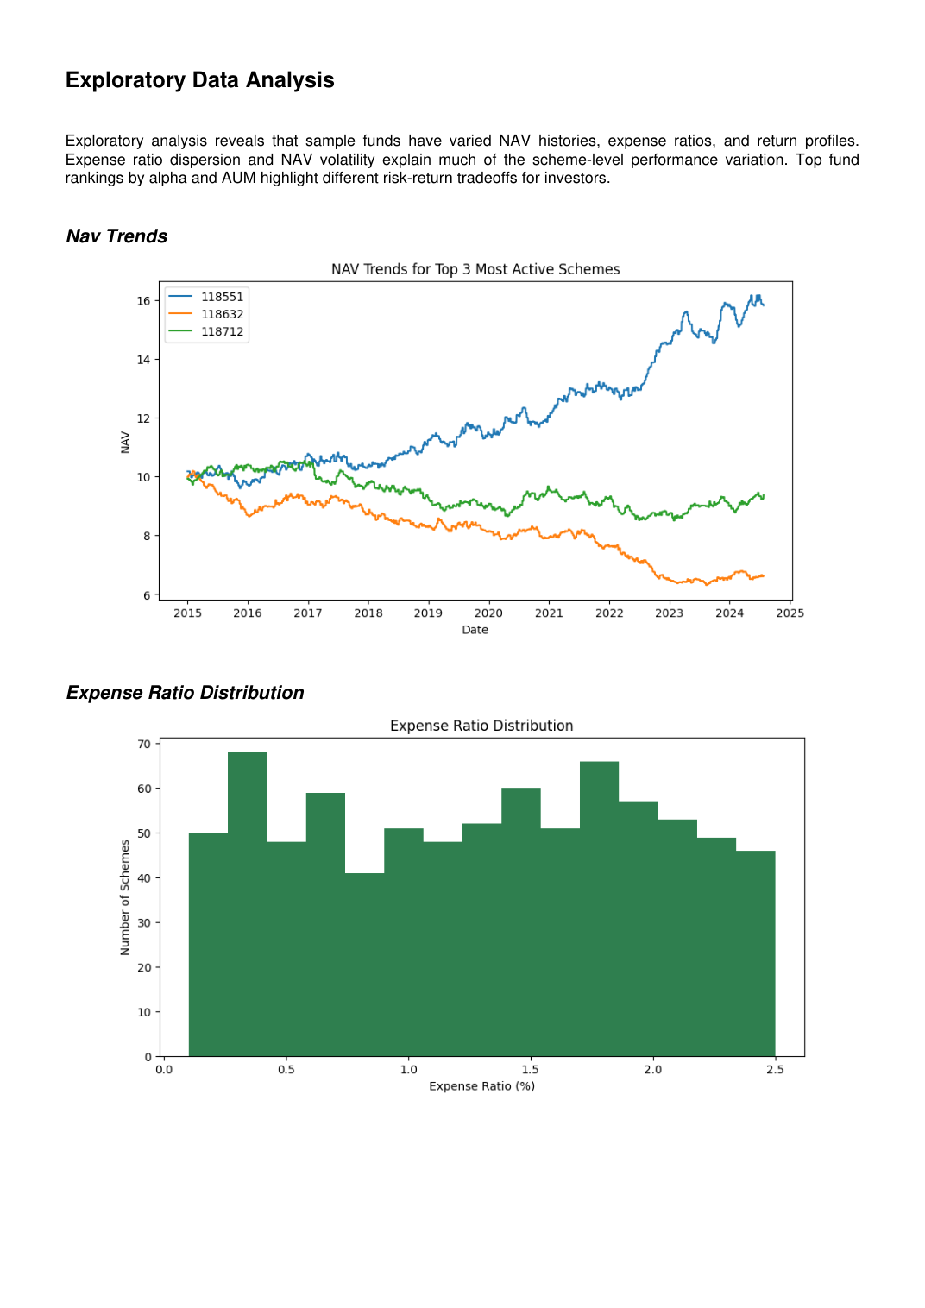
Exploratory Data Analysis
The supplied report highlights NAV trends, cost dispersion, and return variation
• NAV histories diverge materially across sample schemes.
• Expense ratios show meaningful dispersion across schemes.
• The project uses these patterns to motivate multi-factor comparison rather than single-metric ranking.
Bluestock MF • Mutual Fund Analytics Capstone
6

Slide 7
NAV Trend Overview
• The chart covers the 2015–2024 period.
• Three example scheme series show different long-term trajectories.
• Historical movement and volatility provide context that a single return figure cannot capture.
Bluestock MF • Mutual Fund Analytics Capstone
7

Slide 8
Performance Metrics
• 1-year return distribution is used to understand the range and concentration of recent performance.
• Alpha measures benchmark-relative performance and supports scheme ranking.
• Expense ratio provides a cost lens when comparing otherwise similar schemes.
• AUM momentum adds a scale and investor-flow perspective.
Bluestock MF • Mutual Fund Analytics Capstone
8

Slide 9
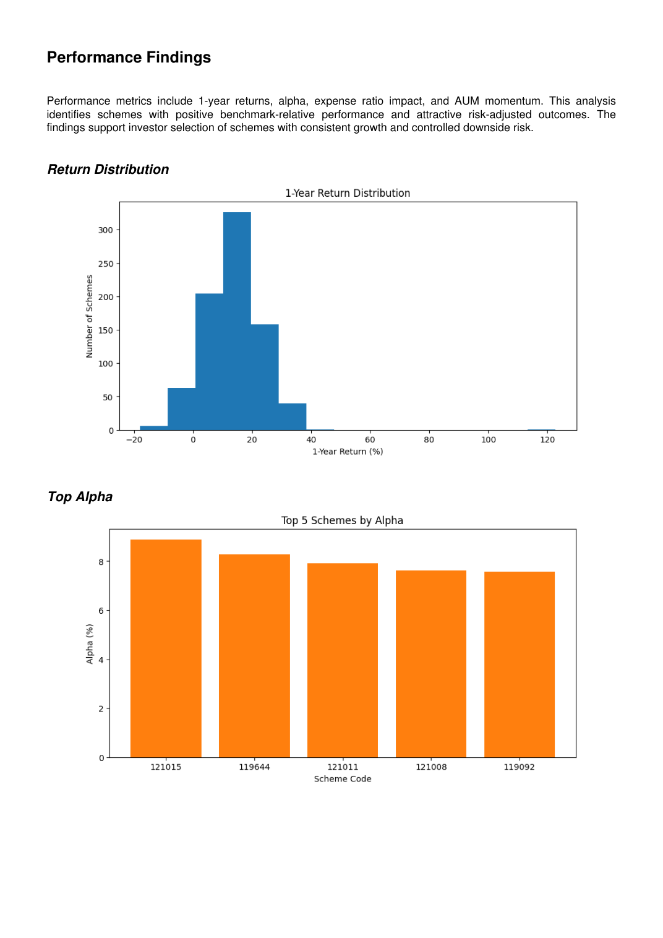
Return Distribution and Alpha
• The report appendix states an average 1-year return of 13.67%.
• Top-alpha scheme codes shown are 121015, 119644, 121011, 121008, and 119092.
• The project uses positive alpha as one screening signal, not as a standalone investment decision.
Bluestock MF • Mutual Fund Analytics Capstone
9

Slide 10
Risk Drivers
Alpha
Benchmark-relative value added
Expense ratio
Cost paid for managing the scheme
AUM stability
Indicator to monitor scale and investor-flow behavior
Volatility
Helps frame return with downside risk
Bluestock MF • Mutual Fund Analytics Capstone
10

Slide 11

AUM Momentum
• The supplied chart shows substantial month-to-month AUM movement for scheme 121018.
• This supports monitoring AUM stability over time rather than relying on a single AUM snapshot.
• AUM should be interpreted together with returns, risk, and cost.
Bluestock MF • Mutual Fund Analytics Capstone
11

Slide 12
Key Findings
• Average 1-year return reported: 13.67%.
• Average expense ratio reported: 1.30%.
• Positive alpha, moderate costs, and stable AUM growth are the main screening signals highlighted by the project.
• The dashboard combines NAV trends, expense distribution, performance rankings, and AUM analytics for rapid comparison.
• The current work is an analytics foundation—not personalized financial advice.
Bluestock MF • Mutual Fund Analytics Capstone
12

Slide 13
Recommendations and Future Work
• Prioritize funds with positive alpha and attractive risk-adjusted outcomes.
• Prefer moderate expense ratios when other characteristics are comparable.
• Monitor AUM stability and downside risk.
• Extend the solution with live daily AMFI integration and a wider scheme universe.
• Add direct-vs-regular plan differentiation, interactive filters, scenario simulations, Monte Carlo modeling, optimization, and automated investor reporting.
Bluestock MF • Mutual Fund Analytics Capstone
13

Slide 14
Thank You
Bluestock MF — Mutual Fund Analytics
Questions & Discussion
Bluestock MF • Mutual Fund Analytics Capstone
14

