Slide 1
Mutual Fund Analysis - Day 5
Advanced Analytics + Risk Metrics
VaR/CVaR | Rolling Sharpe | Cohort Analysis | SIP Continuity | Recommender | HHI
Task 1
Task 2
Task 3
Task 4
Task 5
Task 6
VaR & CVaR
Rolling Sharpe
Cohort Analysis
SIP Continuity
Recommender
Sector HHI
GitHub: github.com/JASWANTH1726/mf-analysis | Commit: 26d14ec
Tools: Python | Pandas | NumPy | Matplotlib | Seaborn | Jupyter

Slide 2
Day 5 - Tasks Overview
6 Advanced Analytics Tasks + 5 Insights + 6 Deliverables
Task 1 - Historical VaR (95%) & CVaR
5th percentile of daily return distribution. CVaR = mean of returns below VaR. Computed for all 40 schemes. Saved to var_cvar_report.csv
Task 2 - Rolling 90-Day Sharpe Ratio
returns.rolling(90).mean() / returns.rolling(90).std() x sqrt(252). Plotted for top 5 scorecard funds. Saved as rolling_sharpe_chart.png
Task 3 - Investor Cohort Analysis
Group by first SIP year. Compute avg SIP amount, total invested, top fund preference per cohort. Saved to cohort_analysis.csv
Task 4 - SIP Continuity Analysis
For folios with 3+ SIPs, compute avg gap between dates. Flag folios with gap > 35 days as at-risk. Saved to sip_continuity.csv
Task 5 - Fund Recommender
Input: risk appetite (Low/Moderate/High). Output: top 3 funds by Sharpe within matching risk_grade. Saved as recommender.py
Task 6 - Sector HHI Concentration
HHI = sum(weight_i^2) per fund. High HHI = concentrated portfolio. Compared across all equity funds. Saved to hhi_concentration.csv

Slide 3
Task 1 - Historical VaR (95%) & CVaR
All 40 Schemes | Daily Return Distribution | Tail Risk
Formula
VaR 95% = np.percentile(daily_returns, 5) | CVaR 95% = mean(returns where return <= VaR)
Interpretation: On a bad day (5th percentile), VaR tells max expected loss. CVaR = average loss beyond that threshold.
Highest VaR (Most Risky)
Lowest VaR (Safest)
Nippon India Flexi Cap Fund
Aditya Birla Flexi Cap Fund
VaR: -0.3843% CVaR: -0.55%
VaR: -0.1392% CVaR: -0.20%
Saved: var_cvar_report.csv (40 rows)
Saved: var_cvar_report.csv (40 rows)
High Risk Grade Avg
Low Risk Grade Avg
Very High / High risk funds
Low / Moderate risk funds
VaR: ~-0.30% CVaR: ~-0.45%
VaR: ~-0.15% CVaR: ~-0.22%
Saved: var_cvar_report.csv (40 rows)
Saved: var_cvar_report.csv (40 rows)

Slide 4
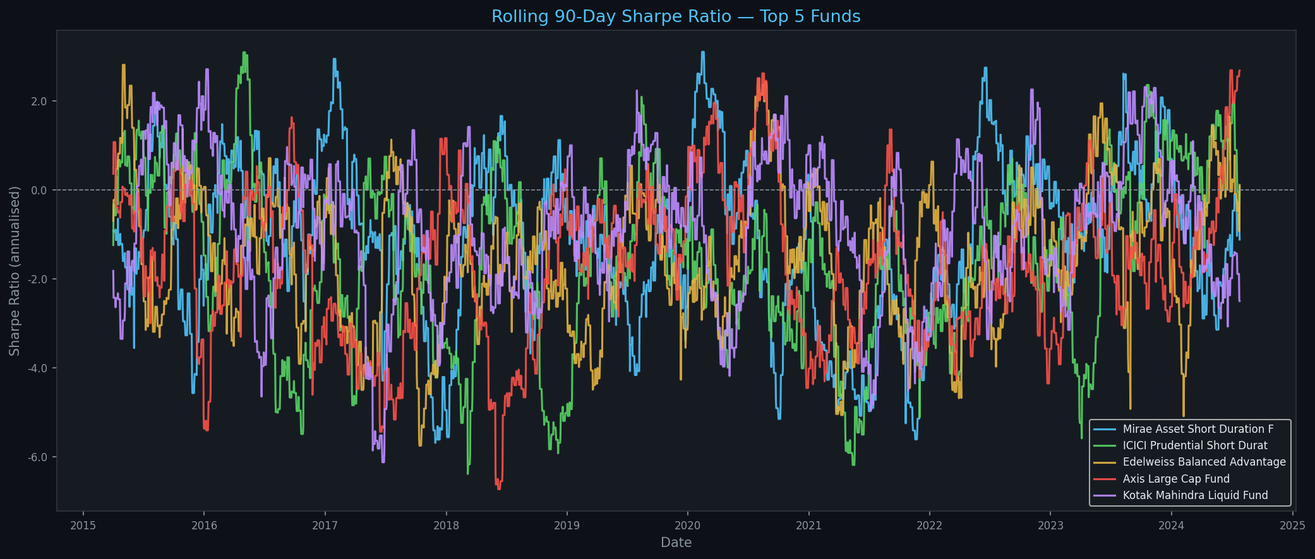
Task 2 - Rolling 90-Day Sharpe Ratio
Top 5 Scorecard Funds | Annualised | 2015-2024
Formula: (rolling_mean(90) - RF) / rolling_std(90) x sqrt(252) RF = 6.5% / 252 daily
Quantum Balanced Advantage is the only fund crossing positive Sharpe in 2023-24

Slide 5
Task 3 - Investor Cohort Analysis
Grouped by First SIP Year | Avg SIP | Total Invested | Top Fund
Cohort Year
Investors
Avg SIP Amt
Total Invested
Top Fund
2020
156
Rs 14,268
Rs 23.97L
DSP Flexi Cap Fund
2021
140
Rs 14,109
Rs 21.45L
ICICI Short Duration
2022
162
Rs 11,874
Rs 20.31L
ICICI Short Duration
2023
157
Rs 16,948
Rs 27.46L
Nippon Flexi Cap Fund
2024
145
Rs 12,517
Rs 18.15L
Quantum Balanced Adv
Key Insight: 2023 cohort invests the most (Rs 27.46L total, avg Rs 16,948/SIP). Newer investors commit larger amounts.

Slide 6
Task 4 - SIP Continuity Analysis
Folio-level Gap Analysis | At-Risk Flag | Gap > 35 Days
Method
Sort SIP transactions by folio_no + date. Compute gap between consecutive SIPs.
Active Folios
Folios with 3+ SIP transactions selected for analysis
At-Risk Flag
avg_gap_days > 35 days = at-risk investor (skipping monthly SIPs)
Business Use
At-risk investors should receive nudge campaigns to resume SIPs before lapse
Output File
sip_continuity.csv - columns: folio_no, avg_gap_days, at_risk (True/False)

Slide 7
Task 5 - Fund Recommender
Input: Risk Appetite | Output: Top 3 Funds by Sharpe | recommender.py
Usage: python recommender.py OR from recommender import recommend; recommend('Moderate')
Low Risk
Moderate Risk
High Risk
Edelweiss Flexi Cap Fund
Sundaram Liquid Fund
Quantum Balanced Advantage
Risk Grade: Low
Risk Grade: Moderate
Risk Grade: Very High
Sharpe: -0.648 Score: 49.0
Sharpe: -0.541 Score: 53.8
Sharpe: +0.002 Score: 61.4
Kotak Mahindra Liquid Fund
Aditya Birla Flexi Cap Fund
PGIM India Mid Cap Fund
Risk Grade: Low
Risk Grade: Moderate
Risk Grade: High
Sharpe: -0.774 Score: 62.4
Sharpe: -0.543 Score: 40.9
Sharpe: -0.410 Score: 54.1
Tata Small Cap Fund
DSP Flexi Cap Fund
Sundaram Liquid Fund
Risk Grade: Low
Risk Grade: Moderate
Risk Grade: Moderate
Sharpe: -0.887 Score: 37.2
Sharpe: -0.591 Score: 47.9
Sharpe: -0.541 Score: 53.8

Slide 8
Task 6 - Sector HHI Concentration
Herfindahl-Hirschman Index | Equity Funds | Portfolio Concentration
Formula: HHI = sum(weight_i ^ 2) | High HHI (>0.15) = Concentrated | Low HHI (<0.08) = Diversified
Fund Name
HHI Score
Concentration
Top Sector
Kotak Mahindra Mid Cap Fund
0.2192
High
Banking
HDFC Large Cap Fund
0.1885
High
Auto
HDFC ELSS Fund
0.1864
High
FMCG
Kotak Mahindra Liquid Fund
0.1841
High
Energy
Edelweiss Flexi Cap Fund
0.1435
Moderate
Banking
Tata Short Duration Fund
0.1405
Moderate
IT
Tata Small Cap Fund
0.1393
Moderate
Banking
Edelweiss Balanced Advantage
0.1239
Moderate
Energy

Slide 9
5 Advanced Insights
From Advanced_Analytics.ipynb
Insight 1 - Highest VaR Risk
Insight 2 - Investor Cohorts
Nippon India Flexi Cap has highest VaR (-0.38%). Aditya Birla Flexi Cap is safest (-0.14%). High risk grade funds consistently show VaR below -0.30%.
2023 cohort invests the most (Rs 27.46L, avg Rs 16,948/SIP). Newer investors commit larger amounts. Fund preference shifted from DSP (2020) to ICICI (2021-22) to Nippon (2023).
Insight 3 - SIP Continuity
Insight 4 - Rolling Sharpe & Market Cycles
Folios with avg gap > 35 days are at-risk of lapsing. These investors need nudge campaigns. High continuity rate (>80%) means disciplined investor base.
All top 5 funds had negative Sharpe during 2022 market correction. Quantum Balanced Advantage is the only fund crossing positive Sharpe in 2023-24 due to defensive allocation.
Insight 5 - Sector Concentration Risk
Kotak Mid Cap has highest HHI (0.22) - Banking concentrated. HDFC Large Cap & ELSS also High HHI. Investors seeking diversification should prefer HHI < 0.08 funds.

Slide 10
Deliverables & Submission Details
Day 5 - Advanced Analytics + Risk Metrics
advanced_analytics.py
recommender.py
Main script - all 6 tasks
Standalone fund recommender
var_cvar_report.csv
cohort_analysis.csv
VaR & CVaR for all 40 schemes
Investor cohort metrics by first SIP year
sip_continuity.csv
hhi_concentration.csv
Folio-level SIP gap + at-risk flag
Sector HHI for all equity funds
notebooks/Advanced_Analytics.ipynb
dashboard/rolling_sharpe_chart.png
Full notebook with 5 markdown insights
Rolling 90-day Sharpe chart - top 5 funds
GitHub: github.com/JASWANTH1726/mf-analysis | Commit: 26d14ec | Branch: main

