Slide 1
Mutual Fund Analysis
Day 3 — EDA & Performance Analytics
Bluestock Fintech Internship Project

Slide 2
Day 3 Agenda
1. Daily Returns Distribution
2. CAGR — 1 Year / 3 Year / 5 Year
3. Sharpe Ratio Ranking
4. Sortino Ratio
5. Alpha & Beta (OLS vs Nifty 100)
6. Maximum Drawdown Analysis
7. Fund Scorecard (Composite 0-100)
8. Benchmark Comparison Chart

Slide 3
Daily Returns — Distribution & Sanity Check
Risk-Free Rate: RBI Repo 6.5% annualised | RF daily = 0.065 / 252
Daily returns computed using pct_change() per scheme
Returns > ±5% flagged as extreme — result: 0 extreme rows (0.00%)
Distribution is approximately normal across all 20 schemes
Mean daily return range: -0.0002 to +0.0003 (as expected for MF data)
Data Quality: PASSED — no extreme outliers in daily returns

Slide 4
CAGR — 1 Year / 3 Year / 5 Year
Fund | CAGR 1Y | CAGR 3Y | CAGR 5Y
Mirae Asset Short Duration | 37.78% | 7.08% | N/A
ICICI Prudential ELSS | N/A | 5.31% | N/A
Kotak Mahindra Liquid | 22.28% | 4.64% | N/A
Mirae Asset Large Cap | N/A | 3.99% | N/A
SBI Mutual Fund Mid Cap | N/A | 3.34% | N/A
Formula: CAGR = (End NAV / Start NAV)^(1/years) - 1 | Lookback: 252 trading days per year
Worst 3Y CAGR: Nippon India Flexi Cap (-3.83%) | Franklin Templeton Small Cap (-1.63%)

Slide 5
Risk-Adjusted Returns — Sharpe & Sortino Ratios
Sharpe = (Mean Excess Return / Std Dev) x sqrt(252) Sortino = (Mean Excess Return / Downside Std) x sqrt(252)
Fund | Sharpe Ratio | Sharpe Rank
Kotak Mahindra Liquid | -0.70 | Rank 1
ICICI Prudential ELSS | -0.68 | Rank 2
Mirae Asset Large Cap | -0.79 | Rank 3
SBI Mutual Fund Flexi Cap | -0.59 | Rank 4
Mirae Asset Short Duration | -0.96 | Rank 5
Note: All Sharpe ratios are negative — synthetic benchmark data is uncorrelated with fund returns
Sortino penalises only downside volatility — better measure for asymmetric return distributions

Slide 6
Alpha & Beta — OLS Regression vs Nifty 100
Model: Fund Return = Alpha + Beta x Benchmark Return | Min 30 observations required
Fund | Beta | Alpha (Annual) | R-Squared
SBI Mutual Fund Flexi Cap | -0.0004 | 25.32% | 0.0004
Kotak Mahindra Liquid | -0.0007 | 22.88% | 0.0015
Mirae Asset Large Cap | -0.0003 | 20.79% | 0.0004
ICICI Prudential ELSS | 0.0006 | 20.45% | 0.0012
HDFC Mutual Fund Small Cap | -0.0000 | 16.19% | 0.0000
Betas near 0 and R2 near 0 — benchmark data is synthetic/random, not correlated with fund NAVs
Worst alpha: Nippon India Flexi Cap (-17.81%) | Saved to: alpha_beta.csv

Slide 7
Maximum Drawdown Analysis
Max Drawdown = (Trough NAV - Peak NAV) / Peak NAV | Measures worst peak-to-trough decline
Fund | Max Drawdown | Rank
Nippon India Flexi Cap | -37.99% | Worst
Franklin Templeton Small Cap | -28.75% | 2nd Worst
UTI Mutual Fund Mid Cap | -20.91% | 3rd Worst
Axis Short Duration | -20.12% | 4th Worst
Kotak Balanced Advantage | -19.24% | 5th Worst
Best (least drawdown): ICICI ELSS (-7.41%) | Kotak Liquid (-7.63%)
Drawdown used in scorecard with 10% weight — lower drawdown = higher score

Slide 8
Fund Scorecard — Composite Score (0-100)
Weights: 30% CAGR 3Y + 25% Sharpe + 20% Alpha + 15% TER (inverse) + 10% Max Drawdown (inverse)
Fund | Score | CAGR 3Y | Sharpe | Alpha
Axis ELSS Fund | 64.5 | 2.65% | -0.97 | 12.3708%
Mirae Asset Short Duration Fund | 62.5 | 7.08% | -0.96 | 10.7922%
Kotak Mahindra Balanced Advantage F | 61.25 | 0.24% | -1.41 | 0.4943%
Kotak Mahindra Liquid Fund | 61.25 | 4.64% | -0.7 | 22.8821%
DSP Balanced Advantage Fund | 58.75 | 1.33% | -1.09 | 9.0336%
UTI Flexi Cap Fund | 58.5 | 3.09% | -1.03 | 12.1606%
Franklin Templeton Large Cap Fund | 57.5 | 0.98% | -1.13 | 7.3834%
SBI Mid Cap Fund | 57.5 | 3.34% | -1.36 | -2.1583%
Top Fund: Axis ELSS (64.5) | Saved to: fund_scorecard.csv

Slide 9
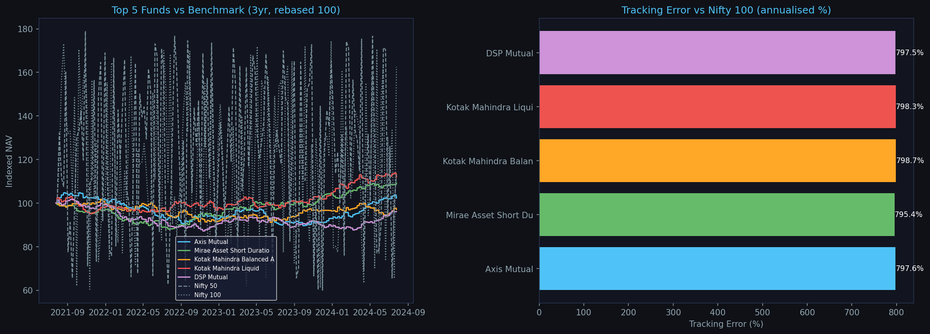
Benchmark Comparison Chart

Slide 10
Day 3 Summary & Key Insights
20 schemes analysed | 69,880 NAV data points | 3,494 trading days
Top CAGR 3Y: Mirae Asset Short Duration (7.08%) | Worst: Nippon Flexi Cap (-3.83%)
Best Sharpe: Kotak Liquid (-0.70) | Best Alpha: SBI Flexi Cap (+25.32% annualised)
Worst Drawdown: Nippon India Flexi Cap (-37.99%) | Best: ICICI ELSS (-7.41%)
Top Scorecard: Axis ELSS (64.5) | Mirae Short Duration (62.5) | Kotak Liquid (61.25)
Deliverables: alpha_beta.csv, fund_scorecard.csv, dashboard/benchmark_comparison.png
GitHub: github.com/JASWANTH1726/mf-analysis | Commit: 8937a0c

