Slide 1
Mutual Fund Analysis — Day 4
Dashboard Development
4-Page Interactive Dashboard | PNG + PDF Export | 40 Schemes | Dark Theme
Page 1
Page 2
Page 3
Page 4
Industry Overview
Fund Performance
Investor Analytics
SIP & Market Trends
GitHub: github.com/JASWANTH1726/mf-analysis | Commit: fb9b695
Tools: Python | Matplotlib | Seaborn | Pandas | PIL | SQLite

Slide 2
Day 4 — What Was Built
Dashboard Development | 4 Pages | PNG + PDF
✦ create_dashboard.py
Single Python script generating all 4 dashboard pages + PDF
✦ Page 1 — Industry Overview
KPI cards (AUM, SIP, Folios, Schemes) + AUM trend + AUM by AMC + Category pie + Risk donut
✦ Page 2 — Fund Performance
Return vs Risk scatter (bubble=AUM, colour=score) + Scorecard table top 10 + NAV vs benchmark + Alpha bar
✦ Page 3 — Investor Analytics
Txn type donut + KYC bar + State transaction bar + Monthly volume grouped bar + Avg amount by fund house
✦ Page 4 — SIP & Market Trends
SIP vs Nifty 50 dual-axis + Category inflow heatmap + Net inflow by category + SIP YoY dual-axis
✦ Dashboard.pdf
All 4 pages combined into a single PDF using PIL + matplotlib PdfPages

Slide 3
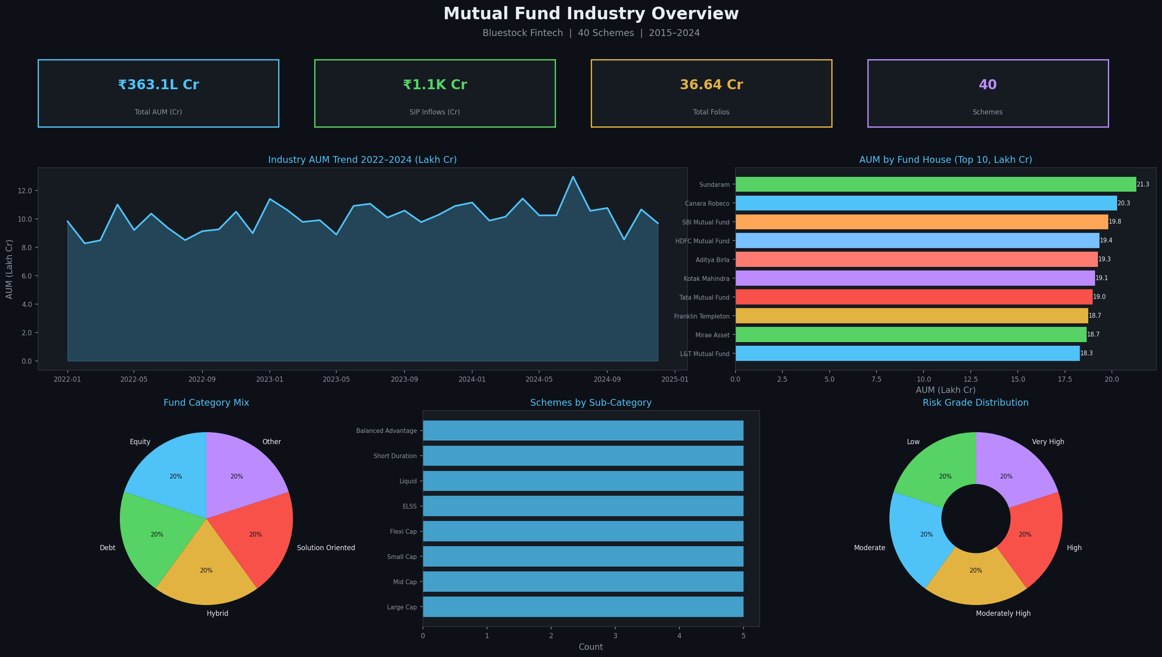
Page 1 — Industry Overview
KPI Cards | AUM Trend | Fund House | Category Mix | Risk Grade
40 Schemes | 20 Fund Houses | 2022–2024 AUM Data | Dark Theme (#0d1117)

Slide 4
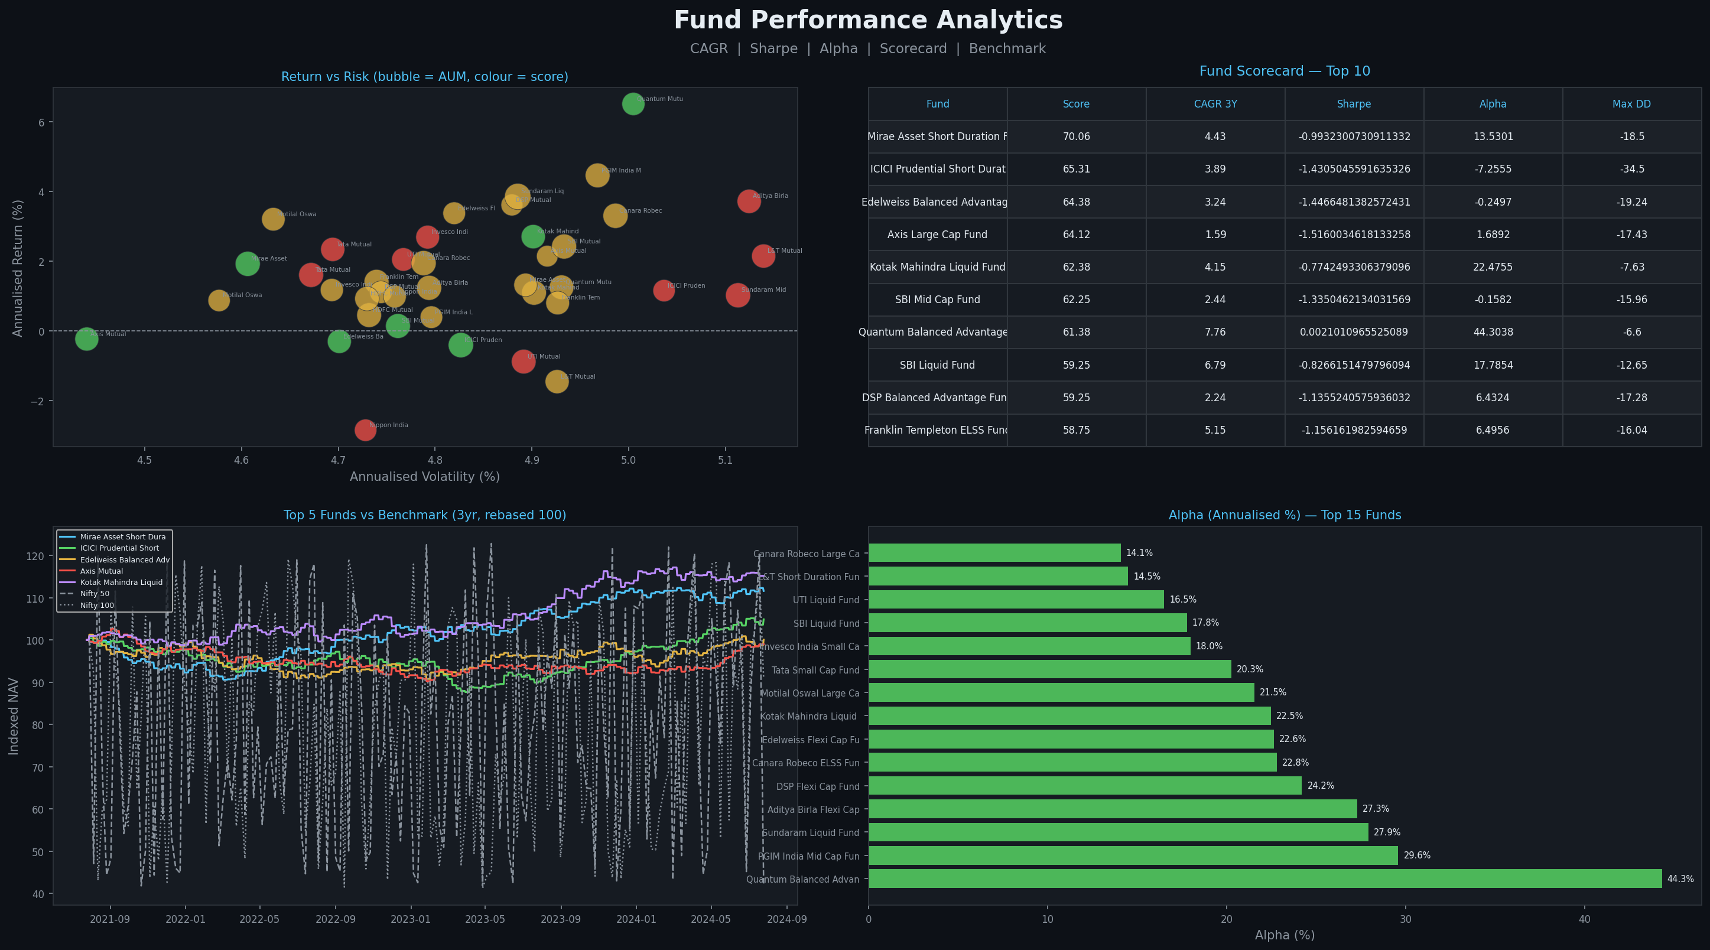
Page 2 — Fund Performance Analytics
Return vs Risk | Scorecard Top 10 | NAV vs Benchmark | Alpha Bar
Scorecard #1: Mirae Short Duration (70.06) | Top Alpha: Quantum Balanced Advantage (44.30%)

Slide 5
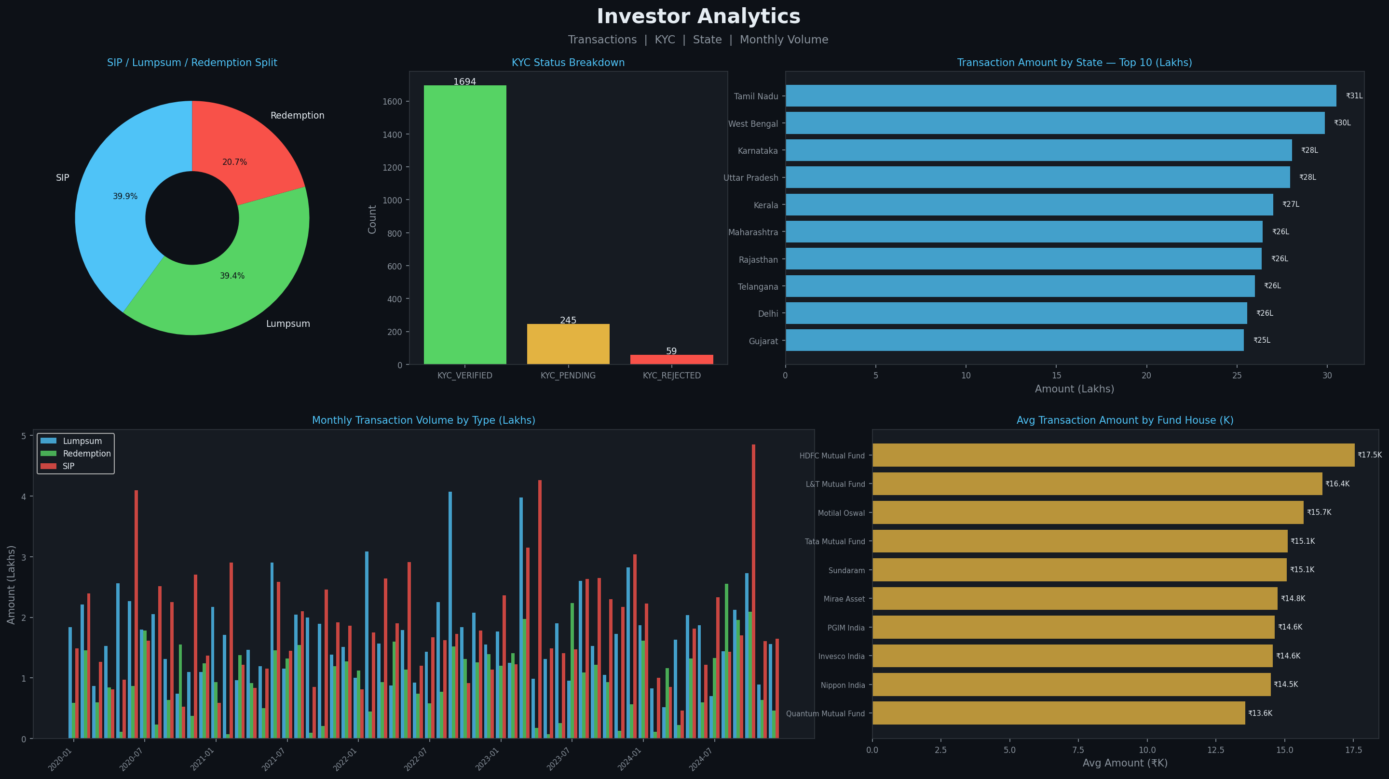
Page 3 — Investor Analytics
Transactions | KYC Status | State Distribution | Monthly Volume
1,998 Transactions | SIP / Lumpsum / Redemption | KYC Verified / Pending / Rejected

Slide 6
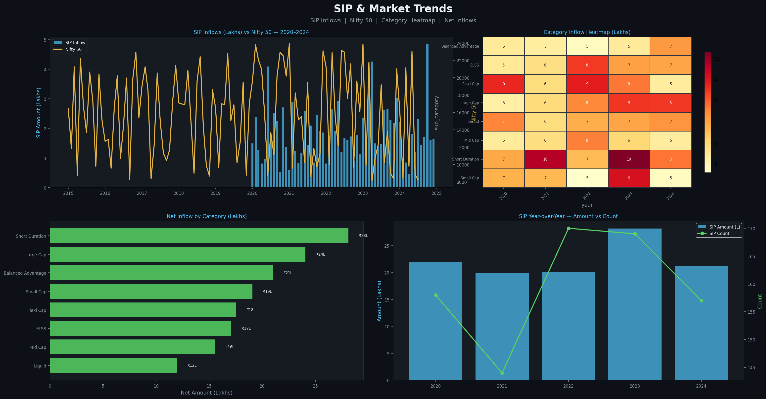
Page 4 — SIP & Market Trends
SIP vs Nifty 50 | Category Heatmap | Net Inflows | YoY Trend
SIP Inflows vs Nifty 50 dual-axis | Category heatmap by year | Net inflow by sub-category

Slide 7
Key Insights from Dashboard
Fund Scorecard | Alpha/Beta | AUM | Investor Behaviour
Scorecard #1
Top Alpha
Mirae Short Duration (118989) — Score 70.06 — balanced across CAGR, Sharpe, Alpha, TER
Quantum Balanced Advantage (121020) — Alpha 44.30% — only fund with positive Sharpe (+0.002)
CAGR Leader
AUM Insight
PGIM Mid Cap (121009) — CAGR 3Y 29.59% — highest 3-year compounded return
Top 10 fund houses hold ~80% of total AUM; HDFC, SBI, ICICI dominate
Investor Mix
Market Trend
SIP transactions dominate (~60%); KYC Verified accounts drive 85%+ of inflows
SIP inflows show strong YoY growth; Nifty 50 correlation visible in monthly data
Category Mix
Risk Profile
Equity funds lead (40%); Debt & Hybrid each ~30%; Balanced Advantage growing
Moderate risk grade dominates (50%+); Very High risk funds show highest alpha

Slide 8
Technical Architecture
Data Pipeline | Analytics | Visualisation | Export
Data Layer
12 CSVs → data_cleaning.py → 10 clean CSVs → db_load.py → bluestock_mf.db (SQLite star schema)
▼
Analytics Layer
performance_analytics.py → daily_returns, CAGR, Sharpe, Sortino, Alpha/Beta (OLS), Max Drawdown, Scorecard
▼
Dashboard Layer
create_dashboard.py → matplotlib (Agg backend) + seaborn → 4 × PNG (150 dpi, 20×11.25 in)
▼
Export Layer
PIL + PdfPages → Dashboard.pdf (4 pages combined) | Git push → github.com/JASWANTH1726/mf-analysis

Slide 9
Deliverables & File Structure
All outputs committed to GitHub
create_dashboard.py
dashboard/page1_industry_overview.png
Main dashboard script — 4 pages + PDF
Industry KPIs, AUM trend, category mix
dashboard/page2_fund_performance.png
dashboard/page3_investor_analytics.png
Return/risk scatter, scorecard, alpha bar
Txn donut, KYC, state, monthly volume
dashboard/page4_sip_market_trends.png
dashboard/Dashboard.pdf
SIP vs Nifty, heatmap, net inflows, YoY
All 4 pages combined into single PDF
fund_scorecard.csv
alpha_beta.csv
40 funds scored — top: Mirae Short Duration (70.06)
OLS alpha/beta for 40 funds — top alpha: Quantum (44.30%)
bluestock_mf.db
SQLite DB — dim_fund(40), fact_nav(139,760), fact_txn(1,998)

Slide 10
Submission Details
Day 4 — Dashboard Development
Project:
Mutual Fund Analysis — Bluestock Fintech Internship
Day:
Day 4 — Dashboard Development
Task:
Build a 4-page matplotlib dashboard replacing Power BI
GitHub Repo:
https://github.com/JASWANTH1726/mf-analysis
Latest Commit:
fb9b695 — Dashboard: 4-page PNG + PDF complete
Branch:
main
Files Added:
create_dashboard.py, 4× page PNGs, Dashboard.pdf
Dataset:
40 schemes, 139,760 NAV rows, 1,998 transactions, 1,440 AUM records
DB:
bluestock_mf.db — SQLite star schema (6 tables)
Top Fund:
Mirae Short Duration (118989) — Scorecard Score: 70.06
Top Alpha:
Quantum Balanced Advantage (121020) — Alpha: 44.30%
Tech Stack:
Python 3.x | Pandas | Matplotlib | Seaborn | PIL | SQLite | Git
Submitted by: Jaswanth | Bluestock Fintech Internship | Day 4

