Slide 1

DEPARTMENT OF COMPUTER SCIENCE AND ENGINEERING
PROJECT PHASE I – MODEL REVIEW
UNLEASHING THE POTENTIAL OF E-NOSE TECHNOLOGY FOR THE FUTURE OF AGRICULTURE
TEAM MEMBERS SUPERVISOR
Mr. Manyam. Jaswanth, 41732008 Dr. S. Vigneshwari, M.E., Ph.D., Ms. Matcha. Bhavana, 41732009 Head of the Department, CSE

Slide 2
AGENDA
Overview
Objective
Inferences from Literature Survey
Problem Description
Proposed System
Architecture
Implementation
Tools and Technologies
Components
Advantages
Modules Identified
Results and Discussion
Summary
References

Slide 3
OVERVIEW
Integrating IoT with intelligent Electronic Noses (E-noses) enhances Smart Agriculture by detecting odors and volatile compounds. E-noses are crucial for climate change monitoring, harmful gas detection, and fruit ripeness assessment, improving crop health, yields, and food security. By incorporating sensor networks, E-noses boost agricultural efficiency, sustainability, and informed decision-making. This technology reduces environmental impact while helping farmers adapt to dynamic environmental conditions.
Keywords: Internet of Things, Electronic Nose, Smart Agriculture, Fruit Ripeness Detection, Climate Change Monitoring, Harmful Gas Detection.

Slide 4
OBJECTIVE
To enhance fruit quality assessment by accurately pinpointing ripeness, leading to reduced waste and optimized harvest times.
To monitor the impact of climate change by tracking specific gas signatures in agricultural environments, enabling data-driven adaptation strategies.
To identify and mitigate the effects of harmful gases to protect crops from damage and ensure optimal farm productivity.

Slide 5
INFERENCES FROM LITERATURE SURVEY
Author & Journal name | Title | Existing techniques | Drawbacks
M Baietto., AD Wilson. MDPI Sensors for Food Safety and Quality (2015). | Electronic-Nose Applications for Fruit Identification, Ripeness, and Quality Grading | Electronic-nose (e-nose) technology with specialized sensor arrays to analyze volatile organic compounds (VOCs) emitted by fruits. | Potential for sensor drift and the need for regular calibration to maintain accuracy.
J. Brezmes., Ma.L.L. Fructuoso., E.Llobet., X. Vilanova., I. Recasens., J.Orts., G. Saiz., X. Cocrreig. IEEE Sensors Journal (2005). | Evaluation of an electronic nose to assess fruit ripeness | Electronic noses to assess ripeness of peaches, nectarines, apples, and pears by comparing sensor measurements with traditional fruit quality techniques. | Requires frequent calibration and can be influenced by environmental conditions.
RR Mohamed., R Yaacob., MA Mohamed., TAT Dir., F A Rahim. International Journal of Engineering & Technology (2018). | Food Freshness Using Electronic Nose and Its Classification Method: A Review | Electronic noses with sensor arrays to detect and classify VOCs for food freshness assessment. | Sensor sensitivity to humidity and temperature changes can affect accuracy.

Slide 6
INFERENCES FROM LITERATURE SURVEY
Author & Journal name | Title | Existing techniques | Drawbacks
IA. Casalinuovo., DD Pierro., MColetta., PD Francesco. MDPI Gas Sensors (2006). | Application of Electronic Noses for Disease Diagnosis and Food Spoilage Detection. | Electronic noses for detecting microbial volatiles related to disease diagnosis and food spoilage. | Lower sensitivity and specificity compared to traditional microbiological and molecular methods.
G Green., A Chan., R Goubran. IEEE 3rd Int. Conf. Pervasive Computing Technologies for Healthcare. (2009) | Monitoring of food spoilage with electronic nose: potential applications for smart homes | Electronic noses equipped with metal-oxide sensor arrays to monitor odor changes in foods. | Challenges in sensor stability, user interaction requirements, and cost considerations.
A Cellini., S Blasioli., E Biondi., A Bertaccini., I Braschi., F Spinelli. MDPI Chemical Sensors (2017) | Potential Applications and Limitations of Electronic Nose Devices for Plant Disease Diagnosis. | Electronic nose technology for detecting plant diseases and pests by analyzing VOCs. | Lower sensitivity and specificity compared to more advanced microbiological and molecular methods.

Slide 7
INFERENCES FROM LITERATURE SURVEY
Author & Journal name | Title | Existing techniques | Drawbacks
Markom., Shakaff., Adom., Ahmad., Hidayat., Abdullah., Ahmad Fikiri. SD Computing and Electronics in Agriculture (2009). | Intelligent electronic nose system for basal stem rot disease detection. | Visual inspection and human olfactory assessment. | Inconsistent, prone to human error, and not scalable.
Z Zheng., C Zhang. SD Computing and Electronics in Agriculture (2022). | Electronic noses based on metal oxide semiconductor sensors for detecting crop diseases and insect pests | Visual inspection and manual sampling. | Time-consuming, labor-intensive, and potentially inaccurate.
B Zhou., J Wang. International Journal of Agriculture and Bology (2011). | Detection of Insect Infestations in Paddy Field using an Electronic Nose. | Visual inspection and manual sampling. | Time-consuming, labor-intensive, and potentially inaccurate.

Slide 8
INFERENCES FROM LITERATURE SURVEY
Author & Journal name | Title | Existing techniques | Drawbacks
Jullada L., Jason P. Moore., Jane E. Taylor., Malcolm Possell., Tim D. Gibson., C. Nicholas Hewitt., Nigel D. Paul. Environmental and science Tech. (2008). | Discrimination of Plant Volatile Signatures by an Electronic Nose: A Potential Technology for Plant Pest and Disease Monitoring. | Electronic nose to differentiate VOC profiles emitted by plants under various conditions. | Difficulty in distinguishing similar VOC profiles and sensitivity to environmental changes
Bhagat., Sinha., Nandini M., K Mukherjee. WP Elect. Optical Materials (2023). | 11 - Sensors and electronic noses for the production of agricultural crops | Electronic noses and various solid-state sensors to monitor field conditions, crop growth, and product quality. | High cost of implementation and need for comprehensive calibration.
L Capelli., S Sironi., RD Rosso. MDPI State-of-the-ArtSensors Technology in Italy (2014). | Electronic Noses for Environmental Monitoring Applications | Electronic noses for detecting and distinguishing gases and odors in environmental monitoring. | Complexity in sensor data interpretation and lack of standardization.

Slide 9
INFERENCES FROM LITERATURE SURVEY
Author & Journal name | Title | Existing techniques | Drawbacks
G Lee., Q Wei., Y Zhu. Wiley Advanced Functional Monitoring (2021). | Emerging Wearable Sensors for Plant Health Monitoring | Wearable sensors placed directly on plant surfaces to detect biomarkers and environmental conditions. | Limited battery life and potential for sensor damage in harsh environments
Ramaswami., Mooventhan., Das., A Dixit., Sharma., Sengottayan., Pankaj., Ghosh. SD Env. Exp. Botany (2022). | The future of plant volatile organic compounds (pVOCs) research: Advances and applications for sustainable agriculture | AI-supported sensors for detecting plant VOCs to diagnose early stress and enhance crop resilience. | High cost and technical complexity in deploying AI-supported systems.

Slide 10
PROBLEM DESCRIPTION
Fruit Ripeness Detection: Current methods rely heavily on visual inspection, which can be subjective and prone to human error. This can lead to fruits being picked too early or reaching stores past their prime, impacting both quality and profitability.
Climate Change Monitoring: Traditional monitoring methods often lack real-time data on how environmental changes affect agricultural ecosystems. This makes it difficult to proactively adapt farming practices and protect crop yields in the face of a changing climate.
Harmful Gas Detection: Existing methods for detecting harmful gases like ammonia or ethylene might be slow or inadequate. This allows these gases to damage crops and reduce farm productivity, impacting both food quality and overall yield.

Slide 11
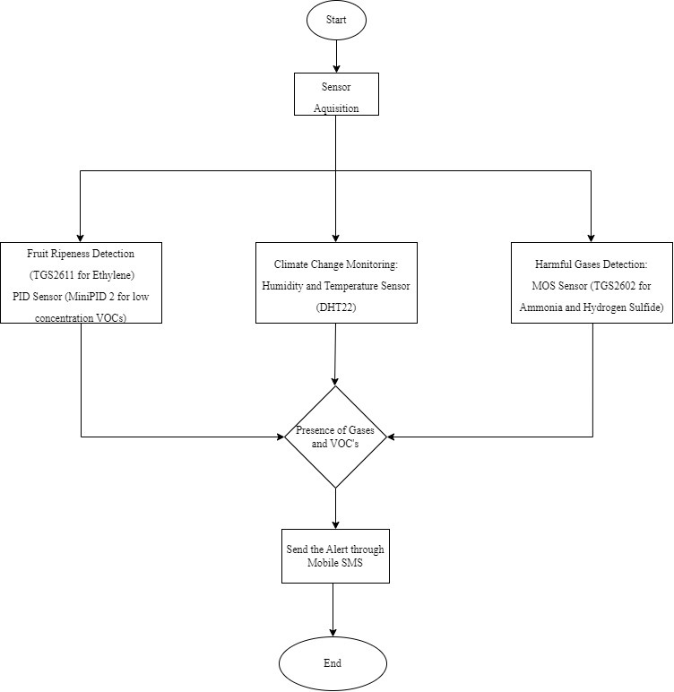
PROPOSED SYSTEM
SYSTEM ARCHITECTURE

Slide 12
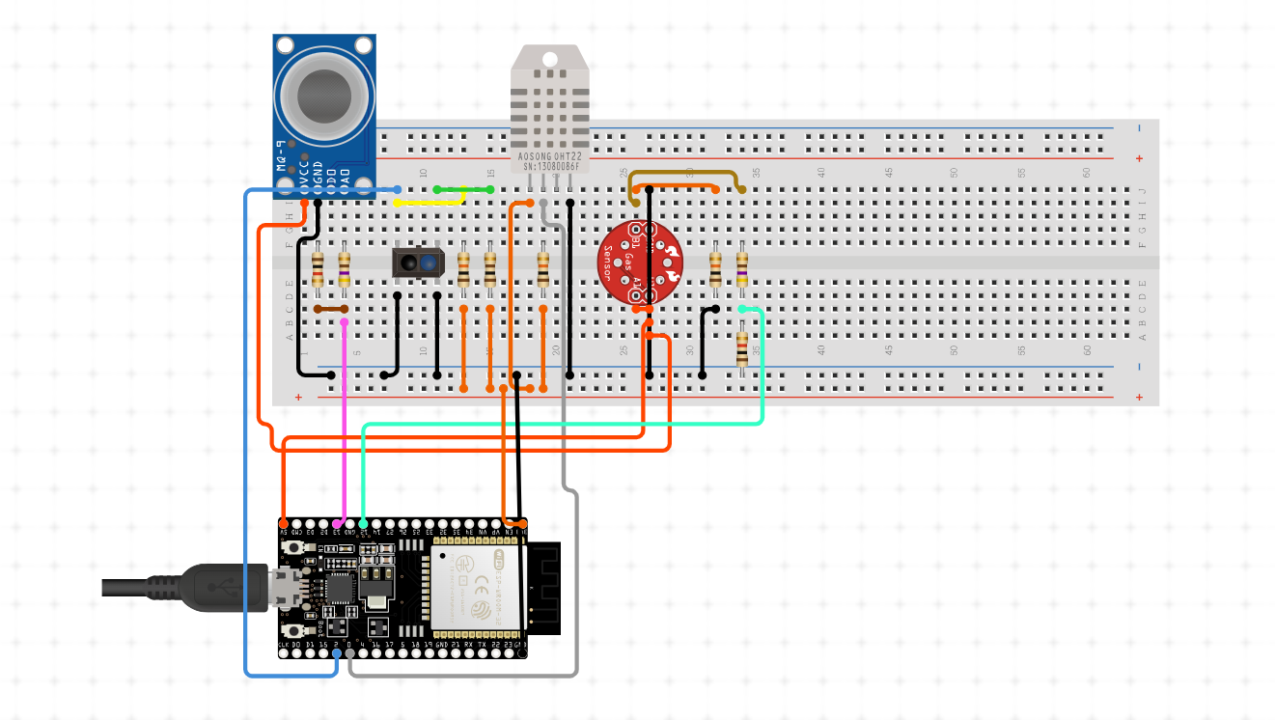
PROPOSED SYSTEM
IMPLEMENTATION

Slide 13
PROPOSED SYSTEM
TOOLS AND TECHNOLOGIES
Sensors: MOS Sensors, PID Sensor, DHT22 Sensor
Microcontrollers: ESP32
Communication Modules: Wi-Fi (ESP32), Bluetooth module
Software Development: Arduino IDE

Slide 14
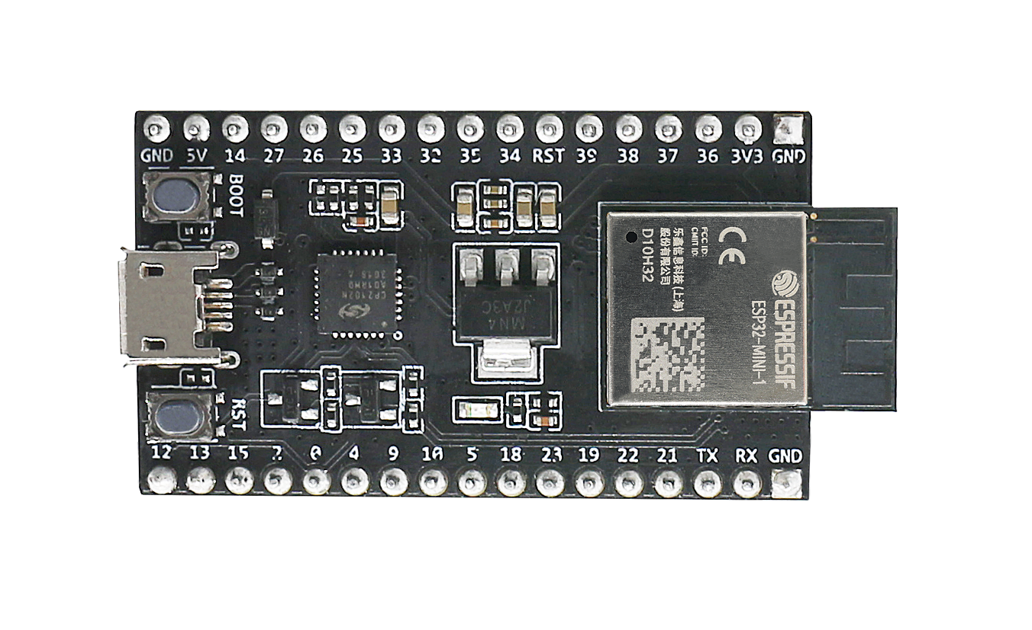
COMPONENTS
ESP32
ESP32: A versatile, low-power microcontroller with integrated Wi-Fi and Bluetooth capabilities for IoT applications.

Slide 15
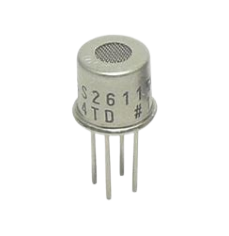
Cont..
MOS Sensor (TGS2611 for Ethylene)
MOS Sensor (TGS2611 for Ethylene): Detects ethylene gas levels to assess fruit ripeness.
The TGS2611 sensor is also a four-pin device:
•Pin 1 (VCC): Supply Voltage
•Pin 2 (GND): Ground
•Pin 3 (Output): Analog Signal Output
•Pin 4 (NC): Not Connected

Slide 16
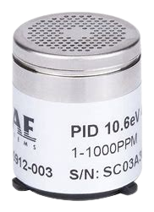
Cont..
PID Sensor (MiniPID 2)
PID Sensor (MiniPID 2 for low concentration VOCs): Measures low concentrations of volatile organic compounds (VOCs) in the air.
The MiniPID 2 sensor typically has the following pin configuration:
•Pin 1 (VCC): Supply Voltage
•Pin 2 (GND): Ground
•Pin 3 (Signal): Analog Signal Output
•Pin 4 (NC): Not Connected (depending on specific model, there might be other configurations)

Slide 17
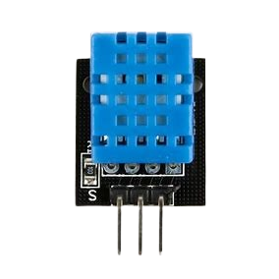
Cont..
DHT22
Humidity and Temperature Sensor (DHT22): Measures both humidity and temperature levels in the environment.
The DHT11 sensor has four pins, but only three are typically used:
•Pin 1 (VCC): 3.3V to 5V Power
•Pin 2 (Data): Serial Data Output
•Pin 3 (NC): Not Connected
•Pin 4 (GND): Ground

Slide 18
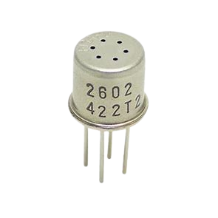
Cont..
MOS Sensor (TGS2602 )
MOS Sensor (TGS2602 for Ammonia and Hydrogen Sulfide): Detects the presence of ammonia and hydrogen sulfide gases.
The TGS2602 sensor is a four-pin device:
•Pin 1 (VCC): Supply Voltage
•Pin 2 (GND): Ground
•Pin 3 (Output): Analog Signal Output
•Pin 4 (NC): Not Connected

Slide 19
PROPOSED SYSTEM
ADVANTAGES
Comprehensive Monitoring
Enhanced Crop Management
Environmental Benefits
Economic Benefits
User-Friendly Design

Slide 20
MODULES IDENTIFIED
1. Sensor Module:
Includes sensors like TGS2611 for ethylene, MiniPID 2 for VOCs, DHT22 for temperature and humidity, SenseAir S8 for CO2, CO2Meter NDIR for methane, and TGS2602 for harmful gases. These sensors collect real-time environmental data for fruit ripeness, climate monitoring, and gas detection.
2. Microcontroller Module:
The NodeMCU (ESP8266) microcontroller processes sensor data, communicates with Firebase, and triggers alerts if certain thresholds (e.g., gas levels or ripeness) are exceeded. It ensures seamless data collection and transmission.
---

Slide 21
MODULES IDENTIFIED
3.Code Implementation Module:
The code for the NodeMCU is developed and uploaded using Arduino IDE. It uses libraries like FirebaseESP8266 for cloud integration, ESP8266WiFi for Wi-Fi, and DHT Sensor Library for temperature/humidity data collection, enabling seamless communication and control of the system.
Percentage of work completed: 50%(Implementing in Arduino IDE)

Slide 22
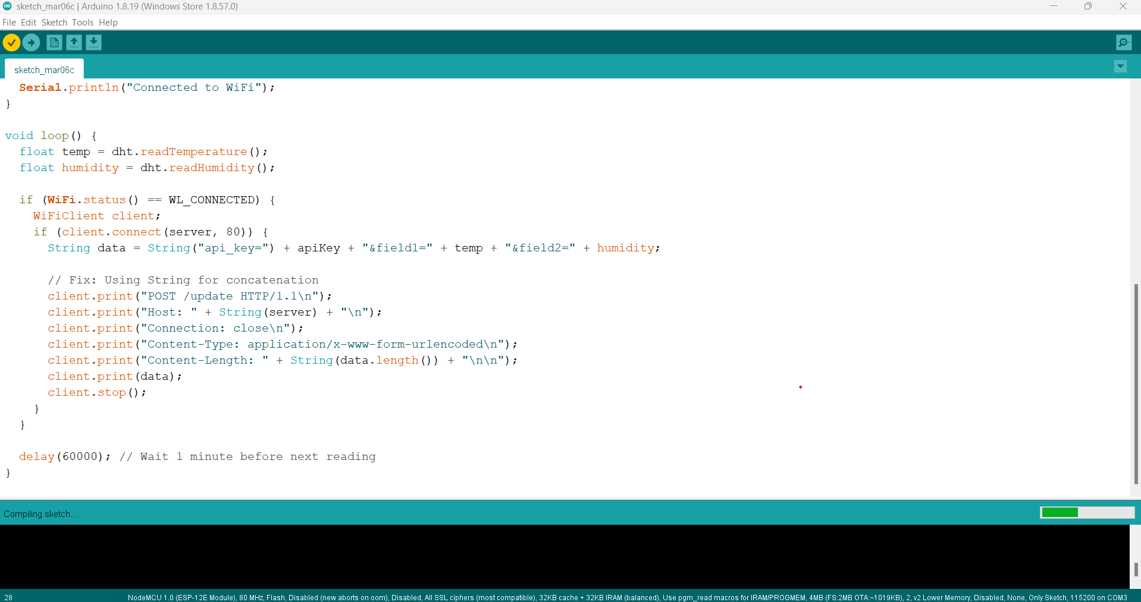
RESULTS AND DISCUSSION

Slide 23
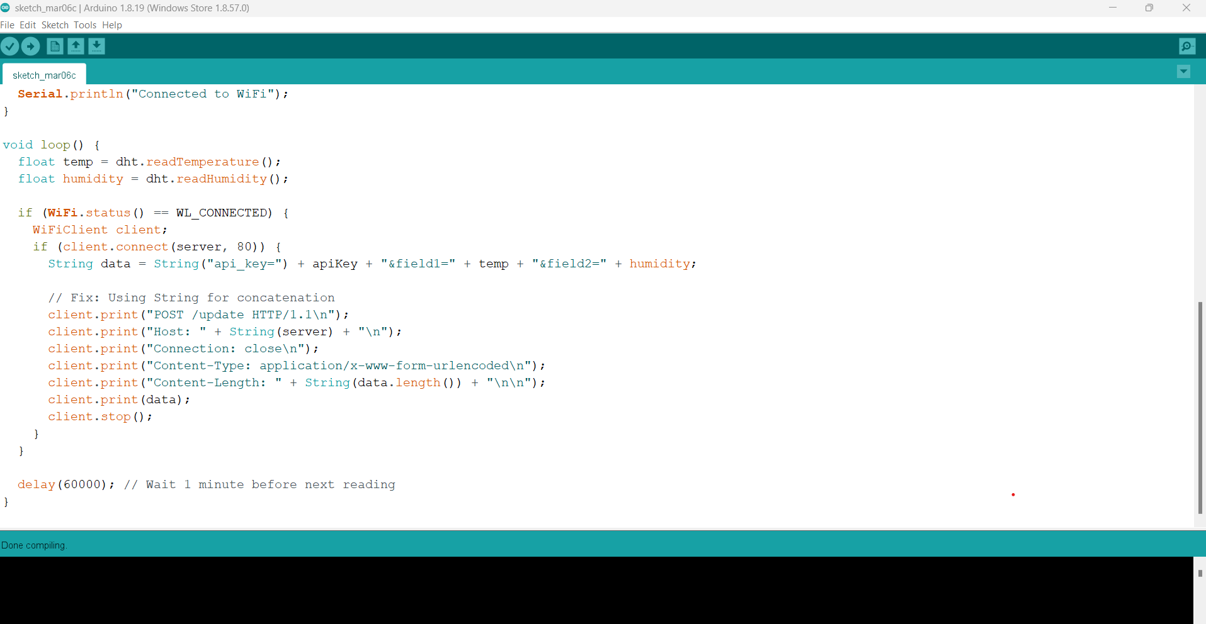
RESULTS AND DISCUSSION

Slide 24
RESULTS AND DISCUSSION
1. Fruit Ripeness Detection
The Ethylene Gas Sensor (TGS2611) accurately detected ethylene levels, which are directly correlated with fruit ripeness. The sensor provided reliable readings, indicating the stage of ripening in fruits and assisting in timely harvesting.
2. Climate Monitoring
The DHT22 sensor measured temperature and humidity, providing valuable environmental data for climate control in agriculture. The readings were consistent with actual environmental conditions, allowing for precise monitoring of optimal conditions for plant growth.

Slide 25
RESULTS AND DISCUSSION
3. Harmful Gas Detection
The Ammonia and Hydrogen Sulfide Sensor (TGS2602) detected hazardous gases like ammonia and hydrogen sulfide, ensuring safe agricultural environments by alerting when dangerous gas levels were detected.

Slide 26
REFERENCES
AD Wilson., M Baietto. (2015). Electronic-Nose Applications for Fruit Identification, Ripeness, and Quality Grading. MDPI Sensors for Food Safety and Quality, 15(1), 899-931. https://doi.org/10.3390/s150100899
Brezmes., Ma.L.L. Fructuoso., E.Llobet., X. Vilanova., I. Recasens., J.Orts., G. Saiz., X. Cocrreig. (2005). Evaluation of an electronic nose to assess fruit ripeness. IEEE Sensors Journal, 5(1), 97-108. https://doi.org/10.1109/JSEN.2004.837495
Bhagat., Sinha., Nandini M., K Mukherjee. (2023). 11 - Sensors and electronic noses for the production of agricultural crops. WP Elect. Optical Materials, 257-280. https://doi.org/10.1016/B978-0-323-91157-3.00015-5
B Zhou., J Wang. (2011). Detection of Insect Infestations in Paddy Field using an Electronic Nose. Int. J. Agric. Biol, 13(5), 707-712. https://www.cabidigitallibrary.org/doi/pdf/10.5555/20113312946

Slide 27
REFERENCES
Casalinuovo., DD Pierro., MColetta., PD Francesco. (2006). Application of Electronic Noses for Disease Diagnosis and Food Spoilage Detection. MDPI Gas Sensors, 6(11), 1428-1439, https://doi.org/10.3390/s6111428
Cellini., Sonia., Biondi., Assunta., Ilaria., Spinelli. (2017). Potential Applications and Limitations of Electronic Nose Devices for Plant Disease Diagnosis. MDPI Chemical Sensors, 17(11)., 2596. https://doi.org/10.3390/s17112596
D Lampson., YJ Han., A Khalilian., Jk Greene., DC Degenhardt., JO Hallstrom. (2014). Development of a portable electronic nose for detection of pests and plant damage. SD Compt. Elect. Agric, 1008, 87-94. https://doi.org/10.1016/j.compag.2014.07.002
EL. Hines., Fu Zhang., DD. Iliescu., MS. Leeson. (2011). Tomato Plant Health Monitoring: An Electronic Nose Approach. IGI Global, 249-276, DOI: 10.4018/978-1-61520-915-6.ch010

Slide 28
REFERENCES
F. Leccese., M. Cagnetti., S. Giarnetti., E. Petritoli., B. Orioni., I. Luisetto., S. Tuti., Mariagrazia Leccisi., A. Pecora., L. Maiolo., G. Spagnolo., R. Ðurović-Pejčev., T. Ðorđević., A. Tomašević., Eduardo De Francesco., R. Quadarella., L. Bozzi., V. Arenella., P. Gabriele., Ciro Formisano., q (2019). Electronic Nose for Pesticides: The First Study Towards a Smart Analysis. Contemporary Agriculture, 68(1), 17-22. DOI: 10.2478/contagri-2019-0004
G Green., A Chan., R Goubran. (2009). Monitoring of food spoilage with electronic nose: potential applications for smart homes. IEEE 3rd Int. Conf. Pervasive Computing Technologies for Healthcare, https://doi.org/10.1109/PCTHEALTH.2009.5291419
G Lee., Q Wei., Y Zhu. (2021). Emerging Wearable Sensors for Plant Health Monitoring. Wiley Advanced Functional Monitoring, 31(52). https://doi.org/10.1002/adfm.202106475
Hidayat.,Markom., Shakaff., Adom., Ahmad., Abdullah., Ahmad Fikiri. (2009). Intelligent electronic nose system for basal stem rot disease detection. SD Compt. Elect. Agric, 66(2), 140-146. https://doi.org/10.1016/j.compag.2009.01.006

Slide 29
REFERENCES
I Braschi., A Cellini., S Blasioli., E Biondi., A Bertaccini., F Spinelli. (2017). Potential Applications and Limitations of Electronic Nose Devices for Plant Disease Diagnosis. MDPI Chemical Sensors, 17(11), 2596. https://doi.org/10.3390/s17112596
Jullada Laothawornkitkul., Jason P. Moore., Jane E. Taylor., Malcolm Possell., Tim D. Gibson., C. Nicholas Hewitt., Nigel D. Paul. (2008). Discrimination of Plant Volatile Signatures by an Electronic Nose: A Potential Technology for Plant Pest and Disease Monitoring. Environmental and sciencwe Tech, 42(22), http://dx.doi.org/10.1021/es801738s
L Capelli., S Sironi., RD Rosso. (2014). Electronic Noses for Environmental Monitoring Applications. MDPI State-of-the-Art Sensors Technology in Italy, 14(11). https://doi.org/10.3390/s141119979
RR Mohamed., R Yaacob., MA Mohamed., TAT Dir., F A Rahim. (2018). Food Freshness Using Electronic Nose and Its Classification Method: A Review. International Journal of Engineering & Technology, 7(3.28), 49-53, http://dx.doi.org/10.14419/ijet.v7i3.28.20964

Slide 30
REFERENCES
Ramaswami., Mooventhan., Das., A Dixit., Sharma., Sengottayan., Pankaj., Ghosh. (2022). The future of plant volatile organic compounds (pVOCs) research: Advances and applications for sustainable agriculture. SD Env. Exp. Botany, 200. https://doi.org/10.1016/j.envexpbot.2022.104912
Thara., Goel., Mahesh., Chatchawal. (2022). Advances in gas sensors and electronic nose technologies for agricultural cycle applications. SD Compt. Elect. Agric, 193(1), https://doi.org/10.1016/j.compag.2021.106673
Z Zheng., C Zhang. (2022). Electronic noses based on metal oxide semiconductor sensors for detecting crop diseases and insect pests. SD Compt. Elect. Agric, 197(3). http://dx.doi.org/10.1016/j.compag.2022.106988

Slide 31
SUMMARY
E-nose technology is set to revolutionize agriculture by accurately detecting fruit ripeness, monitoring climate changes, and identifying harmful gases. This empowers farmers to optimize harvests, adapt to environmental shifts, and protect crops, leading to increased efficiency, sustainability, and resilience. As research advances, the applications of e-noses are expected to expand, ensuring agriculture thrives in a dynamic environment.

Slide 32
QUESTION & ANSWERS
?

Slide 33
THANK YOU
We thank God, Our Department, Guide, Panel Members, Supportive Professors and all Technical and non Technical staff who helped us in our Project.

