Slide 1
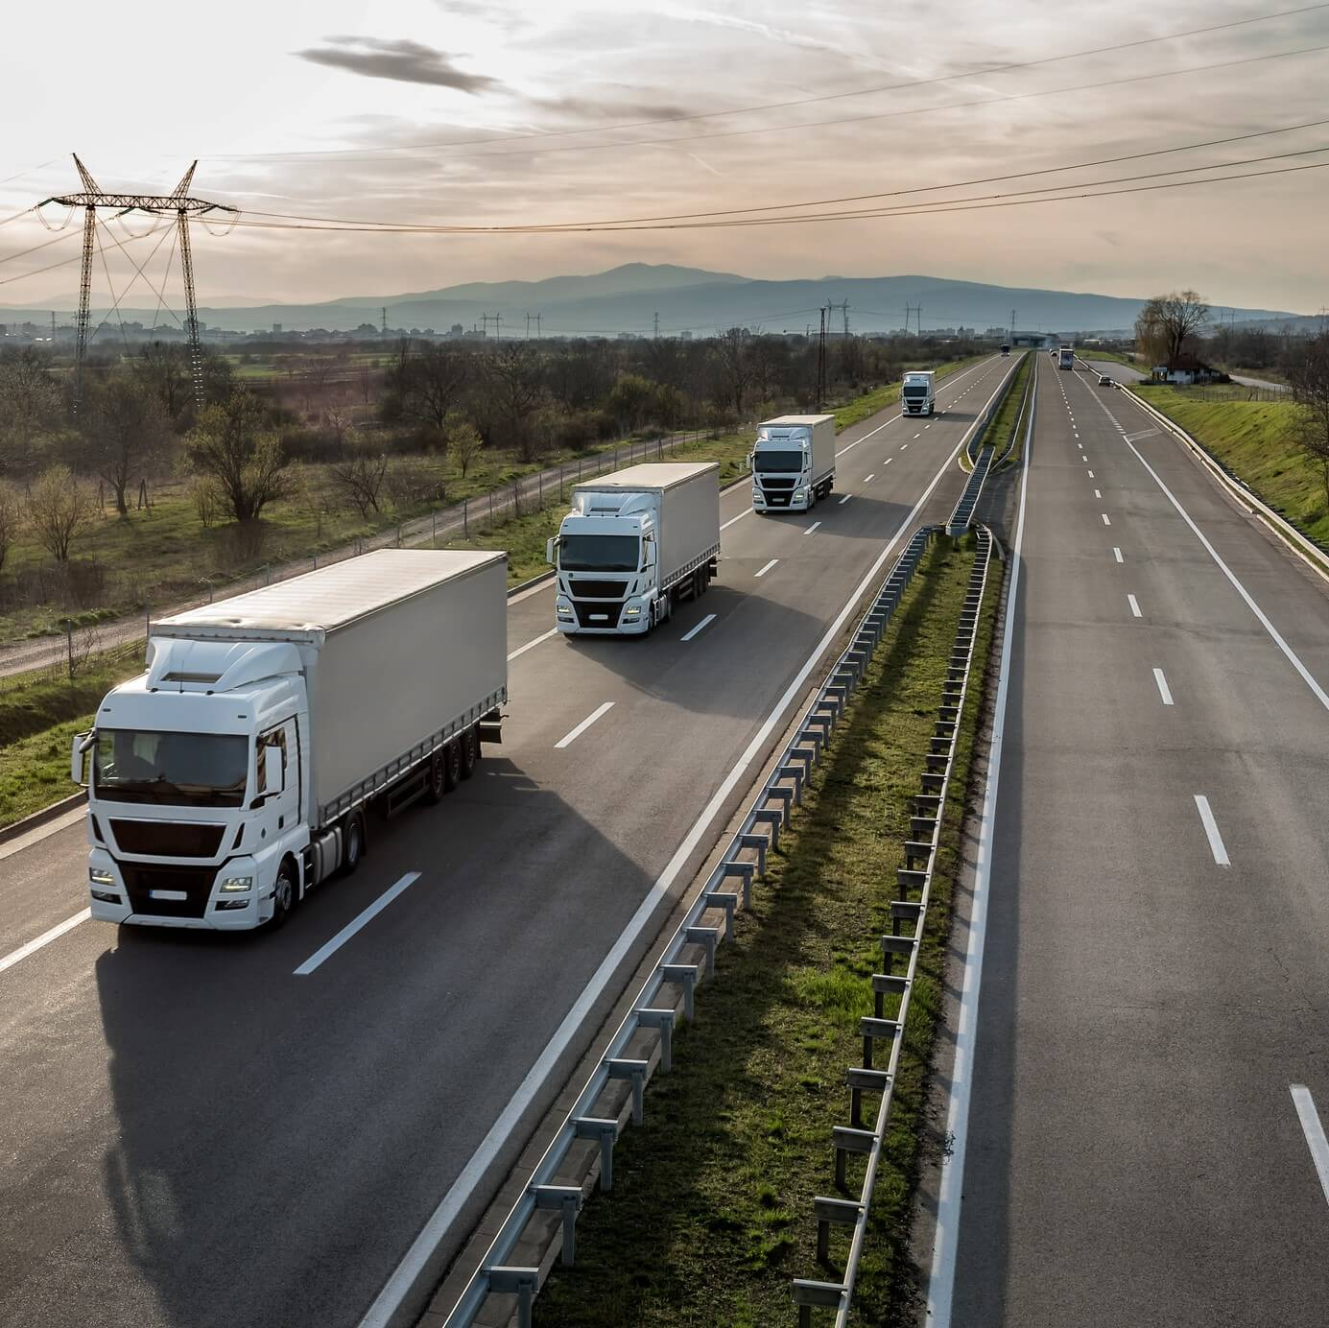
Truck Platooning System: Combining ML and Formal Verification
A project exploring how machine learning for visual steering control and formal verification can create safer, more intelligent autonomous driving systems.
Jiban-Ul Azam Chowdhury Shafin
Yuming Wang
Submitted to: Prof. Dr. Stefan Henkler
Prof. Dr. Martin Hirsch
Electronic Engineering, Hochschule Hamm-LIPPSTADT

Slide 2
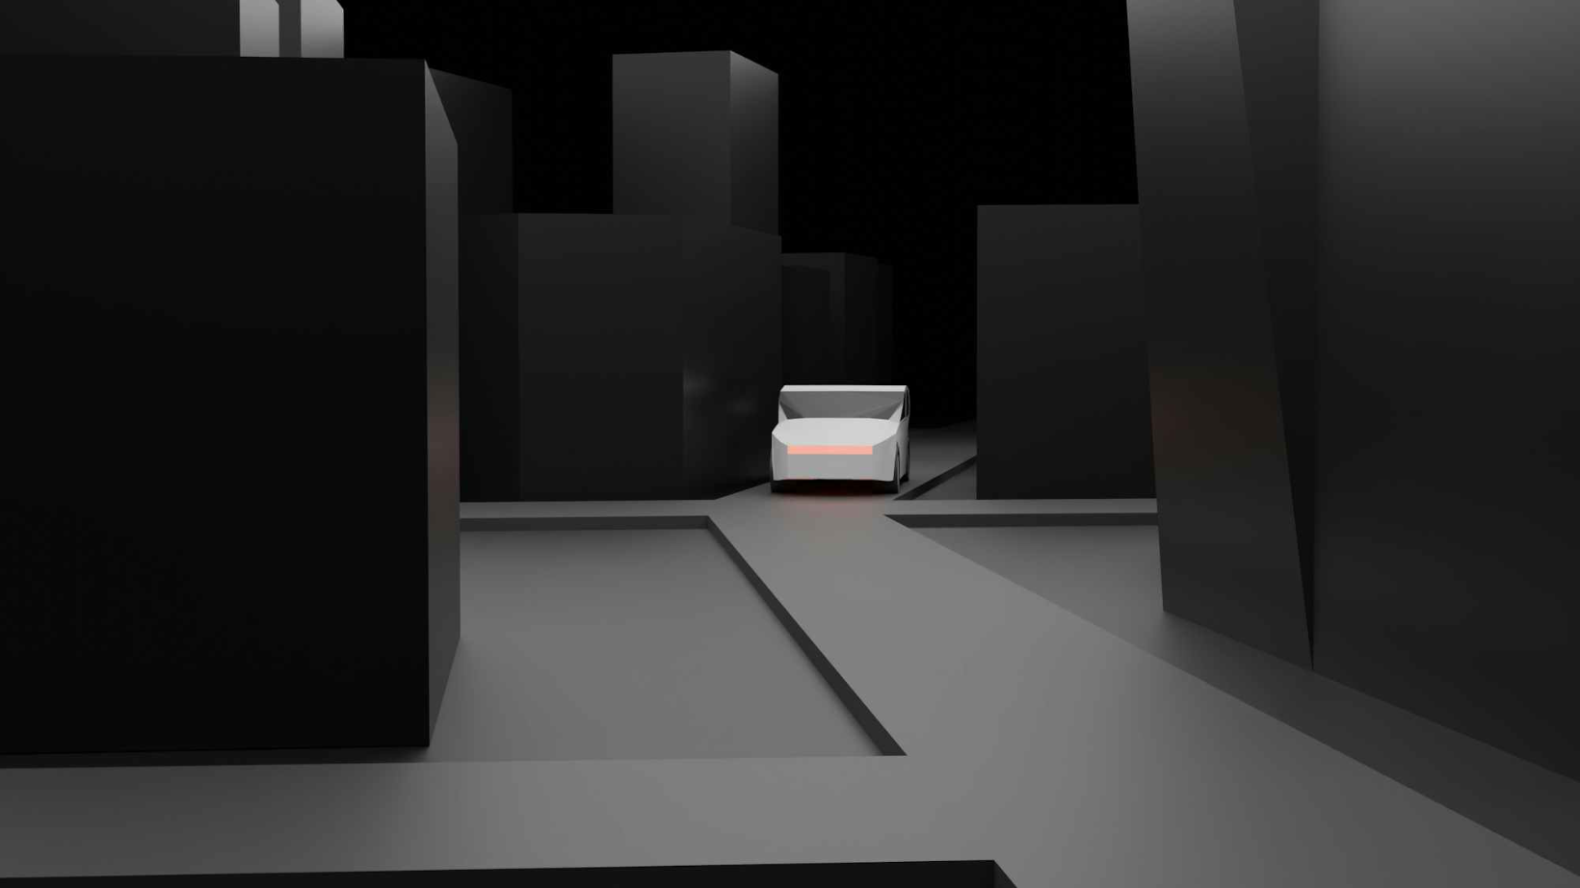
Project Motivation
Smart decisions (ML)
Safer behavior (Formal verification)
Fewer Accidents
Less Traffic
More comfort
Efficient Transport
Better Autonomous System
Big companies (like Tesla, Google, Mercedes-Benz, Bmw) are all investing in this, because they know this is the future.

Slide 3
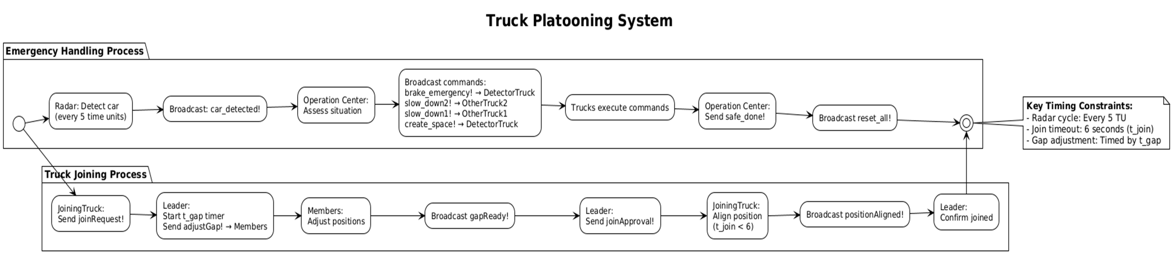

Slide 4
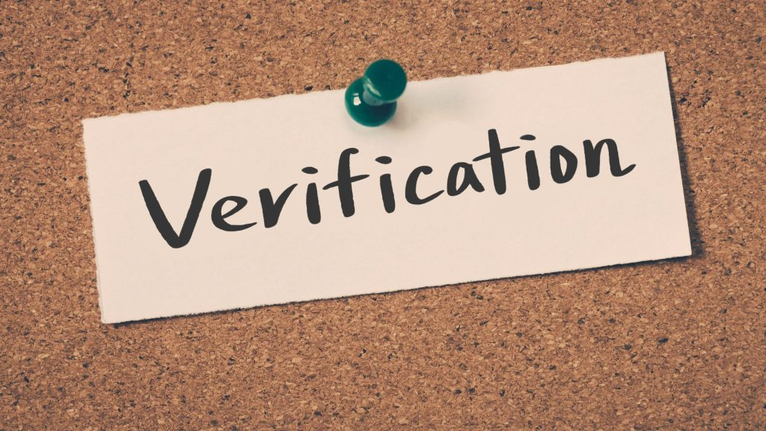
UPPAAL Model for Truck Platooning
Timed Automata Model
Created using UPPAAL to formally verify autonomous truck platooning behavior
Real-World Scenarios
Simulates trucks detecting cut-in cars and coordinating to avoid collisions
Safe Joining Protocol
Enables new trucks to safely join an existing platoon through formal verification

Slide 5



System Components
Timing Constraints
RadarSensor
Periodically detects vehicles and broadcasts car_detected! every 5 time units
Radar checks every 5 time units
Truck must join within 6 time units (t_join < 6)
OperationCenter
Gap adjustment handled with timer (t_gap)
Assesses situations and sends commands (brake_emergency!, slow_down!, create_space!)
These constraints ensure safe coordination between vehicles and prevent dangerous situations.
Truck Network
DetectorTruck, OtherTruck1, OtherTruck2, JoiningTruck, Leader, and Member components

Slide 6
Channel components
Broadcast
car_detected; brake_emergency; slow_down1; slow_down2;
create_space; done_sync; reset_all; safe_done; start_join;
Notifyall; reset
Binary
⇄
joinRequest; joinApproval; adjustGap; gapReady; positionAligned; joinoutoftime; unsafe_done

Slide 7
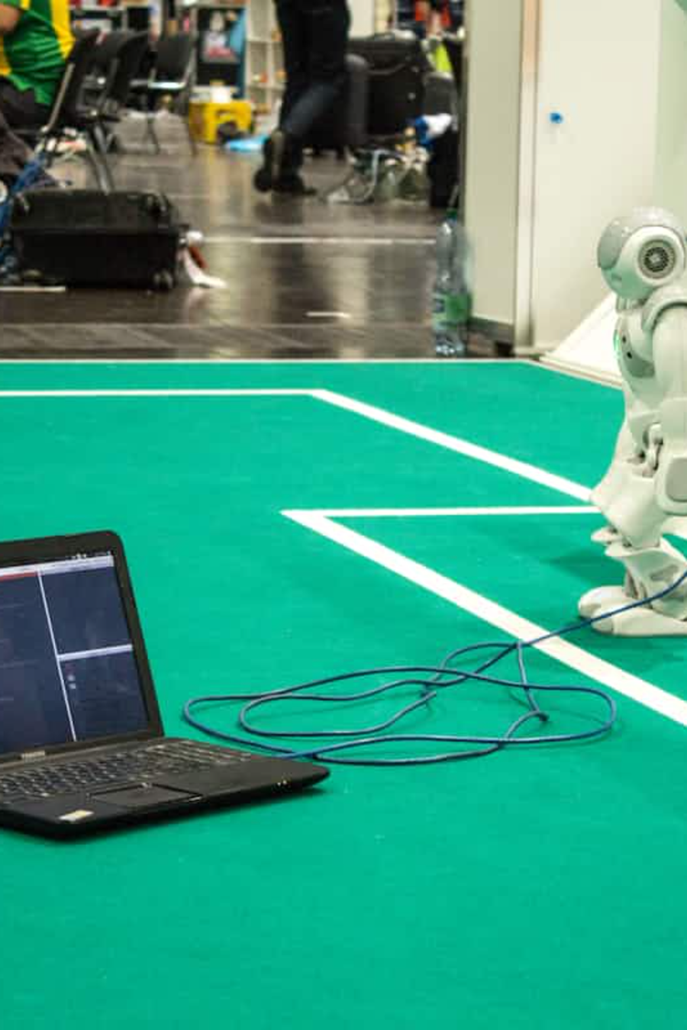
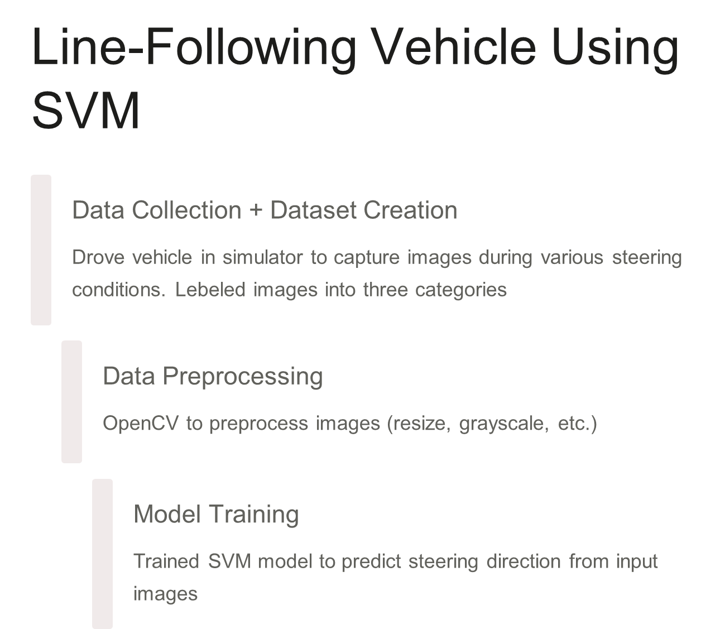

Slide 8
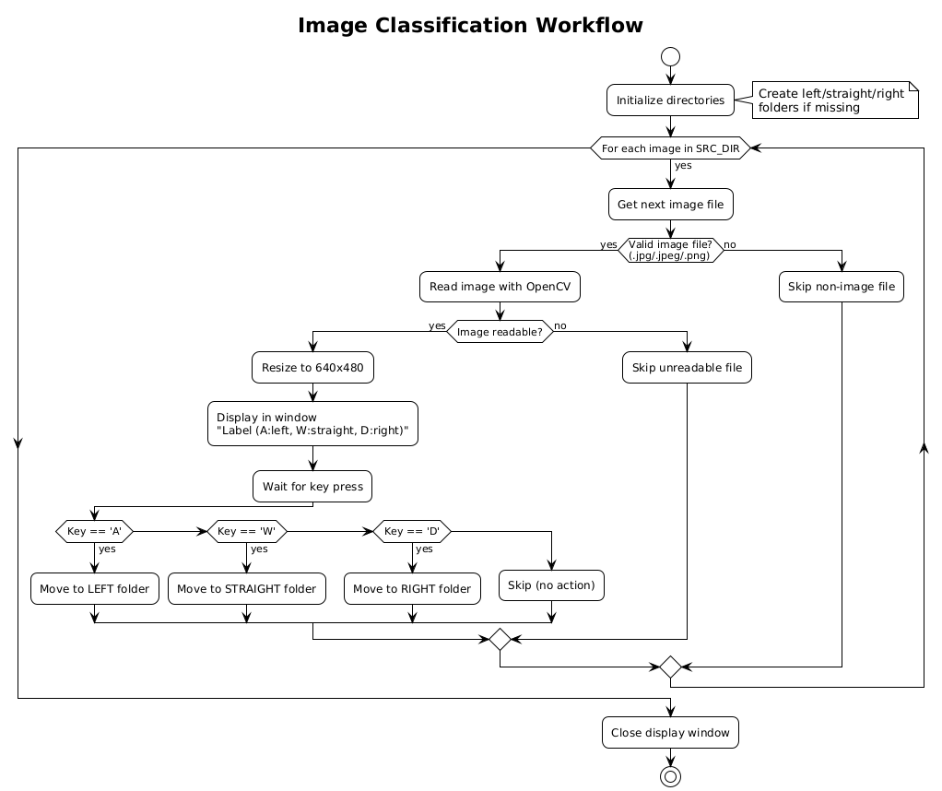

Slide 9
Dataset Preparation
Our dataset preparation involved several key steps:
Manually corrected dataset to improve accuracy
Used OpenCV to preprocess images (resize, grayscale)
Extracted features (X) and labels (Y)
Saved processed data into X_features1.npy and Y_lebels1.

Slide 10
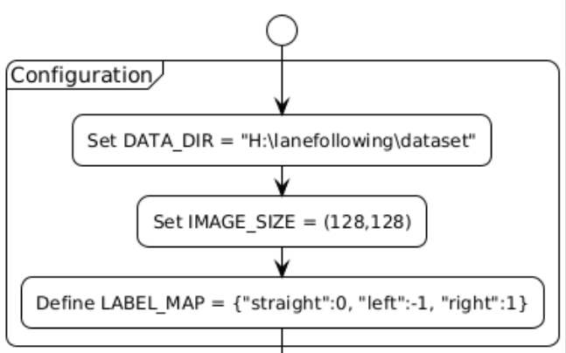
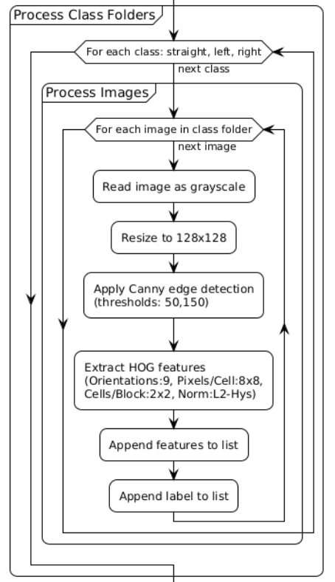
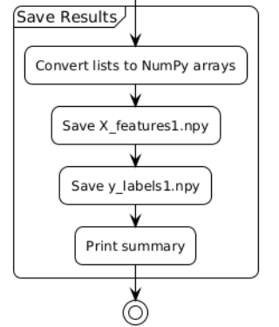

Slide 11

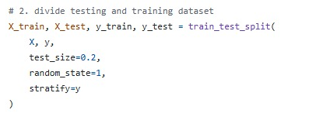
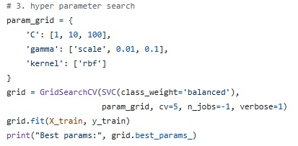
In SVM training step, we first load the data and the labels generated in last step
Set that 20% for data testing
Use GridSearchCV function to search for best parameters, and training kernel is rbf

Slide 12
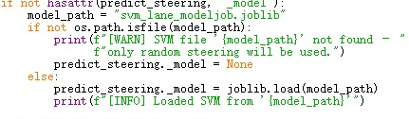
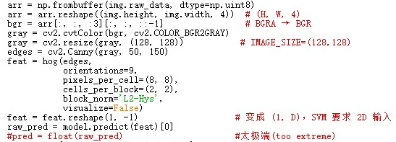
SVM in Carla
Load the model trained
Let the image input experience the same workflow as trained model in OpenCV. Model.predict(feat) function uses the model trained to output the direction of steering, to ensure a more stable behavior, we chose to map steering into 0.5 instead of 1.0.

Slide 13
Results and Next Steps
Achievements
Future Work
Successfully trained SVM to classify camera input into steering directions
Implement real-time control system
Expand verification to more complex scenarios
Created formal verification model for safe truck platooning
Field testing with physical vehicles
Demonstrated integration of ML and formal methods

