Slide 1
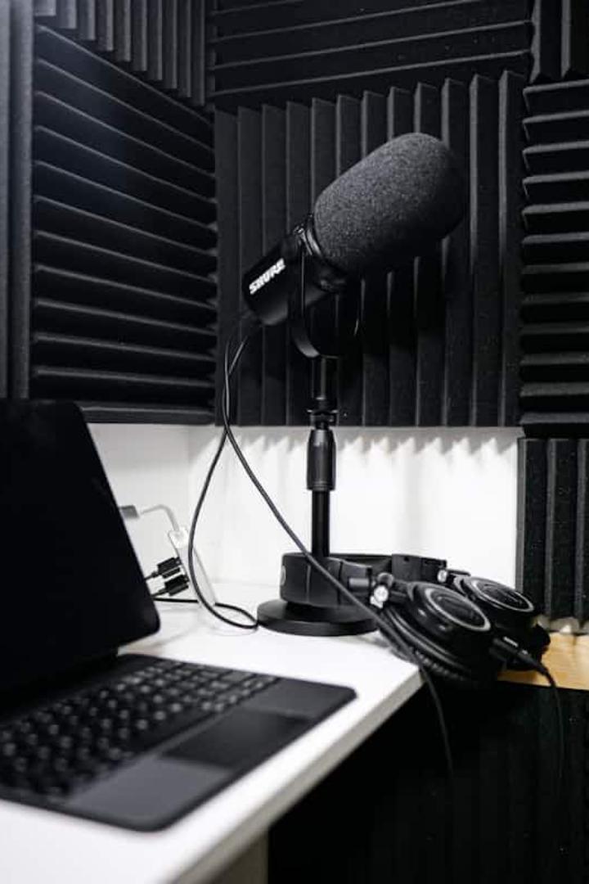
FPGA Audio Synthesizer
A basic digital audio synthesizer implemented on a Nexys A7 FPGA board. The system generates square wave tones through PWM based on 16 slide switch inputs.
Jiban-Ul Azam Chowdhury Shafin
Submitted to: Prof. Dr.-Ing. Ali Hayek
Electronic Engineering, Hochschule Hamm-LIPPSTADT

Slide 2
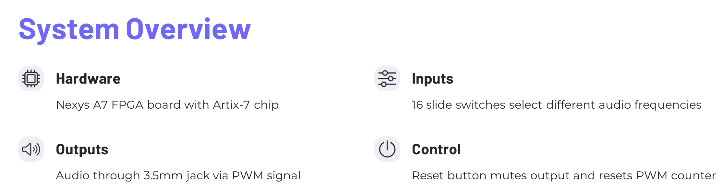

Slide 3





Project Management
Block Diagram Design
Created functional block diagram to visualize system components
VHDL Development
Implemented synthesizer logic in VHDL
Testing & Simulation
Created testbench and validated with ModelSim
Hardware Implementation
Synthesized and deployed to Nexys A7 FPGA board

Slide 4
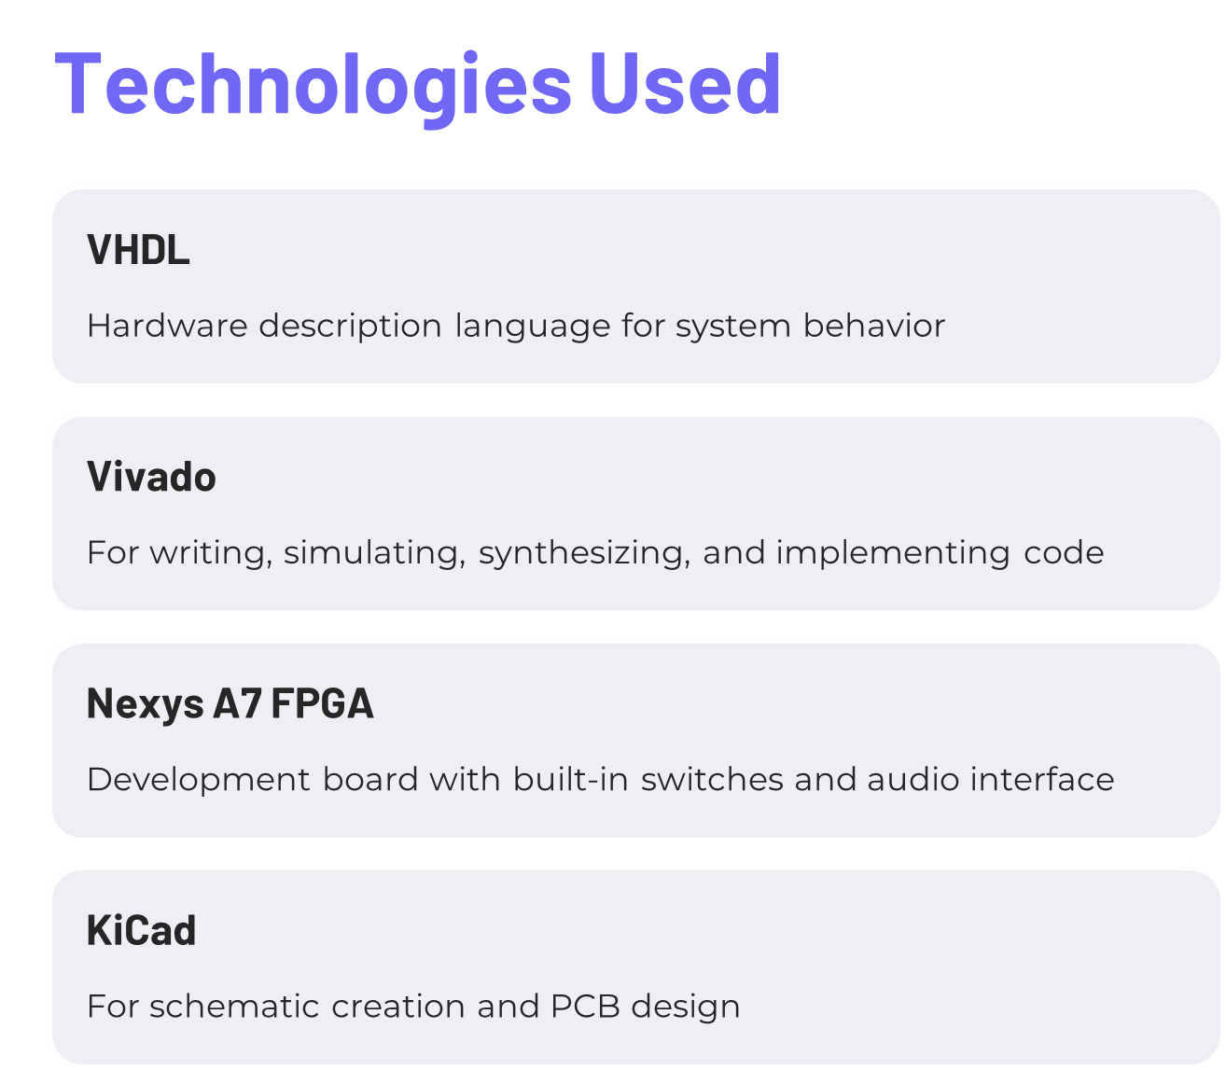

Slide 5
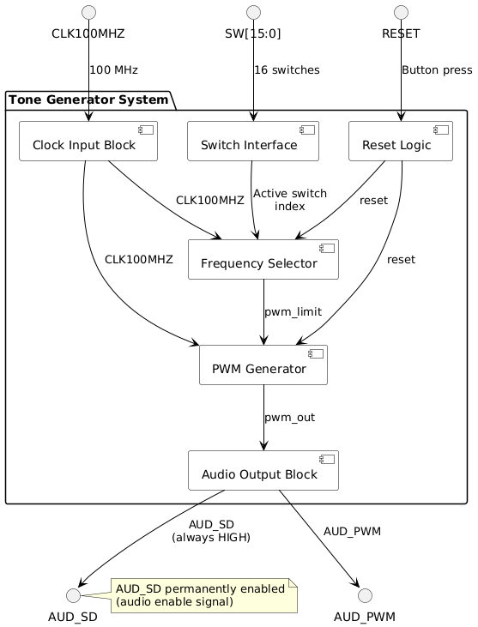

Slide 6
Steps of Implementation
1. Implementation in VHDL
2. Verification, Testbench
3. Schematic Design
4. PCB Design

Slide 7
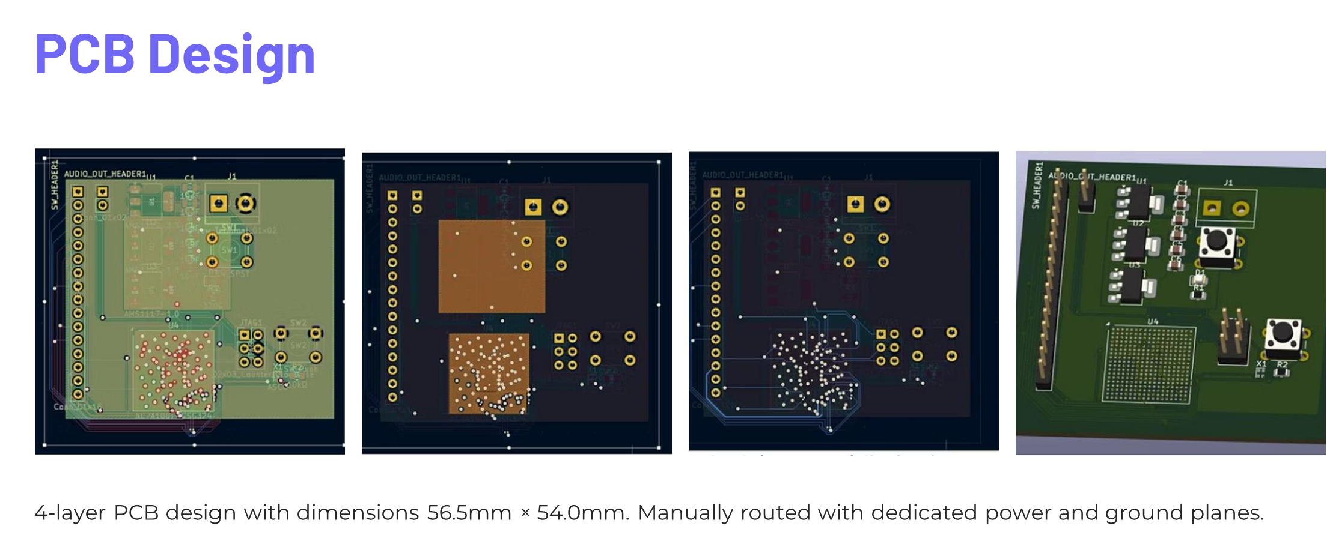

Slide 8
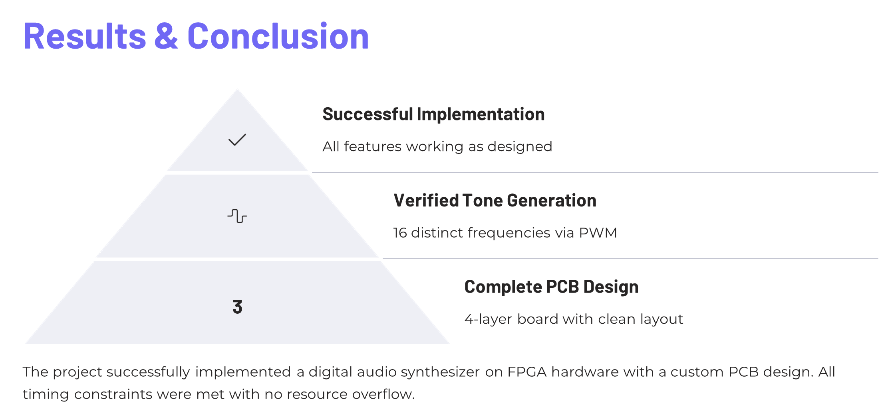

Slide 9
Live Demonstration:
of FPGA Audio Synthesizer

