Slide 1



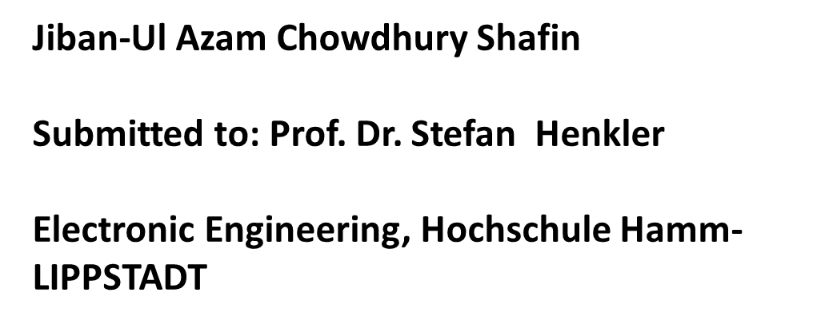

Slide 2
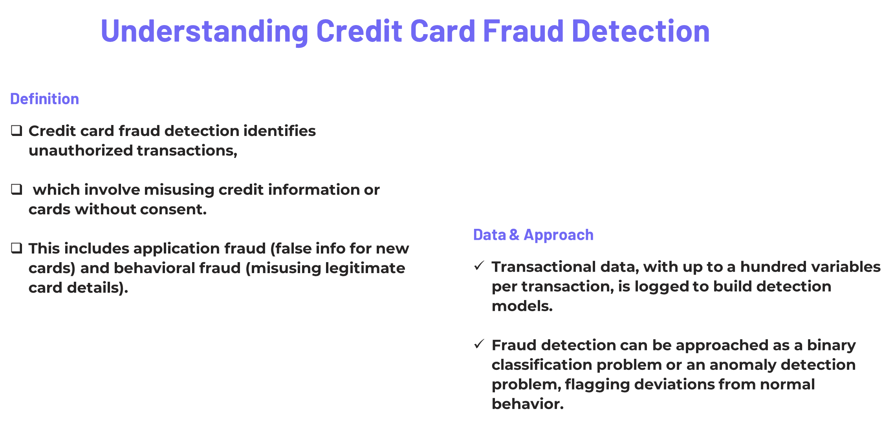

Slide 3
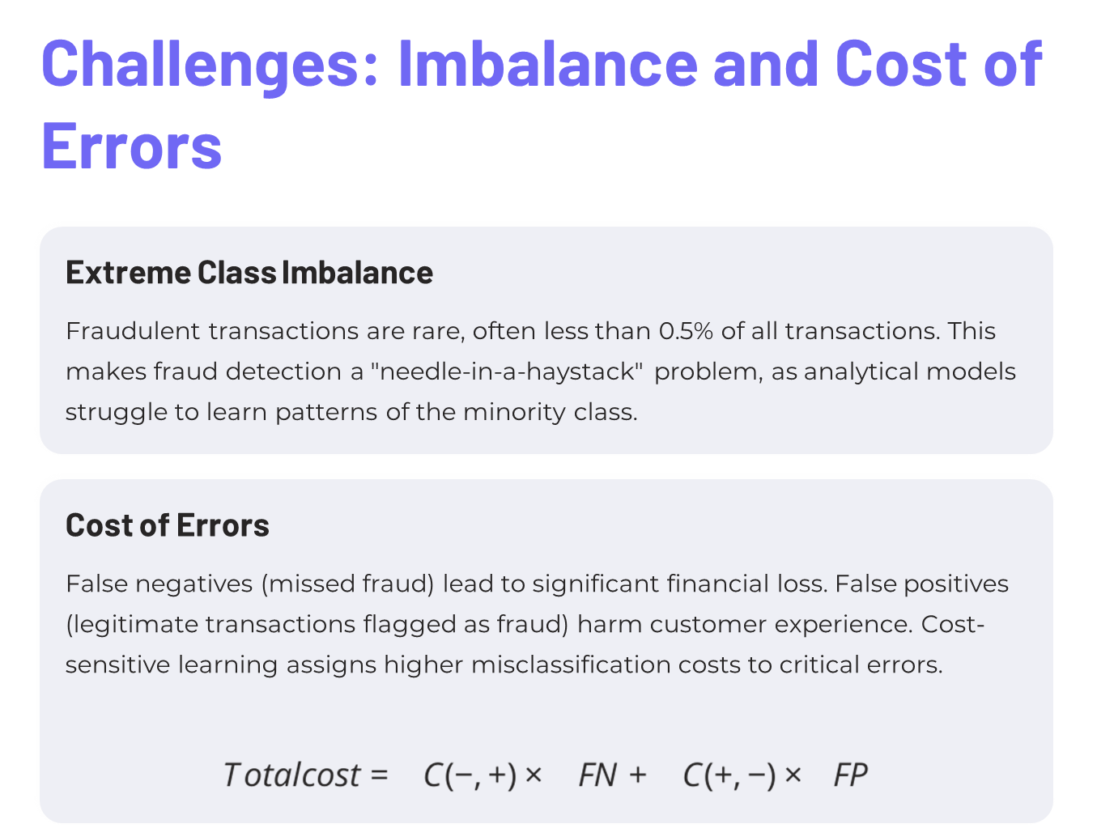
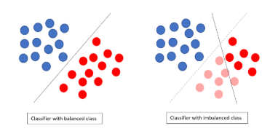
Classifier with balanced data
Classifier with imbalanced data

Slide 4
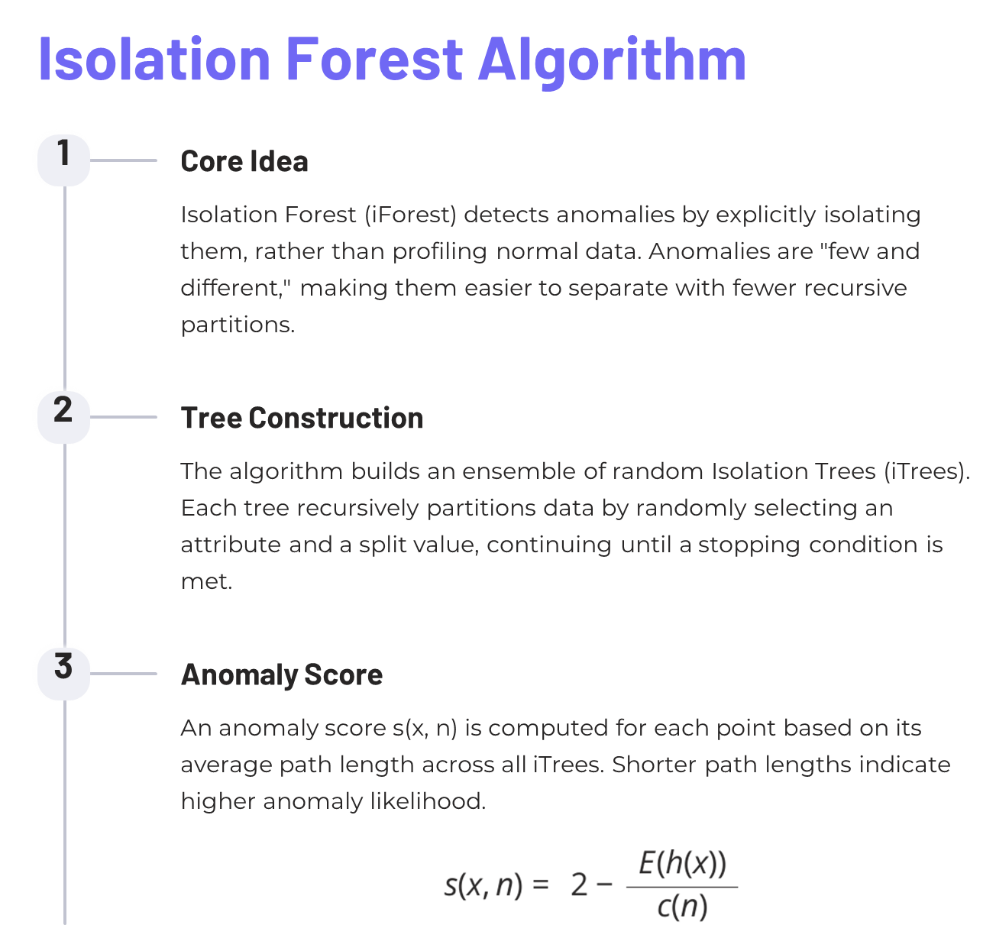

Slide 5
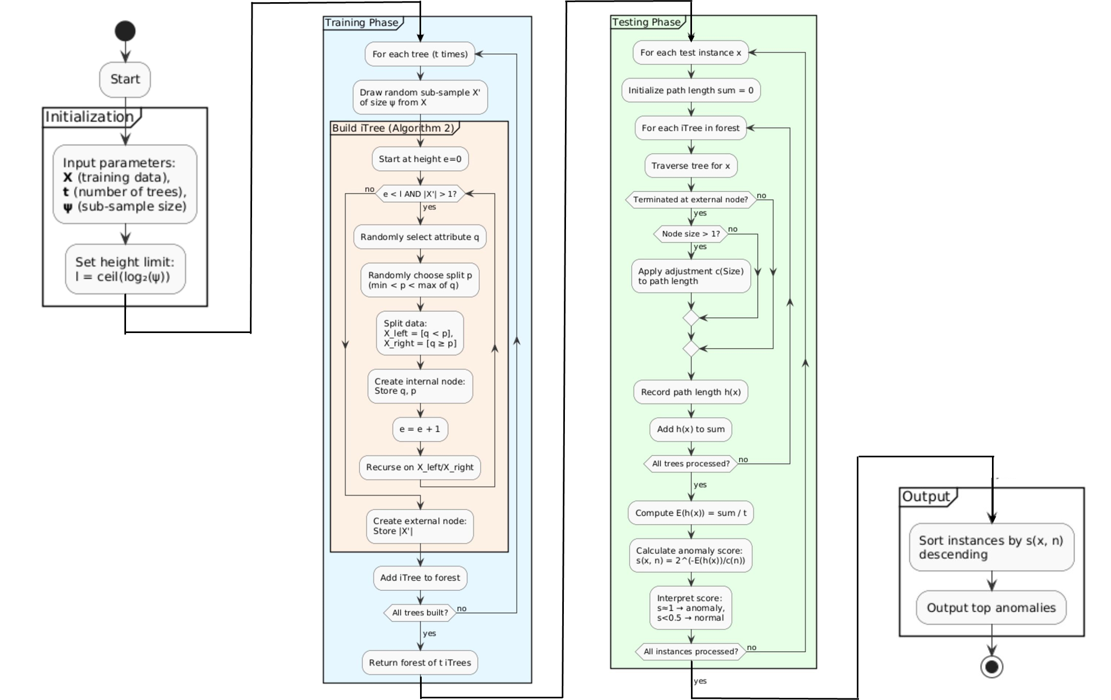

Slide 6
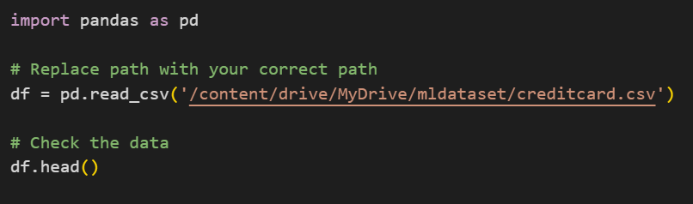
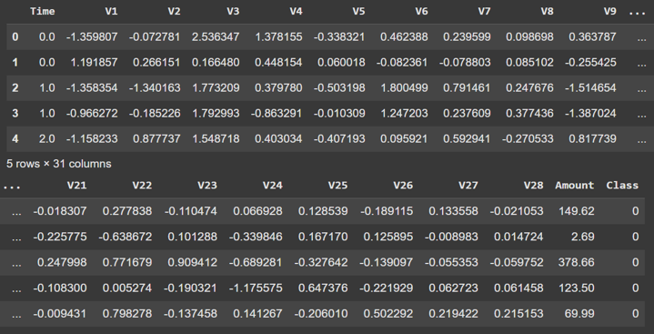
Implementation Steps
Data Loading & Exploration
The Credit Card Fraud Detection dataset (284,807 European transactions, 492 fraudulent) was loaded and explored.
It includes 28 anonymized principal components (V1-V28), transaction amount, and time.

Slide 7
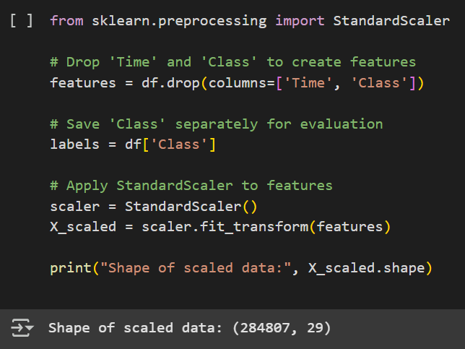
Preprocessing with StandardScaler
The 'Time' and 'Class' columns were removed.
Remaining features were standardized using StandardScaler, ensuring they are centered around zero with unit variance,
which is vital for Isolation Forest.

Slide 8
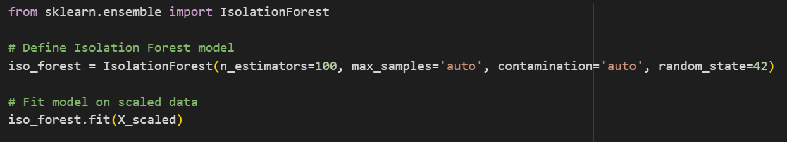
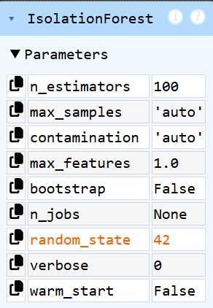
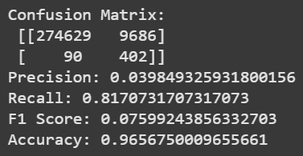
Training Isolation Forest

Slide 9
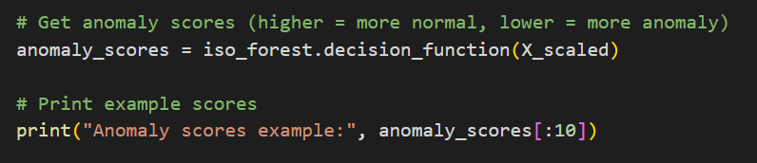
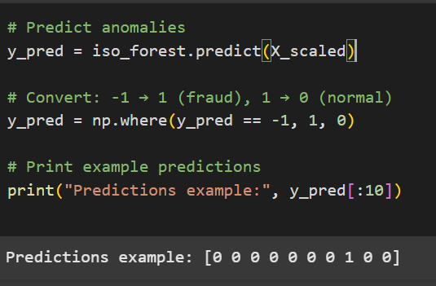
Anomaly Scoring & Prediction
Anomaly scores were computed using the decision_function() method, with lower scores indicating anomalies.
Predictions were then generated using predict(), mapping -1 to fraud (1) and 1 to normal (0).

Slide 10
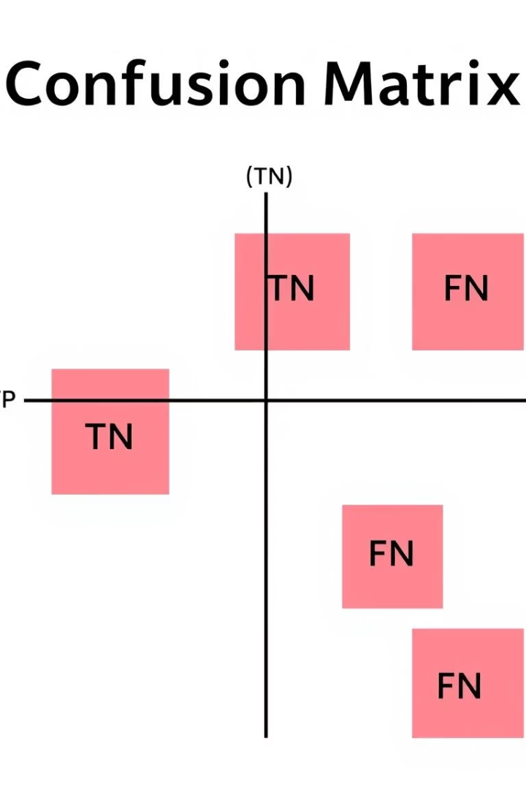




Model Evaluation Metrics
Confusion Matrix
Organizes predictions against actual outcomes: True Positives (TP), True Negatives (TN), False Positives (FP), and False Negatives (FN).
Accuracy & Error Rate
Accuracy is the proportion of correct predictions. Error Rate is its complement.
Recall & Precision
Recall captures correctly detected fraud cases. Precision reflects truly fraudulent predicted cases. High Recall is crucial for fraud detection.
F1-Measure & Specificity
F1-Measure balances Precision and Recall. Specificity measures correct classification of legitimate transactions.

Slide 11

Results and Conclusion
0.17%
High
Lower
Fraud Rate
Recall Achieved
Precision
Only 0.17% of transactions were fraudulent, highlighting the extreme class imbalance challenge.
The model successfully detected most fraudulent transactions, demonstrating high recall.
Precision was lower, a common outcome in highly imbalanced fraud detection problems.
Isolation Forest effectively identifies anomalous transactions without labeled data, proving suitable for large-scale, unsupervised fraud detection. While achieving high recall, precision remains a challenge due to class imbalance. Future work should consider complementary techniques to improve overall performance and manage false positive rates.

Slide 12
Questions?
Thank you for your attention.
I’m happy to answer any questions or feedback you may have.

