Slide 1
_{STRUCTURES}
JASTIN DEILE L. ORDA

Slide 2
A structure is a group of elements which are of different type. Each of the elements is identified by its own identifier and they are called member.
A structure can be thought of as an object without any member functions. The important property of structures is that the data in a structure can be a collection of data items of diverse types.

Slide 3
A structure variable can hold values just like any other variable can. A structure value is a collection of smaller values called member values.
A structure data type is referred to as a record data type and the members are called fields.

Slide 4
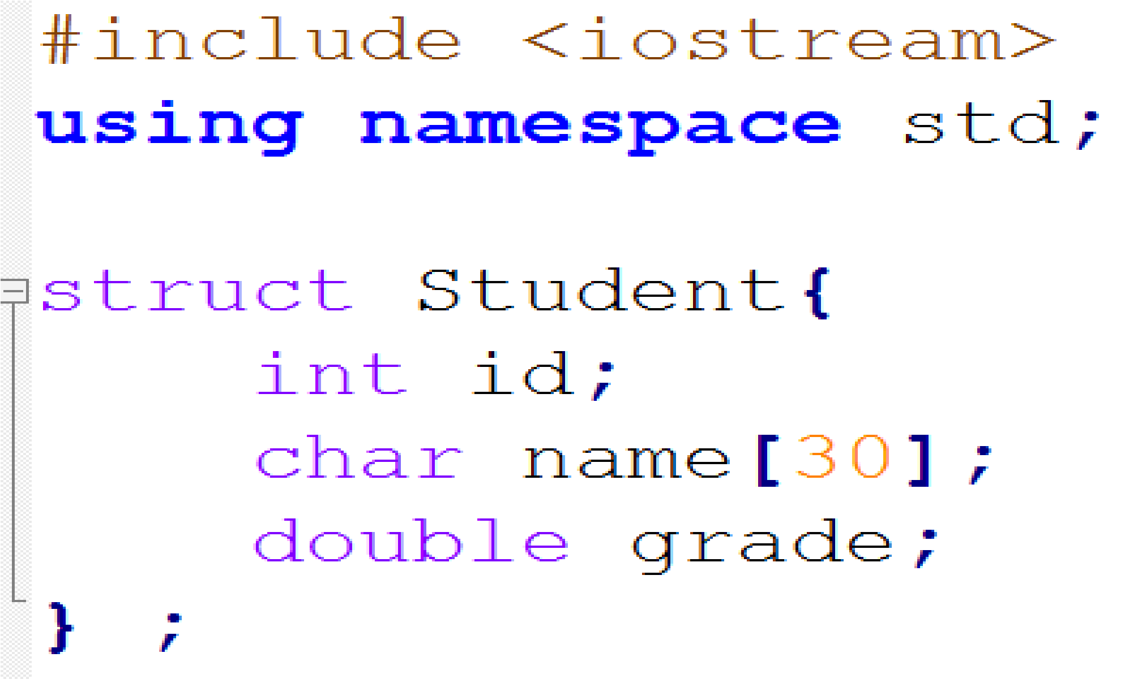
Source Code:

Slide 5
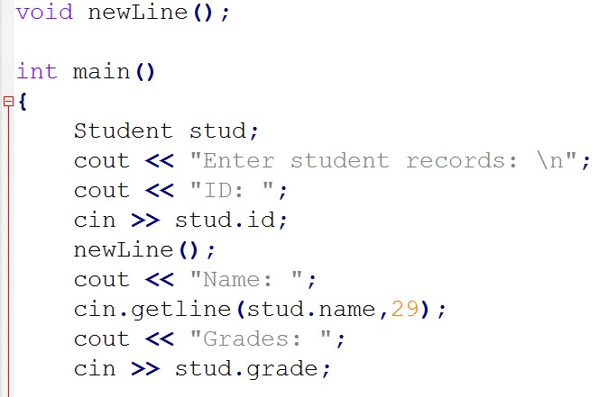

Slide 6
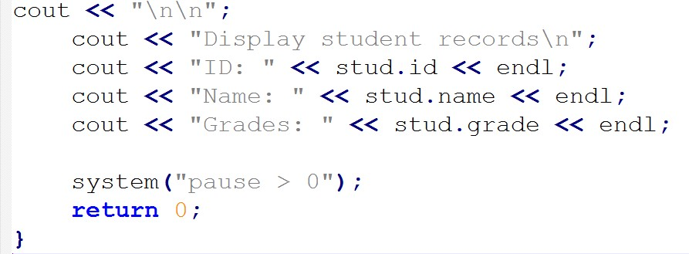

Slide 7
