Slide 1
Our Project name
한국어로
호서대학교
영상처리 특론
Presenter: Nadir Anushah,
Nizam Tanzina,
Soriano Adan

Slide 2
Table of Contents 목차
Introduction / 서론
Motivation / 동기
Problem Statement / 문제 정의
Related Work / 관련 연구
Methodology / 방법론
Results / 결과
Conclusion / 결론

Slide 3
1. Introduction 서론

Slide 4
Introduction 서론
Here goes the introduction with the infographics
표 1. Description 1$^{1}$
*
1. Food Waste Index Report 2024: https://wedocs.unep.org/items/dbe2cd4c-8384-4636-8359-5847f42b9711

Slide 5
2. Motivation 동기

Slide 6
Motivation
동기
Why this matters? 왜 중요한가?
- Early recognition of rotten fruit contributes to decreased food waste.
- Ensures consumer safety by preventing potentially harmful products from reaching consumers.
- Quality control is critical for distribution, retail, and the agricultural industry.

Slide 7
3. Problem Statement 문제 정의

Slide 8
Problem Statement
문제 정의
Distinguishing between fresh and rotten fruits at scale remains a significant challenge and current inspection methods lack the speed and consistency required for modern supply chains.

Slide 9
3. Related Work 관련 연구

Slide 10
Related Work 관련 연구
Paper 논문 (Year) (연도) | Authors 저자 | Dataset 데이터셋 | Model-Method 모델-방법 | Metrics IN KOREAN
Paper #1 (20XX) | Kumar et al. | Banana images | SVM + ResNet (EMLT)
Paper #2 (20XX) | Sultana et al. | 8 fruit types | ResNet50, MobileNetV2
Paper #3 (20XX) | SANGAM et al. | Apple, banana, orange | CNN
Paper #4 (20XX) | Amin et al. | 3 public datasets | AlexNet (8 layers)
Paper ## (20XX) maybe 4 its enough | Kang et al. | Multiple fruit types | Multi-task CNN

Slide 11
4. Methodology 방법론

Slide 12
Methodology 방법론
Data Collection and Preprocessing
Model Architecture
Hyper parameter Tuning
Model Training
Performance Evaluation
Future Directions
데이터 수집 및 전처리
모델 아키텍처
하이퍼파라미터 튜닝
모델 학습
성능 평가
향후 방향
Collect diverse datasets and standardize images through resizing and normalization
Choose pre-trained CNN and adapt it for binary classification task.
Determine optimal learning rate, batch size, dropout rate, and epochs.
Train the model using appropriate loss function and optimizer with early stopping.
Assess generalization performance using accuracy, precision, recall, and F1-score.
Explore domain adaptation and explainable AI techniques for enhanced robustness.
*
*
*
*
*
*
그림 2. 과일 품질 감지를 위한 순서도.
* All the icons from https://www.dreamstime.com/illustration/machine-learning-icon.html

Slide 13






Methodology 방법론
Data Collection and Preprocessing
Model Architecture
Hyper parameter Tuning
Model Training
Performance Evaluation
Future Directions
데이터 수집 및 전처리
모델 아키텍처
하이퍼파라미터 튜닝
모델 학습
성능 평가
향후 방향
Collect diverse datasets and standardize images through resizing and normalization
Choose pre-trained CNN and adapt it for binary classification task.
Determine optimal learning rate, batch size, dropout rate, and epochs.
Train the model using appropriate loss function and optimizer with early stopping.
Assess generalization performance using accuracy, precision, recall, and F1-score.
Explore domain adaptation and explainable AI techniques for enhanced robustness.
*
*
*
*
*
*
그림 2. 과일 품질 감지를 위한 순서도.
* All the icons from https://www.dreamstime.com/illustration/machine-learning-icon.html

Slide 14
Methodology 방법론
Dataset 데이터셋
Class Label 클래스 레이블 | Train Data (Images) 학습 데이터 (이미지) | Test Data (Images) 테스트 데이터(이미지)
Fresh Apples | 1693 | 395
Fresh Banana | 1581 | 381
Fresh Orange | 1466 | 388
Rotten Apples | 2342 | 601
Rotten Banana | 2224 | 530
Rotten Orange | 1595 | 403
*
표 2. 과일 데이터셋 레이블 분포.
그림 3. 샘플 데이터셋 이미지.
* Fruit images from https://www.kaggle.com/datasets/sriramr/fruits-fresh-and-rotten-for-classification

Slide 15
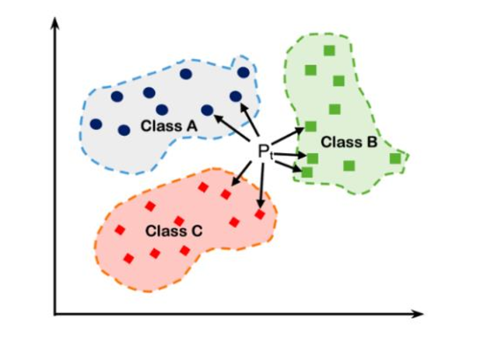
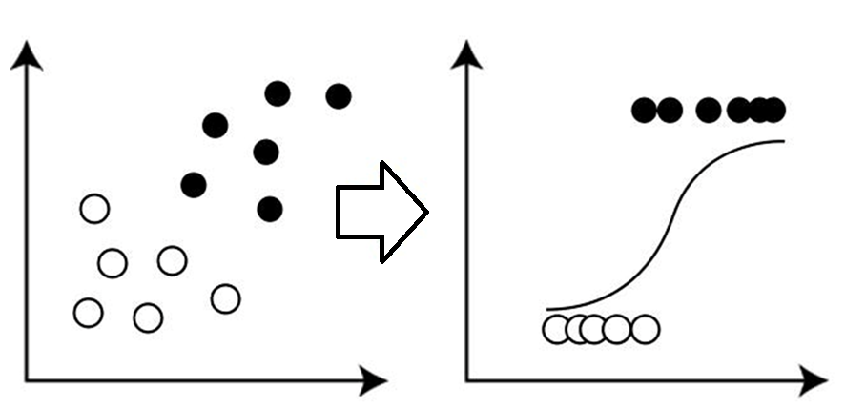
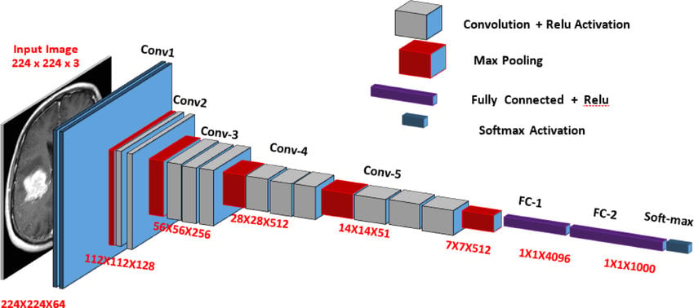
Methodology 방법론
Models 모델
Logistic Regression (Baseline)
로지스틱 회귀 (베이스라인)
- Linear model for binary classification tasks.
- It serves as a primary baseline algorithm for comparison.
- Despite its simplicity, it provides a reference point to measure improvement..
VGG16 (Visual Geometry Group 16)
VGG16 (비주얼 지오메트리 그룹 16)
- A 16-layer deep CNN designed for object recognition.
- It learns to distinguish basic shapes and combines them to recognize complex objects.
- Pre-trained on ImageNet with substantial knowledge from millions of images.
K-Nearest Neighbors (KNN)
K-최근접 이웃 (KNN)
- KNN is a non-parametric instance-based learning method.
- It classifies new data by examining its closest neighbors in the known data.
- Classification is based on the consensus of neighboring data points.
1
2
3
https://medium.com/analytics-vidhya/understanding-logistic-regression-b3c672deac04
https://www.researchgate.net/figure/GG-16-CNN-model-architecture-layer-wise_fig8_346259768
https://www.researchgate.net/figure/K-Nearest-Neighbors-KNN-model_fig4_382849084

Slide 16
5. Results 결과

Slide 17




Results 결과
$$Precision=\frac{TP}{TP+FP}$$
Model 모델 | Precision 정밀도 | Recall 재현율 | F1-Score F1-점수 | Accuracy 정확도
Logistic Regression | 59.3% | 57.6% | 58.4% | 58.5%
KNN | 67.5% | 64.1% | 65.8% | 65.32%
VGG-16 | 97.8% | 96.9% | 97.3% | 97.5%
$$Recall=\frac{TP}{TP+FN}$$
$$Accuracy=\frac{TP+TN}{TP+FP+TN+FN}$$
$$F1−Score=2 ∗ \frac{Recall ∗ Precision}{Recall + Precision}$$
표 3. 모델 메트릭 비교

Slide 18
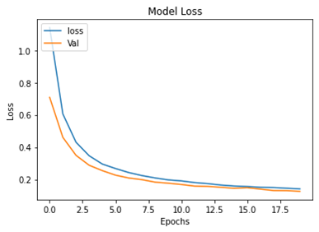
Results 결과
그림 4. 최대 20 에포크 모델 정확도
그림 5. 최대 20 에포크 모델 손실.

Slide 19
6. Conclusion 결론

Slide 20
Conclusion 결론
This study achieved 97.5% accuracy using VGG16, outperforming the baseline by 40%.
Dataset limited to three fruit types and tested only under controlled Kaggle conditions.
Explore domain adaptation, explainable AI techniques, and deployment in real-world industrial systems.

Slide 21
Thank you 감사합니다

