Slide 1
Computational Complexity
Notes:
Introduction
Welcome to COP 4530, Data Structures, Algorithms, and Generic Programming. I hope very much, and sincerely believe, that this course will change you in ways that are deeply satisfying. So far, you have acquired proficiency in programming. This course will start the process of your transformation from a programmer to a computer scientist. One of the important tasks of a computer scientist is to make efficient use of computational resources. This course will teach you about different ways of organizing the data to facilitate such efficient use, and will also discuss efficient techniques to perform some fundamental operations in computer science. A subsequent course on Algorithms, COP 4531, will teach you to use the techniques discussed in this course to solve commonly encountered computer science problems efficiently. Both these courses will also teach you to analyze the efficiency, and prove the correctness, of your program in a mathematically rigorous manner. Material you learn in these two courses is critical to your becoming a good software developer later.

Slide 2
Computational Complexity
Compares growth of two functions
Independent of constant multipliers and lower-order effects
Metrics
  “Big O” Notation O()
  “Big Omega” Notation Ω()
  “Big Theta” Notation Θ()
Notes:
Computational Complexity
The notion of computational complexity was introduced in the prerequisite math courses, so you should be somewhat familiar with it. We will re-introduce the ideas in this chapter. A more thorough and rigorous treatment of com[utational complexity is a central theme of COP 4531, the course that follows COP 4530 in our curriculum.
Computational complexity provides a language for comparing the growth of functions that are defined on (all but finitely many) non-negative integers and which have non-negative real number values. The important class of examples that we will use are functions whose values are run time or run space of an algorithm, and whose input is a number representing the size of the data set on which the algorithm operates.
Complexity of a function is dependent only on its eventual behavior, that is, complexity is independent of any finite number of initial values. The practical effect of this is to ignore initialization phases of algorithms.
Complexity of a function is independent of any constant multiplier. The practical effect of this is to ignore differences in such things as processor speed when comparing performance of two algorithms.
The properties just stated come directly from the definition of computational complexity. A more subtle property, deducible from the definition, is that complexity is independent of so-called "lower order" effects. We will not attempt to make this last statement precise, but we will give some examples to illustrate the concept.
The key measures of computational complexity are known as "Big O" notation, "Big Omega" notation, and "Big Theta" notation. You should be somewhat familiar with at least some of these. The definitions appear in the next slide.

Slide 3
Big “O” Notation
f(n) =O(g(n))
  If and only if
    there exist two constants c > 0 and n₀ > 0,
    such that f(n) ≤ cg(n) for all n ≥ n₀
  iff ∃ c, n₀ > 0 s.t. ∀ n ≥ n₀ : 0 ≤ f(n) ≤ cg(n)
cg(n)
f(n)
f(n) is eventually
upper-
bounded by g(n)
n₀
Notes:
Asymptotic Relations and Notation
The Big O class of a function f consists of all functions that are "asymptotically bounded above by f". The official definition from [Cormen] follows:
g(n) is in O(f(n)) if and only if there exist positive constants c and n₀ such that 0 <= g(n) <= cf(n) for all n >= n₀
Notice that f(n) is in O(f(n)), as are 100f(n) and 100 + f(n). Notice also that the condition defining O(f(n)) is an upper bound condition. Big Omega is defined using the corresponding lower bound condition:
g(n) is in Ω(f(n)) if and only if there exist positive constants c and n₀ such that 0 <= cf(n) <= g(n) for all n >= n₀
and Big Theta is defined using both at once:
g(n) is in Θ(f(n)) if and only if there exist positive constants c₁, c₂, and n₀ such that 0 <= c₁f(n) <= g(n) <= c₂f(n) for all n >= n₀
The following facts about computational complexity are not extremely difficult to prove, nevertheless, the proofs are left to COP 4531.

Slide 4
Big “Omega” Notation
f(n) = Ω(g(n))
  iff ∃ c, n₀ > 0 s.t. ∀ n ≥ n0 , 0 ≤ cg(n) ≤ f(n)
f(n)
cg(n)
f(n) is eventually
lower-bounded by g(n)
n₀

Slide 5
Big “Theta” Notation
f(n) = Θ(g(n))
  iff ∃ c₁, c₂, n₀ > 0 s.t. 0 ≤ c₁g(n) ≤ f(n) ≤ c₂g(n), ∀ n >= n₀
c₂g(n)
f(n)
f(n) has the
same long-term
rate of
growth as g(n)
c₁g(n)
n₀

Slide 6
Examples
3n² + 17
Ω(1), Ω(n), Ω(n²) ➔ lower bounds
O(n²), O(n³), ... ➔ upper bounds
Θ(n²) ➔ exact bound

Slide 7
Analogous to Real Numbers
f(n) = O(g(n)) (a ≤ b)
f(n) = Ω(g(n)) (a ≥ b)
f(n) = Θ(g(n)) (a = b)
…The above analogy is not quite accurate, but its convenient to think of function complexity in these terms
Caveat: The “hidden constants” in the Big-notations can have have real practical implications.

Slide 8
Transitivity
f(n) = O(g(n)) (a ≤ b)
f(n) = Ω(g(n)) (a ≥ b)
f(n) = Θ(g(n)) (a = b)
If f(n) = O(g(n)) and g(n) = O(h(n))
  Then f(n) = O(h(n))
If f(n) = Ω(g(n)) and g(n) = Ω(h(n))
  Then f(n) = Ω(h(n))
If f(n) = Θ(g(n)) and g(n) = Θ(h(n))
  Then f(n) = Θ(h(n))
Notes:
Theorem 1 (transitivity).
(1) If f(n) is in O(g(n)) and g(n) is in O(h(n)) then f(n) is in O(h(n))
(2) If f(n) is in Ω(g(n)) and g(n) is in Ω(h(n)) then f(n) is in Ω(h(n))
(3) If f(n) is in Θ(g(n)) and g(n) is in Θ(h(n)) then f(n) is in Θ(h(n))

Slide 9
Symmetry/ Anti-symmetry
f(n) = Θ(g(n)) (a = b)
f(n) = O(g(n)) (a ≤ b)
f(n) = Ω(g(n)) (a ≥ b)
f(n) = Θ(g(n)) iff g(n) = Θ(f(n))
f(n) = O(g(n)) iff g(n) = Ω(f(n))
Notes:
Theorem 2 (anti-symmetry). f(n) is in O(g(n)) iff g(n) is in Ω(f(n)).

Slide 10
Reflexivity
f(n) = O(g(n)) (a ≤ b)
f(n) = Ω(g(n)) (a ≥ b)
f(n) = Θ(g(n)) (a = b)
f(n) = O(f(n))
f(n) = Ω(f(n))
f(n) = Θ(f(n))
Notes:
Theorem 4 (reflexivity). A function is asymptotically related to itself: f(n) is in O(f(n)), f(n) is in Ω(f(n)), and f(n) is in Θ(f(n)).
In particular, of the three, Θ defines an equivalence relation on functions while O and Ω define an anti-symmetric pair of relations on functions that is analogous to the pair of order relations (<=, >=) on numbers. Thus, Θ is analogous to '=' (equality), while O is analogous to '<=' (less than or equal to) and Ω is analogous to '>=' (greater than or equal to). There is even a form of the dichotomy property of order relations:

Slide 11
Dichotomy
f(n) = O(g(n)) (a ≤ b)
f(n) = Ω(g(n)) (a ≥ b)
f(n) = Θ(g(n)) (a = b)
If f(n) = O(g(n)) and g(n) = O(f(n))
  Then f(n) = Θ(g(n))
If f(n) = Ω(g(n)) and g(n) = Ω(f(n))
  Then f(n) = Θ(g(n))
Notes:
Theorem 5 (dichotomy). If f(n) <= O(g(n)) and g(n) <= O(f(n)) then f(n) = Θ(g(n)).
All of these theorems can be restated in an equivalent form using set notation. For example, Theorem 5 restates as follows:

Slide 12
Arithmetic Properties
Additive Property
  If e(n) = O(g(n)) and f(n) = O(h(n))
  Then e(n) + f(n) = O(g(n) + h(n))
Multiplicative Property
  If e(n) = O(g(n)) and f(n) = O(h(n))
  Then e(n)•f(n) = O(g(n) • h(n))

Slide 13
Typical Growth Rates
Function Name
f(x) = c, c ∈ R | Constant
log(N) | Logarithmic
log²(N) | Log-squared
N | Linear
N log(N)
N² | Quadratic
N³ | Cubic
2^{N} | Exponential

Slide 14
Some Rules of Thumb
If f(n) is a polynomial of degree k
  Then f(n) = Θ(N^{k})
log^{k}N = O(N), for any k
  Logarithms grow very slowly compared to even linear growth

Slide 15
Maximum Subsequence Problem
Given a sequence of integers A₁, A₂, …, A_{N}
  Find the maximum subsequence (A_{i} + A_{i+1} + … + A_{k}),
  where 1 ≤ i ≤ N
  Many algorithms of differing complexity can be found
Algorithm time
Input Size | 1 O(N³) | 2 O(N²) | 3 O(N*logN) | 4 O(N)
N=10 | 0.000009 | 0.000004 | 0.000006 | 0.000003
N=100 | 0.002580 | 0.000109 | 0.000045 | 0.000006
N=1,000 | 2.281013 | 0.010203 | 0.000485 | 0.000031
N=10,000 | N.A. | 1.2329 | 0.005712 | 0.000317
N=100,000 | N.A. | 135 | 0.064618 | 0.003206

Slide 16
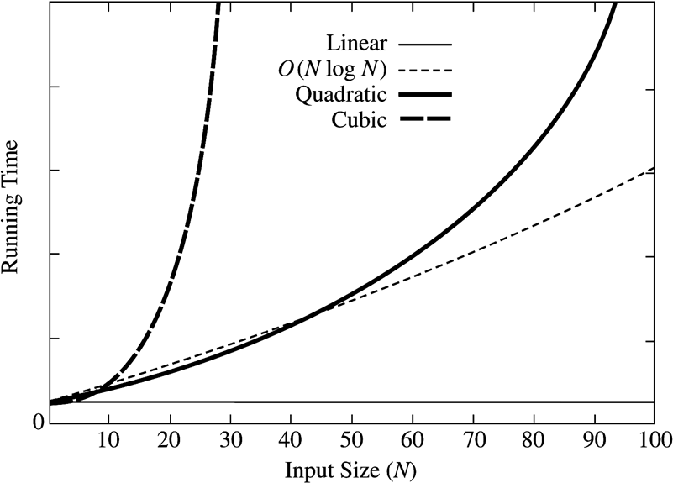
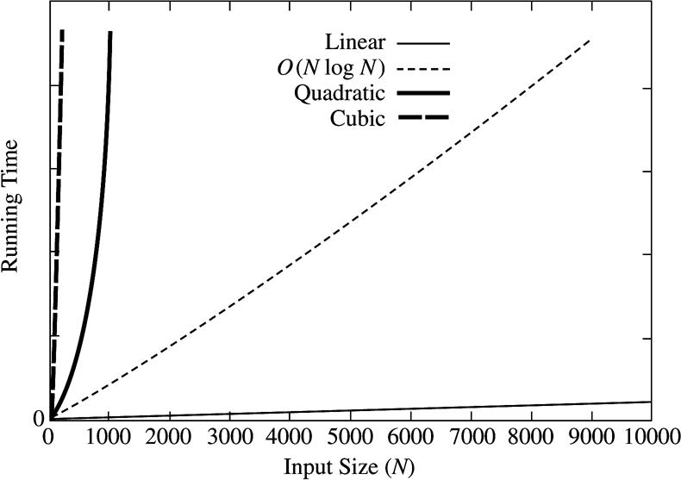
Maximum Subsequence Problem :
How Complexity affects running times

Slide 17
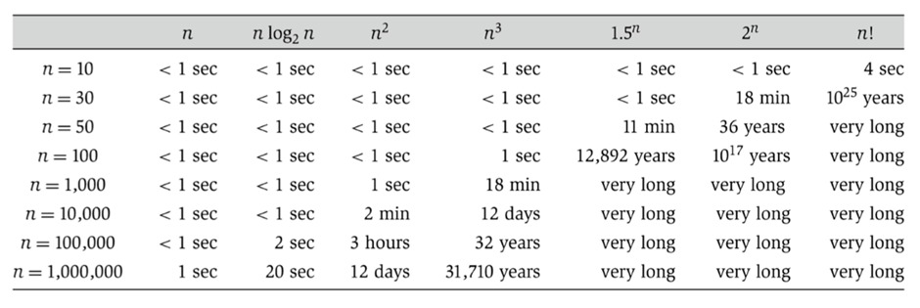
Most current microprocessors can execute at least a million instructions per second

Slide 18
Exercise
f(N) = N logN and g(N) = N ^{1.5}
  Which one grows faster??
Note that g(N) = N ^{1.5} = N•N ^{0.5}
  Hence, between f(N) and g(N), we only need to compare growth rate of log(N) and N ^{0.5}
  Equivalently, we can compare growth rate of log²N with N
  Now, we can refer to the previously state result to figure out whether f(N) or g(N) grows faster!

Slide 19
Complexity Analysis
Estimate n = size of input
Isolate each atomic activities to be counted
Find f(n) = the number of atomic activities done by an input size of n
Complexity of an algorithm =
complexity of f(n)
Notes:
Algorithm Complexity
To apply the notation and theory of computational complexity to algorithms is a four step process. First discover a measure of size of input to the algorithm. Second, decide on a notion of atomic computational activity that captures the work of the algorithm. Third, find the function f(n) = the number of atomic computations performed on input of size n. Finally, the complexity of the algorithm is the complexity of f(n). We illustrate this process in several examples as we conclude this chapter, as well as in various places throughout the remainder of the course.

Slide 20
Running Time Calculations -
Loops
for (j = 0; j < n; ++j) {
// 3 atomics
}
Complexity = Θ(3n) = Θ(n)
Notes:
Algorithm Complexity - Loops
Despite the facetious remarks we made earlier about how "obvious" it is that a simple fixed-bound loop terminates, it actually is true that simple loops are straightforward to analyze. Usually it is clear when and why they terminate and what computational work is accomplished in each iteration of the loop body. If, for example we define an atomic computation as a call to a comparison operator, there might be three such calls in the loop body. That situation is depicted in the slide. The complexity of the loop is defined to be the complexity of the function
f(n)
= (no. of atomics in loop body) x (no. of iterations of loop)
= (3) x (n)
= 3n
Thus, the complexity of this loop is equal to
Θ(f(n))
= Θ(3n)
= Θ(n)
The situation is often not quite this simple, however.

Slide 21
Loops with Break
for (j = 0; j < n; ++j) {
// 3 atomics
if (condition) break;
}
Upper bound = O(4n) = O(n)
Lower bound = Ω(4) = Ω(1)
Complexity = O(n)
Why don’t we have a Θ(…) notation here?
Notes:
Algorithm Complexity - Loops with Break
The case of a loop with a conditional breakout is shown in this slide. In the cases where the loop runs to normal termination, the run time of the loop is correctly modelled by the same function as for the simple loop above. But in other cases, the loop may terminate sooner. These cases are data dependent; that is, the runtime of the loop varies from an upper bound of 3n = O(n) to a lower bound of 3 = Ω(1), depending on the specific input to the loop. We cannot conclude that the algorithm has complexity Θ(n) because the lower bound condition >= Ω(n) does not hold. Therefore, the best we can conclude is that the loop has complexity <= O(n).

Slide 22
Loops in Sequence
for (j = 0; j < n; ++j) {
// 3 atomics
}
for (j = 0; j < n; ++j) {
// 5 atomics
}
Complexity = Θ(3n + 5n) = Θ(n)
Notes:
Algorithm Complexity - Loops in Sequence
This slide shows two loops one following the other in the source code. These are sometimes referred to as concatenated loops. Concatenated program blocks execute in sequence, one after another. Therefore the runtime of two concatenated blocks is the sum of the runtimes of the individual blocks. For the situation depicted on the slide, the runtime is bounded above by O(3n + 5n) <= O(n).

Slide 23
Nested Loops
for (j = 0; j < n; ++j) {
// 2 atomics
for (k = 0; k < n; ++k) {
// 3 atomics
}
}
Complexity = Θ((2 + 3n)n) = Θ(n²)
Notes:
Algorithm Complexity - Loops Nested
This slide shows two loops one inside the other in the source code. These are sometimes referred to as composed loops. The runtime of two composed blocks is the product of the runtimes of the individual blocks. Thus, the runtime of the composed loops depicted in the slide is bounded above by O((2 + 3n)n) <= O(2n + 3n²)) <= O(n²).

Slide 24
Consecutive Statements
Complexity =
O(2n) + O((2+3n)n)
= O(n) + O(n²) = ??
= O(n²)
for (i = 0; i < n; ++i) {
// 1 atomic
if(condition) break;
}
for (j = 0; j < n; ++j) {
// 1 atomic
if(condition) break;
for (k = 0; k < n; ++k) {
// 3 atomics
}
if(condition) break;
}

Slide 25
If-then-else
if(condition)
i = 0;
else
for ( j = 0; j < n; j++)
a[j] = j;
Complexity = ??
= O(1) + max ( O(1), O(N))
= O(1) + O(N)
= O(N)

Slide 26
Sequential Search
Given an unsorted vector a[], find if the element X occurs in a[]
for (i = 0; i < n; i++) {
if (a[i] == X) return true;
}
return false;
Input size: n = a.size()
Complexity = O(n)
Notes:
Algorithm Complexity - Sequential Search
This slide shows the usual (more efficient) version of sequential search in which there is early breakout of the loop immediately upon successful search. This is modelled by the simple loop with break, and hence has complexity <= O(n).

Slide 27
Binary Search
Given a sorted array a[], find the location of element X
unsigned int binary_search(int[] a, int X)
{
unsigned int low = 0, high = a.length-1;
while (low <= high) {
int mid = (low + high) / 2;
if (a[mid] < X)
low = mid + 1;
else if( a[mid] > X )
high = mid - 1;
else
return mid;
}
return NOT_FOUND;
}
Input size: n = a.length
Complexity: O( k iterations x (1 comparison + 1 assignment) per loop)
  = O(log(n))
Notes:
Algorithm Complexity - Binary Search
This algorithm consists of a single loop that does not have any abnormal breakout termination, so the complexity of the loop is essentially the number of loop iterations as a function of n = size of input. Some helpful observations (derived from our previous analysis of correctness) follow.
Observation 1. The loop terminates after the search range is reduced to size <= 1.
Observation 2. The search range is n = size for the first iteration of the loop.
Observation 3. The search range is reduced by 1/2 at each iteration.
Thus, the loop runs for as many times as we can divide n by 2 before reaching the value 1. The first k sizes in these iterations are n, n/2, n/4, n/8, ..., n/2^{k-1}, and the loop termination condition is
n/2^{k-1} == 1 equivalent to n == 2^{k-1} equivalent to log₂n == k-1.
The last inequality shows that the loop terminates in log₂n iterations (give or take one). The complexity of binary search is therefore Θ(log₂n). An exercise for this chapter is to verify the three observations.

Slide 28
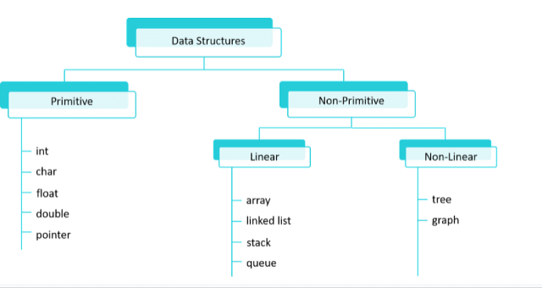
Data Structure Hierarchy

Slide 29
Primitive & Non-Primitive Data Structures
Primitive Data Structures: These are basic data structures that are directly operated upon by the machine and are predefined in most programming languages. Examples include integers, floats, characters, and pointers.
Non-primitive Data Structures: These are more complex data structures constructed using primitive data types. They are used to store and organize collections of data efficiently. Examples include arrays, linked lists, stacks, queues, trees, graphs, etc.

Slide 30
Non-Primitive Data Structures
Array:
  An array can be used to store the scores of students in a class. Each element of the array represents the score of a student, with indices indicating their position in the class.
Linked List:
  A linked list can represent a playlist of songs where each node contains information about a song (such as title, artist, and duration) and a reference to the next song in the playlist.

Slide 31
Non-Primitive Data Structures
Stack:
  The "undo" feature in text editors uses a stack data structure to keep track of the changes made to a document. Each change is pushed onto the stack, allowing users to revert to previous states.
Queue:
  A queue can model a line of customers waiting at a bank. The first customer to arrive is served first (FIFO - First In, First Out), and new customers join the back of the line.
Tree:
  A file system hierarchy can be represented as a tree data structure. Directories (folders) contain files and other directories, forming a hierarchical structure.

Slide 32
Non-Primitive Data Structures
Graph:
Social networks like Facebook or LinkedIn can be represented as graphs, where users are nodes and connections (friendships or professional relationships) are edges between nodes.
  .

Slide 33
Array Data Structure
An array is a collection of elements, each identified by at least one array index or key. It is a fundamental data structure used to store elements of the same data type in contiguous memory locations.
Properties of Array:
  Contiguous memory allocation
  Elements are accessed using indices
  Fixed size (in most languages)

Slide 34
// Point.java
public class Point {
private int x;
private int y;
public Point(int xInit, int yInit) { // Constructor
this.x = xInit;
this.y = xInit;
}
public void setX(int xCoord) {
this.x = xCoord;
}
public void setY(int yCoord) {
this.y = yCoord;
}

Slide 35
// Point.java contd..
public int getX() {
return this.x;
}
public int getY() {
return this.y;
}
public void print() {
System.out.println("(" + this.x + "," + this.y + ")");
}
}

Slide 36
public class Driver {
public static void main(String[] args) {
Point p1 = new Point();
p1.setX(2);
p1.setY(3);
Point p2 = new Point();
p2.setX(2);
p2.setY(3);
if (p1 == p2) // p1 and p2 are different JVM references
System.out.println("Same"); // will never be executed
else
System.out.println("Different"); // This line is always executed
}
}

Slide 37
/** Return true if both x and y are 0s. Else return false. */
public boolean isOrigin() {
// Your code here
}
Create a new test case to check the correct working of isOrigin().
Point p = new Point(4,7);
System.out.println( p.isOrigin() ); // should print false
Point q = new Point();
System.out.println( q.isOrigin() ); // should print true

Slide 38
Sum of 2 points
Given points p = (xp,yp) and q = (xq,yq), adding them amounts to adding their respective x and y coordinates. This operation results in a new Point r given by (xp+xq, yp+yq). In the object-oriented approach, Point p invokes its sum() method by passing Point q as an argument. The implementation is given below.
/** Add the respective x- and y-coordinates */
public Point sum(Point q) {
return new Point(this.x + q.x, this.y + q.y);
}
How come we accessed q.x and q.y directly? And why did it work?

Slide 39
Defining the attributes as private restricts direct access from objects of a different class. In this case, q is also a Point instance and 'this' instance can access private members of another Point instance directly. However, from the Driver class, you will be forced to invoke getX() and getY() to read x and y values.
Implement a driver to test the correct working of sum.
Point p = new Point(7,-3);
Point q = new Point(4,10);
System.out.println( p.sum(q) );
As an exercise, you can check if p.sum(q) is the same as q.sum(p). What do you expect?

Slide 40
The slope of a line passing through 2 points
Given points p = (xp,yp) and q = (xq,yq), the slope can be computed by (yq - yp)/(xq - xp). In the object-oriented approach, Point p invokes its slope() method by taking Point q as an argument to compute the slope. In other words, Point p collaborates with Point q. Note that the slope() method can return a real number too.
/** 'this' x and y attributes collaborates with q's x and y to compute the slope */
public double slope(Point q) {
return (q.y - this.y) / (q.x - this.x);
}
Implement a test driver to check its working.
Point p = new Point(4,7);
Point q = new Point(1,3);
System.out.println( p.slope(q) );

Slide 41
Single and Multi-dimensional Arrays:
Single-dimensional Array: It is an array in which elements are arranged sequentially in a single row or column.
Multi-dimensional Array: It is an array in which elements are arranged in multiple rows and columns, forming a matrix-like structure. Common examples include 2D arrays, 3D arrays, etc.

Slide 42
Functions/Operations on Array
Accessing elements
Insertion
Deletion
Searching
Sorting
Updating elements

Slide 43
Example Problems
Find the maximum/minimum element in an array.
Calculate the sum/average of elements in an array.
Reverse an array.
Check if an array is sorted.
Remove duplicate elements from an array.
Merge two sorted arrays.
Find the frequency of each element in an array.

Slide 44
Find the Maximum/Minimum Element in an Array
public class MaxMinElement {
public static void main(String[] args) {
int[ ] array = {5, 8, 3, 12, 9, 4};
int max = array[0];
int min = array[0];
for (int i = 1; i < array.length; i++) {
if (array[i] > max) {
max = array[i];
}
if (array[i] < min) {
min = array[i];
}
}
System.out.println("Maximum element: " + max);
System.out.println("Minimum element: " + min);
}
}

Slide 45
Merge Two Sorted Arrays
public class MergeSortedArrays {
public static void main(String[] args) {
int[] array1 = {1, 3, 5, 7, 9};
int[] array2 = {2, 4, 6, 8, 10};
int[] mergedArray = new int[array1.length + array2.length];
int i = 0, j = 0, k = 0;
while (i < array1.length && j < array2.length) {
if (array1[i] < array2[j]) {
mergedArray[k++] = array1[i++];
} else {
mergedArray[k++] = array2[j++];
}
}
while (i < array1.length) {
mergedArray[k++] = array1[i++];
}
while (j < array2.length) {
mergedArray[k++] = array2[j++];
}
// Print the Merged array using a loop.
}
}

Slide 46
public class OneDimensionalArray {
public static void main(String[] args) {
// Declaration and initialization of an array with size 5
int[] array = new int[5];
// Initializing elements of the array
array[0] = 10;
array[1] = 20;
array[2] = 30;
array[3] = 40;
array[4] = 50;
// Printing elements of the array
System.out.println("Array elements:");
for (int i = 0; i < array.length; i++) {
System.out.println("Element at index " + i + ": " + array[i]);
}
}
}

Slide 47
import java.util.ArrayList;
public class CheckElementInArrayList {
public static void main(String[] args) {
// Create an ArrayList of integers
ArrayList<Integer> numbers = new ArrayList<>();
numbers.add(10);
numbers.add(20);
numbers.add(30);
// Check if an element exists in the ArrayList
int elementToCheck = 30;
boolean containsElement = numbers.contains(elementToCheck);
if (containsElement) {
System.out.println("Element " + elementToCheck + " exists in the ArrayList.");
} else {
System.out.println("Element " + elementToCheck + " is not in the ArrayList.");
}
}
}

Slide 48
import java.util.ArrayList;
public class ColorList {
public static void main(String[] args) {
ArrayList<String> colors = new ArrayList<>();
// Add some colors to the list
colors.add("Red");
colors.add("Green");
colors.add("Blue");
colors.add("Yellow");
// Print the list of colors
System.out.println("List of colors: " + colors);
// Remove a color from the list
String colorToRemove = "Blue";
colors.remove(colorToRemove);

Slide 49
// Print the updated list of colors
System.out.println(“ Updated List: " + colors);
// Access an element in the list
int indexToAccess = 1;
String accessedColor = colors.get(indexToAccess);
System.out.println("Color at index " + indexToAccess + ": " + accessedColor);
// Iterate through the list of colors
System.out.println("Iterating through the list of colors:");
for (String color : colors) {
System.out.println(color);
}
}
}

Slide 50
public class Simple2DArray{
public static void main(String[] args) {
// Creating a 2D array
int[][] matrix = {
{1, 2, 3},
{4, 5, 6},
{7, 8, 9}
};
// Printing the 2D array
System.out.println("2D Array:");
for (int i = 0; i < matrix.length; i++) {
for (int j = 0; j < matrix[i].length; j++) {
System.out.print(matrix[i][j] + " ");
}
System.out.println();
}
}
}

Slide 51
import java.util.ArrayList;
public class Simple2DArrayWithArrayList {
public static void main(String[] args) {
ArrayList<ArrayList<Integer>> matrix = new ArrayList<>();
matrix.add(new ArrayList<>());
matrix.add(new ArrayList<>());
matrix.add(new ArrayList<>());
// Adding elements to the matrix
matrix.get(0).add(1);
matrix.get(0).add(2);
matrix.get(0).add(3);
matrix.get(1).add(4);
matrix.get(1).add(5);
matrix.get(1).add(6);
matrix.get(2).add(7);
matrix.get(2).add(8);
matrix.get(2).add(9);

Slide 52
// Printing the 2D array
System.out.println("2D Array:");
for (ArrayList<Integer> row : matrix) {
for (int num : row) {
System.out.print(num + " ");
}
System.out.println();
}
}
}

Slide 53
import java.util.Arrays;
public class MatrixMedian {
public static void main(String[] args) {
int[][] matrix = {
{1, 2, 3},
{4, 5, 6},
{7, 8, 9}
};
double median = findMedian(matrix);
System.out.println("Median of the matrix: " + median);
}
public static double findMedian(int[][] matrix) {
int rows = matrix.length;
int cols = matrix[0].length;
int totalElements = rows * cols;

Slide 54
int[] elements = new int[totalElements];
int index = 0;
for (int[] row : matrix) {
for (int num : row) {
elements[index++] = num;
}
}
Arrays.sort(elements);
if (totalElements % 2 == 0) {
int mid1 = elements[totalElements / 2 - 1];
int mid2 = elements[totalElements / 2];
return (double) (mid1 + mid2) / 2;
} else {
return elements[totalElements / 2];
}
}
}

