Slide 1
Stack

Slide 2

Basic Idea
A stack is an Abstract Data Type (ADT), commonly used in most programming languages. It is named stack as it behaves like a real-world stack, for example – a deck of cards or a pile of plates, etc.
An ADT is a programmer-defined data type that is more abstract than the data types provided by the programming language. ADT's provide a representation for data entities in the problem domain, e.g., Customer, Vehicle, Parts List, Address Book.

Slide 3
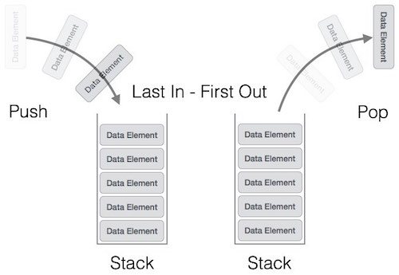
Stack Representation
Can be implemented by means of Array and Linked List.
Stack can either be a fixed size or dynamic.

Slide 4
push
STACK
pop
create
isempty
isfull

Slide 5
STACK: Last-In-First-Out (LIFO)
Assumption: stack contains integer elements!
//Insert an element in the stack
void push (int element);
//Remove and return the top element
int pop ();
//Return the size of the stack
Int size ();
// Check if stack is empty
int isempty ();
// Check if stack is full
int isfull ();

Slide 6

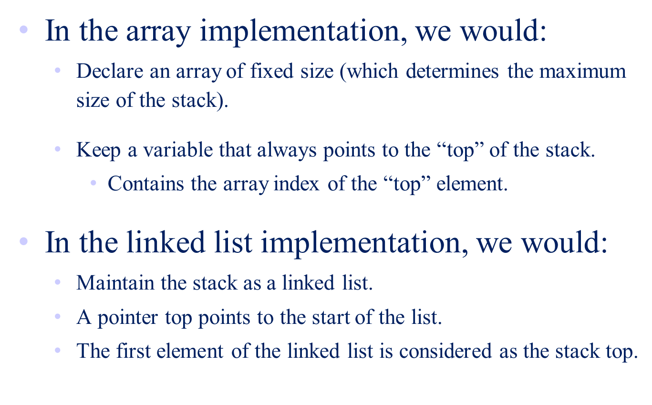

Slide 7
Stack using Array

Slide 8
public class Stack {
private int maxSize;
private int[] stackArray;
private int top;
// Constructor
public Stack(int size) {
this.maxSize = size;
this.stackArray = new int[maxSize];
this.top = -1;
}
Notes:
Computational Complexity
The notion of computational complexity was introduced in the prerequisite math courses, so you should be somewhat familiar with it. We will re-introduce the ideas in this chapter. A more thorough and rigorous treatment of com[utational complexity is a central theme of COP 4531, the course that follows COP 4530 in our curriculum.
Computational complexity provides a language for comparing the growth of functions that are defined on (all but finitely many) non-negative integers and which have non-negative real number values. The important class of examples that we will use are functions whose values are run time or run space of an algorithm, and whose input is a number representing the size of the data set on which the algorithm operates.
Complexity of a function is dependent only on its eventual behavior, that is, complexity is independent of any finite number of initial values. The practical effect of this is to ignore initialization phases of algorithms.
Complexity of a function is independent of any constant multiplier. The practical effect of this is to ignore differences in such things as processor speed when comparing performance of two algorithms.
The properties just stated come directly from the definition of computational complexity. A more subtle property, deducible from the definition, is that complexity is independent of so-called "lower order" effects. We will not attempt to make this last statement precise, but we will give some examples to illustrate the concept.
The key measures of computational complexity are known as "Big O" notation, "Big Omega" notation, and "Big Theta" notation. You should be somewhat familiar with at least some of these. The definitions appear in the next slide.

Slide 9
// Method to check if the stack is empty
public boolean isEmpty() {
return (top == -1);
}
// Method to check if the stack is full
public boolean isFull() {
return (top == maxSize - 1);
}
// Method to get the current size of the stack
public int size() {
return top + 1;
}
Notes:
Computational Complexity
The notion of computational complexity was introduced in the prerequisite math courses, so you should be somewhat familiar with it. We will re-introduce the ideas in this chapter. A more thorough and rigorous treatment of com[utational complexity is a central theme of COP 4531, the course that follows COP 4530 in our curriculum.
Computational complexity provides a language for comparing the growth of functions that are defined on (all but finitely many) non-negative integers and which have non-negative real number values. The important class of examples that we will use are functions whose values are run time or run space of an algorithm, and whose input is a number representing the size of the data set on which the algorithm operates.
Complexity of a function is dependent only on its eventual behavior, that is, complexity is independent of any finite number of initial values. The practical effect of this is to ignore initialization phases of algorithms.
Complexity of a function is independent of any constant multiplier. The practical effect of this is to ignore differences in such things as processor speed when comparing performance of two algorithms.
The properties just stated come directly from the definition of computational complexity. A more subtle property, deducible from the definition, is that complexity is independent of so-called "lower order" effects. We will not attempt to make this last statement precise, but we will give some examples to illustrate the concept.
The key measures of computational complexity are known as "Big O" notation, "Big Omega" notation, and "Big Theta" notation. You should be somewhat familiar with at least some of these. The definitions appear in the next slide.

Slide 10
// Method to push an element onto the stack
public void push(int value) {
if (isFull()) {
System.out.println("Stack is full. Cannot push element " + value);
return;
}
stackArray[++top] = value;
System.out.println("Pushed element: " + value);
}
// Method to pop an element from the stack
public int pop() {
if (isEmpty()) {
System.out.println("Stack is empty. Cannot pop element.");
return -1;
}
int value = stackArray[top--];
System.out.println("Popped element: " + value);
return value;
}
Notes:
Computational Complexity
The notion of computational complexity was introduced in the prerequisite math courses, so you should be somewhat familiar with it. We will re-introduce the ideas in this chapter. A more thorough and rigorous treatment of com[utational complexity is a central theme of COP 4531, the course that follows COP 4530 in our curriculum.
Computational complexity provides a language for comparing the growth of functions that are defined on (all but finitely many) non-negative integers and which have non-negative real number values. The important class of examples that we will use are functions whose values are run time or run space of an algorithm, and whose input is a number representing the size of the data set on which the algorithm operates.
Complexity of a function is dependent only on its eventual behavior, that is, complexity is independent of any finite number of initial values. The practical effect of this is to ignore initialization phases of algorithms.
Complexity of a function is independent of any constant multiplier. The practical effect of this is to ignore differences in such things as processor speed when comparing performance of two algorithms.
The properties just stated come directly from the definition of computational complexity. A more subtle property, deducible from the definition, is that complexity is independent of so-called "lower order" effects. We will not attempt to make this last statement precise, but we will give some examples to illustrate the concept.
The key measures of computational complexity are known as "Big O" notation, "Big Omega" notation, and "Big Theta" notation. You should be somewhat familiar with at least some of these. The definitions appear in the next slide.

Slide 11
Example: A Stack using an Array
public static void main(String[] args) {
Stack stack = new Stack(10);
stack.push(1);
stack.push(2);
stack.push(3);
stack.push(4);
stack.push(5);
System.out.println("Current stack size: " + stack.size());
stack.pop();
stack.pop();
stack.pop();
System.out.println("Current stack size: " + stack.size());
}

Slide 12
Stack using Linked List

Slide 13
Linked Stack
class Stack extends LinkedList {
void push(int key) {
insertFirst(key); // Merely calls LinkedList's method to achieve it
}
int pop() throws RuntimeException {
if ( isEmpty() ) // i.e. stack is empty
throw new RuntimeException("Stack is empty");
int top = head.data;
deleteFirst();
return top;
}
Notes:
Computational Complexity
The notion of computational complexity was introduced in the prerequisite math courses, so you should be somewhat familiar with it. We will re-introduce the ideas in this chapter. A more thorough and rigorous treatment of com[utational complexity is a central theme of COP 4531, the course that follows COP 4530 in our curriculum.
Computational complexity provides a language for comparing the growth of functions that are defined on (all but finitely many) non-negative integers and which have non-negative real number values. The important class of examples that we will use are functions whose values are run time or run space of an algorithm, and whose input is a number representing the size of the data set on which the algorithm operates.
Complexity of a function is dependent only on its eventual behavior, that is, complexity is independent of any finite number of initial values. The practical effect of this is to ignore initialization phases of algorithms.
Complexity of a function is independent of any constant multiplier. The practical effect of this is to ignore differences in such things as processor speed when comparing performance of two algorithms.
The properties just stated come directly from the definition of computational complexity. A more subtle property, deducible from the definition, is that complexity is independent of so-called "lower order" effects. We will not attempt to make this last statement precise, but we will give some examples to illustrate the concept.
The key measures of computational complexity are known as "Big O" notation, "Big Omega" notation, and "Big Theta" notation. You should be somewhat familiar with at least some of these. The definitions appear in the next slide.

Slide 14
Stack class contd.
int peek() throws RuntimeException {
if ( isEmpty() ) // i.e. stack is empty
throw new RuntimeException("Stack is empty");
return head.data;
}
boolean isEmpty() {
if (head == null)
return true;
else
return false;
}
}
Notes:
Computational Complexity
The notion of computational complexity was introduced in the prerequisite math courses, so you should be somewhat familiar with it. We will re-introduce the ideas in this chapter. A more thorough and rigorous treatment of com[utational complexity is a central theme of COP 4531, the course that follows COP 4530 in our curriculum.
Computational complexity provides a language for comparing the growth of functions that are defined on (all but finitely many) non-negative integers and which have non-negative real number values. The important class of examples that we will use are functions whose values are run time or run space of an algorithm, and whose input is a number representing the size of the data set on which the algorithm operates.
Complexity of a function is dependent only on its eventual behavior, that is, complexity is independent of any finite number of initial values. The practical effect of this is to ignore initialization phases of algorithms.
Complexity of a function is independent of any constant multiplier. The practical effect of this is to ignore differences in such things as processor speed when comparing performance of two algorithms.
The properties just stated come directly from the definition of computational complexity. A more subtle property, deducible from the definition, is that complexity is independent of so-called "lower order" effects. We will not attempt to make this last statement precise, but we will give some examples to illustrate the concept.
The key measures of computational complexity are known as "Big O" notation, "Big Omega" notation, and "Big Theta" notation. You should be somewhat familiar with at least some of these. The definitions appear in the next slide.

Slide 15
Example: A Stack using Linked List
class StackTest {
public static void main(String[] args) {
Stack s = new Stack();
s.push(45);
s.push(30);
s.push(17);
s.push(56);
s.push(84);
s.push(23);
System.out.println( s.peek() );
s.pop();
System.out.println( s.peek() );
s.pop();
System.out.println( s.isEmpty() );
s.print(); // What does this print?
// Note: print is defined in LinkedList and hence accessible to Stack
}
}

Slide 16
Applications of Stacks
Direct applications:
  Page-visited history in a Web browser
  Undo sequence in a text editor
  Chain of method calls in the Java Virtual Machine
  Validate XML
Indirect applications:
  Auxiliary data structure for algorithms
  Component of other data structures

Slide 17
Infix and Postfix Notations
Infix: operators placed between operands:
A+B*C
Postfix: operands appear before their operators:-
ABC*+
There are no precedence rules to learn in postfix notation, and parentheses are never needed

