Slide 1

PROJECT TITLE
Team Member JATHISWAR B - RA1811003040088
Department : B.Tech, CSE (FT)
Semester/Year : VIIth / IVth
SEC : D

Slide 2
Abstract
Development of mobile application especially android development is increasing day by day. It is one of the dominant mobile operating systems in the current scenario with an 80 percent market share. There is a need to develop and deliver high quality mobile applications. Selecting a right architectural pattern for the development purpose is essential because it does not only make things easier but it also makes testing more efficient and increases the quality of an application. There are different architectures for mobile development such as MVC, MVP and MVVM, clean architecture and VIPER. Apple (iOS) uses MVP to develop its applications but android developers do not have a specific architecture to develop their applications it rather depends on the developer’s experience that which pattern he chooses for the development. This project aims to create an application based on MVVM architectural pattern.

Slide 3

Existing System
After rushed the product to market and had made a huge mess in the code, as added more and more features, the code gets worse and worse until simply couldn’t manage it any longer. It was the spaghetti code that brought the product down, as the mess builds, the productivity of the team continues to decrease, approaches zero, as productivity decreases, management does the only thing they can, they add more staff to the project in hopes of increasing productivity. The new staff, and everyone else on the team, are under pressure to increase productivity. So they all make more and more messes, driving the productivity toward zero. Until they realize that the old code will never be helpful for achieving new progress, then they must build a new systemthat does everything that the old system does. Not only that, they have to keep up with the changes that are continuously being made to the old system. Management won’t replace the old system until the new system can do everything that the old system does.
3

Slide 4
Proposed System
Model-View-ViewModel (MVVM) is a software design pattern that is structured to separate program logic and user interface controls. MVVM is also known as model-view-binder and was created by Microsoft architects Ken Cooper and John Gossman.
Like many other design patterns, MVVM helps organize code and break programs into modules to make development, updating and reuse of code simpler and faster. The pattern is often used in Windows and web graphics presentation software.
4

Slide 5
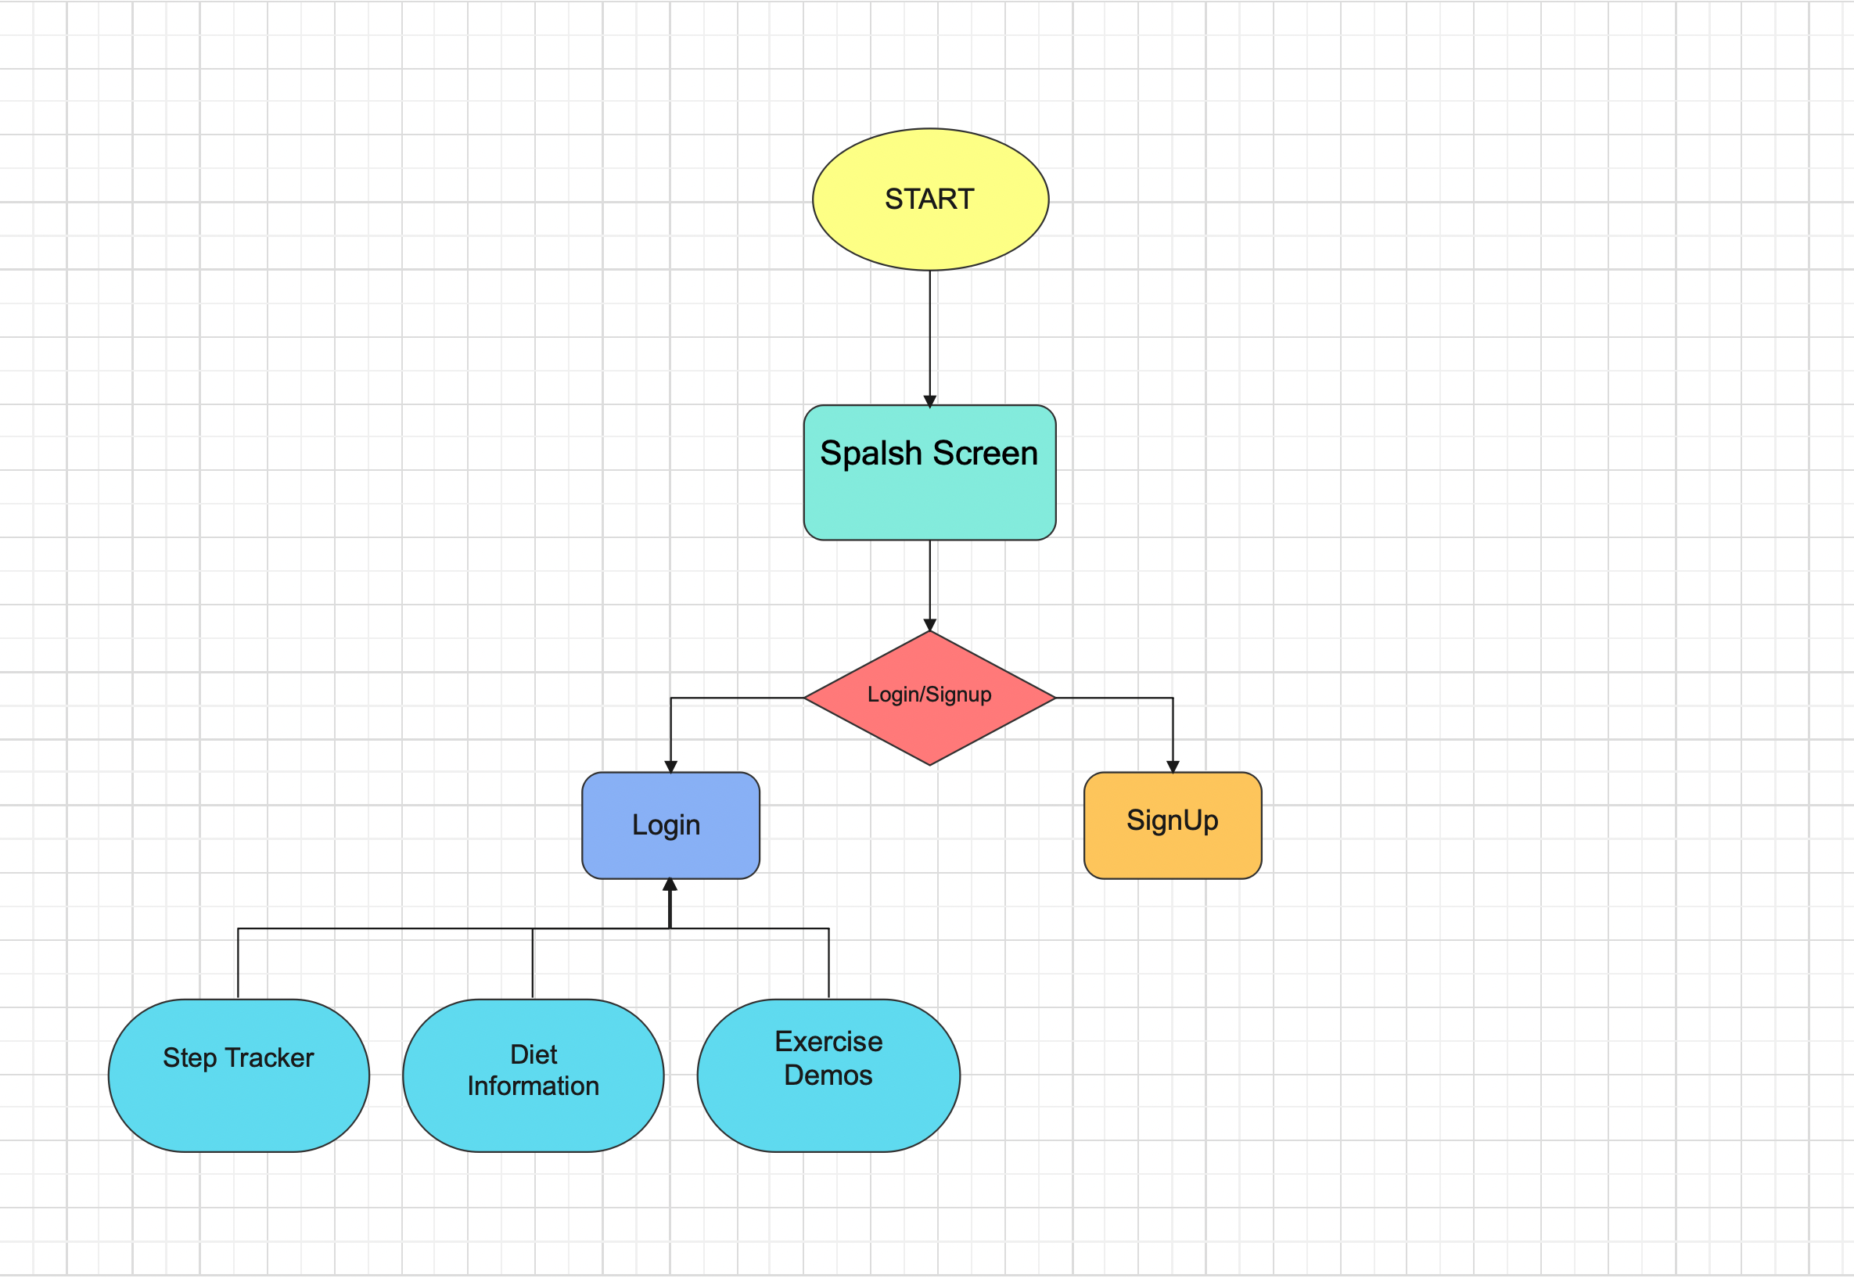
ARCHITECTURE DIAGRAM

Slide 6
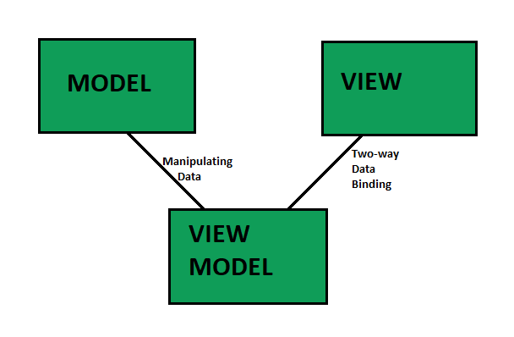
ALGORITHM USED
MODEL: ( Reusable Code – DATA ) Business Objects that encapsulate data and behavior of application domain, Simply holds the data.
VIEW: ( Platform Specific Code – USER INTERFACE ) What the user sees, The Formatted data.
VIEWMODEL: ( Reusable Code – LOGIC ) Link between Model and View OR It Retrieves data from Model and exposes it to the View. This is the model specifically designed for the View.

Slide 7
TECHNICAL MODULES
MainActivity – Which contain a bottom navigation bar to show different fragments.
Step Tracker – Detection of steps based on motion sensor.
Exercise Demos – Information regarding exercises developed using Firebase (MVVM)
Diet Information – REST API diet information.
Login – Login Using Firebase Authentication
Sign Up – New User Signup
SplashScreen

Slide 8
MODULE IMPLEMENTATION DETAILS (CODE) WITH COMPLETE DEMO

Slide 9
Thank you

