Slide 1

Improving the reusability of JATS
JATS4R Working Group
jats4r.org

Slide 2





I want to be able to easily harvest JATS XML from open access content
WHY JATS4R?
We want greater standardization across publishers and creators of JATS XML so we can globally reduce production costs
Daniel Mietchen
Data miner
I want greater standardization of the content that arrives at PMC
Tom Mowlam/Melissa Harrison
Journal production
I am enthusiastic about the effort to represent common data structures in principled ways, while considering the needs of consuming channels that have different requirements and purposes
Jeff Beck
PMC
Mike Minarik
HighWire Press

Slide 3

Publisher 1
Publisher 2
Publisher 3
Publisher 4
Publisher 5
Vendor 1
Vendor 2
Vendor 3
Vendor 1
JATS
JATS
JATS
JATS
JATS
JATS
JATS
JATS
JATS
JATS
JATS
JATS
JATS
Host 1
Host 1
Host 2
Repository 1
Repository 2
Host 3

Slide 4

Publisher 1
Publisher 2
Publisher 3
Publisher 4
Publisher 5
Vendor 1
Vendor 2
Vendor 3
Vendor 1
XML
Anyone!

Slide 5
History
Apr 2014
Call for action
Jun 2014
Kick off meeting
Formation of group
Oct 2014
Open access week Google Hangout
Jan 2015
Apr 2015
Recruited more collaborators
1st formal recommendations released
Released validation tool

Slide 6
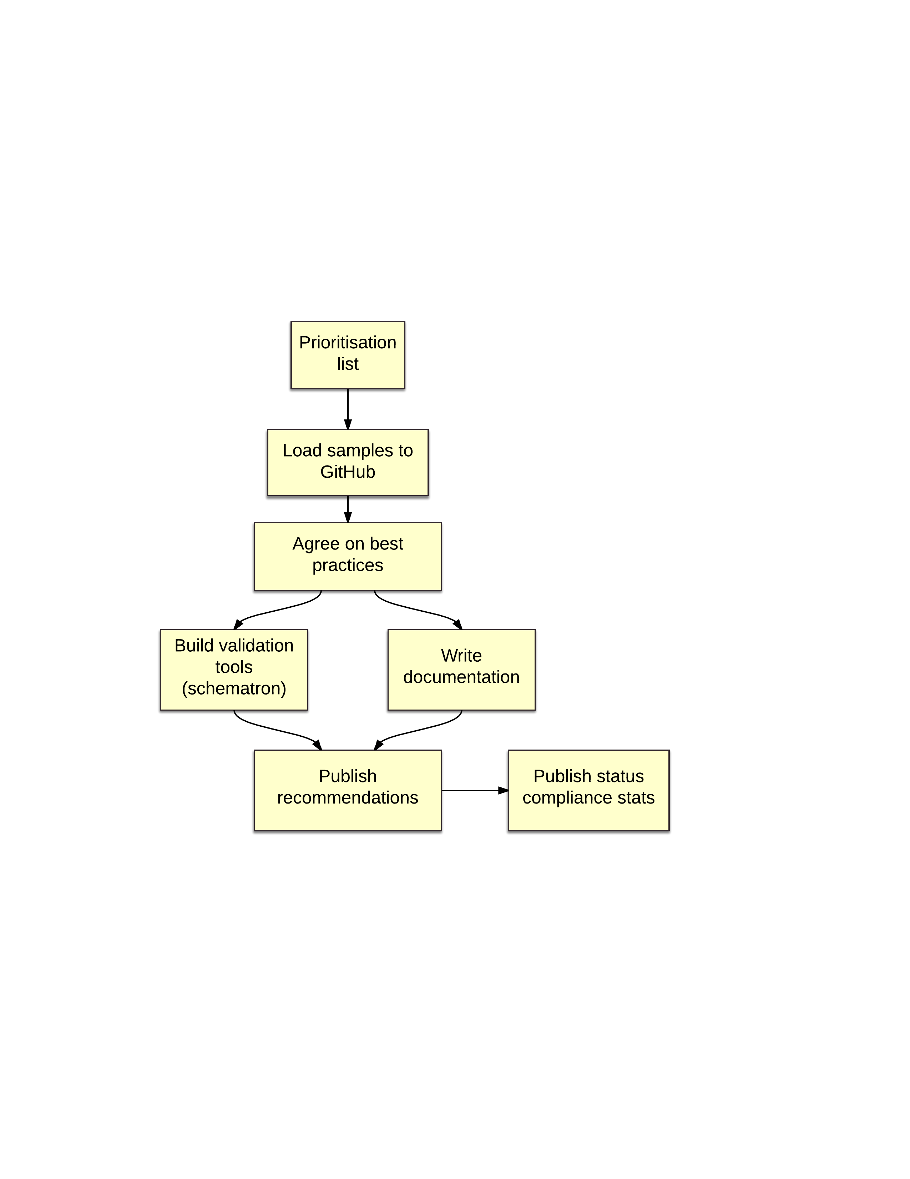
Workflow

Slide 7
<permissions>
Contained in: <article-meta> section of the <front> matter
Whenever an article is under copyright, both <copyright-year> and <copyright-holder> should be present, and <copyright-year> should be a full four-digit year with no whitespace
<copyright-statement>
<copyright-year>
Machine readable
<copyright-holder>
Human readable
<license>
License should be a stable URL in the @xlink:href attribute on the <license> element
<license-p>
Notes:
License -

Slide 8
Cascading <permissions>
For incorporation of third party or other material which is released under different licenses
There are 16 potential containers for <permissions> , eg <fig>
<permissions> contained in: <article-meta> section of the <front> matter taken to apply to the article as a whole
Unless another container contains its own <permissions> element

Slide 9
Final recommendation?
NISO Accessing and License Indicators:
<license_ref>
<free_to_read>
JATS recommendation:
<ali:license_ref>
<ali:free_to_read>
JATS will recommend moving the URL for the license from the @xlink:href attribute of <license> Source: http://jats.nlm.nih.gov/1.1d3/
JATS4R recommendation:
<license>
License should be a stable URL in the @xlink:href attribute on the <license> element

Slide 10
Math

Slide 11
Three ways to save math
TeX (or LaTeX)
richest content
MathML
most reusable
Picture
always looks the same

Slide 12
Full recommendations
http://jats4r.org/recommendations/math.html

Slide 13
Two positions for math
<inline-formula>…</inline-formula>
<disp-formula>…</disp-formula>

Slide 14
So for TeX math
<inline-formula>
<tex-math id="M1”> a + b = c </tex-math>
</inline-formula>

Slide 15
Alternatives
<inline-formula>
<alternatives>
<tex-math id="M1">...</tex-math>
<mml:math id="M2">...</mml:math>
<inline-graphic xlink:....gif"/>
</alternatives>
</inline-formula>

Slide 16
LaTeX macros
<article-meta>
...
<custom-meta>
<meta-name>tex-math-definitions</meta-name>
<meta-value>
\def\rmi{\rm i}
\def\rme{\rm e}
</meta-value>
</custom-meta>
</article-meta>

Slide 17
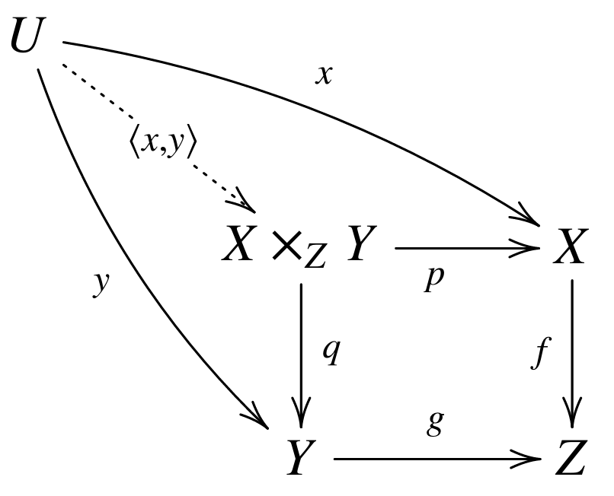
LaTeX is richer than MathML

Slide 18

Sometimes only graphic will do

Slide 19
General recommendations
Use graphic only when no alternative
Ensure Alternatives are equivalent
Generate all from one source
LaTeX?

Slide 20
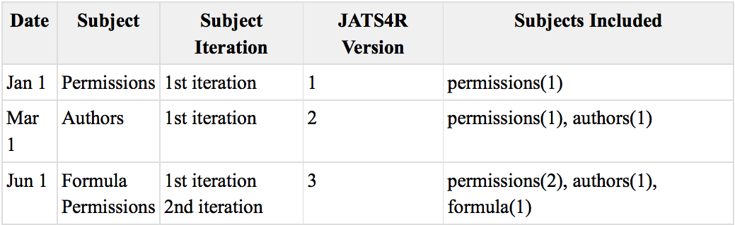
Versions
We will version the recommendations linearly – i.e. a new version number for each update.

Slide 21
Validation
Along with the recommendations, we will provide a way to test an article’s compliance to the recommendations.
There will be three levels of reporting: Errors, Warnings, and Information.
A file is JATS4R-compliant if there are no Errors.
The master validation files are in Schematron format.
Notes:
Beck will write

Slide 22
Schematron(s)
The Schematrons are available in the GitHub repository: https://github.com/JATS4R/jats4r.github.io/tree/master/schema
The tests are written in Schematron modules by Topic (currently “permissions” and “math”) and reporting level (“errors”, “warnings”, and “info”).
A reporting level of “errors” will return only errors.
A reporting level of “warnings” will return errors and warnings.
And a reporting level of “info” will return errors, warnings, and tagging information.
Notes:
Beck will write

Slide 23
For the current version we have the following Schematron modules:
math-errors.sch
math-info.sch
math-warnings.sch
permissions-errors.sch
permissions-info.sch
permissions-warnings.sch
That are used by different Schematron files with phase:
jats4r-level.sch - groups tests by reporting level for all topics. Using this with phase=info (or phase=#ALL) will report at all levels.
jats4r-topic.sch - groups tests by topic. So, for example, when you run this with the phase=math, you will run just the math tests.

Slide 24
jats4r.sch - all topics, error level only.
This is the Schematron to use for Validation.
<?xml version="1.0" encoding="UTF-8"?>
<schema xmlns="http://purl.oclc.org/dsdl/schematron" queryBinding="xslt2">
<ns prefix="mml" uri="http://www.w3.org/1998/Math/MathML"/>
<ns prefix="xsi" uri="http://www.w3.org/2001/XMLSchema-instance"/>
<ns prefix="xlink" uri="http://www.w3.org/1999/xlink"/>
<include href="permissions-errors.sch"/>
<include href="math-errors.sch"/>
</schema>

Slide 25
jats4r.sch - all topics, error level only.
This is the Schematron to use for Validation.
<?xml version="1.0" encoding="UTF-8"?>
<schema xmlns="http://purl.oclc.org/dsdl/schematron" queryBinding="xslt2">
<ns prefix="mml" uri="http://www.w3.org/1998/Math/MathML"/>
<ns prefix="xsi" uri="http://www.w3.org/2001/XMLSchema-instance"/>
<ns prefix="xlink" uri="http://www.w3.org/1999/xlink"/>
<include href="permissions-errors.sch"/>
<include href="math-errors.sch"/>
</schema>

Slide 26
Identifying Compliant Articles
Articles can signal their JATS4R compliance with an <?xml-model?> processing instruction that references the appropriate Schematron.
<?xml-model href="http://jats4r.org/schema/0.1/jats4r.sch" schematypens="http://purl.oclc.org/dsdl/schematron" title="JATS4R 0.1"?>
Notes:
Beck will write

Slide 27
Identifying Compliant Articles
Articles can signal their JATS4R compliance with an <?xml-model?> processing instruction that references the appropriate Schematron.
<?xml-model href="http://jats4r.org/schema/0.1/jats4r.sch" schematypens="http://purl.oclc.org/dsdl/schematron" title="JATS4R 0.1"?>
Notes:
Beck will write

Slide 28
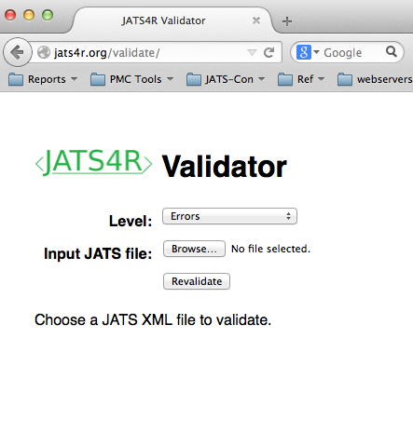
Public Validation Tool
http://jats4r.org/validate/
Notes:
Beck will write

Slide 29
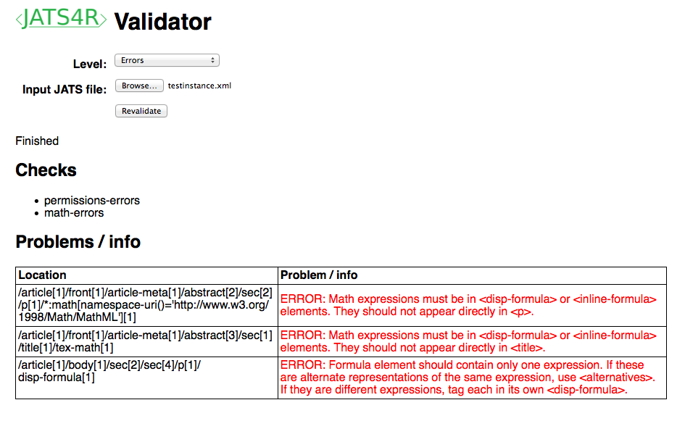
Notes:
Beck/Alf?/Chris?

Slide 30
Live Demo!
https://commons.wikimedia.org/wiki/File%3AAnxiety.gif
By GRPH3B18 (Own work) [CC BY-SA 3.0 (http://creativecommons.org/licenses/by-sa/3.0)], via Wikimedia Commons
Notes:
Beck/Alf?/Chris?

Slide 31
Next priorities
Prioritization list
37 items – 5 done
Next 2 identified:
versioning + corrections
references
Revisit permissions
Constant revision
https://docs.google.com/spreadsheets/d/1wBqpxzCE-42u-pfXWl6Y4_zRKDa8UY4eruumlPg6B6g/edit#gid=0&fvid=1514001492

Slide 32
