Slide 1

SHARING DROPWIZARD FRAMEWORK
Chém gió-er: Đinh Thanh
Da Nang branch, May 25, 2018

Slide 2
Contents
Overview
What is Dropwizard?
Why Dropwizard?
Main Components
Demo
Q&A

Slide 3
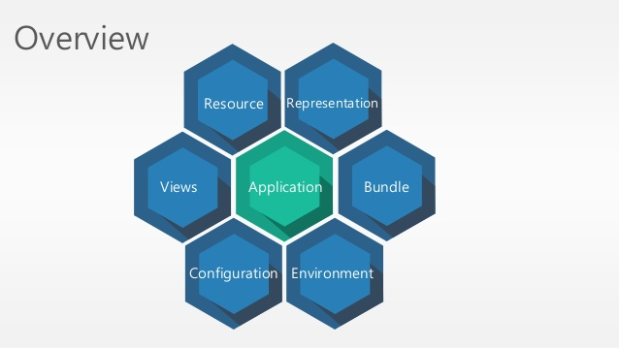

Slide 4
What is Dropwizard?
Dropwizard is an open source Java framework for the rapid development of REST(Representational state transfer) APIs(Application programming interface).
Frist version: v0.1.0: Dec 21 2011
Last version: v1.3.2: Apr 6, 2018

Slide 5
Why Dropwizard?
Pros
Microservices are hot (Why hot - Used by large companies)
Simple & Lightweight
Easy test, deployment and management
Performance
Posts quote (Daniel Jagielski)
Cons
???

Slide 6
Main Components
Jetty
As a Servlet container and HTTP server. So you don't have to deploy your app to a standalone server, it is already embedded into your application which you normally start from a main method.
Jersey
A JAX-RS implementation used for creating REST services with Java.
Jackson
In terms of data formats JSON for your REST services.
Metrics
Support for tracking your app performance.(exp: @Timed)

Slide 7


Slide 8


