Slide 1
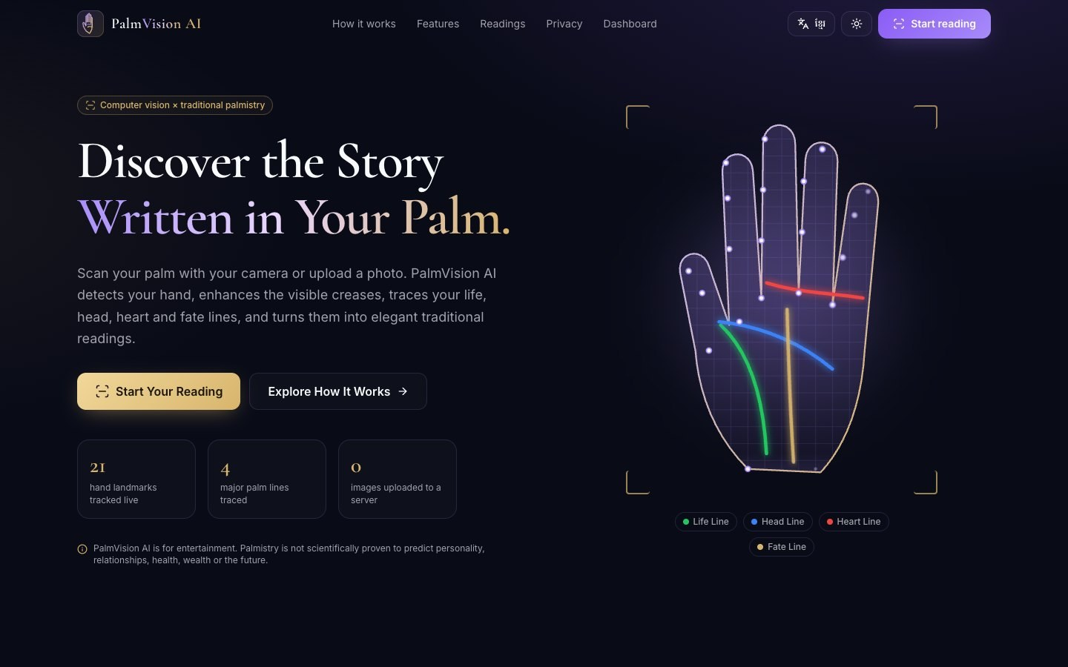
PalmVision AI
AI PALM READING · COMPUTER VISION
Discover the Story Written in Your Palm.
A web app that scans a palm with the camera or a photo, detects the hand and its creases with real computer vision, and turns the measurements into traditional palmistry readings, for entertainment.
React · MediaPipe · OpenCV.js · Tailwind CSS · Vercel
Notes:
Introduce PalmVision AI: a complete, working web application, not a mock-up. It uses real hand detection and image processing, and it is honest that palmistry readings are for entertainment.

Slide 2




One scan, four readings, measured honestly
Capture
Webcam with live guidance, or upload a JPG, PNG or WEBP palm photo.
Core principle
Visual confidence ≠ interpretation
Measure
MediaPipe finds 21 landmarks; OpenCV.js enhances creases; a tracer follows four lines.
Every line shows how clearly it was detected (0–100%).
Readings say what tradition associates with a feature, never a prediction.
Unclear lines are flagged and can be corrected by the user.
No fake results: images without a hand are rejected.
Interpret
A rule engine applies traditional palmistry to the measured features.
Notes:
The key design decision: separate what the computer actually saw from what palmistry tradition says. The app never pretends the lines predict anything.

Slide 3

The product
Features, user journey and reading reports

Slide 4






Key features
Live hand tracking
Crease enhancement
Assisted correction
21-point MediaPipe landmarks over the camera, with 6 scanning states and quality checks.
Grayscale, CLAHE, bilateral denoising and black-hat morphology reveal palm lines.
Drag points, redraw or hide a line; corrections are re-measured.
Rule-based readings
English & Khmer
Private by default
Personality, Love, Career and Fortune reports that work fully offline.
The whole UI and every reading switch between English and ខ្មែរ.
On-device processing; images saved only with explicit consent.
Notes:
Six headline features. Everything listed here is implemented and was tested end to end.

Slide 5
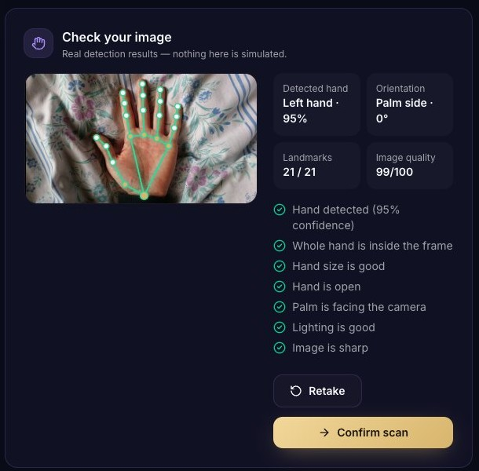
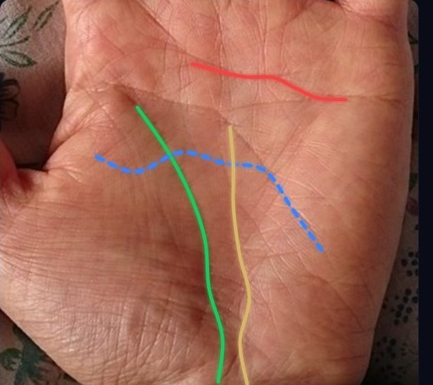
User journey
1
Choose hand & capture
2
Quality check
3
Palm analysis
4
Correct lines
5
Reading & save
Real checks
Hand in frame
Palm facing
Lighting
Blur
Size & rotation
Notes:
Walk through the five steps. The quality review on the left shows real MediaPipe output and the checks that passed. The palm on the right has the four traced lines: green life, blue head, red heart and gold fate.

Slide 6
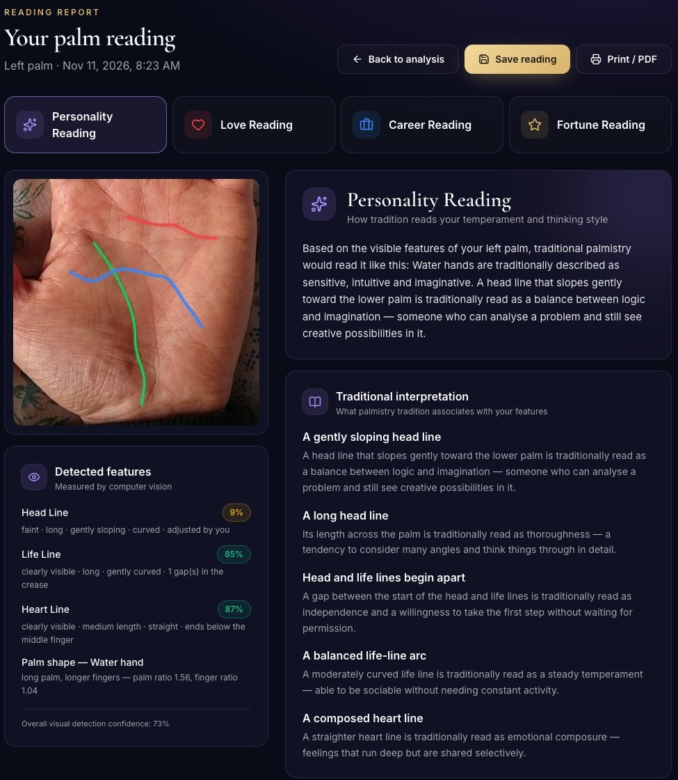
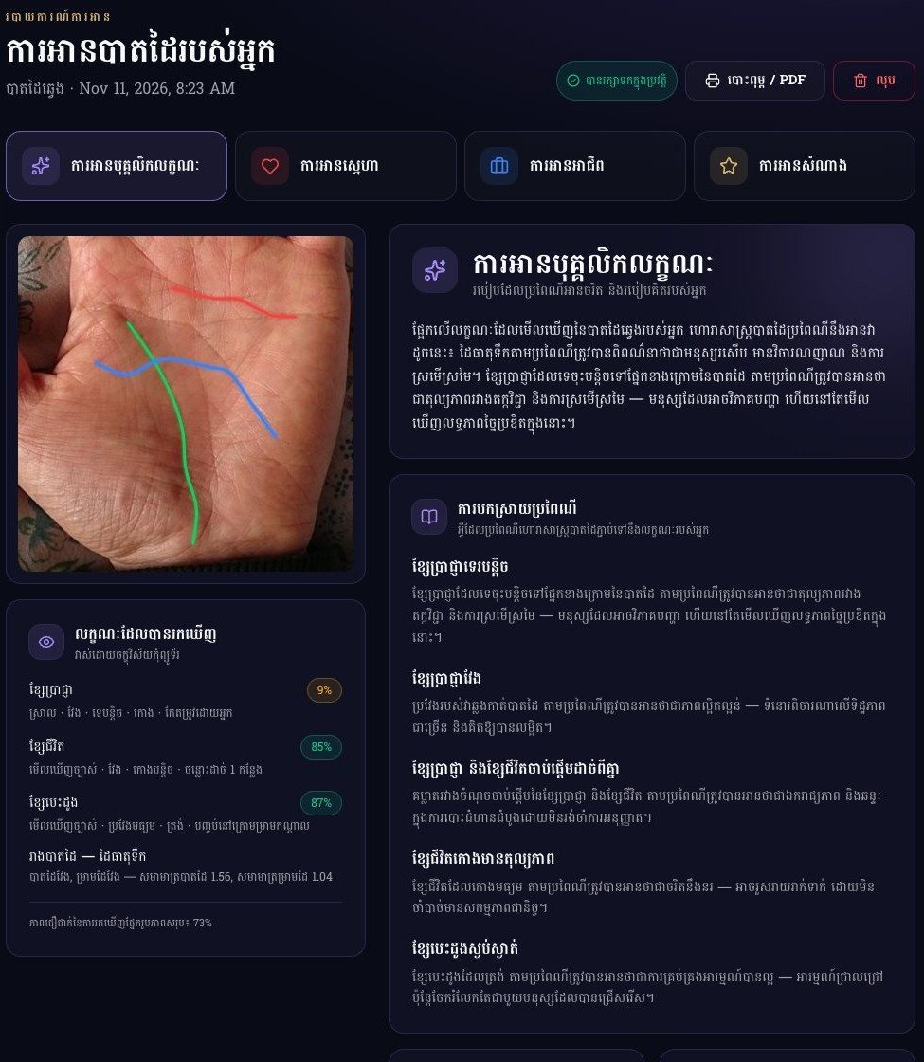
Reading reports in English and Khmer
Each report contains
Detected features with confidence
Traditional interpretation
Detailed explanation
Observations
Reflection questions
Disclaimer
Notes:
The same saved scan rendered in English and Khmer. Reports are regenerated deterministically from stored features, so switching language never changes the content.

Slide 7

How it works
Computer-vision pipeline, line tracing and the interpretation engine

Slide 8
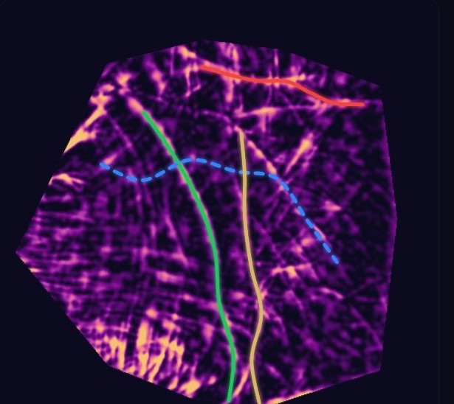
Computer-vision pipeline
1
MediaPipe Hand Landmarker
21 landmarks, handedness, 3D world points
2
Quality validation
Brightness, contrast, Laplacian blur, geometry
3
Palm extraction
Affine warp to an upright 512×512 frame
4
OpenCV.js enhancement
Gray → CLAHE → bilateral → black-hat → blur
5
Line tracing
Corridor search + dynamic programming
Palm region (thumb always on the left)
Crease map: bright = dark skin crease
6
Feature extraction
Length, curvature, slope, breaks, palm shape
Runs in the browser; OpenCV.js is lazy-loaded with a JavaScript fallback.
Notes:
MediaPipe does not detect creases, so a separate OpenCV pipeline enhances them. The black-hat filter highlights thin dark structures. Lines are traced on this map inside landmark-guided corridors.

Slide 9
Line tracing with honest confidence
Each line has a search corridor in the canonical palm.
Dynamic programming finds the smoothest strongest path (90 × 35 grid).
A maximum-sum segment keeps the visible stretch and counts breaks.
Confidence = crease contrast (σ) × continuity, from 0 to 100%.
Lines are found in order heart → life → head → fate, suppressing each one.
Below 55% a line is drawn dashed and marked "Weak", inviting the user to correct it.
Notes:
Results from a real test photo: life, heart and fate were detected clearly; the head line scored 52%, so the app flagged it as weak instead of pretending it was certain.

Slide 10
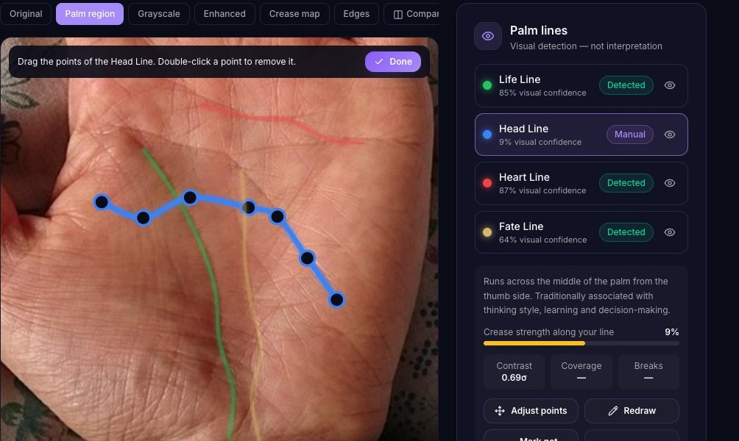

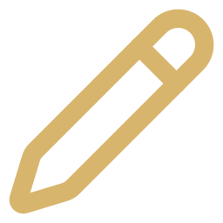


Assisted manual correction
Adjust points
Drag control points; double-click to remove one.
Redraw
Click along the crease to draw the line again.
Mark not visible
Exclude a line that is not really there.
Reset to auto
Return to the automatic detection.
Edited lines are re-measured against the crease map, so a careless edit shows low confidence.
Notes:
If automatic detection is unreliable, the user fixes it. The app never assumes the correction is perfect: here a dragged head line measured only 9%.

Slide 11


Traditional interpretation engine
Structured features
41 bilingual rules
4 reports
visibility · length · curvature · slope · end point · origin · breaks · palm element
Traditional conventions; admins can enable, disable or edit them
Personality · Love · Career · Fortune, offline and deterministic
Measured feature | Traditional reading (example rule)
Head line gently sloping (23°) | Balance between logic and imagination
Heart line ends below the middle finger | Shows care through actions more than words
No clear fate line | A self-made, flexible path, not a lack of success
Long palm + long fingers ("Water") | Sensitive, intuitive and imaginative
Optional: a server-side Claude call rewrites the rule output as prose. It receives features only, never images.
Notes:
Rules only fire for lines that were actually detected. The optional LLM step is constrained to the supplied features and traditional wording, and the API key stays on the server.

Slide 12

Architecture & tech stack
Browser: React SPA (all processing on-device)
Optional server
Scanner
imageProcessing
palmAnalysis
/api/interpret (Vercel function) or FastAPI + OpenCV; Claude key on the server only
useCamera · MediaPipe
Affine warp · OpenCV.js
Tracer · features
Stack
interpretationEngine
storageService
i18n
React 19 · Vite 8 · Tailwind CSS 4 · React Router 7 · Framer Motion · Lucide · MediaPipe Tasks Vision · OpenCV.js 4.10 · IndexedDB · Vitest · Python FastAPI (optional)
Rules · 4 reports
IndexedDB adapter
English · Khmer
Notes:
Heavy libraries are lazy-loaded: MediaPipe only on the scanner, OpenCV only on analysis. Storage sits behind a five-method adapter, so MySQL or Firebase can replace IndexedDB later.

Slide 13

Trust & quality
Privacy, administration and testing

Slide 14




Privacy by design
On-device processing
Store | Key fields
users | id, name, email, role, dominantHand, createdAt
scans | id, userId, handType, imageReference*, scanDate, detectionStatus
features | id, scanId, life/head/heart/fateLine, palmShape, detectionConfidence
readings | id, scanId, category, title, interpretation {en, km}, createdAt
feedback | id, userId, readingId, rating, comment
Camera frames and photos never leave the browser.
No images by default
Readings are saved without the photo unless the user consents.
Delete anytime
One reading, all images or the whole history.
Export
Everything stored can be downloaded as JSON.
* only with consent. A storage adapter allows MySQL or Firebase later.
Notes:
Data minimisation: the default path stores no images at all. History previews are drawn as vector line sketches instead.

Slide 15
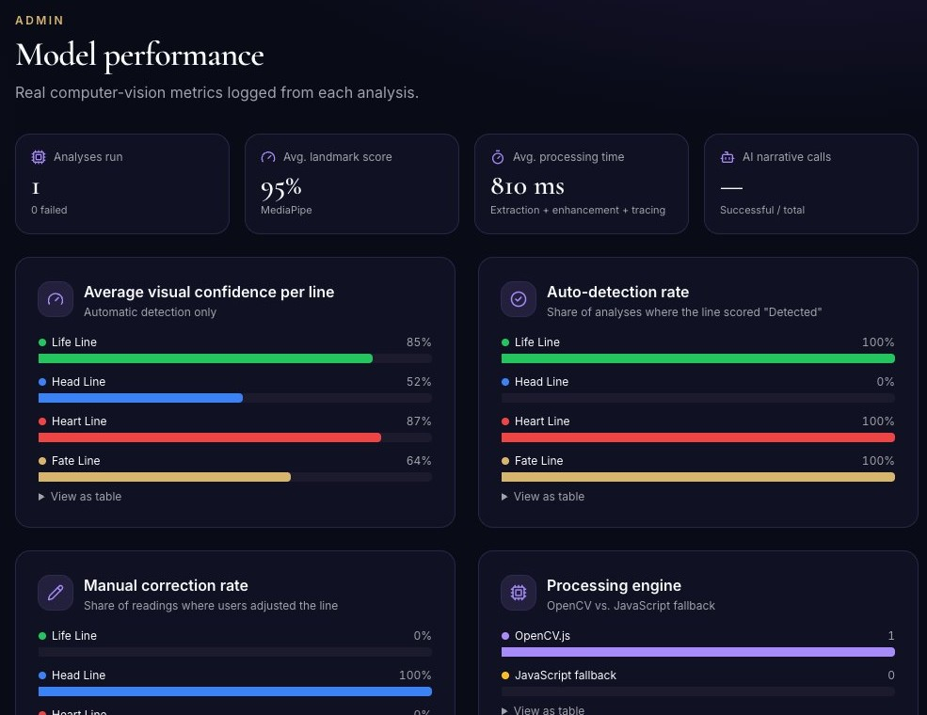




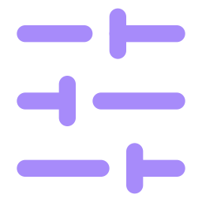
Admin dashboard & model monitoring
Overview
Scans per day, detection outcomes, ratings
Users & scans
Roles, delete, every saved scan
Reading content
Enable, disable or edit all 41 rules
Model performance
Line confidence, auto-detection and correction rates
App settings
Quality thresholds, upload limit, AI switch
Notes:
Every number in the admin console comes from real pipeline events logged during scans; there is no demo data.

Slide 16
Testing & verification
16
4
23
0
Vitest unit tests passing
FastAPI tests passing
E2E steps on the production build
console errors in E2E run
What was verified
Fixed during testing
Tracer finds a synthetic crease within 2% and stays low on pure noise
Rules never fire for undetected lines; EN and KM keys match 1:1
Image consent respected; deletes cascade to readings and feedback
Real palm upload → correction → reading → save → history → admin
Fake camera stream, non-hand image rejection, mobile, Khmer, light theme
OpenCV.js 5.0 WASM failed in Chrome, so pinned to 4.10
Life line split at weak gaps, so switched to a max-sum segment
Tailwind 4 @apply, analysis grid overflow, Khmer letter-spacing
AI test misread the SPA fallback page
Notes:
Test counts are from the final run. The E2E script drove Chrome against the production preview with real palm photos.

Slide 17

Delivery
Deployment, limitations and roadmap

Slide 18
Deploying to Vercel
1
Push to GitHub
Import the repo in Vercel; Vite is detected automatically.
Run it locally
npm install
npm run dev
npm test
npm run build
vercel --prod
2
Build
npm run build copies MediaPipe WASM + OpenCV.js and outputs dist/.
3
Routing & headers
vercel.json: SPA rewrites, HSTS, camera permissions, asset caching.
The Python FastAPI service is optional and is hosted separately (Render, Railway, Fly.io or Docker), because Vercel does not run a persistent Python server.
4
Optional AI
Add ANTHROPIC_API_KEY; /api/interpret becomes active.
Notes:
The frontend deploys on its own and needs no paid services. HTTPS on Vercel satisfies the camera secure-context requirement.

Slide 19


Limitations & roadmap
Current limitations
Next steps
Line tracing is a classical heuristic; low light or blur lowers accuracy
Corridors were calibrated on a small set of palms
Admin manages local browser data only
Khmer copy needs native-speaker review
Palmistry itself has no scientific validity
Train a U-Net on consented, user-corrected line labels
Server-side auth and a MySQL or Firebase storage adapter
Evaluate per-line Dice/IoU against the current tracer
Run the model in the browser with ONNX Runtime Web
More palm features: mounts, minor lines, finger shapes
Notes:
User corrections already produce labelled line data in canonical coordinates, a natural training set for a future segmentation model.

Slide 20
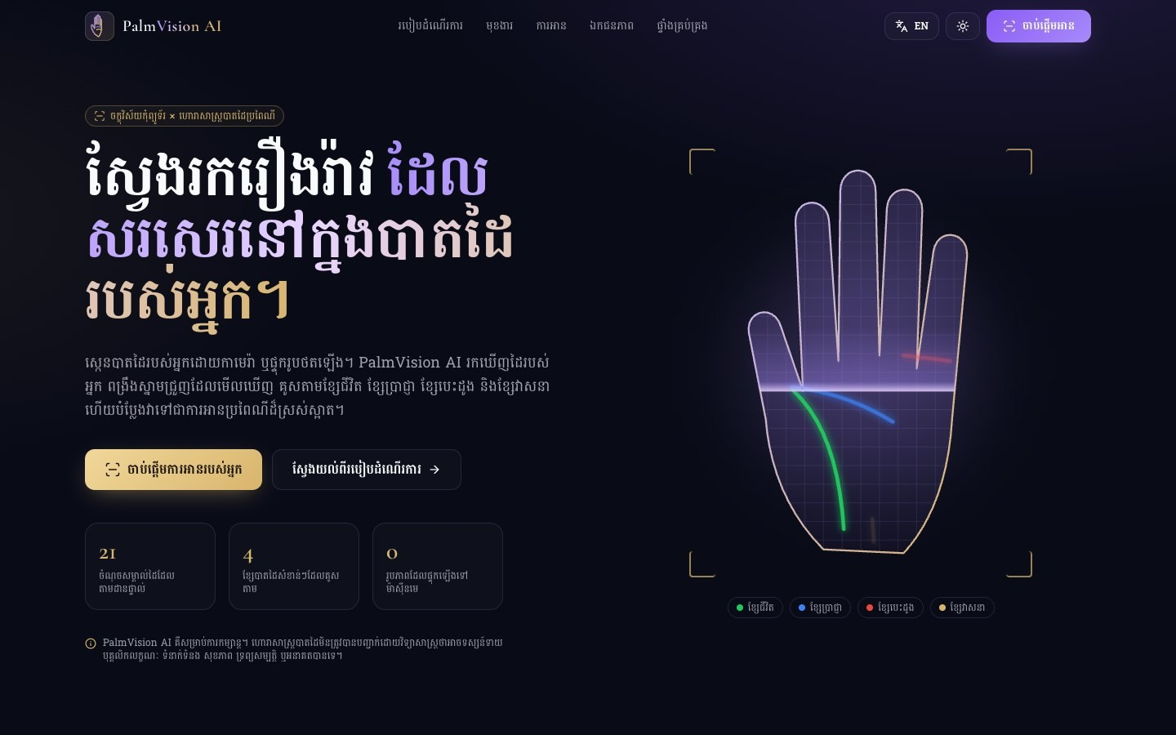
Thank you
QUESTIONS & LIVE DEMO
Live demo: npm run dev → /scan
For entertainment only. Palmistry is not scientifically proven to predict personality, relationships, health, wealth or the future. PalmVision AI measures visible creases; the readings are traditional conventions.
Sample palm photo: "Left-palm.jpg" by 些細な日常, Wikimedia Commons, CC BY-SA 4.0
Notes:
Close with the live demo and the disclaimer. Invite questions.

