Slide 1
Analysis and Analytics of Coronavirus Tweets and Political Tweet Traits
Acikgoz, Mehmet | ma96f@mail.umkc.edu | acikgozmehmet | 1
Wolfe, Jonathan Andrew | jawhf4@mail.umkc.edu | JAWolfe04 | 17
Attaluri, Lalith Chandra | la4kf@mail.umkc.edu | LalithChandraAttaluri | 4
Karumanchi, Pranitha Saroj | pkt59@mail.umkc.edu | pranithakarumanchi99 | 7

Slide 2
Analysis and Analytics of Coronavirus Tweets and Political Tweet Traits (Part-A)
Acikgoz, Mehmet | ma96f@mail.umkc.edu | acikgozmehmet | 1
Wolfe, Jonathan Andrew | jawhf4@mail.umkc.edu | JAWolfe04 | 17

Slide 3
Motivation
Twitter makes public Tweets and replies available to developers,and allow developers to post Tweets via API.
These tweets can easily be used by people to identify, understand and counter misinformation around public health initiatives.
We collected tweets on the topic “coronavirus” and saved them to files to perform further analysis with Map-Reduce, Hive and Spark Framework.

Slide 4
Introduction
The advances in science and technology have made the modern lifestyle more interactive with people through social media such as Twitter.
Besides this personal use of Twitter, it also provides valuable information about the global threats such as COVID19 pandemic.
We believe that Twitter messages provide instant pictures of threat that will shed light to unseen part of the pandemic.

Slide 5
Background
Twitter has been analyzed countless times involving numerous types of statistical interpretations for different reasons
We decided to look at the features of tweets with #Coronavirus in English and implement various queries on this dataset.
In addition, we will extend past works analyzing political tweets and learn how features of tweets relate to its likelihood of being political.

Slide 6
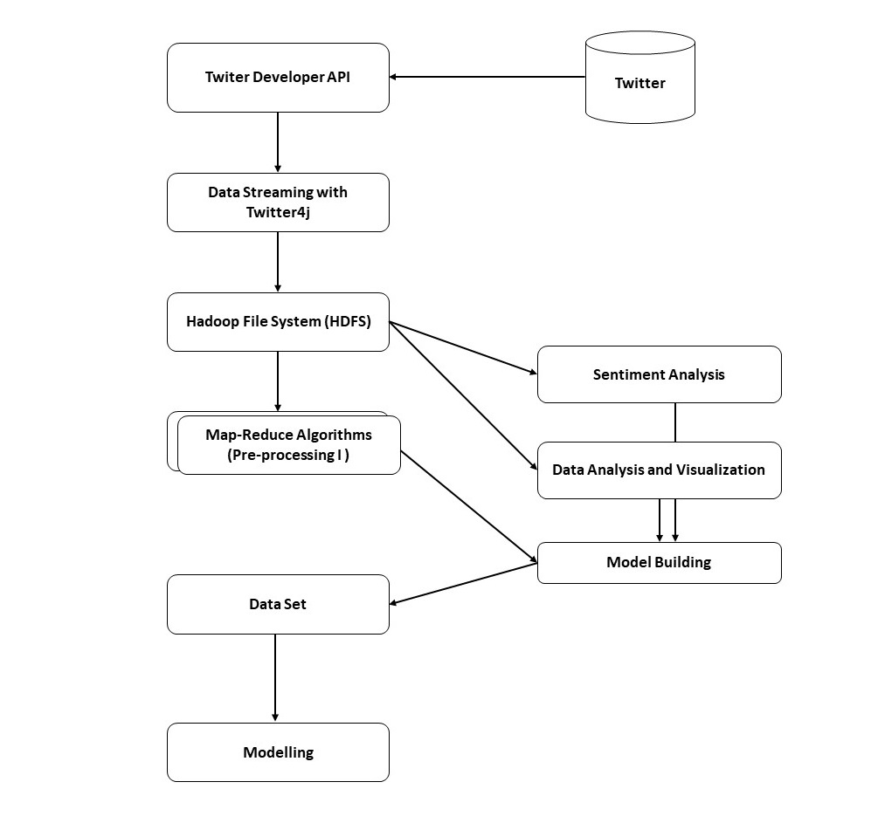
Model
Collect tweets via Twitter4j
Saving to HDFS
Multiple Analysis with Map-Reduce Algorithms
Sentiment Analysis
Data Analysis and Visualization
Model Building
Modelling & Using MLIB

Slide 7
Dataset
The data set used in this project is collected on between 2.30-6.51 UTC on March 14.
The data set contains 199,924 tweets.
Data is in json format per line.
The following fields are taken into account for modelling and ML.
id , created_at, full_text, user.created_at, retweet_count, user.follower_count, user.friend_count, user.listed_count

Slide 8
Preliminary Data Analysis with Map-Reduce (I)
To find out the people tweeting more than others.
Algorithm:
Process all tweets and parse out tokens with "user.id_str"
Count all the 'user.id_str's.
Find out top n 'user.id_str's by sorting them
In order to perform this analysis we created 2 separate Map-Reduce jobs;
first one covering from step-1 and step-2
the second one covering step-3 (for sorting)

Slide 9
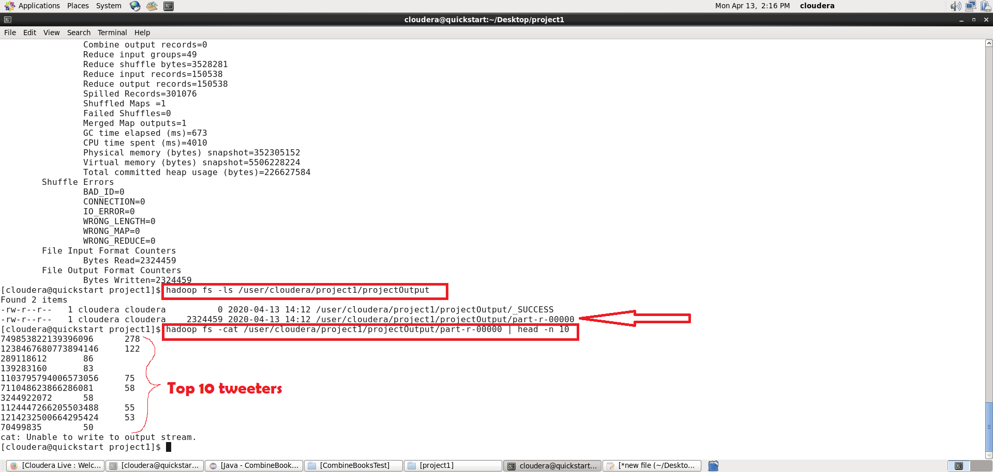
Preliminary Data Analysis with Map-Reduce (I)

Slide 10
Detailed Data Analysis with Spark
Before we create the model, it would best to understand the dataset we have.
We created 8 queries in SparkSQL and performed Sentiment Analysis in order to better understand the data that will eventually help us in building the model.
We used some other cutting edges tools such as pandas, matplotlib in addition to Apache Spark.

Slide 11
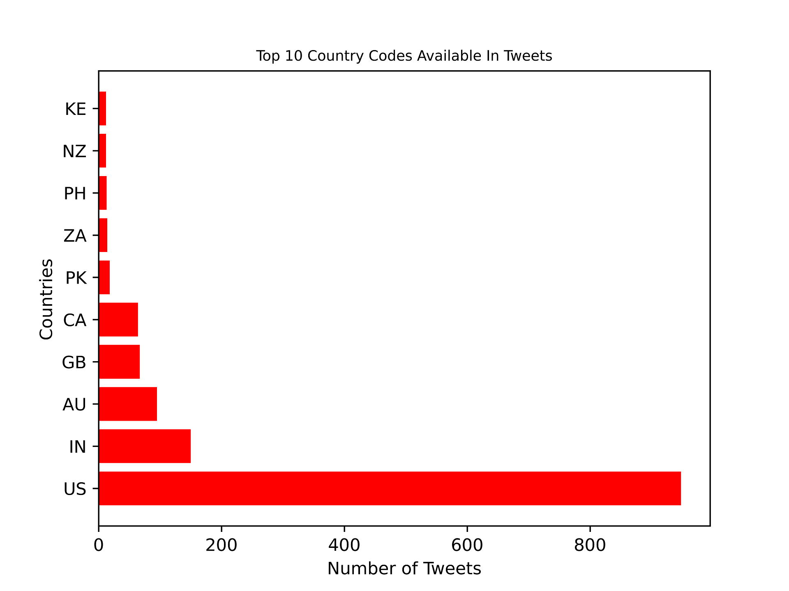

Slide 12
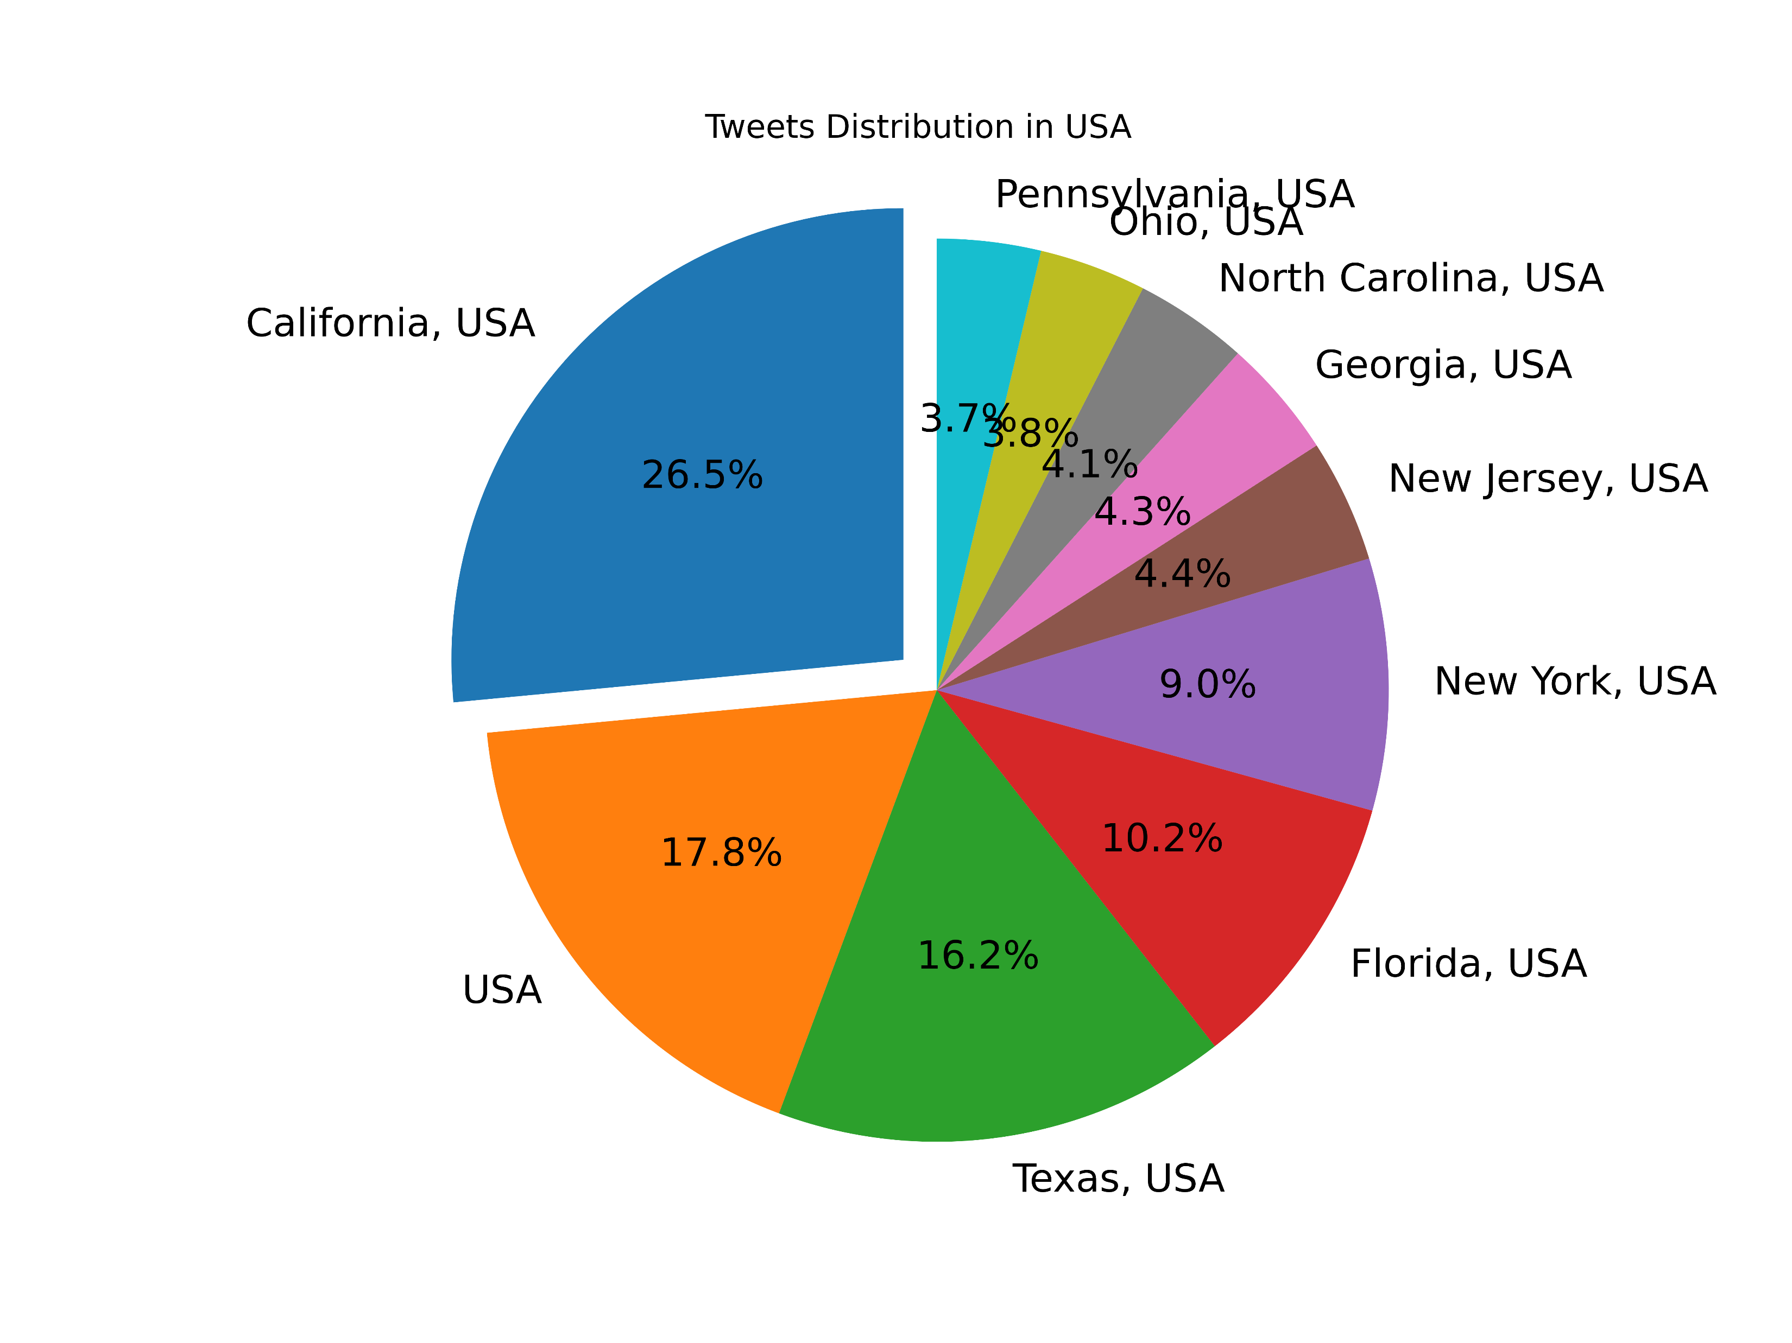

Slide 13
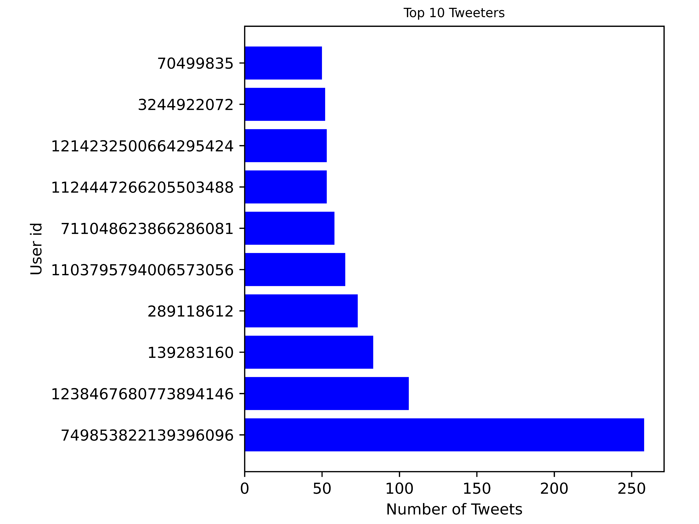

Slide 14
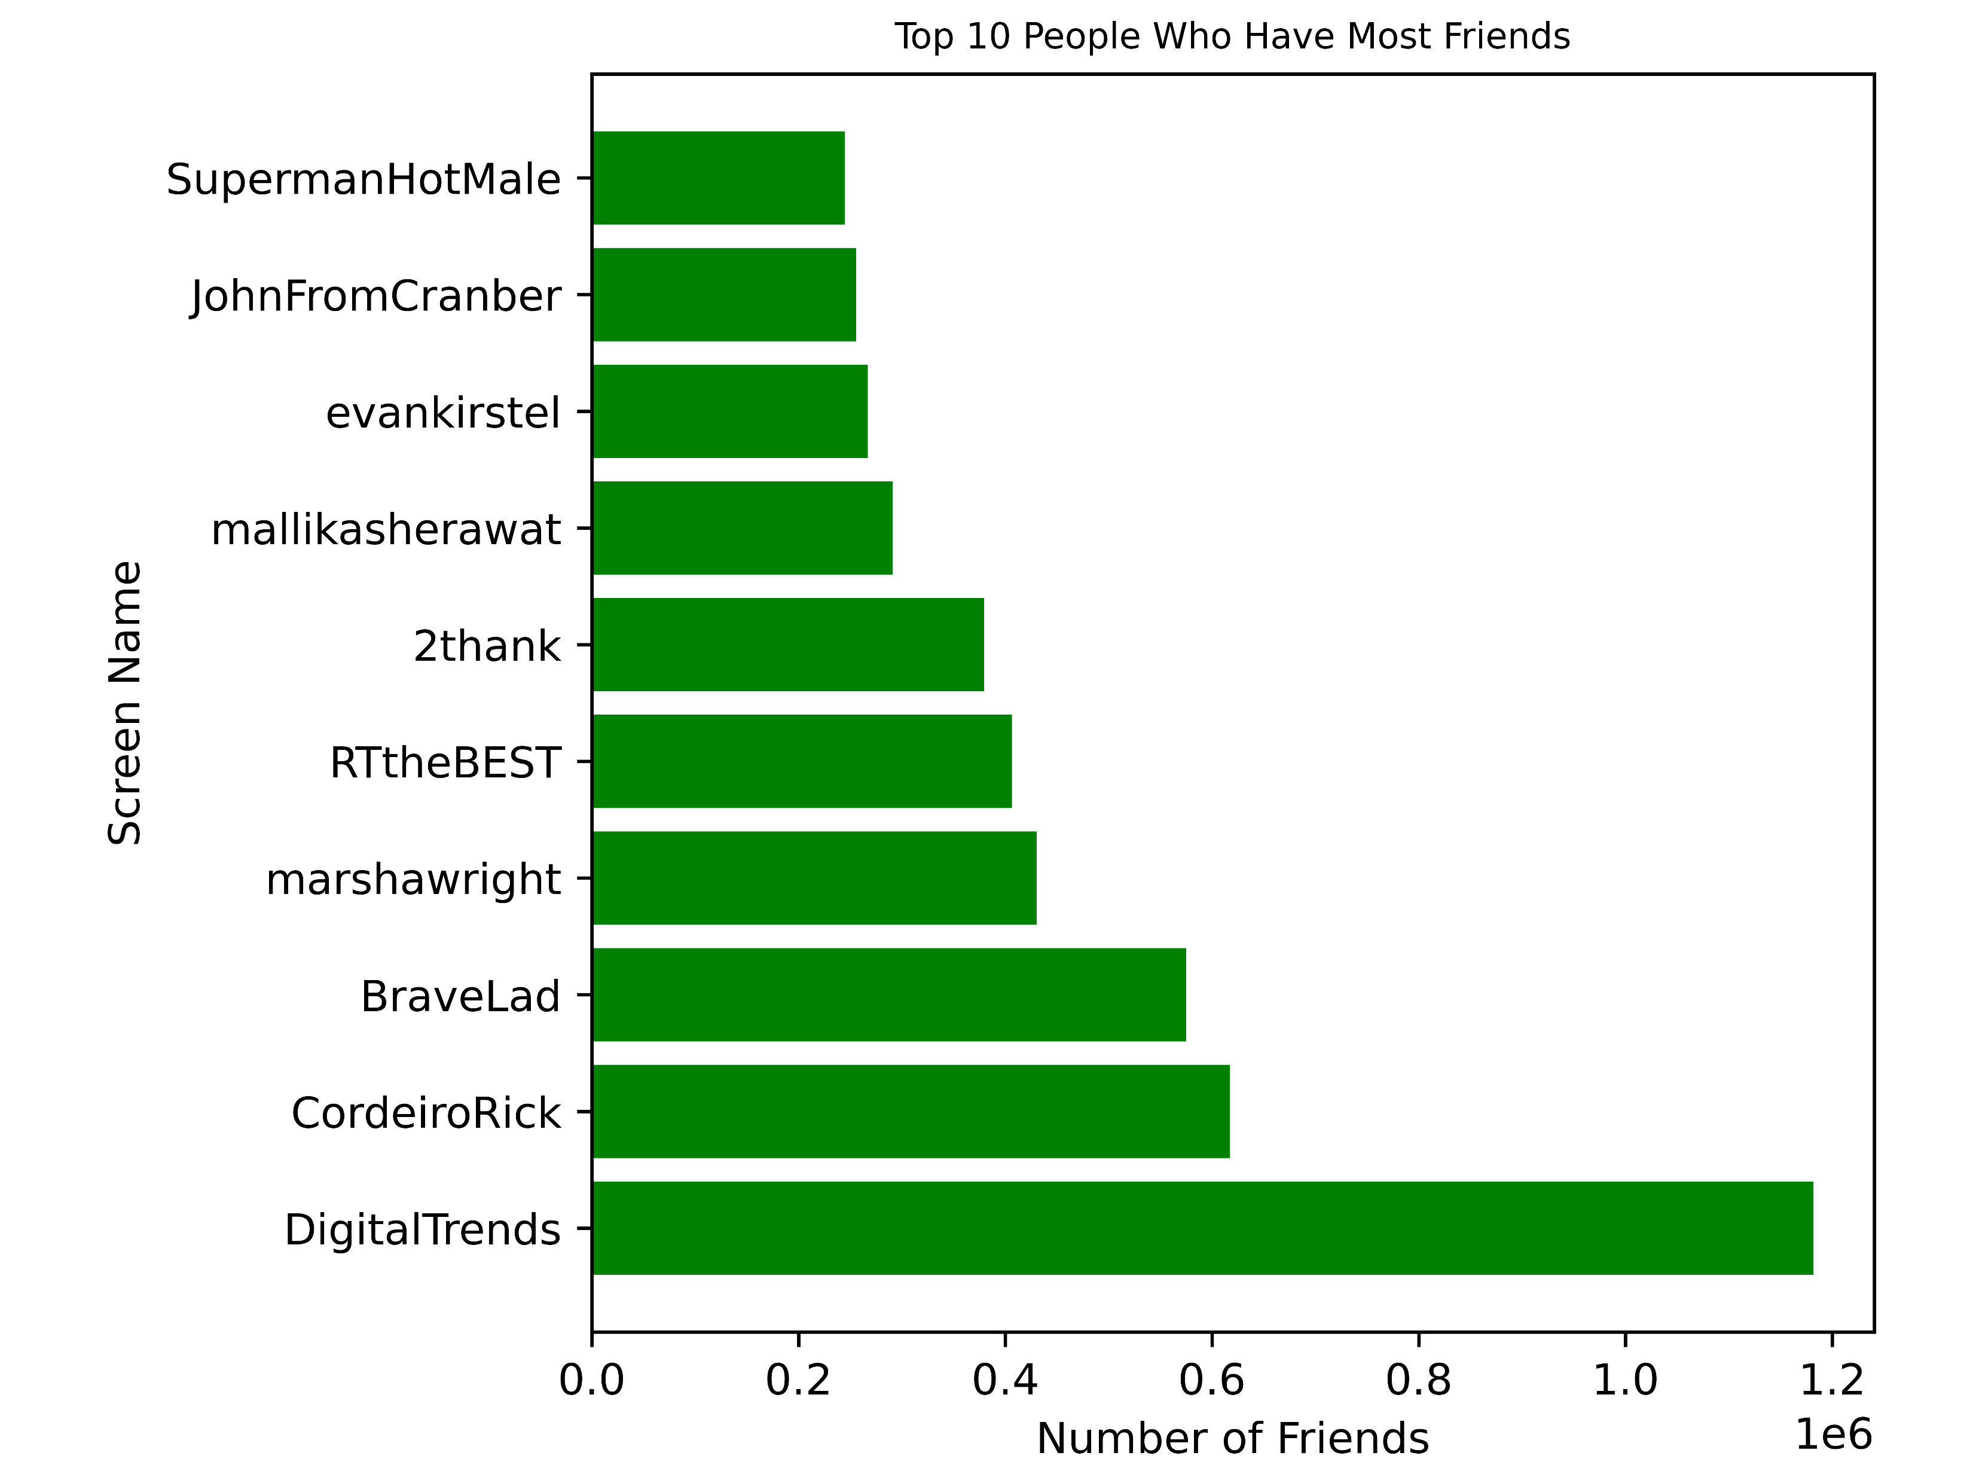

Slide 15
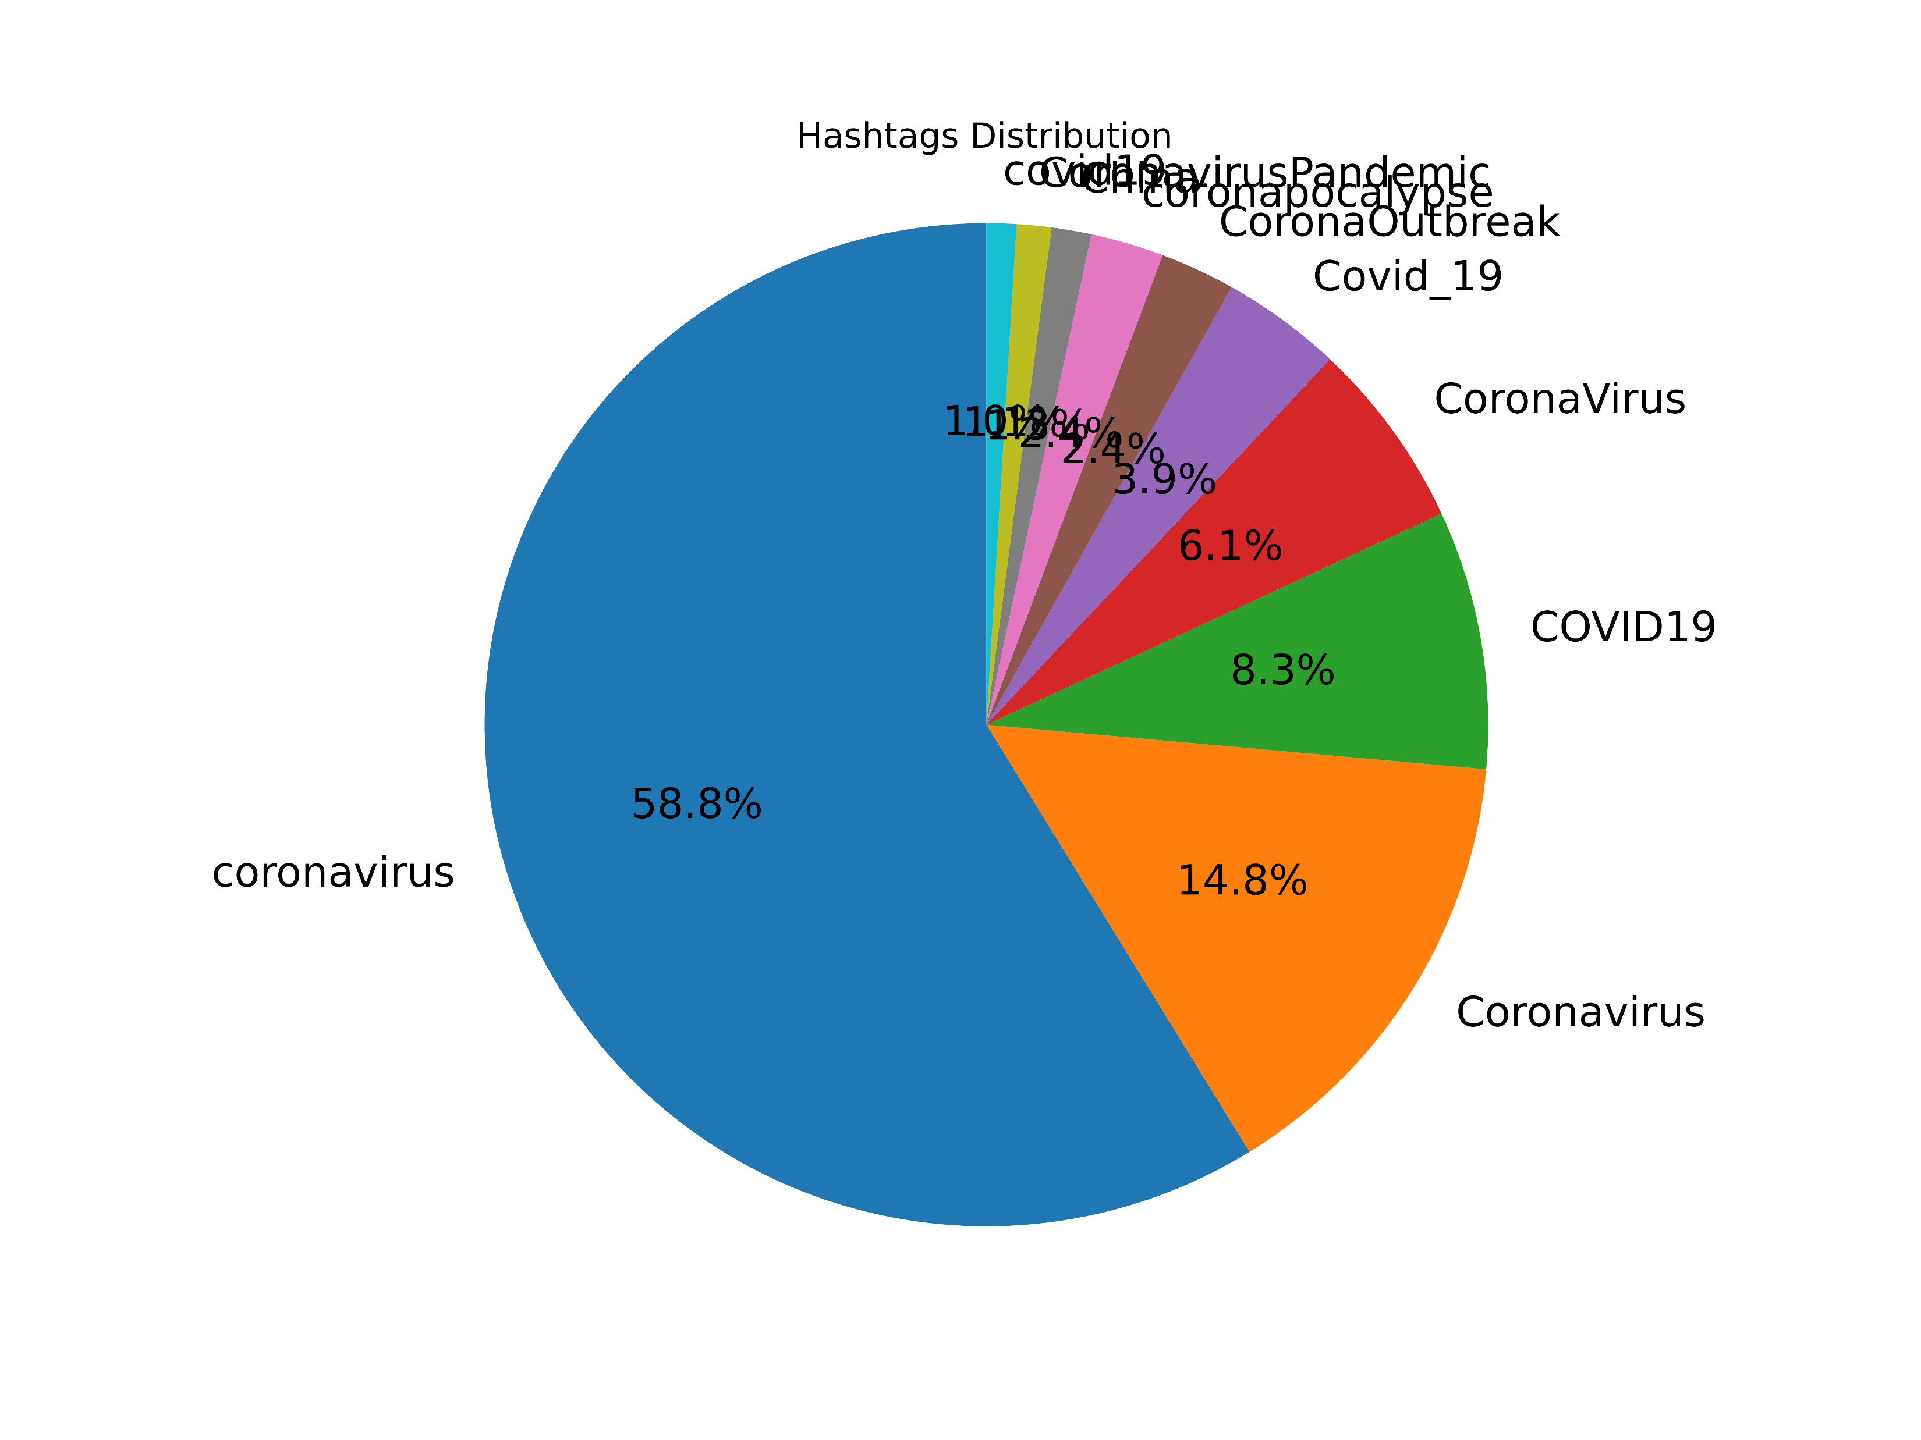

Slide 16
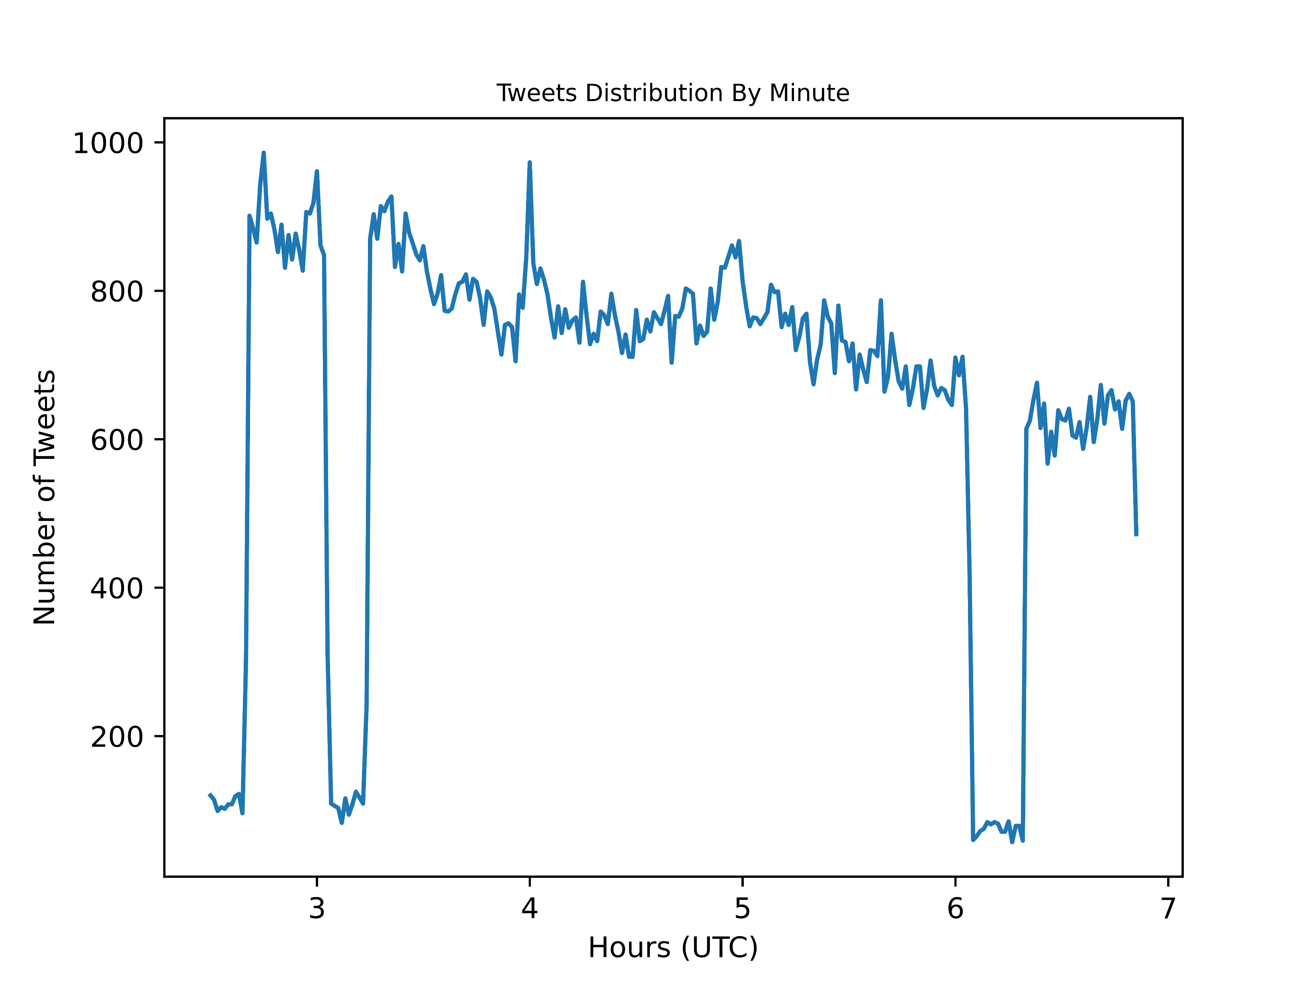

Slide 17
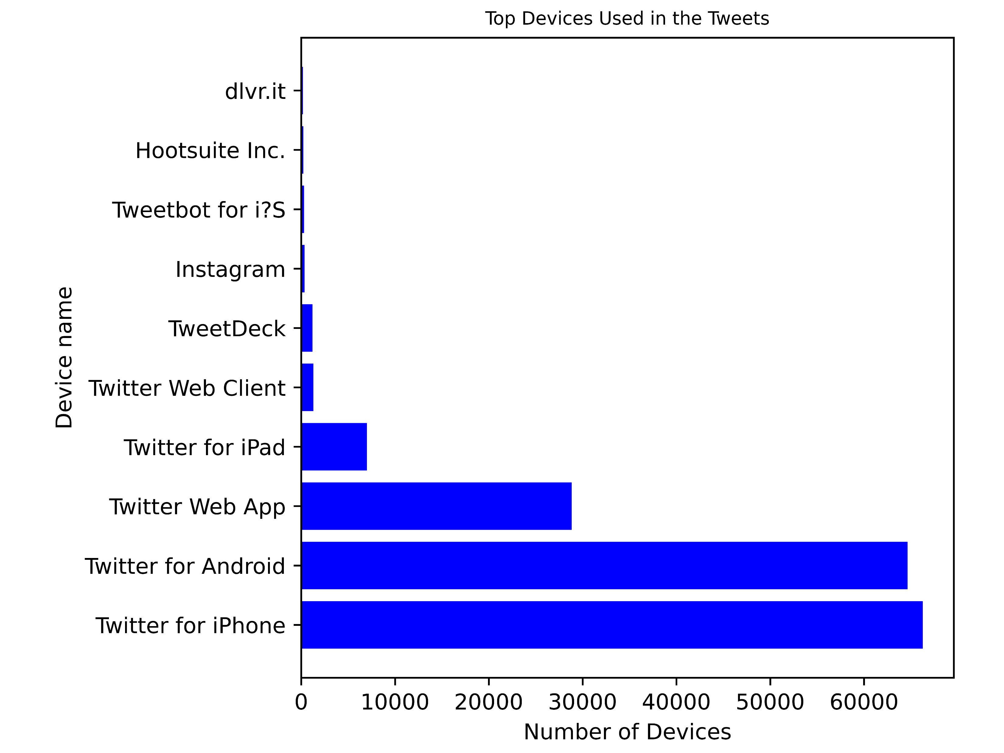

Slide 18
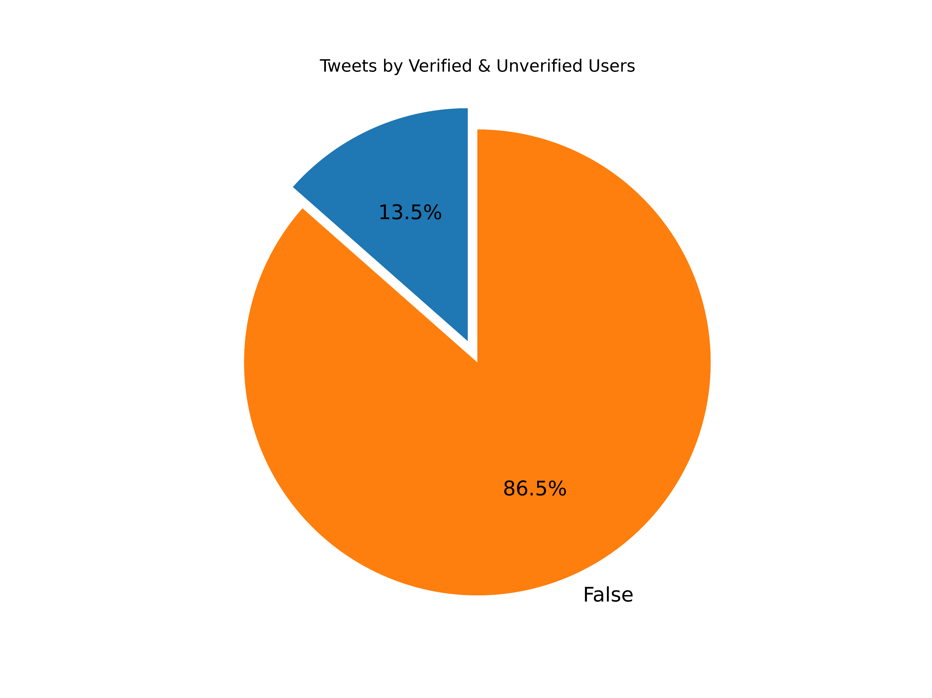

Slide 19
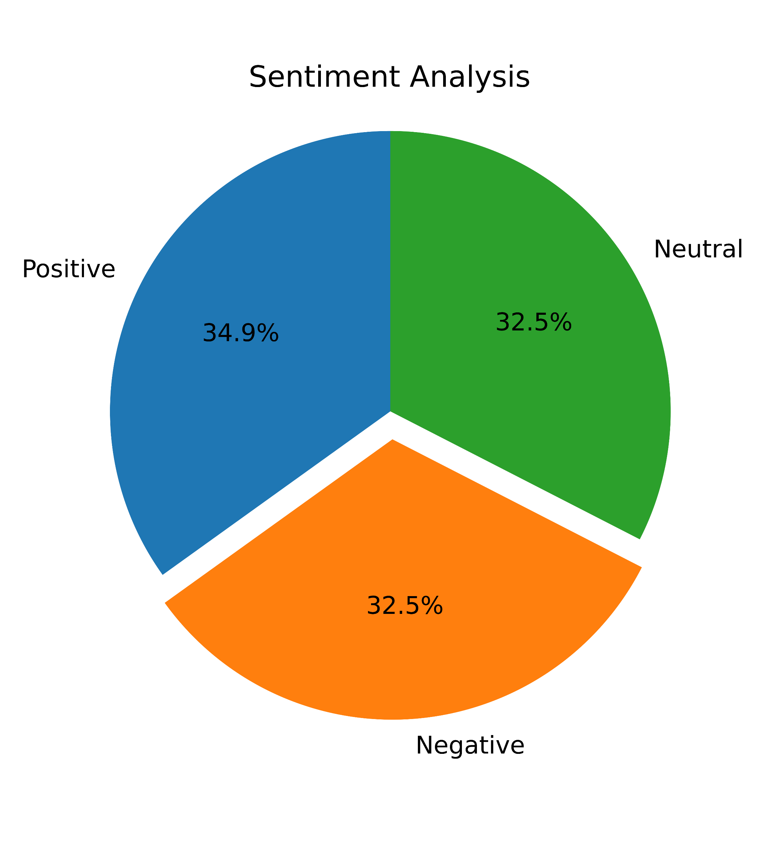

Slide 20
Data Pre-processing
The first step in generating a data set to use for the development of a model was to develop a list of political terms to determine if a tweet is political.
To develop this list, we use Map-Reduce to make a word count and order it by the count so that the most frequent words appear on top.
The first part of this program was a traditional Map-Reduce applied to each tweet's full text converted to lower-case and with special characters removed

Slide 21
Data Pre-processing
The second part of the Map Reduce sorted the word count by the count value
The data was processed to remove null values for select columns and dates were converted to timestamps to make the dates usable by Spark
Next a column identifying if the tweet is political with a 1 and not political with a 0 was generated from a list of key words after the text had been converted to lower-case and special characters were removed using a user-defined function.

Slide 22
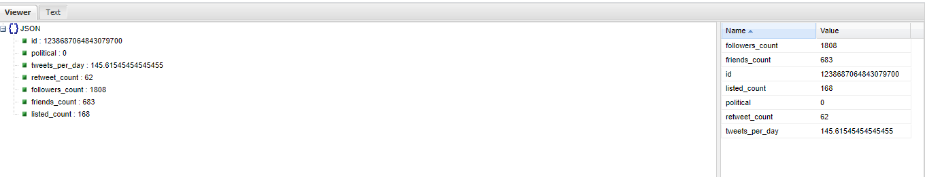
Data Pre-processing
Then the timestamps for the time the tweet was created and the time the user account was created were compared to get the time the account active and divide the amount of status updates for the account by this time to get the average tweets per day, then the selected data was output to a json file.

Slide 23
Modeling
Independent: Tweets_per_day {double}, retweet_count {int}, followers_count {int}, friends_count {int}, listed_count {int}
Dependent: Political {boolean}

