Slide 1
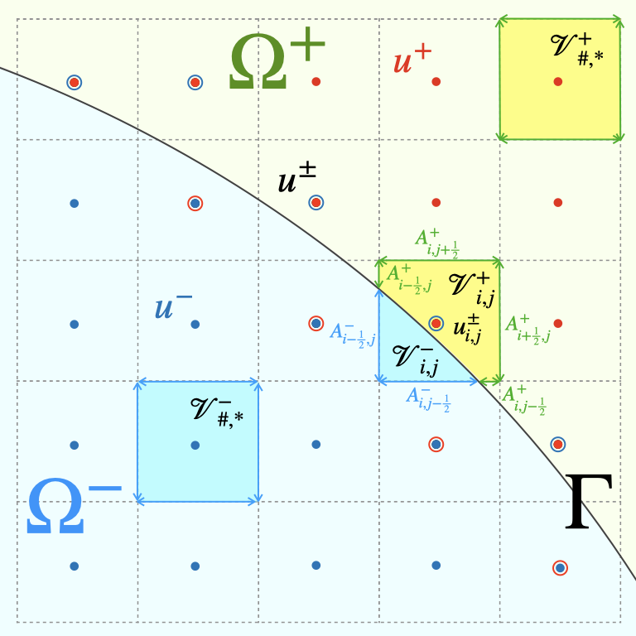
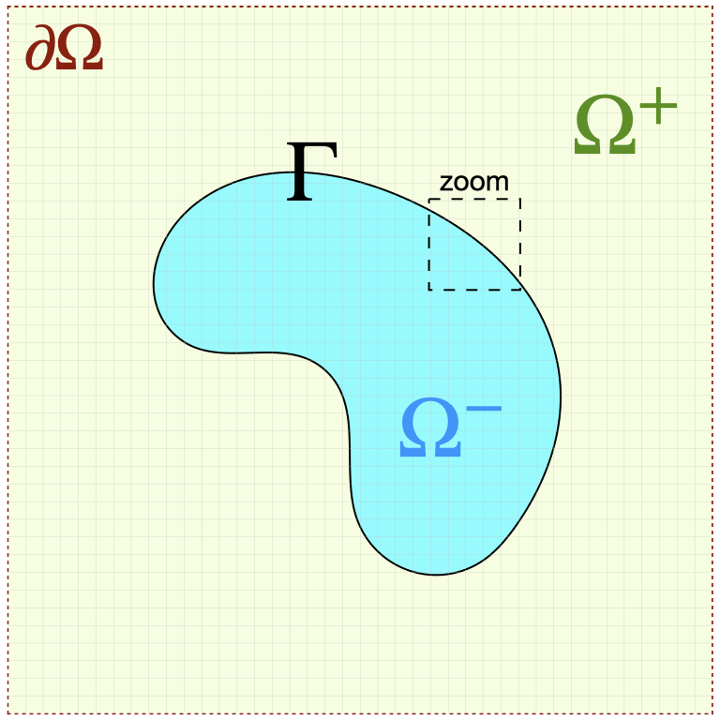
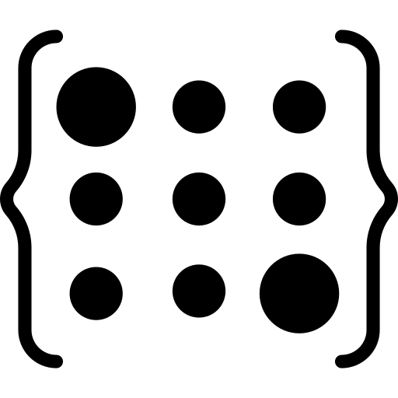

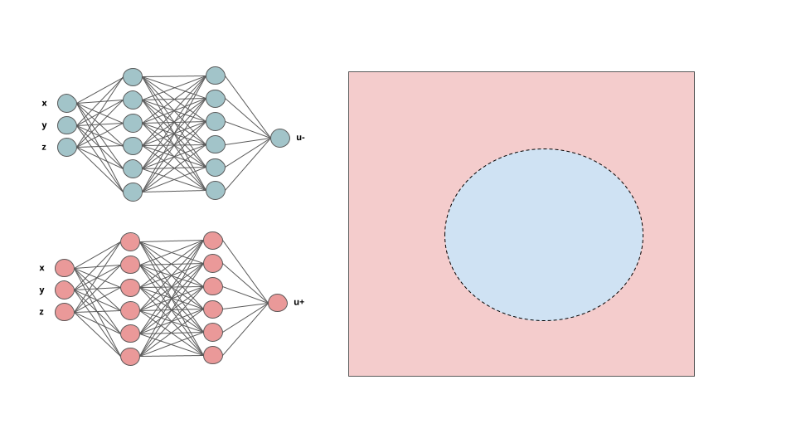
Assemble Linear System
Surrogate Neural Model
Mesh
solution evaluation
Training Loop
backpropagation

Slide 2

Assemble Linear System
Precondition?
Jump Conditions
Surrogate Model
Bulk Solution
Mesh
Training Loop

