Slide 1
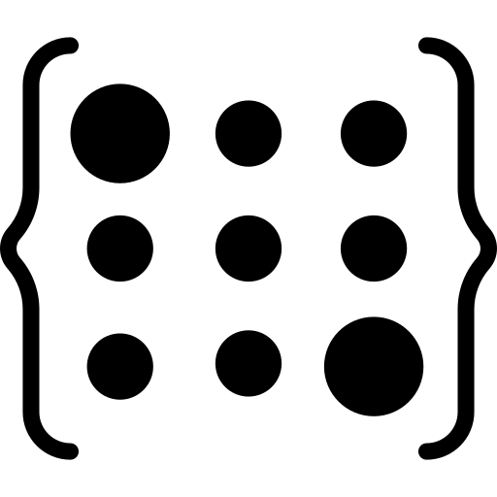

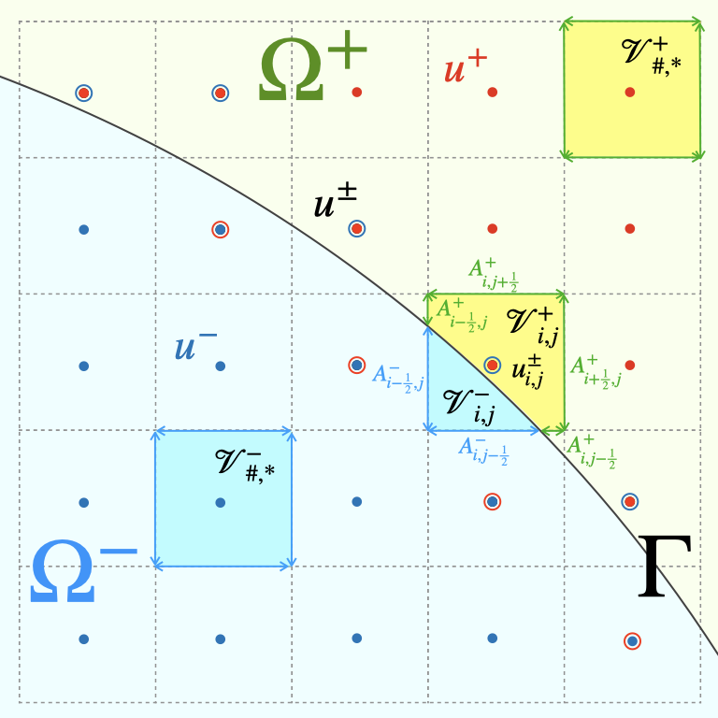
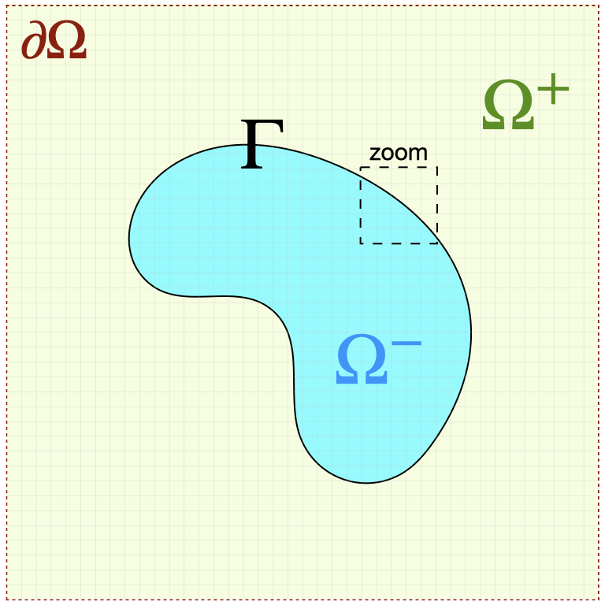
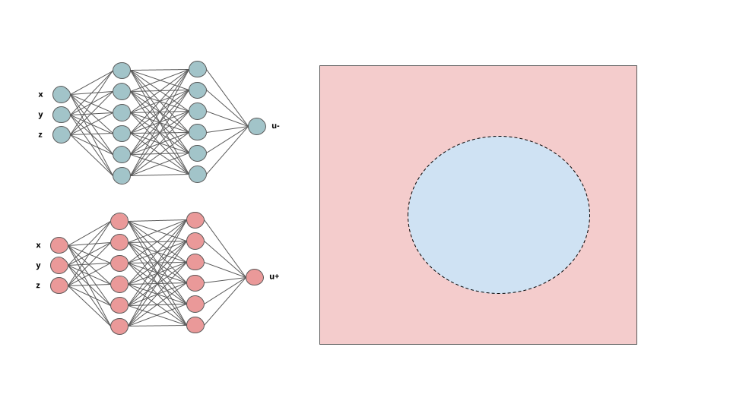
Assemble Linear System
Precondition?
Surrogate Neural Model
Bulk Solution
Mesh
Training Loop

Slide 2

Assemble Linear System
Precondition?
Jump Conditions
Surrogate Neural Model
Bulk Solution
Mesh
Training Loop

