Slide 1
Retail Product Recommendation Using GNN
LightGCN on Amazon Reviews 2023 (Video Games)
[Team member names] | [Enrollment numbers]
Guide: [Guide name] | [Institute / Department / Year]

Slide 2
Problem: what should this customer see next?
• Retail catalogues hold thousands of products; customers see a handful.
• Goal: given a customer ID (or a few liked products) return a ranked list of products they are likely to want.
• Signal: who bought what, and who buys like whom - naturally a graph.
• Output: top-K candidates, history excluded, judged on future behaviour.

Slide 3
Data: Amazon Reviews 2023 - Video Games
• Official 5-core files, already split by timestamp: train < valid < test.
• Rating >= 4 = positive implicit interaction.
• Subsample for laptop CPU: 22,269 customers, 7,811 products, 147,013 training edges.
• Users with future activity kept first, so the test set is meaningful (graph still uses train edges only).
• Metadata (title, category, price) used for display in the demo.

Slide 4
Graph: customers and products as nodes
• Bipartite graph; edge = positive review in the TRAINING period.
• A = [[0, R], [R^T, 0]] → A_hat = D^-1/2 · A · D^-1/2 (sparse).
• Density 0.0008; ~6.6 edges per customer, long-tailed item degrees.
• No validation/test edge ever enters the graph → no leakage.

Slide 5
Model: LightGCN
• Propagate: E(k+1) = A_hat · E(k) - no weights, no non-linearity.
• Final embedding = mean of layers 0..K (K = 3, dim 64).
• Score = dot(user, item).
• Loss (BPR): -log σ(s(u,i) - s(u,j)) + L2 on initial embeddings; Adam, early stopping on val NDCG@10.
• Baselines: Popularity, and MF-BPR (same loss, no graph).

Slide 6
Evaluation protocol
• Full ranking: score ALL products for each test customer.
• Mask products already seen in train/val; take the top K = 5, 10, 20.
• Precision@K, Recall@K, NDCG@K averaged over customers with test positives.
• 2,111 test customers; metrics unit-tested on hand-computed cases.

Slide 7
Results (test set)
Metric | Popularity | MF-BPR | LightGCN
NDCG@10 | 0.0113 | 0.0042 | 0.0167
RECALL@10 | 0.0224 | 0.0083 | 0.0296
PRECISION@10 | 0.0033 | 0.0014 | 0.0046
NDCG@20 | 0.0157 | 0.0060 | 0.0217
RECALL@20 | 0.0384 | 0.0146 | 0.0478
LightGCN is best on every metric: NDCG@10 is 47% above popularity. Absolute scores are low (sparse data, future period); one seed, so small gaps are indicative only.

Slide 8
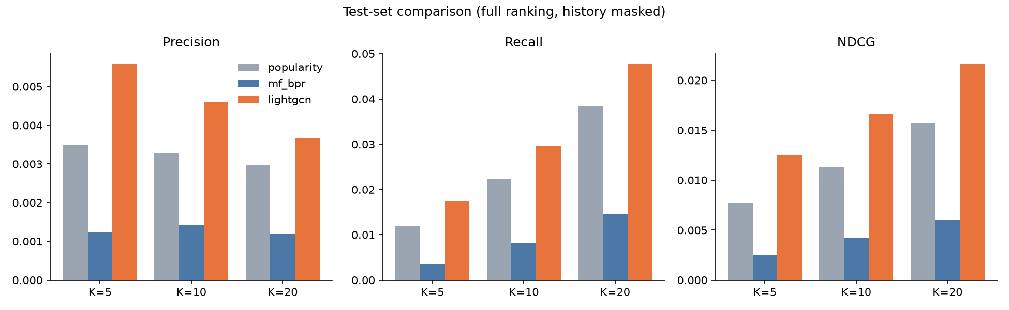
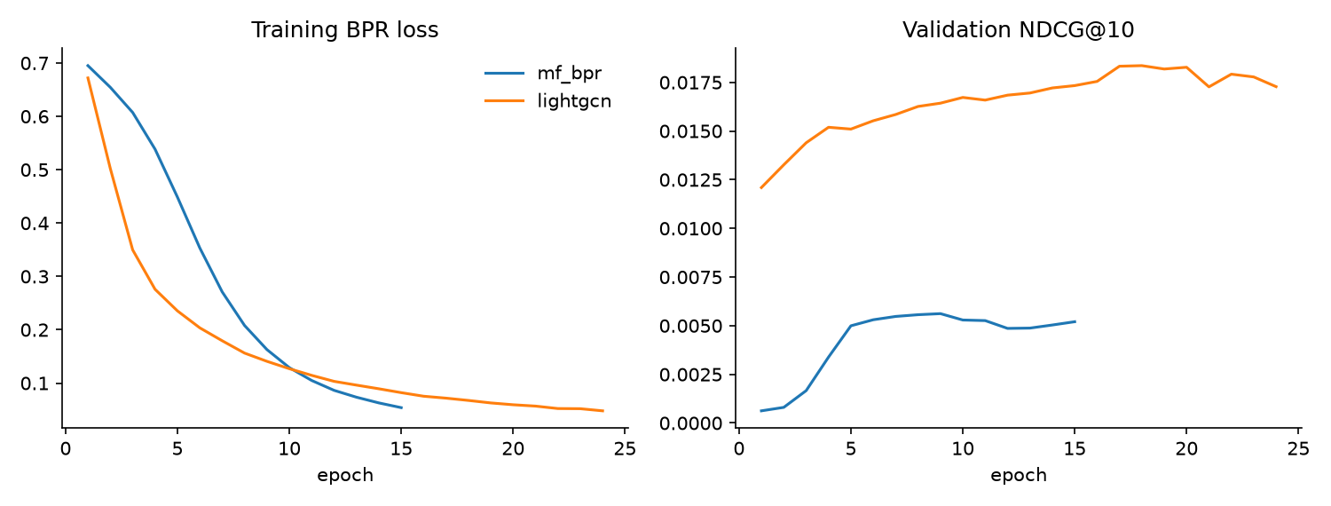
Comparison and training behaviour
MF-BPR overfits: loss falls, validation NDCG stalls - too little data per customer for a free vector.
LightGCN's neighbourhood averaging smooths sparse customers and generalises better (our interpretation; no ablation run).

Slide 9
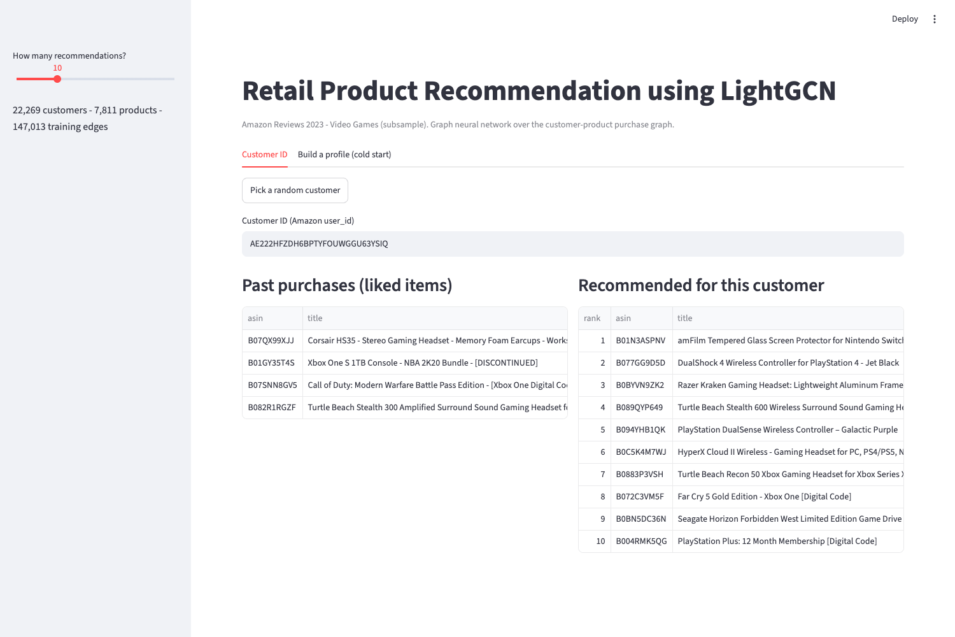
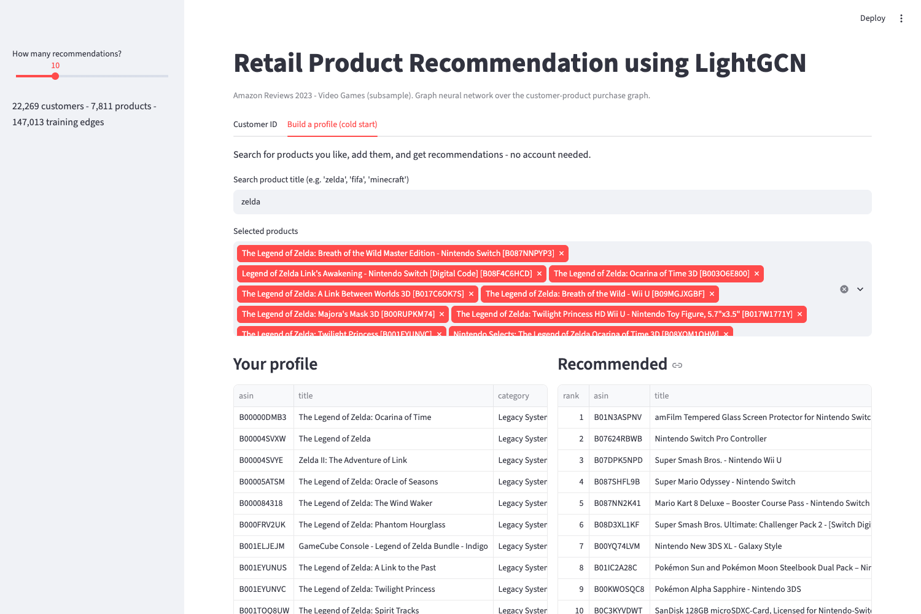
Live demo (Streamlit)
Left: customer ID → past purchases next to recommendations. Right: cold start - pick products, average their embeddings, rank the rest.

Slide 10
Limitations and future scope
• One category, subsampled; single seed, no confidence intervals.
• Only interaction edges used - no text, category or price features yet.
• Cold-start works for new customers, not for brand-new products.
• Next: side-information features, hard negatives, multi-seed evaluation, other graph models, full-data run.

Slide 11
Conclusion
• End-to-end graph recommender: data → graph → LightGCN → evaluation → app.
• Leakage-free temporal protocol with full-ranking metrics.
• LightGCN beat Popularity and MF-BPR (NDCG@10 0.0167 vs 0.0113 / 0.0042).
• Thank you - questions?

