Slide 1
N.JAYACHITRA BE CSE DATA ANALYTICS PROJECT PRESENTION 1

Slide 2
RAIN FALL WEATHER REPORT IN TAMILNADU

Slide 3
Statistical data
The collection of data that are relevant to the problem being studied is commonly the most difficult, expensive, and time-consuming part of the entire research project.
Statistical data are usually obtained by counting or measuring items.
Primary data are collected specifically for the analysis desired
Secondary data have already been compiled and are available for statistical analysis
A variable is an item of interest that can take on many different numerical values.
A constant has a fixed numerical value.

Slide 4
Types of statistics
Descriptive statistics – Methods of organizing, summarizing, and presenting data in an informative way
Inferential statistics – The methods used to determine something about a population on the basis of a sample
Population –The entire set of individuals or objects of interest or the measurements obtained from all individuals or objects of interest
Sample – A portion, or part, of the population of interest

Slide 5
Descriptive Statistics
Collect data
e.g., Survey
Present data
e.g., Tables and graphs
Summarize data
e.g., Sample mean =

Slide 6
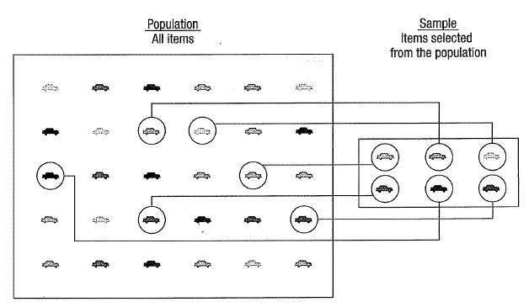
EXAMPLE

Slide 7
Charts and graphs
Frequency distributions are good ways to present the essential aspects of data collections in concise and understable terms
Pictures are always more effective in displaying large data collections

Slide 8
Histogram
Frequently used to graphically present interval and ratio data
Is often used for interval and ratio data
The adjacent bars indicate that a numerical range is being summarized by indicating the frequencies in arbitrarily chosen classes

Slide 9
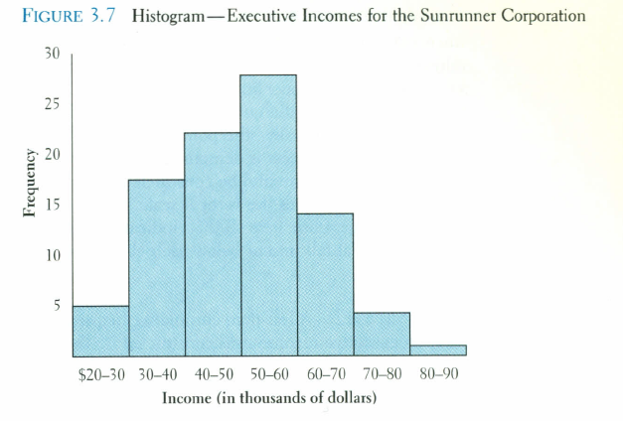
HISTOGRAM EXAMPLE

Slide 10
Pie Chart
The pie chart is an effective way of displaying the percentage breakdown of data by category.
Useful if the relative sizes of the data components are to be emphasized
Pie charts also provide an effective way of presenting ratio- or interval-scaled data after they have been organized into categories

Slide 11
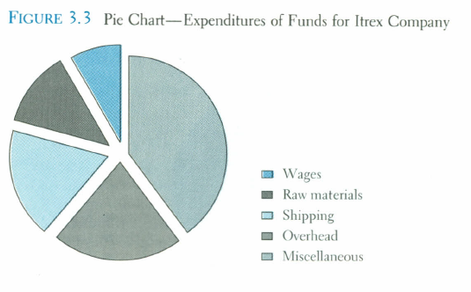
Pie Chart

Slide 12
Bar chart
Another common method for graphically presenting nominal and ordinal scaled data
One bar is used to represent the frequency for each category
The bars are usually positioned vertically with their bases located on the horizontal axis of the graph
The bars are separated, and this is why such a graph is frequently used for nominal and ordinal data – the separation emphasize the plotting of frequencies for distinct categories

Slide 13
THANK YOU

