Slide 1
DATA ANALYTICS MEGA INTERNSHIP
PHASE-1

Slide 2
PROCUREMENT DASHBOARD
DONE BY
GOPIKRISHNA S
JAYAKUMAR S
ARUN

Slide 3
OBJECTIVE
This project aims to create an interactive Excel dashboard for seamless collaboration and performance evolution.
Designing an user friendly procurement dashboard to optimise procurement process and real time resource tracking .

Slide 4
APPROACH
Identifying data source
Data collection and cleaning
Design the dashboard
Creating Visualizations
Dashboard Interactivity
Testing and accessibility

Slide 5
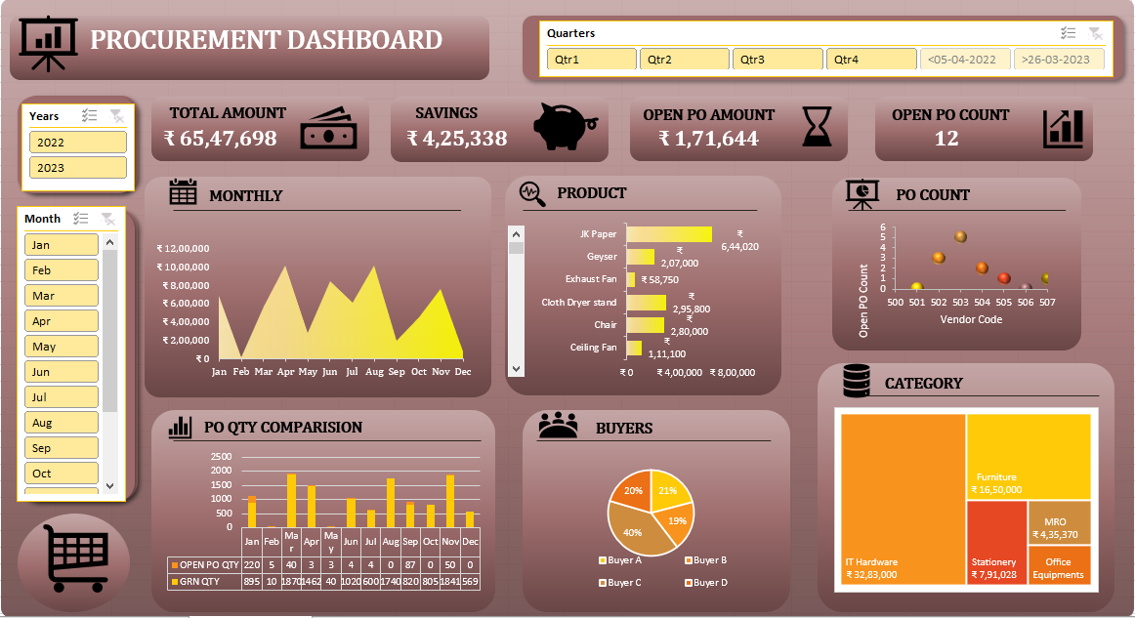
DASHBOARD VISUALS

Slide 6
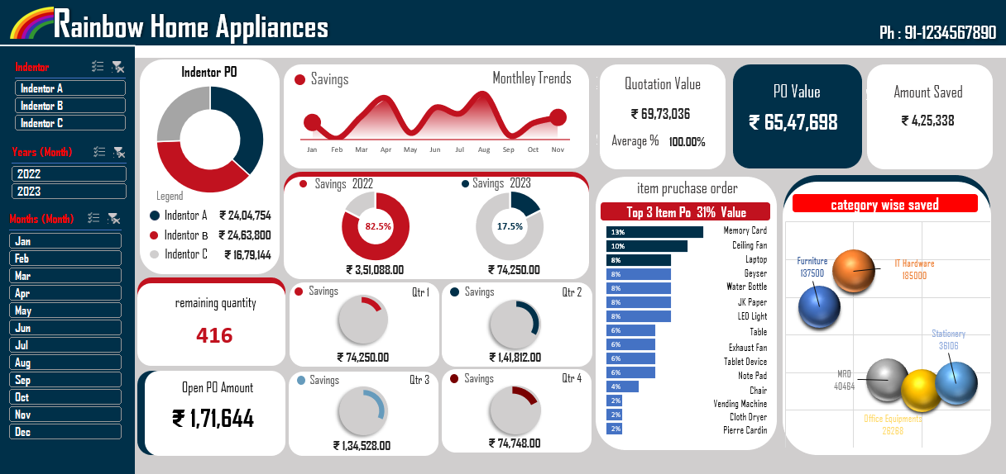
DASHBOARD VISUALS

Slide 7
INSIGHTS
From the created dashboards we can get insights about the cost saving efficiency and vendor performances etc.
This Dashboard allows us to compare data insights across different time periods, products and other relevant dimensions.
Hence this dashboards provides a clear picture about the current situation and making it easier to make decisions quickly.

Slide 8
CONCLUSION
Dashboards are powerful tool for data analysis and decision making in various domains.
This visual approach enhances understanding and helps in decision making.
Dataset link: Raw Data

