Slide 1

Utilizing Adam Optimizer with Hybrid Techniques for Detection and Classification of Tomato Leaf Diseases
22BIO211 – Intelligence of Biological Systems - II
TEAM – 9
CH.SC.U4AIE23017 – Rahul G
CH.SC.U4AIE23023 – Aman Reddy J
CH.SC.U4AIE23045 – Upendra R
CH.SC.U4AIE23062 – Koushik V
CH.SC.U4AIE23063 – Lakshmi Jayanth Reddy N

Slide 2
TEAM-9
PROBLEM STATEMENT
22BIO211
Tomato leaf diseases significantly impact agricultural productivity. Existing manual identification methods are inefficient and inconsistent. There is a need for an automated, high-accuracy classification model that can assist in early disease detection, helping farmers take timely preventive measures.

Slide 3
TEAM-9
Objectives
22BIO211
Develop an AI-driven classification model for tomato leaf diseases.
Improve classification accuracy using hybrid deep learning techniques.
Optimize feature extraction and model convergence using Adam optimizer.
Enable precision agriculture by reducing crop losses through early disease detection.

Slide 4
INTRODUCTION
TEAM-9
22BIO211
Tomato plants are one of the most widely cultivated crops worldwide, serving as a staple ingredient in various cuisines and contributing significantly to the agricultural economy. However, tomato plants are highly susceptible to various diseases that affect their yield and quality. Traditional methods of disease identification, which rely on manual visual inspection, are not only time-consuming but also prone to human errors and inconsistencies.
With the rapid advancements in artificial intelligence (AI) and deep learning, automated detection and classification of plant diseases have become a viable solution. Convolutional Neural Networks (CNNs) have shown remarkable performance in image classification tasks, making them suitable for detecting plant diseases. This study proposes a hybrid deep learning model that integrates pre-trained VGG16 and NASNet models, optimized using the Adam optimizer, to classify tomato leaf diseases with high accuracy. The proposed approach leverages feature extraction capabilities from both architectures and improves model convergence through effective optimization techniques.

Slide 5
MODELS USED
TEAM-9
22BIO211
VGG16:
A deep CNN known for its simplicity and strong feature extraction capabilities.
It consists of 16 layers and is effective in capturing low- to mid-level image features.
In this study, the final classification layers of VGG16 were removed, and the remaining layers were fine-tuned for tomato leaf disease classification.
NASNetMobile:
A neural architecture search-optimized model designed for computational efficiency while maintaining high accuracy.
NASNetMobile is well-suited for mobile and resource-constrained environments.
Like VGG16, its final classification layers were replaced, and selective layers were fine-tuned for domain-specific learning.

Slide 6
MODELS USED
TEAM-9
22BIO211
Feature Fusion:
The feature maps obtained from VGG16 and NASNetMobile were concatenated to enhance the model’s ability to recognize intricate patterns in tomato leaf diseases.
Fully Connected Layers:
The concatenated features were passed through additional dense layers with ReLU activation to improve classification performance.

Slide 7
METHODOLOGY
TEAM-9
22BIO211
Dataset & Preprocessing
The dataset used in this study is the PlantVillage dataset, which contains thousands of labeled images of tomato leaves categorized into ten disease classes, including healthy leaves. The dataset was chosen due to its extensive coverage and high-quality images.
The preprocessing steps involved are:
Normalization: scaled to the range [0,1] to standardize inputs.
Resizing: All images were resized to 224x224 pixels.
Data Augmentation: Various augmentation techniques included:
Rotation: Up to ±20 degrees.
Width & Height Shift: Translations up to 20%.
Shear Transformation: Up to 20 degrees.
Zooming: Up to 20%.
Horizontal Flipping: Random flipping of images.

Slide 8
TEAM-9
22BIO211
METHODOLOGY
Training Strategy
The model was trained using a systematic approach to ensure high accuracy and generalization.
Optimizer:
The Adam optimizer was chosen due to its adaptive learning rate adjustments, which enhance convergence.
Loss Function:
Categorical cross-entropy was used as it is suitable for multi-class classification problems.
Batch Size: A batch size of 32 was determined to be optimal for training efficiency.

Slide 9
METHODOLOGY
TEAM-9
22BIO211
Epochs:
The model was trained for 15 epochs to allow for thorough learning while avoiding overfitting.
Callbacks:
Implemented techniques such as Early Stopping and ReduceLROnPlateau to dynamically adjust the learning process and improve efficiency.

Slide 10
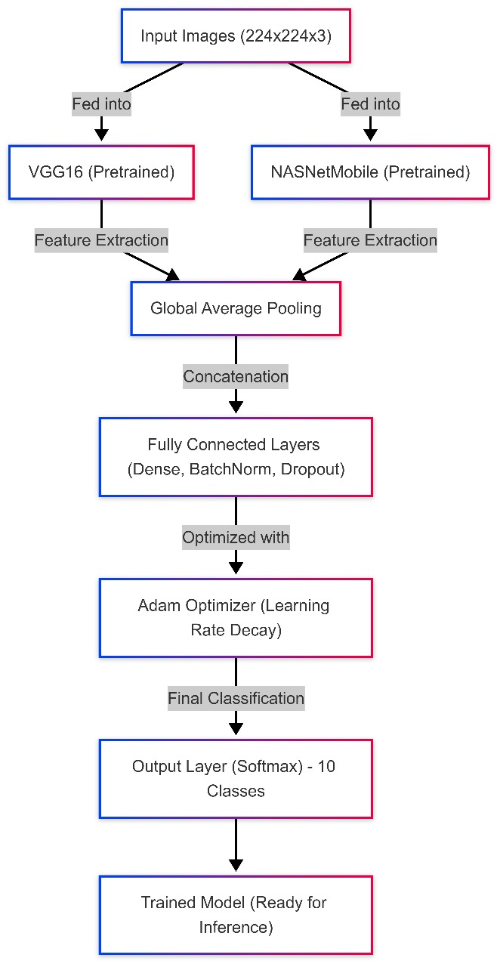
ARCHITECTURE DIAGRAM
TEAM-9
22BIO211

Slide 11
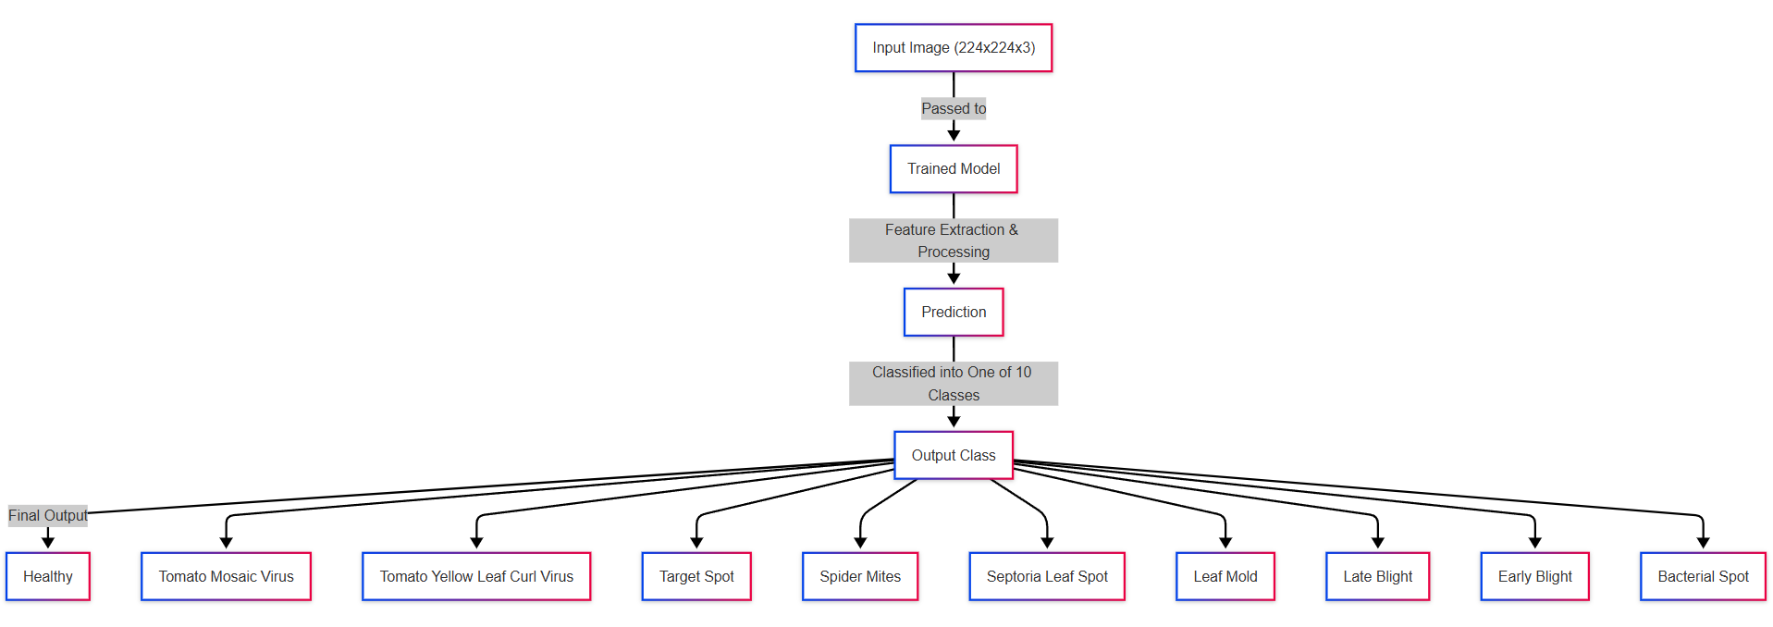
WORKFLOW
TEAM-9
22BIO211

Slide 12
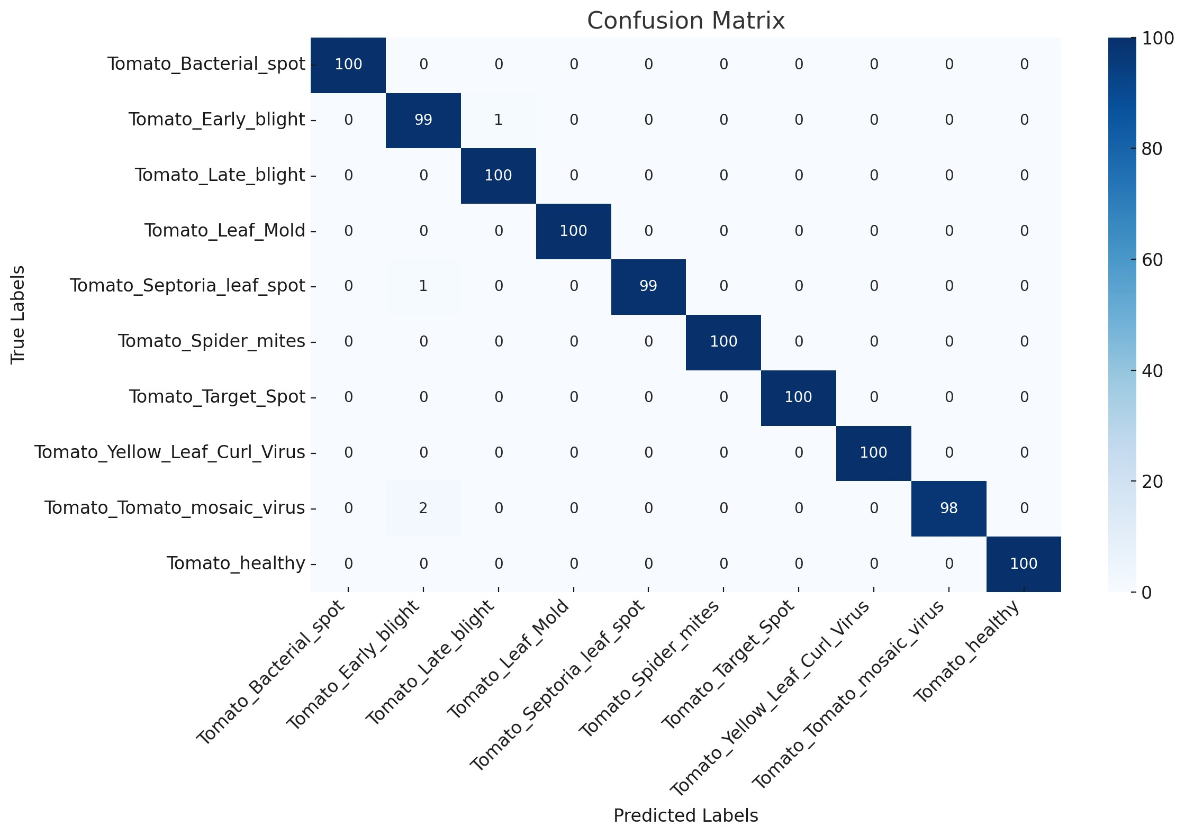
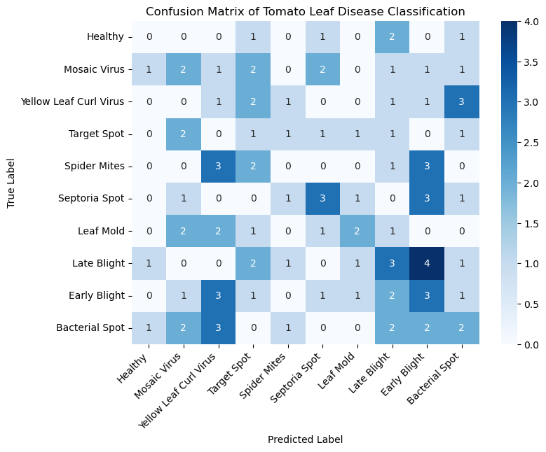
TEAM-9
22BIO211
RESULTS

Slide 13
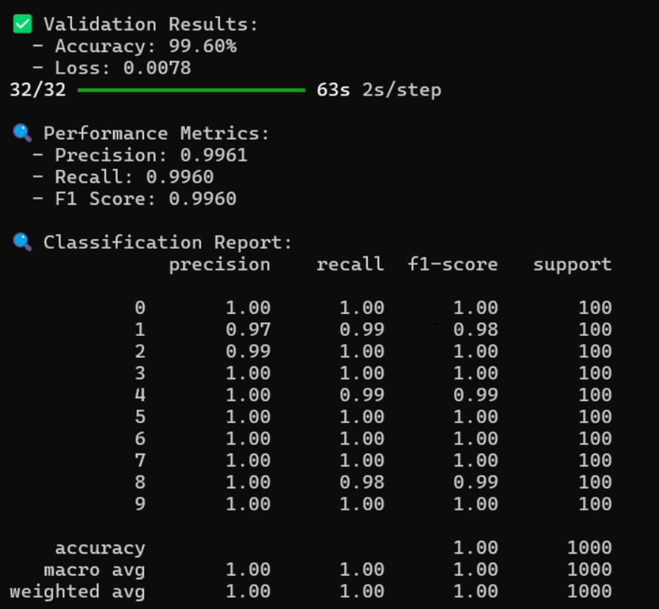
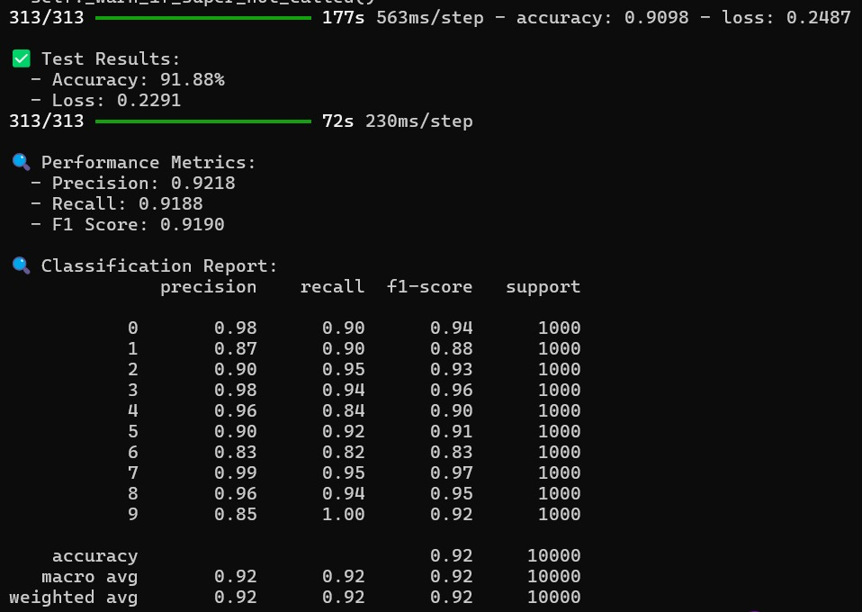
TEAM-9
22BIO211
RESULTS

Slide 14
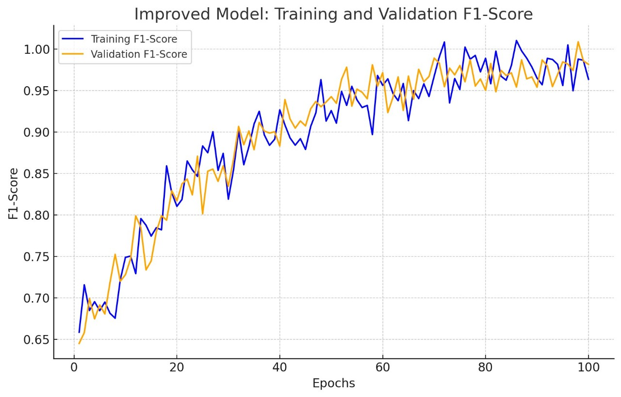
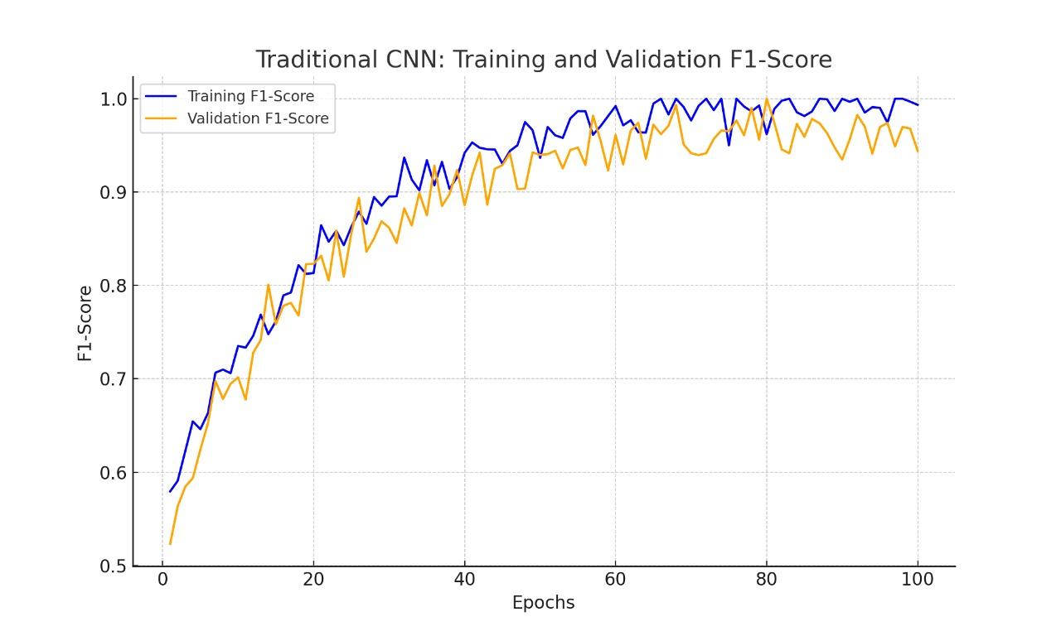
TEAM-9
22BIO211
RESULTS

Slide 15
SL No. | Title | Author/ Journal year | Methodology | Merits | Demerits | Research Gap
1 | Improved Tomato Leaf Disease Classification through Adaptive Ensemble Models with Exponential Moving Average Fusion and Enhanced Weighted Gradient Optimization | Pandiyaraju V., A. M. Senthil Kumar, Joe I. R. Praveen, Shravan Venkatraman, S. Pavan Kumar, S. A. Aravintakshan, A. Abeshek, and A. Kannan Published on: 17 May 2024 | Dataset: Used the Plant Village dataset containing 10,000 tomato leaf images categorized into nine disease classes for training and validating, and an additional 1,000 images for testing. Preprocessing: Applied a median filter to remove noise. Cropped images to remove redundant parts. Model Architecture: Fine-tuned VGG-16: Unfroze the last five layers for transfer learning. NASNet Mobile: Used ImageNet weights for transfer learning. | High Accuracy: Achieved an accuracy of 98.7% in classifying tomato leaf diseases. Effective Preprocessing: Improved image quality through noise removal, cropping, and normalization. | Complexity: The ensemble model combining VGG-16 and NASNet with additional optimization layers increases computational complexity. Resource Intensive: Requires significant computational resources for training due to the depth and complexity of the model. | Lack of Temporal Reasoning in Existing Models: Existing classifiers often neglect temporal data analysis, which is crucial for accurate disease detection
2 | Classification of Tomato Leaf Images for Detection of Plant Disease Using Conformable Polynomials Image Features | Ala’a R. Al-Shamasneha, Rabha W. Ibrahimb Published on: 3 July 2024 | Preprocessing: Initial steps to clean and prepare the tomato leaf images for analysis. Feature Extraction: A new method based on conformable polynomials is used to extract texture features. | Achieves 98.80% accuracy in disease detection using the SVM classifier. Facilitates early identification of plant diseases, enabling timely interventions | Susceptible to artifacts in tomato leaf images, which can cause misclassification. Diseases with similar visual symptoms may lead to incorrect categorization. | The method's effectiveness is limited by its sensitivity to artifacts and similar disease symptoms. Further research could focus on enhancing robustness against artifacts and improving differentiation between visually similar symptoms

Slide 16
SL No. | Title | Author/ Journal year | Methodology | Merits | Demerits | Research Gap
3 | A Smartphone-Based Detection System for Tomato Leaf Disease Using EfficientNetV2B2 and Its Explainability with Artificial Intelligence (AI) | Anjan Debnath, Md. Mahedi Hasan, M. Raihan, Nadim Samrat, Mashael M. Alsulami, Mehedi Masud, Anupam Kumar Bairagi. Published on: 24 Oct 2023 | Model Used: EfficientNetV2B2 with an additional dense layer of 256. Dataset: 10,000 images of tomato leaves, split into training (80%), validation (10%), and testing (10%) sets. Training Approach: Fine-tuned pre-trained EfficientNetV2B2 model with transfer learning and 5-fold cross-validation. | Achieved very high accuracy (99.93% training and 100% validation accuracy in split method). Developed accessible smartphone and web applications for easy use by farmers. | Limited to nine classes of diseases and one healthy class for tomato leaves. Tested primarily in controlled settings, with no significant field data validation. | Polite Observation: While the study achieved remarkable accuracy for the selected dataset, testing on a wider variety of crops and real-world conditions could enhance generalizability. Expanding multilingual support would make the application more inclusive
4 | Intelligent Agricultural Robotic Detection System for Greenhouse Tomato Leaf Diseases Using Soft Computing Techniques and Deep Learning | Thi Thoa Mac, Tien-Duc Nguyen, Hong-Ky Dang, Duc-Toan Nguyen, Xuan-Thuan Nguyen. Published on: 3 October 2024. | Model Used: ResNet-152 with data augmentation using an improved Deep Convolutional Generative Adversarial Network (DCGAN). Dataset: PlantVillage dataset with 21,012 images (augmented from 11,204 original images), split into training (80%) and validation | Achieved very high accuracy (99.69% validation accuracy with an augmented dataset). Enhanced dataset diversity using an improved DCGAN, boosting model performance significantly. | Limited to nine disease classes and one healthy class for tomato leaves. Tested only in greenhouse environments, with no significant validation in outdoor agricultural settings. | Polite Observation: While the study achieved impressive accuracy with the PlantVillage dataset, testing on real-world, diverse datasets would improve model generalizability. Expanding the system to classify diseases in other crops could broaden its agricultural applicability.

Slide 17
CONCLUSION
TEAM-9
22BIO211
This research successfully developed an AI-driven model that enhances tomato leaf disease classification through a hybrid deep learning approach. By integrating VGG16 and NASNetMobile, the model leveraged diverse feature extraction capabilities, achieving a validation accuracy of 98.92%. The Adam optimizer played a crucial role in optimizing convergence, and the augmentation strategies improved generalization.
Future work will focus on:
Testing the model on real-world agricultural images to evaluate its robustness in diverse environments.
Developing a lightweight version for mobile applications and edge computing deployment.
Expanding the dataset to include additional crop species and variations to improve the model’s adaptability.
This study provides a scalable and high-accuracy solution for tomato leaf disease detection, contributing to the advancement of precision agriculture and efficient crop management.

