Slide 1










How to Get Job in

Slide 2

Hello!
I am Tech Siddhar

Slide 3

Want big impact?
Dream big

Slide 4
Trending Jobs
AI architect
Business intelligence analyst
Cloud architect
Data (analyst, scientist, engineer)
Developer (web, software, mobile)
DevOps engineers
Network security (architect, engineer, administrator

Slide 5



Choose your
professional career
Let’s start with the fresh mind

Slide 6






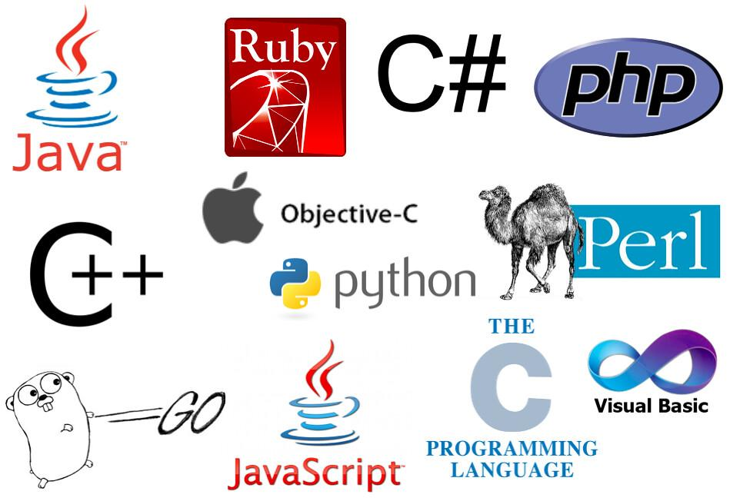


Build Up
Coding Skill

Slide 7
Resume Building
Uniqueness
1
Be a inspiration
2
Show your Talent
3

Slide 8




Open source Contribution
Public Project
Write a article
Youtube videos

Slide 9




Community

Slide 10



Social Profile

Slide 11

Algorithm
Data structure
System design

Slide 12


Slide 13

Thanks!
techsiddhar@gmail.com

