Slide 1
MINI Project -Team g4
PREPARED BY
JAYASHREE.M
VENMATHEE.B.T
PRIYANKA.V
DURGA VISHALINI.M
RITHIHA.S.K

Slide 2
Topic : ONLINE QUIZ system
CONTENT
DEFINITION
PROCEDURE
FIRST PAGE OF OUTPUT
STEPS TO FOLLOW
LAST PAGE OF OUTPUT
CONCLUSION
THE END

Slide 3
Online Quiz system
ONLINE QUIZ SYSTEM is a web-based examination system , where quiz is taken in online . The purpose of online quiz system is to take exams and tests in an efficient manner and no time wasting for checking the paper.
Nowadays, Most of the students are attending lot of quizzes with Multiple Choice Question(MCQ) through online .After a few minutes they got the result also.
In this project we are going to see How we can conduct online quiz using java program and java applet with Multiple Choice Question (MCQ).

Slide 4
Procedure
In this project, there are given 10 questions to play. User can bookmark any question for the reconsideration while going to result.
We are using here java array to store the questions, options and answers . You can use collection framework or database in place of array.
Using java applet, the given 10 MCQ will be played. There are four choice for each multiple choice question.
If the user click next button once , then the user cannot modify the respective question again .
If the user click the result button , which will come at the 10th question then the exact marks or score will appear on the screen.
In the result dialog box number of correct answer will appear eg . Correct ans=10.

Slide 5
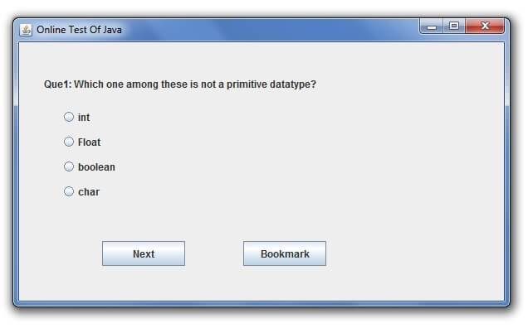
First Page of output
This will be the first dialog box appeared on java applet screen . The title of this dialog box is Online Test Of Java and the respective question will appeared.
The question has four options with corresponding radio buttons. Next and bookmark button can be when needed.
This will be continued till the final question and then the result dialog box will appear on the same screen.

Slide 6
STEPS TO FOLLOW
For the Second question the same dialog box will be there . The only difference is the respective question and the option will be changed .
The above step will be continued till the final question that is till 10th question.
Remember that once you click the next button , then we cannot modify or change anything for the corresponding question.
If you have any doubts in that question , you can add it as bookmark .
So that you can review or modify the respective question again.
In Tenth question the next button will not be enabled and bookmark button will not appear on the dialog box screen.
Instead of that , Result button will appear.

Slide 7
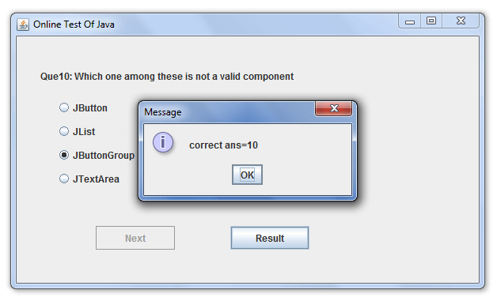
Last page of output
This will be the final dialog box of the java applet screen. After the final question ie. 10th question , Result dialog box appear .In that, Message is the title of this dialog box .
After that, OK button can be clicked . Hence , this is the final output of the java applet screen and also the java program.

Slide 8
CoNClusion
From the given procedure we can easily create our own quiz using java program.
In this project we used java applet for the online quiz system.
Due to online quiz system, students can save their wonderful time and also plenty of papers , etc.,
It is easy to execute the java code and compile the program.
You can modify the quiz using alternative coding

Slide 9
Thank you

