Slide 1
MINI Project -Team g4
PREPARED BY
JAYASHREE.M
VENMATHEE.B.T
PRIYANKA.V
DURGA VISHALINI.M
RITHIHA.S.K

Slide 2
Topic : banking system
LIST OF MODULES
WELCOME MODULE
LOGIN PAGE MODULE
CREATING ACCOUNT MODULE
ACCOUNT CREATED MODULE
TRANSACTION MODULE
TRANSACTION SUCCESSFUL MODULE
TRANSCATION INSUFFICENT MODULE
THE END SCREEN MODULE

Slide 3
Banking system
Banking is defined as the business activity of accepting and safeguarding money owned by other individuals and entities, and then lending out this money in order to conduct economic activities such as making profit or simply covering operating expenses.
A banking system is a group or network of institutions that provide financial services for us. These institutions are responsible for operating a payment system, providing loans, taking deposits, and helping with investments.
From this project you can easily create an account ,initial amount , deposit and withdrawal. You can also find the current balance in the bank.

Slide 4
Procedure
First of all the dialog box will be created with the title ” bank account tester” on the java applet screen.
Next the two radio buttons are created with the naming of create account and test account that will appear on first page of output and second page of output respectively.
Then four different label will be created with the name of account number, initial balance, deposit amount, withdraw amount.
Once you entered your account number and initial balance, then click create account button. It will be keep the data till the end of the output.
After you enter the amount of deposit and amount of withdrawal, the current balance will changed by adding the deposited amount and then reducing the withdrawal amount .

Slide 5
STEPS TO FOLLOW
First step is to enter your account number in the account number field, It will store the data as account in the further page.
Next. enter the amount that you have initially in the bank, then it will rename as current balance in the next page. Then click the create account radio button, it will store the above given data and also create your own account.
Now, the new page will appear with two fields called deposit amount and withdraw amount.
Enter your amount of deposit and also the amount of withdraw in the respective fields and labels.
Then click ‘test account’ radio button, after that you can see the below message “transaction successful” at the same time your current balance also changed respectively
NOTE: Only enter integer value for all the input.

Slide 6
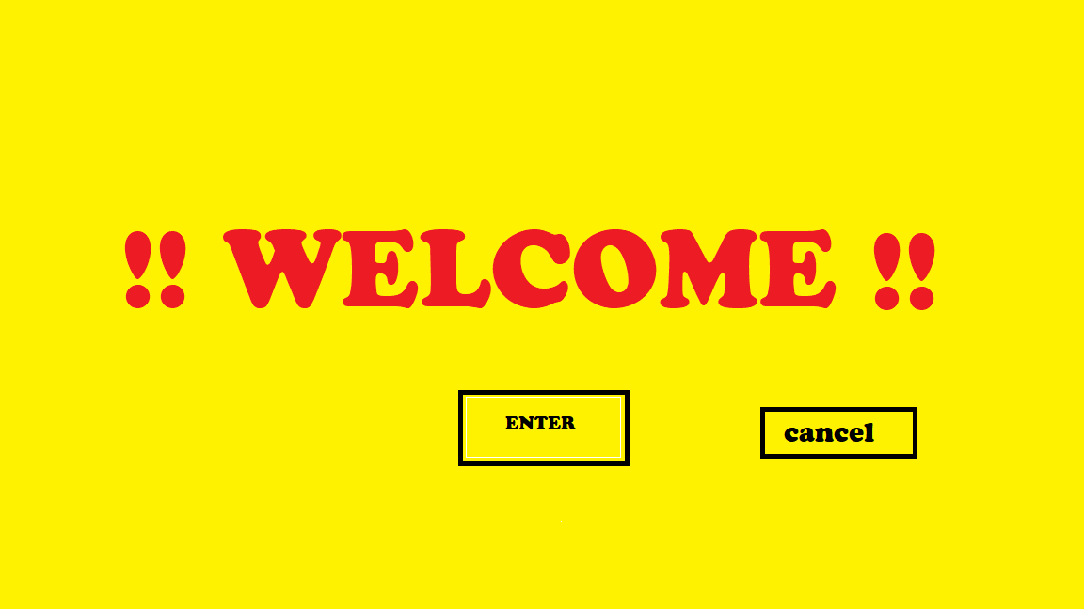
WELCOME MODULE
This is our welcome page. Here there is a enter button on the applet screen, which will show our bank account while clicking this enter button. If Cancel button is clicked, then the applet screen will close and the program will end.
So , This is our first page of output of our bank account tester.

Slide 7
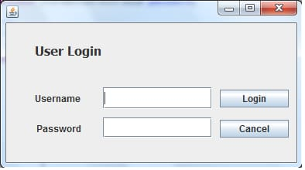
Login page module
This is the login page of our bank account in the username column you have to enter the name as per in the bank and then you have to enter the accurate password given for the bank account.
Then click login button if you go further to create your account etc.,
Otherwise clicking cancel button then the project will get end.

Slide 8
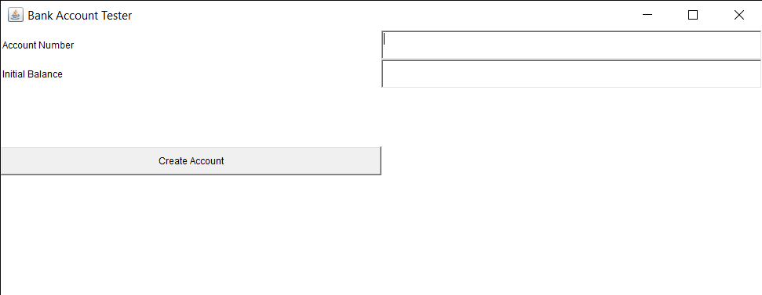
CREATING ACCOUNT MODULE
This will be the dialog box appeared on java applet screen . The title of this dialog box is Bank Account Tester and the field will be appeared.
The first field is Account Number, In that field enter your appropriate account number.
Next field is Initial Balance, In that enter the amount that Initially in balance in the bank.
After that click create account then your account will be created.

Slide 9
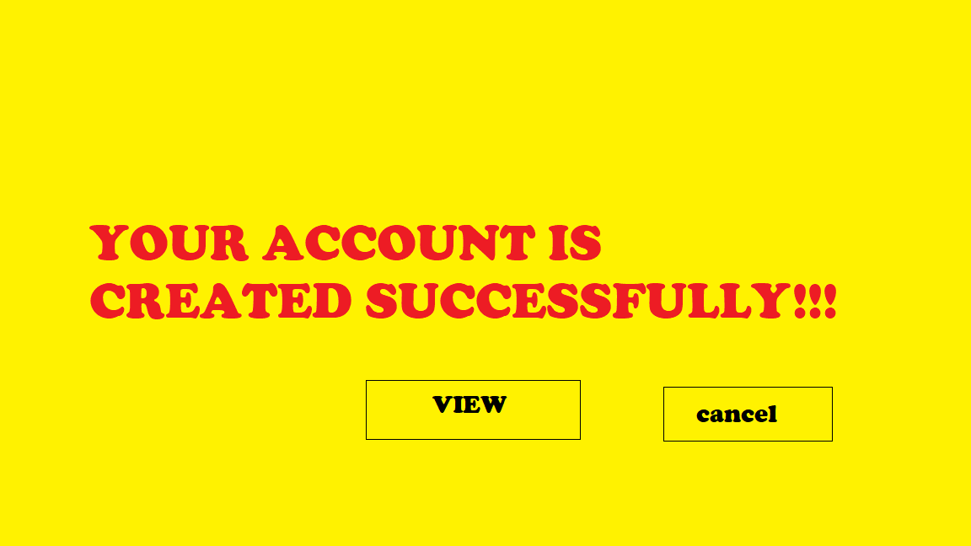
ACCOUNT CREATED MODULE
After you create your account created this page will appear on the screen.
Click the view button to see the current balance of your account, account number and transactions. If you want to quit it , click the cancel button then your project will closed.

Slide 10
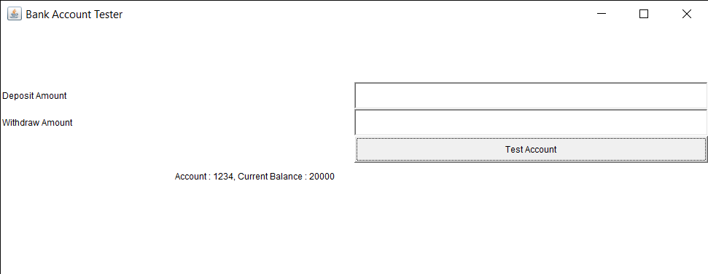
TRANSACTION MODULE
This will be the dialog box of the java applet screen. Here you can enter the amount you want to deposit in the bank.
After that, You can enter the amount you want to withdraw from the bank .
After entering both click the Test Account button. Then your current balance will be changed based upon your input.

Slide 11
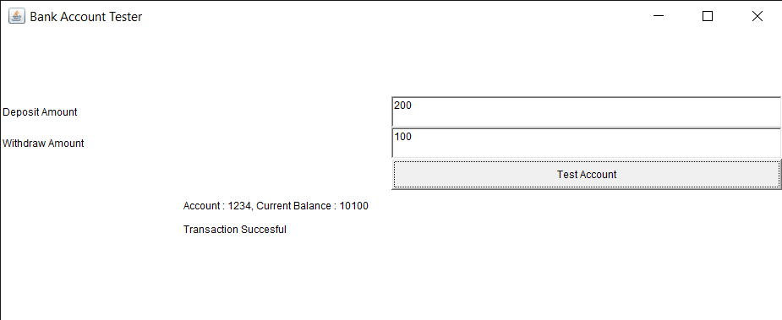
Transaction successful module
This message will appear on your screen after the entered transaction is successful
At the same time your current balance also modified respectively.

Slide 12
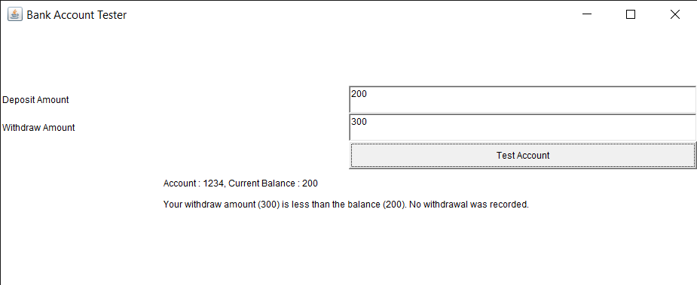
Transaction insufficient module
This message will appear on your screen when the withdrawal amount is more than your current balance.
Then there will not occur any withdrawal.

Slide 13
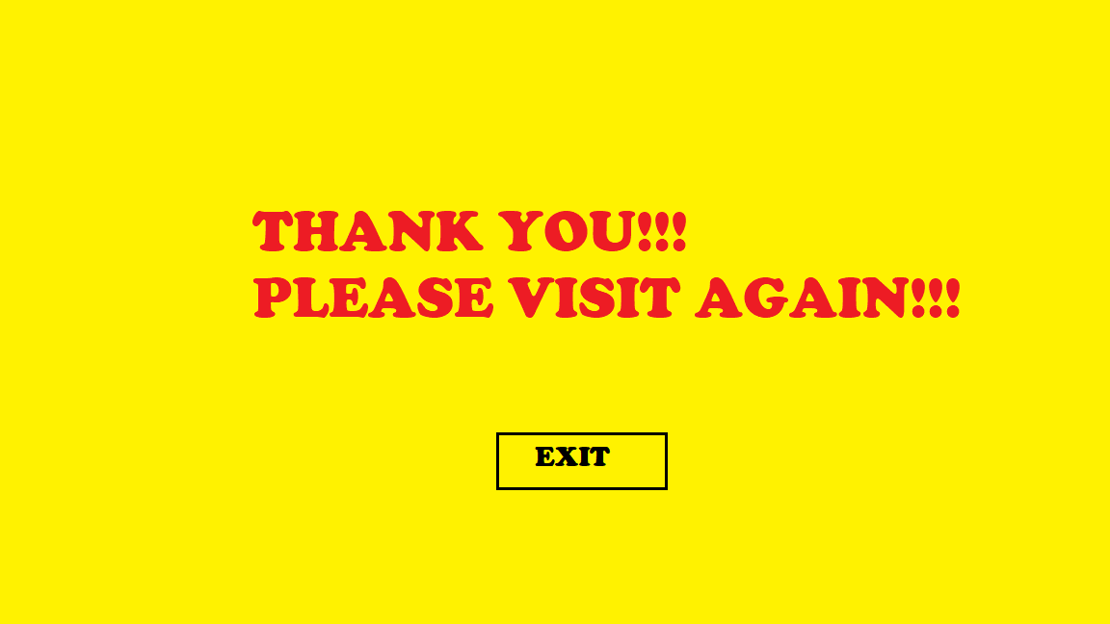
THE END SCREEN
This is our end screen . In this click exit button to quit the java applet screen and our project too. After this our project is finished.

Slide 14
CoNClusion
From the given procedure we can easily create our bank account tester using java program with GUI.
In this project we used java applet for the banking system.
Due to Banking system, you can easily deposit or withdraw your money .
By this method , you can save your wonderful time and you can check the current balance easily whenever it needed etc.,
It is easy to execute the java code and compile the banking system program.
You can also find the accurate transaction of amount in your bank account easily.

Slide 15
Thank you

