Slide 1
MINI Project -Team g4
PREPARED BY
JAYASHREE.M
VENMATHEE.B.T
PRIYANKA.V
DURGA VISHALINI.M
RITHIHA.S.K

Slide 2
Topic : Banking System
LIST OF MODULES
LOGIN MODULE
REGISTRATION MODULE
MENU MODULE
OPEN ACCOUNT MODULE
DEPOSIT MODULE
WITHDRAW MODULE
TRANSFER MODULE
ACCOUNT INFO MODULE
CLOSE ACCOUNT MODULE
EXIT ATM MODULE

Slide 3
Banking system
Banking is defined as the business activity of accepting and safeguarding money owned by other individuals and entities, and then lending out this money in order to conduct economic activities such as making profit or simply covering operating expenses.
A banking system is a group or network of institutions that provide financial services for us. These institutions are responsible for operating a payment system, providing loans, taking deposits, and helping with investments.
From this project you can easily create an account ,initial amount , deposit and withdrawal. You can also find the current balance in the bank.

Slide 4
Procedure
First of all the dialog box will be created with the title ” bank account tester” on the java applet screen.
Next the two radio buttons are created with the naming of create account and test account that will appear on first page of output and second page of output respectively.
Then four different label will be created with the name of account number, initial balance, deposit amount, withdraw amount.
Once you entered your account number and initial balance, then click create account button. It will be keep the data till the end of the output.
After you enter the amount of deposit and amount of withdrawal, the current balance will changed by adding the deposited amount and then reducing the withdrawal amount .

Slide 5
STEPS TO FOLLOW
First step is to enter your account number in the account number field, It will store the data as account in the further page.
Next. enter the amount that you have initially in the bank, then it will rename as current balance in the next page. Then click the create account radio button, it will store the above given data and also create your own account.
Now, the new page will appear with two fields called deposit amount and withdraw amount.
Enter your amount of deposit and also the amount of withdraw in the respective fields and labels.
Then click ‘test account’ radio button, after that you can see the below message “transaction successful” at the same time your current balance also changed respectively
NOTE: Only enter integer value for all the input.

Slide 6
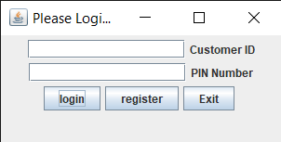
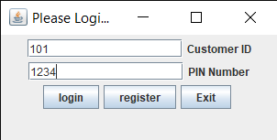
LOGIN MODULE
This is the login module of our banking system and this is the first page of our project.
In that enter your accurate customer ID and PIN number in the corresponding field and then click login button.
If you enter wrong id or password then there show some error message after that you have register it.

Slide 7
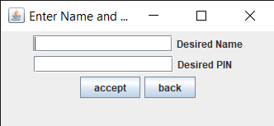
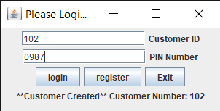
REGISTRATION module
This is the register page of our bank account in the desired name column you have to enter the name as per in the bank and then you have to enter the accurate PIN given for the bank account.
Then click accept to continue the login page.
Then click login button if you go further etc.,
Otherwise clicking exit button then the project will get end.

Slide 8
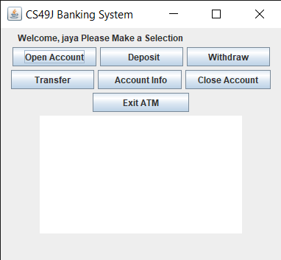
MENU MODULE
This is the menu page module, in this page there are seven option as menu.
After the use of each menu the corresponding changes will be appeared on the above white page.

Slide 9
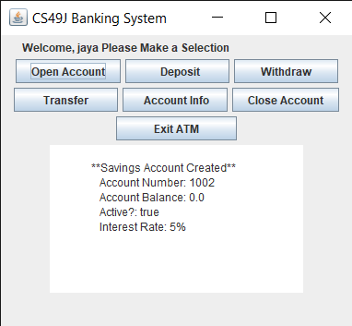
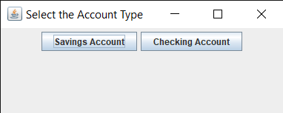
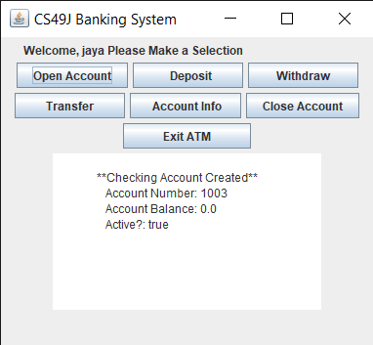
OPEN ACCOUNT MODULE
If you click the open account in the menu page the two option will be available.
If you click saving account button the above shown message will be displayed on the white space.
If you click checking account then the side shown message will be appeared.

Slide 10
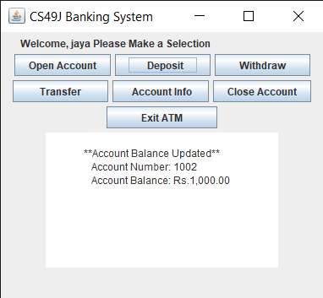
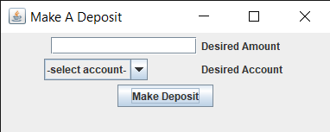
Deposit MODULE
This is the deposit page, enter the deposit amount in the desired amount field .
And enter the account to which you want to deposit your amount.
Click the make deposit button to go further.
Then your menu page will updated with message as shown in the second dialog box.

Slide 11
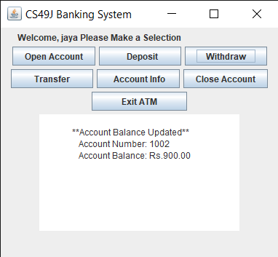
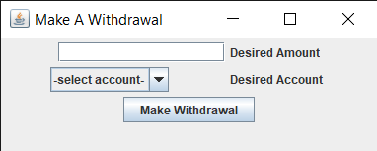
Withdraw module
If you click deposit option in your menu page then the first dialog box will appear.
Here you have to enter the amount to be withdraw from an account in the desired amount field.
Then you have to select the account in the desired account column in the field required.
Then click make withdrawal button to make changes in the menu page as shown in the dialog box.

Slide 12
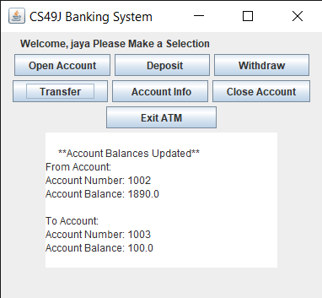
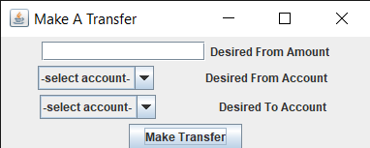
Transfer module
If you click the transfer option in the menu page then the above first dialog box will be appeared.
Now enter the desired amount in the corresponding field and also enter the account is transferring the amount and also the account which get the amount from it respectively.
Then the changes will be updated in the white space as shown in the second dialog box.

Slide 13
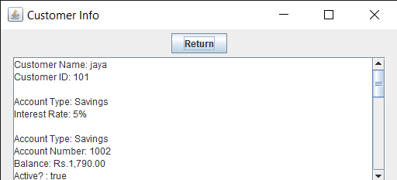
Account info module
If you click the account info option in the menu page then the above second dialog box will be appeared.
In that dialog box, the detailed customer information will be shown then you can return to the menu page by clicking the return button.

Slide 14
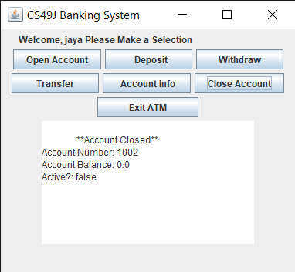
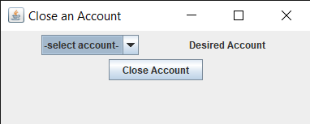
close Account module
If you click close account option in the menu page then the first dialog box appear.
Enter the account you want to close in the desired account field and click the close account button.
After clicking the button once , the corresponding account will be closed.
Then the changes will be updated in the white screen in the menu page .

Slide 15
Exit atm module
If you click the exit ATM option in the menu page then the login page dialog box will reopen automatically.

Slide 16
CoNClusion
From the given procedure we can easily create our bank account tester using java program with GUI.
In this project we used java applet for the banking system.
Due to Banking system, you can easily deposit or withdraw your money .
By this method , you can save your wonderful time and you can check the current balance easily whenever it needed etc.,
It is easy to execute the java code and compile the banking system program.
You can also find the accurate transaction of amount in your bank account easily.

Slide 17
Thank you

