Slide 1
J.K.JAYAVARSHINI
REGISTER NO :211521104060
Neural Style Transfer For Images
3/21/2024 Annual Review

Slide 2
Neural Style Transfer For Images
Neural Style Transfer (NST) is a fascinating technique in the field of deep learning and computer vision that combines the content of one image with the style of another image to generate visually appealing and artistically inspired results. It is based on the idea of using neural networks to separate and recombine the content and style representations of arbitrary images.
The basic concept of NST involves three key components:
Content Image: This is the image whose content we want to preserve in the final stylized output.
Style Image: This is the image whose artistic style we want to apply to the content image.
Generated Image: This is the output image that will retain the content of the content image while adopting the style of the style image.
3/21/2024 Annual Review

Slide 3


AGENDA
1. Introduction to Neural Style Transfer
2. Understanding the Core Concepts
3. Deep Dive into Neural Style Transfer Algorithms
6. Evaluation and Performance Metrics
7. Applications and Use Cases
8. Future Directions and Research Opportunities
9. Case Studies and Success Stories
10. Interactive Session and Q&A
3/21/2024 Annual Review

Slide 4

PROBLEM STATEMENT
Neural image transfer is a technique that aims to combine the content of one image with the style of another, creating visually appealing and artistically inspired results. However, the challenge lies in developing algorithms that efficiently and accurately transfer the style while preserving the content of the original image.
Content Preservation: The transferred image should retain the essential content and structure of the original content image. This includes maintaining recognizable objects, shapes, and spatial arrangements.
Computational Efficiency: Neural image transfer algorithms should be computationally efficient to enable real-time or near-real-time processing, especially for applications like video processing or interactive artistic tools.
Artifact Reduction: Artifacts such as distortion, blurring, or inconsistency between content and style regions should be minimized or eliminated to enhance the visual quality of the transferred images.
3/21/2024 Annual Review

Slide 5
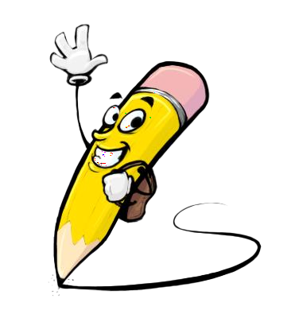
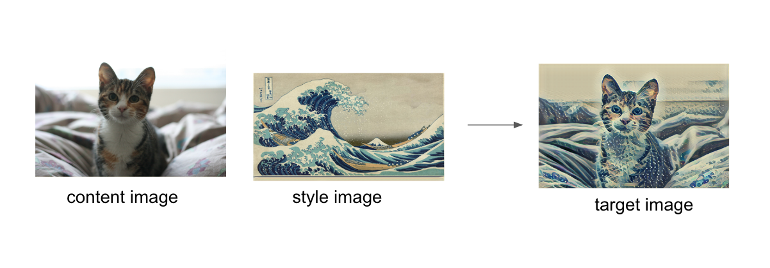
PROJECT OVERVIEW
Neural style transfer is an optimization technique used to take two images—a content image and a style reference image (such as an artwork by a famous painter)—and blend them together so the output image looks like the content image, but “painted” in the style of the style reference image.
This is implemented by optimizing the output image to match the content statistics of the content image and the style statistics of the style reference image. These statistics are extracted from the images using a convolutional network.
3/21/2024 Annual Review

Slide 6

WHO ARE THE END USERS?
The end users of style transfer images can vary depending on the context in which the technology is being used. Here are some examples:
Artists and Designers: Artists and designers might use style transfer techniques to create unique and visually appealing artwork or graphics.
Photographers: Photographers may utilize style transfer to apply artistic styles to their photographs, enhancing their visual appeal or achieving a particular aesthetic.
Content Creators: Content creators on social media platforms, blogs, or other online platforms might use style transfer to enhance the visual impact of their content and engage their audience.
App Developers: Developers may integrate style transfer technology into photo editing apps or other software tools to allow users to apply artistic styles to their images.
Researchers and Developers: Researchers and developers in the field of artificial intelligence and computer vision may use style transfer techniques for experimentation, improving algorithms, or developing new applications.
General Public: With the popularity of various photo editing apps and online platforms, style transfer is increasingly accessible to the general public, allowing anyone to experiment with transforming their images into various artistic styles.
3/21/2024 Annual Review

Slide 7

YOUR SOLUTION AND ITS VALUE PROPOSITION
Authors could draft once, but automatically restyle that content to appeal to a variety of audiences - making their ideas more Shakespearean, polite, objective, humorous, or professional.
Style Transfer is a technique in computer vision and graphics that involves generating a new image by combining the content of one image with the style of another image. The goal of style transfer is to create an image that preserves the content of the original image while applying the visual style of another image.
Neural style transfer has many applications, such as enhancing photos, generating wallpapers, creating animations, and more.
Style transfer is a fascinating application of generative AI that allows you to transform an image or a video into a different artistic style, such as painting, sketching, or cartooning. It can be used for fun, education, or creative expression
3/21/2024 Annual Review

Slide 8

THE WOW IN YOUR SOLUTION
Wavelet Transformations: Wavelet transformations are mathematical operations used for signal and image processing. They decompose an image into different frequency components, allowing for analysis and manipulation at multiple scales.
Combination of Techniques: WOW combines neural networks with wavelet transformations to exploit their complementary strengths. While neural networks excel at learning abstract features and global structures, wavelet transformations are effective at capturing local details and textures.
Quality and Efficiency: One of the key advantages of WOW is its ability to generate high-quality images efficiently. By leveraging the parallel processing capabilities of modern GPUs and optimizing the computational workflow, WOW can produce visually appealing results in a reasonable amount of time.
Enhanced Optimization: WOW employs advanced optimization techniques to ensure the fidelity and realism of the synthesized images. By iteratively refining the image based on both neural network predictions and wavelet transformations, WOW achieves superior results compared to traditional methods.
3/21/2024 Annual Review

Slide 9
MODELLING
Preprocessing: Both the content and style images are preprocessed to prepare them for input into the neural network. This usually involves resizing the images to a standard size and normalizing the pixel values.
Content Representation: The content features of the content image are extracted from one of the intermediate layers of the CNN. These features represent the high-level content of the image, such as objects and shapes.
Feature Extraction: The content and style features are extracted from the intermediate layers of the pretrained CNN. The feature maps in these layers capture information about the content and style of the input images.
Style Representation: The style features of the style image are extracted by computing the Gram matrix of the feature maps in multiple intermediate layers of the CNN. The Gram matrix captures the correlations between the different feature maps, which represent the style of the image.
Backpropagation: The gradients of the total loss with respect to the pixels of the generated image are computed using backpropagation, and the pixel values of the generated image are updated iteratively to minimize the loss.
3/21/2024 Annual Review

Slide 10
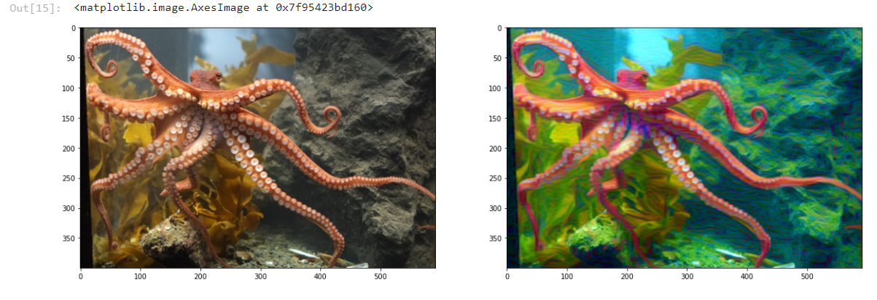
RESULTS
3/21/2024 Annual Review

