Slide 1
HealthCare Analysis
Team Members
Jayavedhan
Taher Baniyan
Abhay Bhargava
Saharsh Tiwari

Slide 2
Introduction:
Healthcare analysis is a systematic approach to evaluating data and trends within the healthcare sector to improve decision-making, enhance patient outcomes, and optimize resource allocation. As healthcare systems face increasing complexity, rising costs, and shifting demographics, robust analysis becomes crucial for effective management and policy-making.

Slide 3
Importance of Healthcare Analysis
Improving Patient Outcomes: By analyzing clinical data, healthcare providers can identify effective treatments, reduce complications, and enhance patient safety.
Cost Management: Understanding the financial aspects of healthcare delivery helps organizations manage expenses, reduce waste, and improve the overall efficiency of services.
Policy Development: Analyzing healthcare data informs policymakers about the impact of existing policies and helps design evidence-based interventions to address public health challenges.
Population Health: Healthcare analysis helps identify health disparities and allows for targeted strategies to improve the health of specific populations.
Quality Improvement: Ongoing analysis of performance metrics facilitates continuous improvement initiatives aimed at enhancing care quality.

Slide 4
Key Performance Indicators
Total Discharge
Patient Days
Net Patient Revenue
Revenue Trend
Patient Stays
State Wise No of hospital /Revenue
Type Of hospital Revenue
MTD/QTD/YTD Revenue
Total Patient, Total Doctor, Total Hospital ‘’

Slide 5
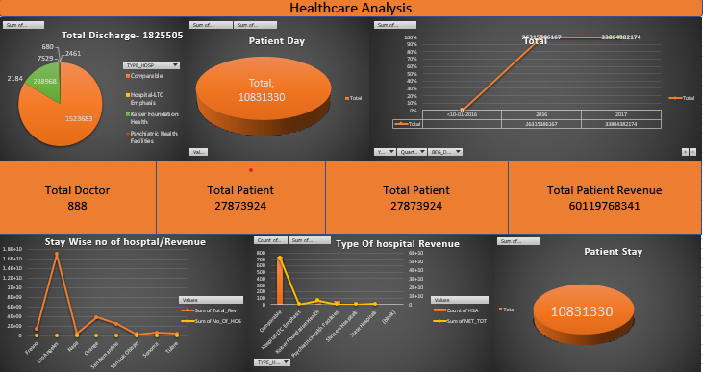

Slide 6
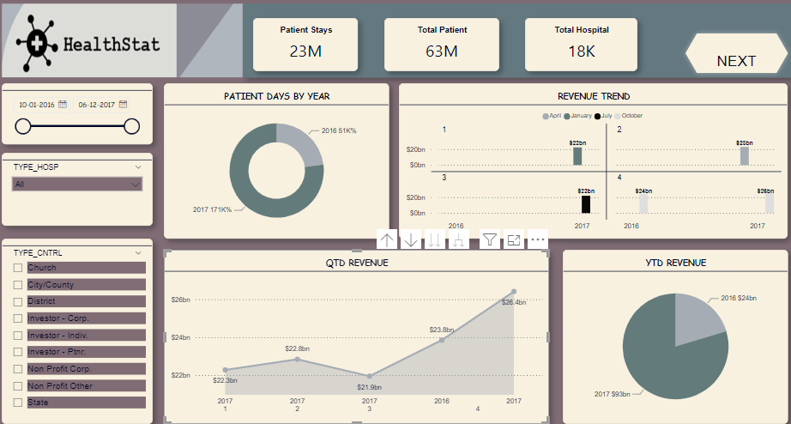

Slide 7
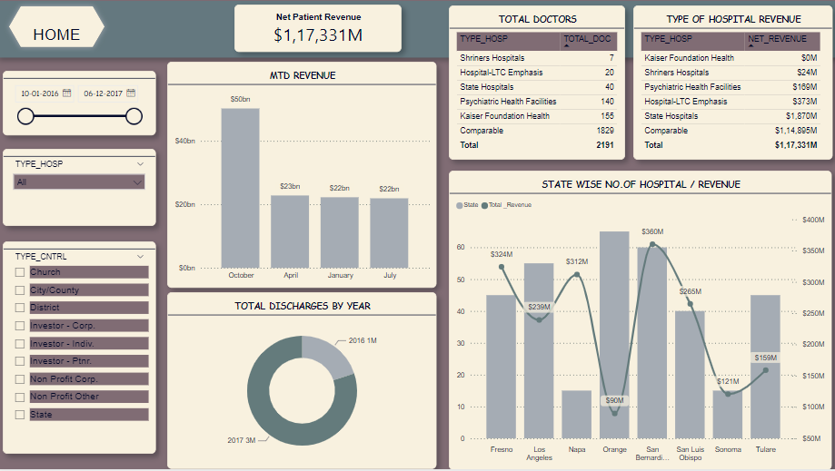

Slide 8
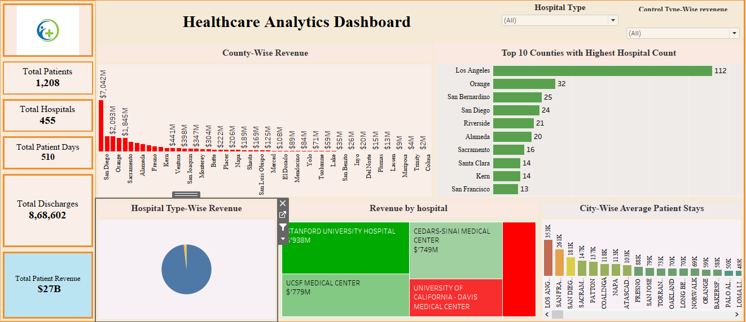

Slide 9
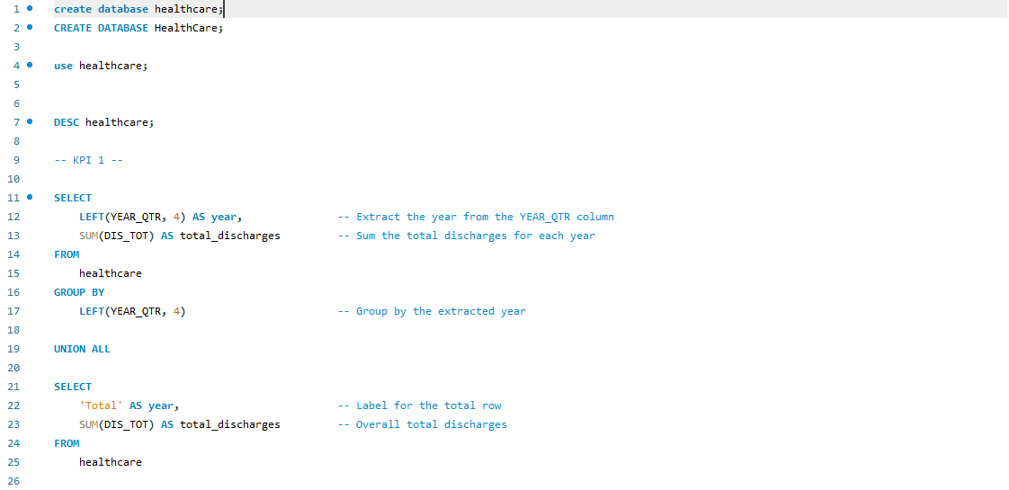

Slide 10
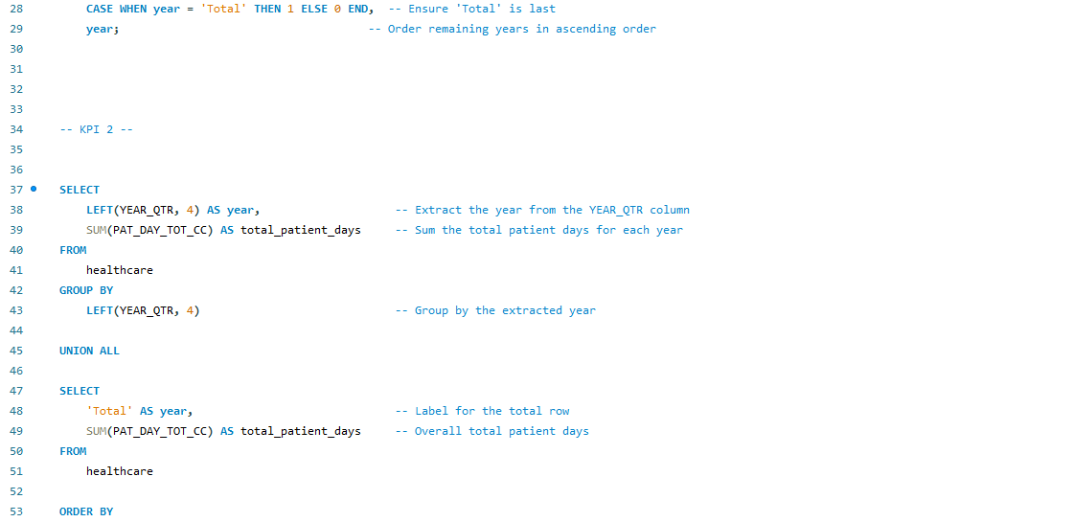

Slide 11
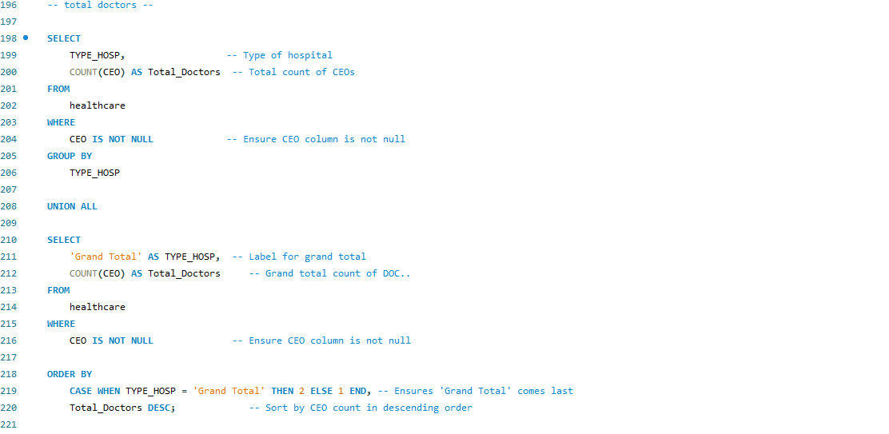

Slide 12
Project Summary:
A healthcare analysis dashboard is a powerful tool that consolidates and visualizes critical data to support decision-making in healthcare settings. Key takeaways from such a dashboard typically include: Patient Outcomes Metrics such as readmission rates, patient satisfaction scores, and treatment effectiveness highlight the quality of care and areas needing improvement.2. Operational Efficiency Data on patient flow, resource utilization, and staff performance help identify bottlenecks, optimize scheduling, and improve overall efficiency. Financial Insights The dashboard provides insights into cost management, revenue cycle performance, and payer mix, enabling better financial planning and sustainability.

Slide 13
Population Health Management Analytics on demographics, chronic conditions, and social determinants of health facilitate targeted interventions and preventive care strategies. Regulatory Compliance Monitoring compliance metrics ensures that healthcare providers adhere to legal standards and quality benchmarks. Overall the dashboard serves as an essential resource for stakeholders, fostering data-driven decisions that enhance patient care, optimize operations, and improve financial performance. By leveraging real-time data, healthcare organizations can adapt to changing circumstances and improve health outcomes effectively.

