Slide 1

SCSB – 1502 Design and Analysis of Algorithm
SCSA1403 DAA-Unit I

Slide 2
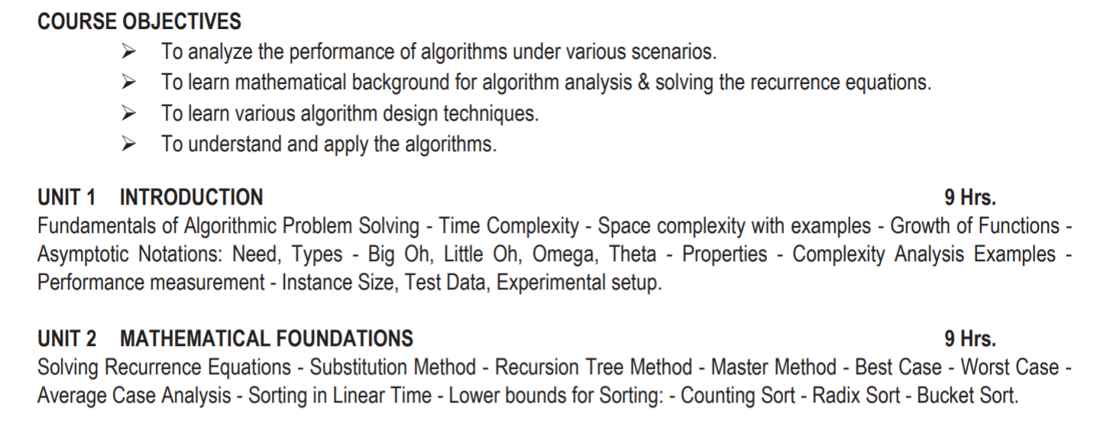

Slide 3
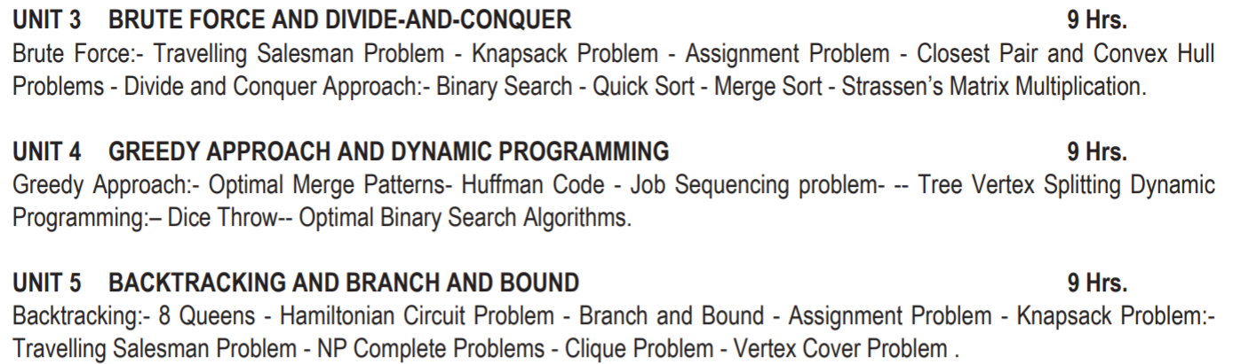

Slide 4
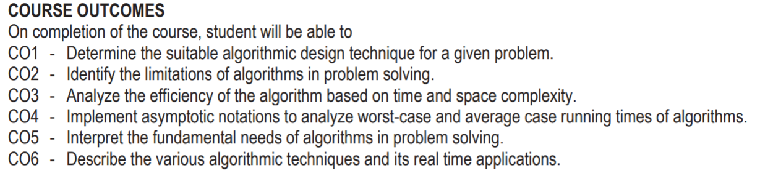

Slide 5
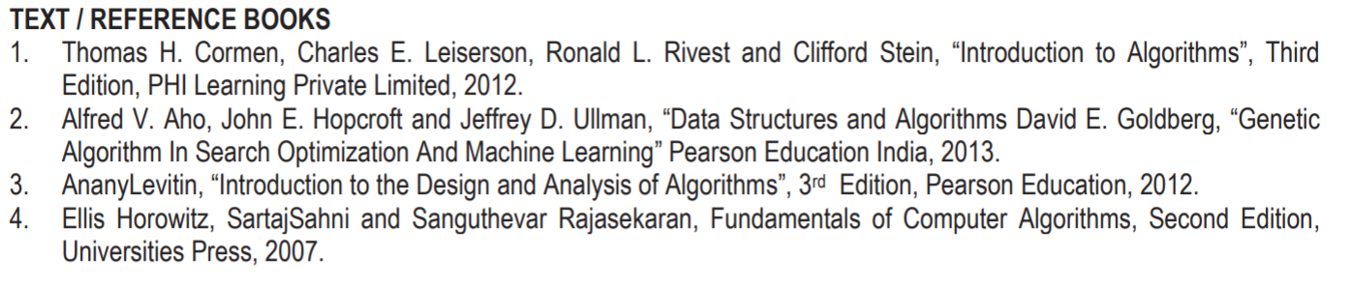

Slide 6
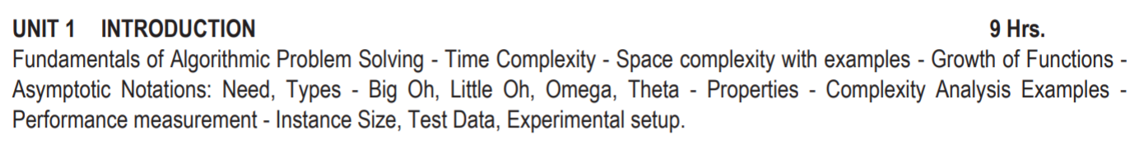
Road Map to Unit I

Slide 7
Algorithm
  An algorithm can be defined as a finite set of steps, which has to be followed while carrying out a particular problem.
  It is nothing but a process of executing actions step by step.
  An algorithm is a distinct computational procedure that takes input as a set of values and results in the output as a set of values by solving the problem.

Slide 8
Characteristics of Algorithms
  Input: It should externally supply zero or more quantities.
  Output: It results in at least one quantity.
  Definiteness: Each instruction should be clear and ambiguous.
  Finiteness: An algorithm should terminate after executing a finite number of steps.
  Effectiveness: Every instruction should be fundamental to be carried out, in principle, by a person using only pen and paper.
  Feasible: It must be feasible enough to produce each instruction.

Slide 9
Characteristics of Algorithms
  Flexibility: It must be flexible enough to carry out desired changes with no efforts.
  Efficient: The term efficiency is measured in terms of time and space required by an algorithm to implement. Thus, an algorithm must ensure that it takes little time and less memory space meeting the acceptable limit of development time.
  Independent: An algorithm must be language independent, which means that it should mainly focus on the input and the procedure required to derive the output instead of depending upon the language.

Slide 10
Advantages of Algorithms
  Effective Communication: Since it is written in a natural language like English, it becomes easy to understand the step-by-step delineation of a solution to any particular problem.
  Easy Debugging: A well-designed algorithm facilitates easy debugging to detect the logical errors that occurred inside the program.
  Easy and Efficient Coding: An algorithm is nothing but a blueprint of a program that helps develop a program.
  Independent of Programming Language: Since it is a language-independent, it can be easily coded by incorporating any high-level language.

Slide 11
Disadvantages of Algorithms
  Developing algorithms for complex problems would be time-consuming and difficult to understand.
  It is a challenging task to understand complex logic through algorithms.

Slide 12
Problem:
Suppose there are 60 students in the class. How will you calculate the number of absentees in the class?
Algorithm:
  Initialize a variable called as Count to zero, absent to zero, total to 60
  FOR EACH Student PRESENT DO the following:
  Increase the Count by One
  Then Subtract Count from total and store the result in absent
  Display the number of absent students

Slide 13
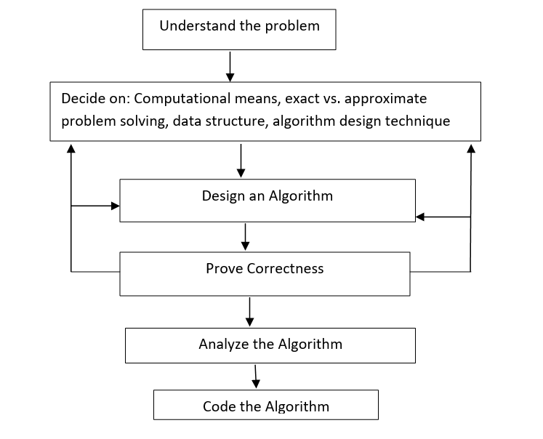
Steps in Design and Analysis of Algorithm:

Slide 14
Steps in Design and Analysis of Algorithm:
Understanding the problem:
The problem given should be understood completely.
Check if it is similar to some standard problems and if a Known algorithm exists, otherwise a new algorithm has to be devised.
2. Ascertain the capabilities of the computational device:
Once a problem is understood we need to know the capabilities of the computing device this can be done by knowing the type of the architecture, speed and memory availability.
Exact /approximate solution:
Once algorithm is devised, it is necessary to show that it computes answer for all the possible legal inputs.

Slide 15
Steps in Design and Analysis of Algorithm:
Deciding data structures :
  Data structures play a vital role in designing and analyzing the algorithms.
  Some of the algorithm design techniques also depend on the structuring data specifying a problem’s instance.
Algorithm + Data structure = Programs
5. Algorithm design techniques:
  Creating an algorithm is an art which may never be fully automated.
  By mastering these design strategies, it will become easier for you to devise new and useful algorithms.

Slide 16
Steps in Design and Analysis of Algorithm:
6. Prove correctness:
Correctness has to be proved for every algorithm.
For some algorithms, a proof of correctness is quite easy; for others it can be quite complex.
A technique used for proving correctness is by mathematical induction because an algorithm’s iterations provide a natural sequence of steps needed for such proofs.
But we need one instance of its input for which the algorithm fails.
If it is incorrect, redesign the algorithm, with the same decisions of data structures design technique etc

Slide 17
Steps in Design and Analysis of Algorithm:
7. Analyze the algorithm
There are two kinds of algorithm efficiency: time and space efficiency.
Time efficiency indicates how fast the algorithm runs
space efficiency indicates how much extra memory the algorithm needs.
8. Coding
Programming the algorithm by using some programming language.
Formal verification is done for small programs.
Validity is done by testing and debugging
Some compilers allow code optimization which can speed up a program by a constant factor whereas a better algorithm can make a difference in their running time.

Slide 18
Performance of a program:
The performance of a program is measured based on the amount of computer memory and time needed to run a program.
The two approaches which are used to measure the performance of the program are:
Analytical method → called the Performance Analysis.
Experimental method → called the Performance Measurement.

Slide 19
SPACE COMPLEXITY
The Space complexity of a program is defined as the amount of memory it needs to run to completion.
It is one of the factor which accounts for the performance of the program.
The space complexity can be measured using experimental method, which is done by running the program and then measuring the actual space occupied by the program during execution.
But this is done very rarely.
We estimate the space complexity of the program before running the program.

Slide 20
SPACE COMPLEXITY
The reasons for estimating the space complexity before running the program even for the first time are:
We should know in advance, whether or not, sufficient memory is present in the computer. If this is not known and the program is executed directly, there is possibility that the program may consume more memory than the available during the execution of the program. This leads to insufficient memory error and the system may crash, leading to severe damages if that was a critical system.
In Multi user systems, we prefer, the programs of lesser size, because multiple copies of the program are run when multiple users access the system. Hence if the program occupies less space during execution, then more number of users can be accommodated.

Slide 21
SPACE COMPLEXITY
Space complexity is the sum of the following components:
Instruction space:
The program which is written by the user is the source program. When this program is compiled, a compiled version of the program is generated. For executing the program an executable version of the program is generated. The space occupied by these three when the program is under execution, will account for the instruction space.
The instruction space depends on the following factors:
Compiler used – Some compiler generate optimized code which occupies less space.
Compiler options – Optimization options may be set in the compiler options.
Target computer – The executable code produced by the compiler is dependent on the processor used.

Slide 22
SPACE COMPLEXITY
Space complexity is the sum of the following components:
(ii) Data space:
The space needed by the constants, simple variables, arrays, structures and other data structures will account for the data space.
The Data space depends on the following factors:
Structure size – It is the sum of the size of component variables of the structure.
Array size – Total size of the array is the product of the size of the data type and the number of array locations.

Slide 23
SPACE COMPLEXITY
Space complexity is the sum of the following components:
(iii) Environment stack space:
The Environment stack space is used for saving information needed to resume execution of partially completed functions. That is whenever the control of the program is transferred from one function to another during a function call, then the values of the local variable of that function and return address are stored in the environment stack. This information is retrieved when the control comes back to the same function.
The environment stack space depends on the following factors:
Return address
Values of all local variables and formal parameters.

Slide 24
SPACE COMPLEXITY
The Total space occupied by the program during the execution of the program is the sum of the fixed space and the variable space.
Fixed space - The space occupied by the instruction space, simple variables and constants.
Variable space – The dynamically allocated space to the various data structures and the environment stack space varies according to the input from the user.
Space complexity S(P) = c + S_{p}
c -- Fixed space or constant space
S_{p} -- Variable space
We will be interested in estimating only the variable space because that is the one which varies according to the user input.

Slide 25
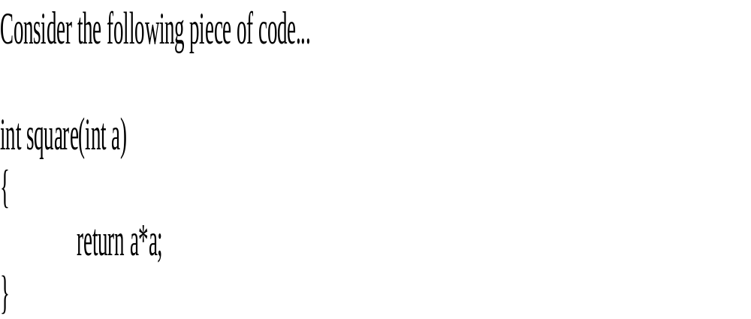
SPACE COMPLEXITY

Slide 26
SPACE COMPLEXITY
  Totally it requires 4 bytes of memory to complete its execution. And this 4 bytes of memory is fixed for any input value of 'a'. This space complexity is said to be Constant Space Complexity.
  If any algorithm requires a fixed amount of space for all input values then that space complexity is said to be Constant Space Complexity
  Eg 2:
        {
        int z = a + b + c;
        return(z);
        }

Slide 27
SPACE COMPLEXITY
  Eg.3
      #include<stdio.h>
      int main()
      {
      int a = 5, b = 5, c;
      c = a + b;
      printf("%d", c);
      }

Slide 28
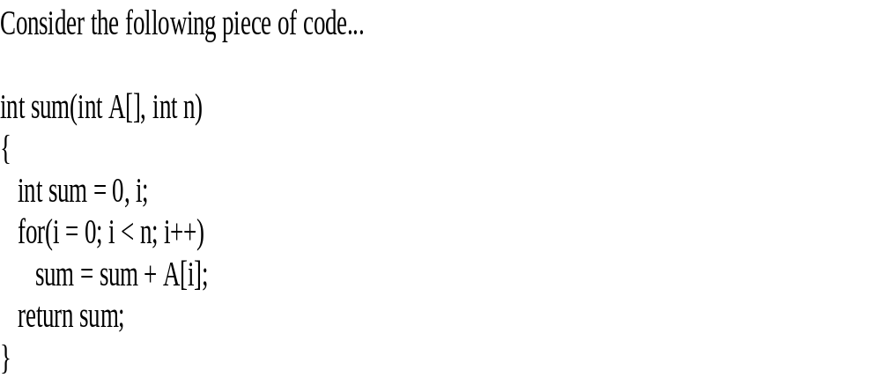
SPACE COMPLEXITY

Slide 29
SPACE COMPLEXITY
In above piece of code it requires
    'n*2' bytes of memory to store array variable ‘a[].
    2 bytes of memory for integer parameter ‘n’.
    4 bytes of memory for local integer variables 'sum' and 'i' (2 bytes each) .
    2 bytes of memory for return value.
    That means, totally it requires '2n+8' bytes of memory to complete its execution.
    Here, the amount of memory depends on the input value of 'n'. This space complexity is said to be Linear Space Complexity.

Slide 30
TIME COMPLEXITY
  Time complexity of the program is defined as the amount of computer time it needs to run to completion.
  The time complexity can be measured, by measuring the time taken by the program when it is executed. This is an experimental method. But this is done very rarely.
  We always try to estimate the time consumed by the program even before it is run for the first time.

Slide 31
TIME COMPLEXITY- Example
  Imagine a classroom of 100 students in which you gave your pen to one person. Now, you want that pen. Here are some ways to find the pen and what the O order is.
  O(n): Going and asking each student individually is O(N).
  O(n²): You go and ask the first person of the class, if he has the pen. Also, you ask this person about other 99 people in the classroom if they have that pen and so on.
  O(log n): Now I divide the class into two groups, then ask: “Is it on the left side, or the right side of the classroom?” Then I take that group and divide it into two and ask again, and so on. Repeat the process till you are left with one student who has your pen. This is what you mean by O(log n).

Slide 32
TIME COMPLEXITY- Example
  I might need to do the O(n²) search if only one student knows on which student the pen is hidden.
  I’d use the O(n) if one student had the pen and only they knew it.
  I’d use the O(log n) search if all the students knew, but would only tell me if I guessed the right side.

Slide 33
TIME COMPLEXITY
The reasons for estimating the time complexity of the program even before running the program for the first time are:
We need real time response for many applications. That is a faster execution of the program is required for many applications. If the time complexity is estimated beforehand, then modifications can be done to the program to improve the performance before running it.
It is used to specify the upper limit for time of execution for some programs. The purpose of this is to avoid infinite loops.

Slide 34
TIME COMPLEXITY
The time complexity of the program depends on the following factors:
  Compiler used – some compilers produce optimized code which consumes less time to get executed.
  Compiler options – The optimization options can be set in the options of the compiler.
  Target computer – The speed of the computer or the number of instructions executed per second differs from one computer to another

Slide 35
TIME COMPLEXITY
The total time taken for the execution of the program is the sum of the compilation time and the execution time.
Compile time – The time taken for the compilation of the program to produce the intermediate object code or the compiler version of the program. The compilation time is taken only once as it is enough if the program is compiled once. If optimized code is to be generated, then the compilation time will be higher.
Run time or Execution time - The time taken for the execution of the program. The optimized code will take less time to get executed.

Slide 36
TIME COMPLEXITY
Time complexity T(P) = c + T_{p}
c -- Compile time
T_{p} -- Run time or execution time
We will be interested in estimating only the execution time as this is the one which varies according to the user input.

Slide 37
TIME COMPLEXITY
Time Complexity of algorithm/code is not equal to the actual time required to execute a particular code but the number of times a statement executes.
We can prove this by using time command.
For example, Write code in C/C++ or any other language to find maximum between N numbers, where N varies from 10, 100, 1000, 10000.
And compile that code on Linux based operating system (Fedora or Ubuntu) with below command:
gcc program.c – o program
run it with time ./program

Slide 38
TIME COMPLEXITY
You will get surprising results i.e. for N = 10 you may get 0.5ms time and for N = 10, 000 you may get 0.2 ms time.
Also, you will get different timings on the different machine. So, we can say that actual time requires to execute code is machine dependent (whether you are using pentium1 or pentiun5) and also it considers network load if your machine is in LAN/WAN.
Even you will not get the same timings on the same machine for the same code, the reason behind that the current network load.
Now, the question arises if time complexity is not the actual time require executing the code then what is it?

Slide 39
TIME COMPLEXITY
The answer is : Instead of measuring actual time required in executing each statement in the code, we consider how many times each statement execute.
For example: int main()
    {
    printf("Hello World");
    }
    Output
    Hello World

Slide 40
TIME COMPLEXITY
The answer is : Instead of measuring actual time required in executing each statement in the code, we consider how many times each statement execute.
For example: int main()
    {
    printf("Hello World");
    }
    Output
    Hello World

Slide 41
TIME COMPLEXITY
In above code “Hello World!!!” print only once on a screen.
So, time complexity is constant: O(1) i.e. every time constant amount of time require to execute code, no matter which operating system or which machine configurations you are using.

Slide 42
TIME COMPLEXITY
void main()
{
int i, n = 8;
for (i = 1; i <= n; i++) {
printf("Hello Word !!!\n");
}
}

Slide 43
TIME COMPLEXITY
Output
Hello Word !!!
Hello Word !!!
Hello Word !!!
Hello Word !!!
Hello Word !!!
Hello Word !!!
Hello Word !!!
Hello Word !!!
In above code “Hello World!!!” will print N times. So, time complexity of above code is O(N).

Slide 44
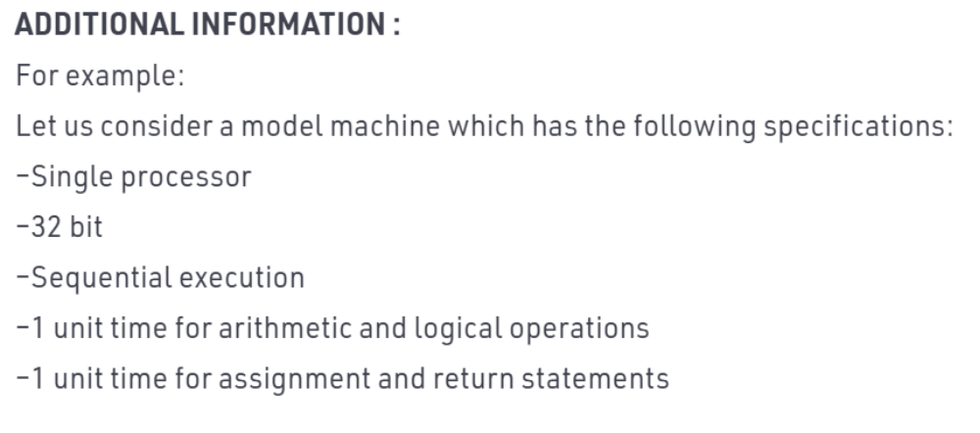
TIME COMPLEXITY

Slide 45
TIME COMPLEXITY
Pseudocode:
Sum(a,b){
return a+b //Takes 2 unit of time(constant) one for arithmetic operation and one for return.(as per above conventions) cost=2 no of times=1
}
Tsum= 2 = C =O(1)

Slide 46
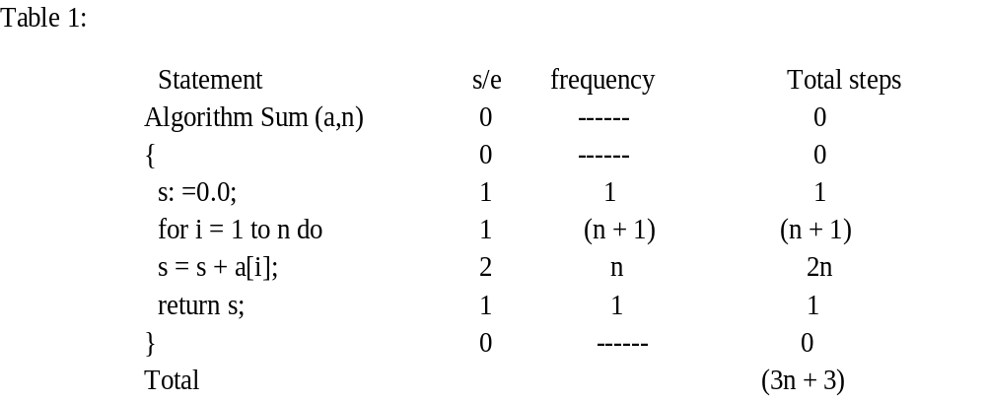
TIME COMPLEXITY

Slide 47
TIME COMPLEXITY
Pseudocode:
list_Sum(A,n){//A->array and n->number of elements in the array
total =0 // cost=1 no of times=1
for i=0 to n-1 // cost=2 no of times=n+1 (+1 for the end false condition)
sum = sum + A[i] // cost=2 no of times=n
return sum // cost=1 no of times=1
}
Tsum=1 + 2 * (n+1) + 2 * n + 1 = 4n + 4 =C1 * n + C2 = O(n)

Slide 48
TIME COMPLEXITY
How to Compare Algorithms?
To compare algorithms, let us define a few objective measures:
Execution times: Not a good measure as execution times are specific to a particular computer.
A number of statements executed: Not a good measure, since the number of statements varies with the programming language as well as the style of the individual programmer.
Ideal solution: Let us assume that we express the running time of a given algorithm as a function of the input size n (i.e., f(n)) and compare these different functions corresponding to running times. This kind of comparison is independent of machine time, programming style, etc.

Slide 49
Asymptotic Notation
Asymptotic Notations are the expressions that are used to represent the complexity of an algorithm.
There are three types of analysis that we perform on a particular algorithm.
Best Case: In which we analyse the performance of an algorithm for the input, for which the algorithm takes less time or space.
Worst Case: In which we analyse the performance of an algorithm for the input, for which the algorithm takes long time or space.
Average Case: In which we analyse the performance of an algorithm for the input, for which the algorithm takes time or space that lies between best and worst case.

Slide 50
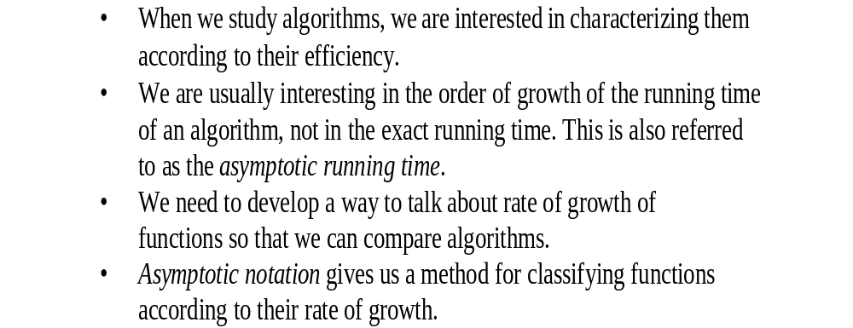
Growth of Functions and Asymptotic Notation

Slide 51
Groth of Functions and Asymptotic Notation
Types of Data Structure Asymptotic Notation
Big-O Notation (Ο) – Big O notation specifically describes worst case scenario.
2. Omega Notation (Ω) – Omega(Ω) notation specifically describes best case scenario.
3. Theta Notation (θ) – This notation represents the average complexity of an algorithm.

Slide 52
Big-O Notation (Ο)
Big O notation specifically describes worst case scenario. It represents the upper bound running time complexity of an algorithm. Lets take few examples to understand how we represent the time and space complexity using Big O notation.
O(1)
Big O notation O(1) represents the complexity of an algorithm that always execute in same time or space regardless of the input data.
O(1) example
The following step will always execute in same time(or space) regardless of the size of input data.
Accessing array index(int num = arr[5])

Slide 53
Big-O Notation (Ο)
O(n)
Big O notation O(N) represents the complexity of an algorithm, whose performance will grow linearly (in direct proportion) to the size of the input data.
O(n) example
The execution time will depend on the size of array. When the size of the array increases, the execution time will also increase in the same proportion (linearly)
Traversing an array

Slide 54
Big-O Notation (Ο)
O(n^2)
Big O notation O(n^2) represents the complexity of an algorithm, whose performance is directly proportional to the square of the size of the input data.
O(n^2) example
Traversing a 2D array
Similarly there are other Big O notations such as:
logarithmic growth O(log n), log-linear growth O(n log n), exponential growth O(2^n) and factorial growth O(n!).

Slide 55
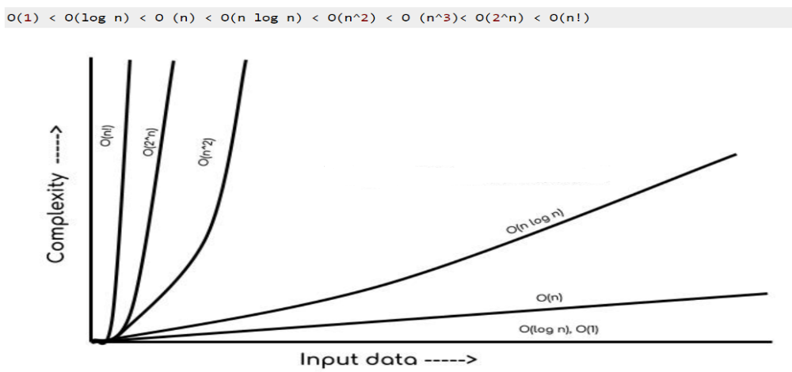
Big-O Notation (Ο)

Slide 56
Omega Notation (Ω)
Omega notation specifically describes best case scenario. It represents the lower bound running time complexity of an algorithm. So if we represent a complexity of an algorithm in Omega notation, it means that the algorithm cannot be completed in less time than this, it would at-least take the time represented by Omega notation or it can take more (when not in best case scenario).

Slide 57
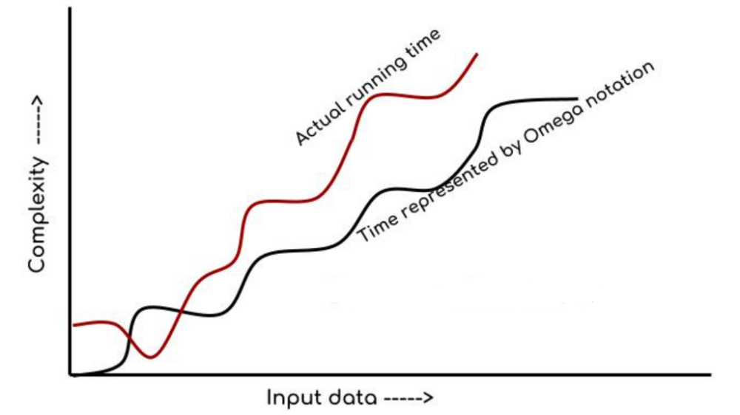
Omega Notation (Ω)

Slide 58
Theta Notation (θ)
This notation describes both upper bound and lower bound of an algorithm so we can say that it defines exact asymptotic behaviour. In the real case scenario the algorithm not always run on best and worst cases, the average running time lies between best and worst and can be represented by the theta notation.

Slide 59
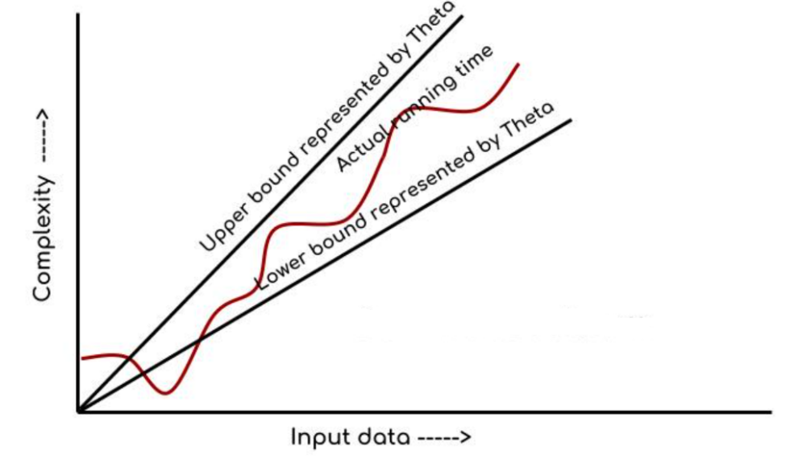
Theta Notation (θ)

Slide 60
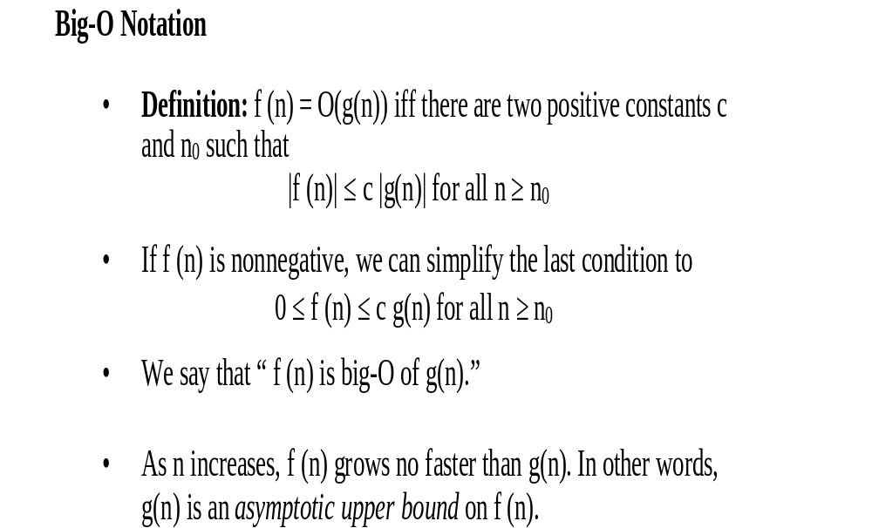
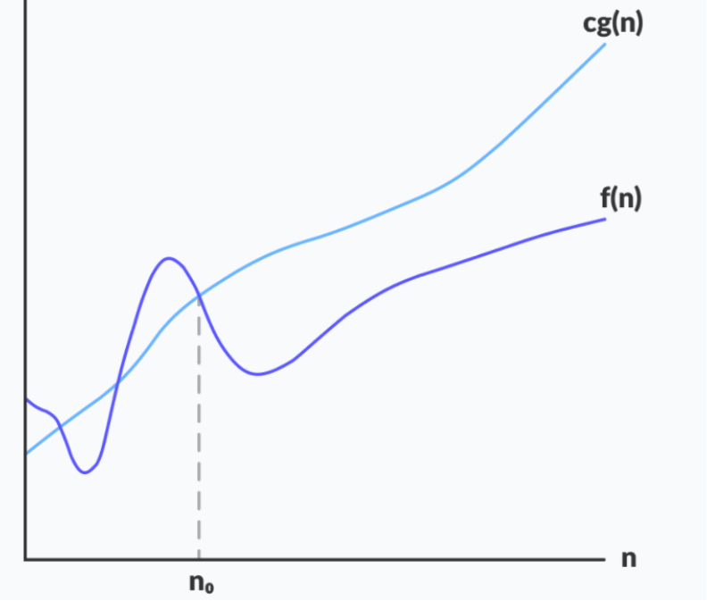

Slide 61
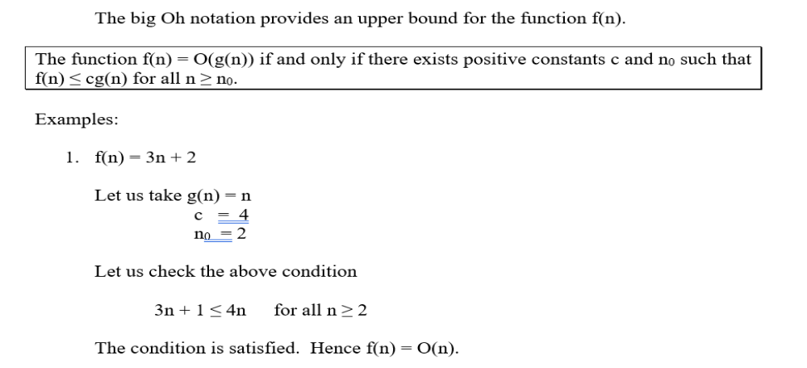
Big-O Notation (Ο)

Slide 62
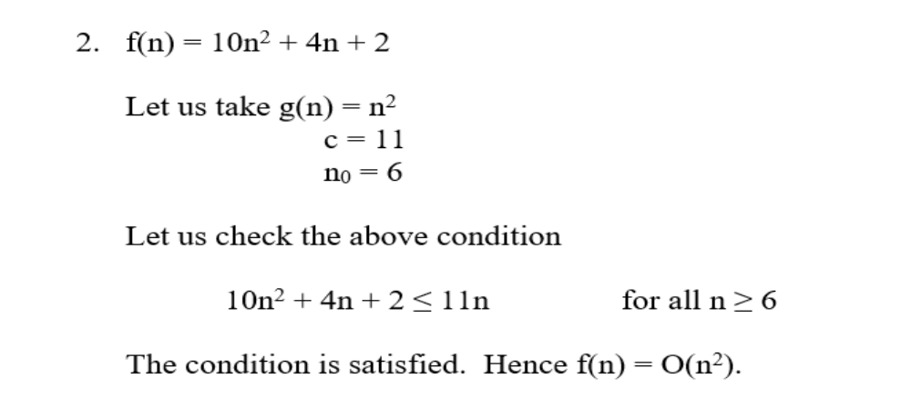
Big-O Notation (Ο)

Slide 63
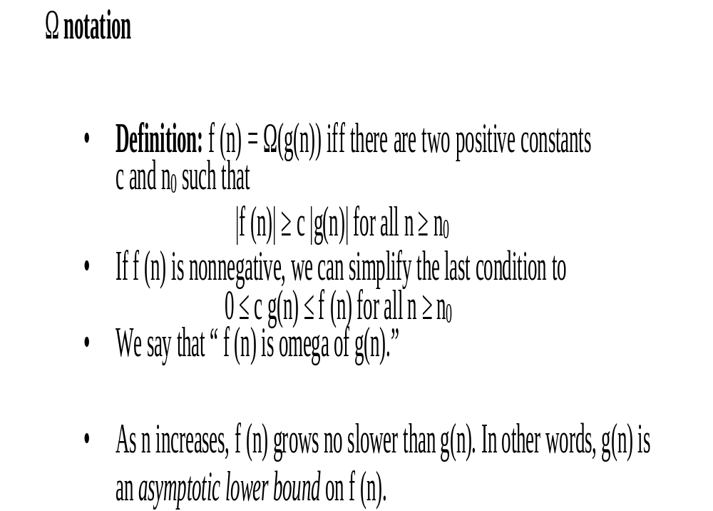
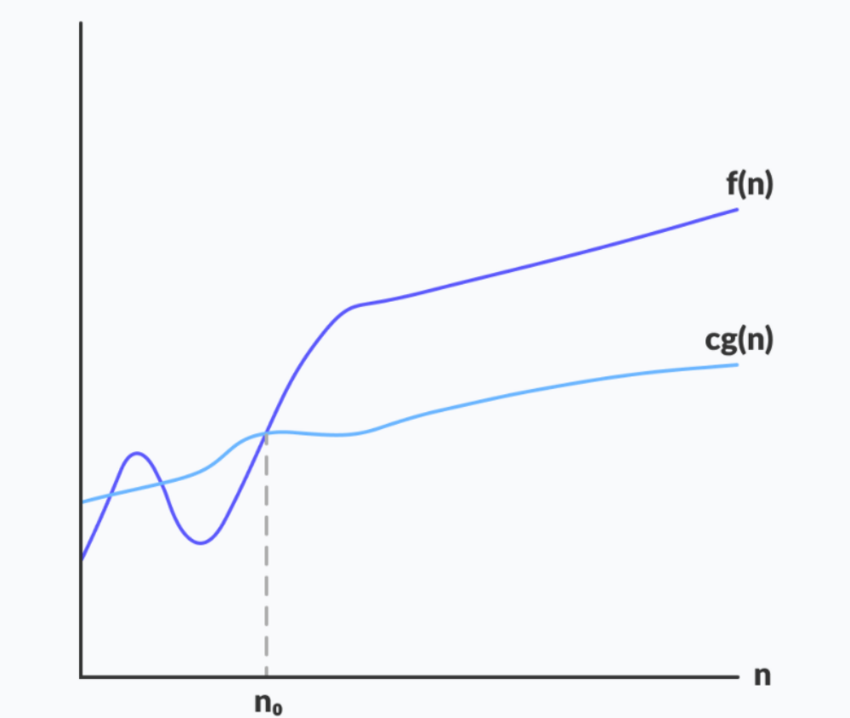

Slide 64
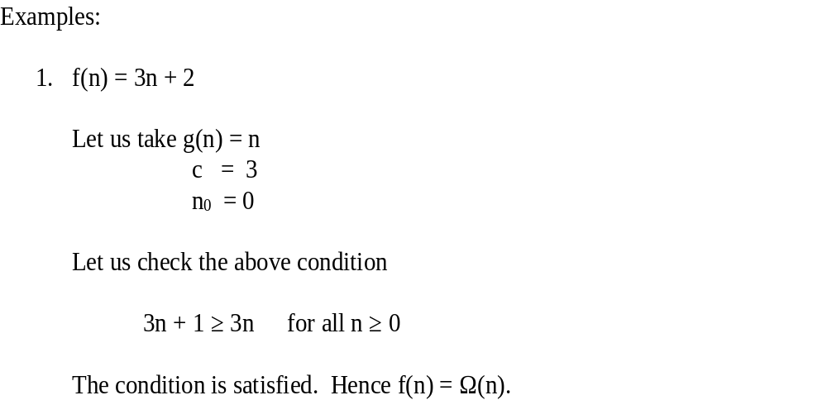
Omega Notation (Ω)

Slide 65
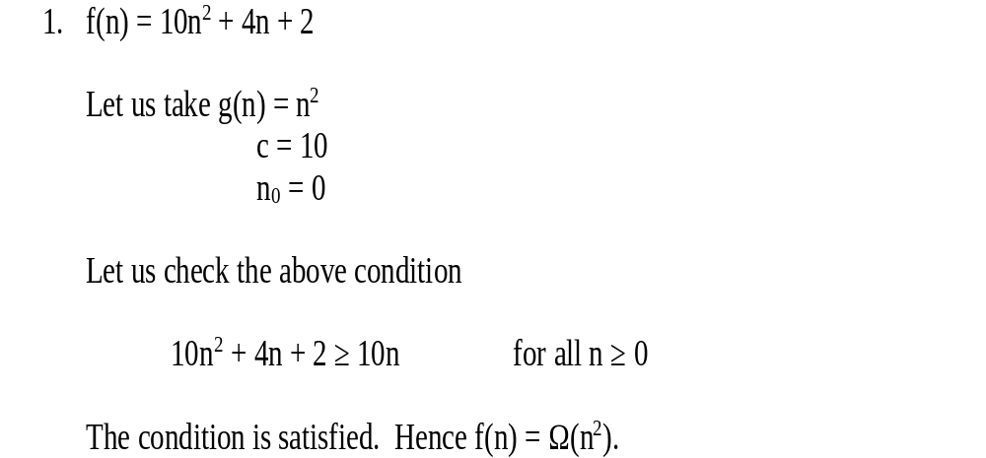
Omega Notation (Ω)

Slide 66
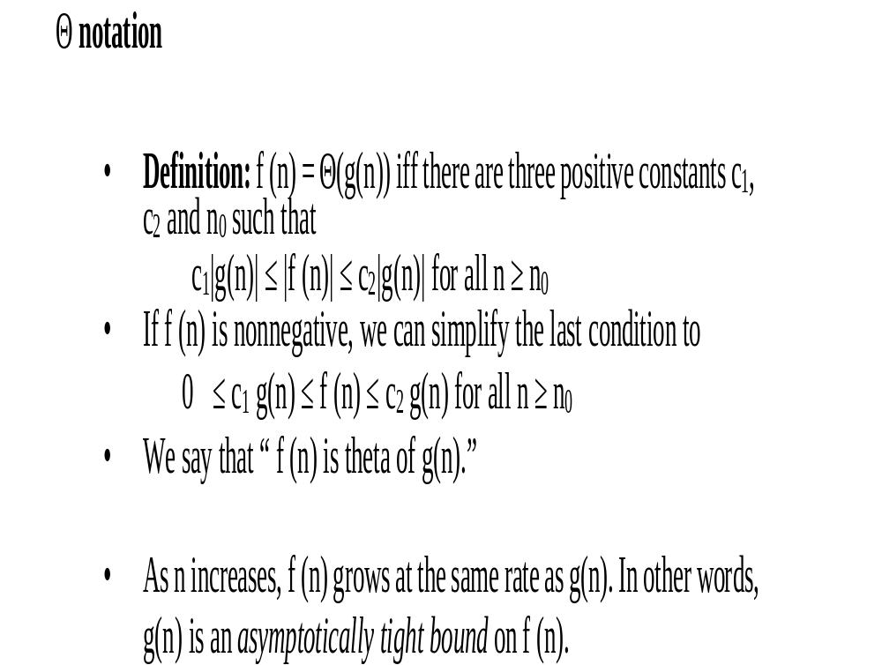
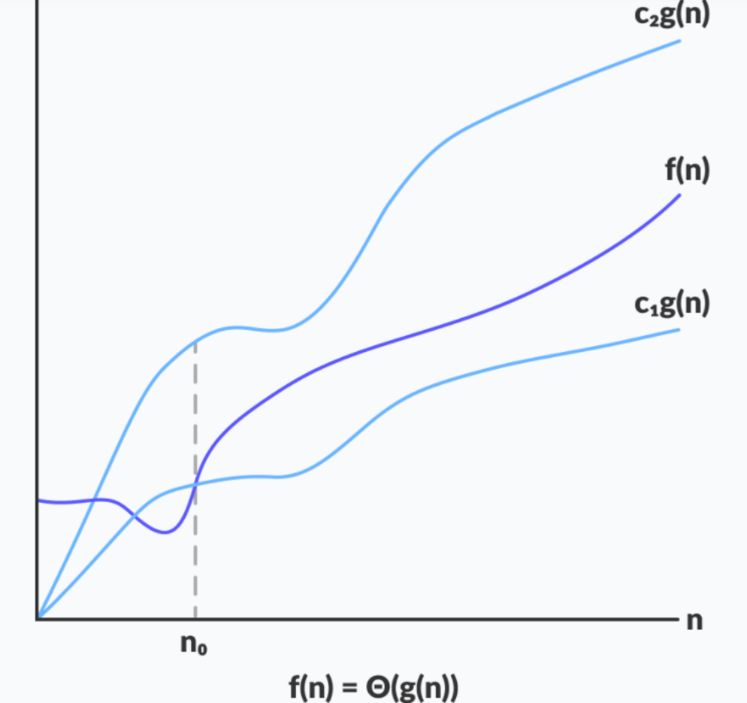

Slide 67
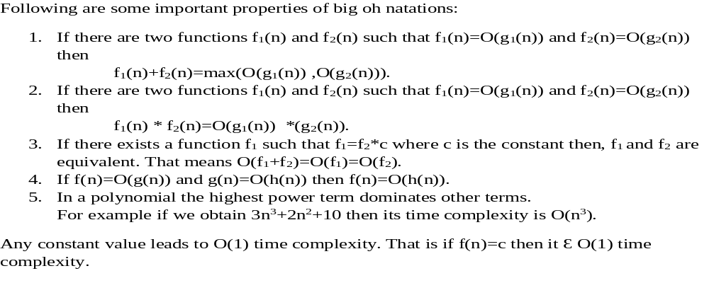
Properties of Big Oh Notation

Slide 68
Order of Growth
Measuring the performance of an algorithm in relation with the input size ‘n’ is called order of growth.
It is clear that logarithmic function is the slowest growing function and Exponential function 2^{n} is the fastest function.
n | logn | nlogn | n² | 2^{n}
1 | 0 | 0 | 1 | 2
2 | 1 | 2 | 4 | 4
4 | 2 | 8 | 16 | 16
8 | 3 | 24 | 64 | 256
16 | 4 | 64 | 256 | 65536
32 | 5 | 160 | 1024 | 4294967296

Slide 69
Basic Efficiency Classes:
Different efficiency classes and each class possessing certain characteristic.
Name of efficiency class | Order of growth | Description | Example
Constant | 1 | As the input size grows then we get constant running time. | Scanning array elements
Logarithmic | logn | When we get logarithmic running time then it is sure that the algorithm does not consider all its input rather the problem is divided into smaller parts on each iteration | Perform binary search operation.
Linear | n | The running time of algorithm depends on the input size n | Performing sequential search operation.
Nlogn | nlogn | Some instance of input is considered for the list of size n. | Sorting the elements using merge sort or quick sort.

Slide 70
Basic Efficiency Classes:
Different efficiency classes and each class possessing certain characteristic.
Name of efficiency class | Order of growth | Description | Example
Quadratic | n2 | When the algorithm has two nested loops then this type of efficiency occurs. | Scanning matrix elements.
Cube | n3 | When the algorithm has three nested loops then this type of efficiency occurs. | Performing matrix multiplication.
Exponential | 2n | When the algorithm has very faster rate of growth then this type of efficiency occurs. | Generating all subsets of n elements.
Factorial | nǃ | When the algorithm is computing all the permutations then this type of efficiency occurs | Generating all permutations.

Slide 71
Examples:
Linear
for ( i=0 ; i<n ; i++ )
m += i;
Time Complexity O(n)
Quadratic
for ( i=0 ; i<n ; i++ )
for( j=0 ; j<n ; j++ )
sum[i] += entry[i][j];
Time Complexity O(n2)

Slide 72
Examples:
Cubic
For(i=1;i<=n;i++)
For(j=1;j<=n;j++)
        For(k=1;k<=n;k++)
Printf(“AAA”);
Time Complexity is O(n3)
Logarithmic
For(i=1;i<n;i=i*2)
Printf(“AAA”)
Time Complexity O(log n)

Slide 73
Examples:
Linear Logarithmic (Nlogn)
For(i=1;i<n;i=i*2)
For(j=1;j<=n,j++)
Printf(“AAA”)

