Slide 1
DATA COMMUNICATION AND COMPUTER NETWORKS
UNIT-1
INTRODUCTION

Slide 2
UNIT-1
Data communication process
Components of communication media
Modes of Communication
IEEE protocol and Standards
Network classifications
Rudiments of networks topologies
Client Server and Peer to Peer Network Architecture.

Slide 3
DATA & INFORMATION
Data refers to the raw facts that are collected while information refers to processed data that enables us to take decisions.
Ex. When result of a particular test is declared it contains data of all students, when you find the marks you have scored you have the information that lets you know whether you have passed or failed.
The word data refers to any information which is presented in a form that is agreed and accepted upon by is creators and users.

Slide 4
1.1 DATA COMMUNICATION
Data Communication is a process of exchanging data or information In case of computer networks this exchange is done between two devices over a transmission medium.
This process involves a communication system which is made up of hardware and software. The hardware part involves the sender and receiver devices and the intermediate devices through which the data passes. The software part involves certain rules which specify what is to be communicated, how it is to be communicated and when. It is also called as a Protocol.
The following sections describes the fundamental characteristics that are important for the effective working of data communication process and is followed by the components that make up a data communications system.

Slide 5
1.1.1 Characteristics of Data Communication
The effectiveness of any data communications system depends upon the following four fundamental characteristics:
1.Delivery: The data should be delivered to the correct destination and correct user.
2. Accuracy: The communication system should deliver the data accurately, without introducing any errors. The data may get corrupted during transmission affecting the accuracy of the delivered data.
3. Timeliness: Audio and Video data has to be delivered in a timely manner without any delay; such a data delivery is called real time transmission of data.
4. Jitter: It is the variation in the packet arrival time. Uneven Jitter may affect the timeliness of data being transmitted.

Slide 6
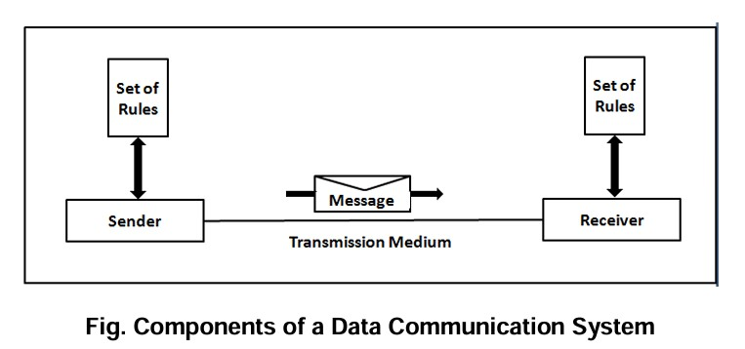
1.1.2 Components of Data Communication
A Data Communication system has five components as shown in the diagram below:

Slide 7
1.Message Message is the information to be communicated by the sender to the receiver.
2. Sender The sender is any device that is capable of sending the data (message).
3. Receiver The receiver is a device that the sender wants to communicate the data (message).
4. Transmission Medium It is the path by which the message travels from sender to receiver. It can be wired or wireless and many subtypes in both.
5. Protocol It is an agreed upon set or rules used by the sender and receiver to communicate data. A protocol is a set of rules that governs data communication. A Protocol is a necessity in data communications without which the communicating entities are like two persons trying to talk to each other in a different language without know the other language.

Slide 8
1.2 DATA REPRESENTATION
Data is collection of raw facts which is processed to deduce information. There may be different forms in which data may be represented. Some of the forms of data used in communications are as follows:
1.Text -Text includes combination of alphabets in small case as well as upper case. It is stored as a pattern of bits. Prevalent encoding system : ASCII, Unicode
2. Numbers -Numbers include combination of digits from 0 to 9. It is stored as a pattern of bits. Prevalent encoding system : ASCII, Unicode
3. Images ―An image is worth a thousand words‖ is a very famous saying. In computers images are digitally stored. A Pixel is the smallest element of an image. To put it in simple terms, a picture or image is a matrix of pixel elements. The pixels are represented in the form of bits. Depending upon the type of image (black n white or color) each pixel would require different number of bits to represent the value of a pixel.
The size of an image depends upon the number of pixels (also called resolution) and the bit pattern used to indicate the value of each pixel.
Example: if an image is purely black and white (two color) each pixel can be represented by a value either 0 or 1, so an image made up of 10 x 10 pixel elements would require only 100 bits in memory to be stored.

Slide 9
4. Audio -Data can also be in the form of sound which can be recorded and broadcasted.
Example: What we hear on the radio is a source of data or information. Audio data is continuous, not discrete.
5. Video -Video refers to broadcasting of data in form of picture or movie

Slide 10
1.3 The Data Communication Process
The data communication process involves the following steps:
a) Data Generation
Data is created by the sender using input devices or software applications.
b) Encoding and Formatting
The data is encoded into signals (analog or digital) suitable for transmission and formatted according to a protocol.
c) Transmission
Encoded signals are transmitted over a medium to the receiving device.
d) Reception
The receiver accepts the transmitted signal and detects the incoming data.
e) Decoding and Interpretation
The received signal is decoded back into meaningful data for the receiver to understand.
f) Acknowledgment and Feedback
In many systems, the receiver sends an acknowledgment (ACK) back to confirm the receipt of the data.

Slide 11
Data Generation
This is the initial stage of the communication process where the sender creates the data that needs to be transmitted. Data generation can occur in different ways depending on the type of system or device used.
The sender can be a human user or a computer system.
Input devices such as keyboard, mouse, camera, or sensors can be used to generate data.
In software systems, data may be created automatically by applications, such as system logs, transaction details, or user activity.
The generated data may include text, images, audio, video, or sensor readings.

Slide 12
Encoding and Formatting
Before data can be transmitted, it needs to be converted into a suitable format for communication over a specific medium.
Encoding refers to converting the data into signals — either analog (continuous) or digital (discrete binary).
For example:
  Text may be converted into ASCII or Unicode.
  Audio signals may be encoded using MP3 or PCM.
  Video may use H.264 or MPEG formats.
Formatting involves structuring the data using communication protocols (such as HTTP, TCP/IP, FTP) to ensure compatibility and consistency between sender and receiver.
Error detection and correction codes may also be added during this step.

Slide 13
Transmission
Once the data is encoded and formatted, it is transmitted over a communication channel to the receiver.
The medium can be wired (like coaxial cable, twisted pair, fiber optics) or wireless (like radio waves, Wi-Fi, infrared).
Devices such as modems, routers, or transceivers may assist in the transmission process.
The transmission is often done in packets in digital communication, where large messages are split into smaller units.
The data signal can be affected by noise, interference, attenuation, and other physical disturbances during this step.

Slide 14
Reception
In this stage, the receiver device accepts the transmitted signal from the medium.
The receiver must be compatible with the transmission technology and protocol used.
It receives the incoming signals and begins processing them.
If the signal is strong and properly formatted, reception is successful.
If the signal is weak or corrupted, the receiver might request retransmission or discard the message depending on the protocol.

Slide 15
Decoding and Interpretation
After receiving the signal, the receiver must convert it back to its original form so it can be understood and used.
Decoding is the reverse of encoding. For example, binary data is converted back to text or audio format.
The structure and meaning of the data are interpreted according to the communication protocol used.
The decoded data is presented to the user via output devices (e.g., screen, speaker, printer) or stored for later use.
Errors detected during decoding can trigger correction mechanisms if supported.

Slide 16
Acknowledgment and Feedback
To ensure reliable communication, the receiver sends a signal back to the sender confirming successful receipt.
The acknowledgment is usually a short message like ACK (Acknowledged) or NACK (Not Acknowledged).
This is common in reliable communication protocols like TCP.
If the sender does not receive an acknowledgment within a certain time, it may retransmit the message.
In interactive systems (like messaging apps or online calls), feedback may also include live status updates like "Seen", "Typing", or "Delivered".
This step ensures data integrity and enables error recovery in case of transmission failure.

Slide 17
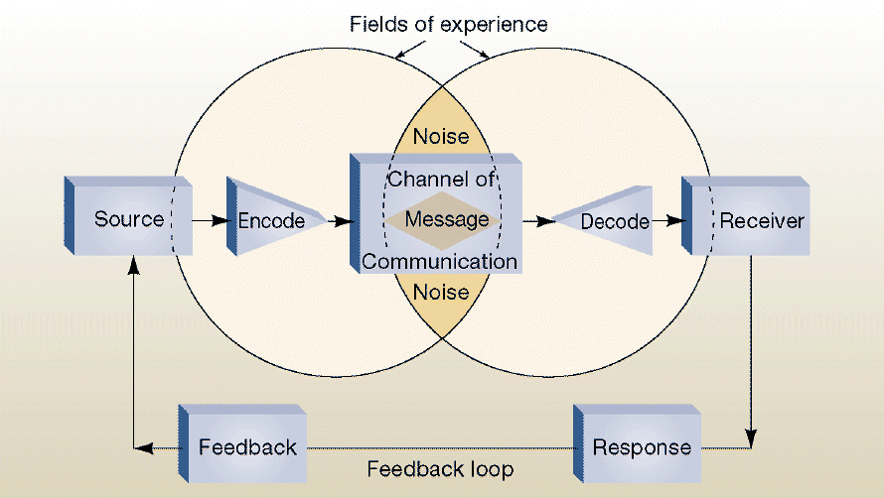
1.4 Components of communication media
The diagram you've shared illustrates the Components of Communication Media in the data communication process. Here's an explanation of each component typically represented in such models:

Slide 18
1. Source (Sender)
The source is the originator of the message. It could be a person, group, or system that has information, feelings, or thoughts to communicate.
Functions:
Initiates the communication.
Encodes the message (chooses how to express it).
Decides the purpose and content of the communication.
Example:
A teacher explaining a concept.
A server sending data to a client.

Slide 19
2. Message
The message is the actual content or information being conveyed from the sender to the receiver.
Forms:
Verbal: Spoken or written language.
Non-verbal: Gestures, body language, tone.
Digital: Files, emails, multimedia.
Must be clear, concise, and well-structured.
Can be influenced by the sender’s vocabulary, emotions, and cultural background.

Slide 20
3. Channel
The channel is the medium through which the message travels from sender to receiver.
Types:
Physical: Sound waves (speech), printed paper (letters), cables (network).
Digital: Email, social media, messaging apps.
Visual: Gestures, images, facial expressions.
Importance:
The right channel ensures message delivery with minimal distortion.
The effectiveness of communication often depends on the choice of channel.

Slide 21
4. Receiver
The receiver is the person or system that receives and interprets the message.
Functions:
Decodes or interprets the message based on knowledge, experience, and context.
Forms a response or reaction.
Can be one person or multiple people (audience).
Miscommunication often occurs if the receiver misunderstands the message due to poor decoding.

Slide 22
5. Feedback
Feedback is the response given by the receiver back to the sender after interpreting the message.
Importance:
Confirms whether the message was understood correctly.
Helps in adjusting and improving future communication.
Can be verbal (“I understand”) or non-verbal (a nod).
Example:
A student asking a question after a lecture.
A reply email acknowledging receipt.

Slide 23
6. Environment
The environment refers to the physical and psychological setting in which communication occurs.
Includes:
Location: Classroom, office, street.
Time: Day/night, urgency.
Mood: Emotions of sender/receiver.
Distractions: Background noise, temperature, crowd.
Role:
A comfortable and distraction-free environment enhances effective communication.

Slide 24
7. Context
Context provides the background or situation surrounding the communication.
Types:
Example:Situational Context: What's happening at the time.
Cultural Context: Beliefs, values, customs.
Relational Context: The relationship between sender and receiver.
A formal tone in a business meeting vs. casual talk among friends.
Using respectful language with elders.

Slide 25
8. Interference (Noise)
Interference, also known as noise, is any factor that disrupts or distorts communication.
Types of Noise:
Physical Noise: Sounds, visual distractions.
Psychological Noise: Stress, emotions, assumptions.
Semantic Noise: Language barriers, jargon.
Technical Noise: Signal loss, slow internet.
Outcome:
Can lead to misunderstanding, incomplete message delivery, or communication failure.

Slide 26
1.5 MODES OF DATA COMMUNICATION
devices communicate with each other by sending and receiving data. The data can flow between the two devices in the following ways.
1. Simplex
2. Half Duplex
3. Full Duplex

Slide 27
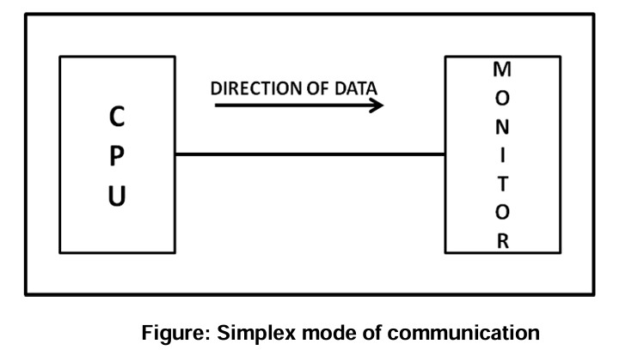
1. Simplex
In Simplex, communication is unidirectional Only one of the devices sends the data and the other one only receives the data. Example: in the above diagram: a cpu send data while a monitor only receives data.

Slide 28
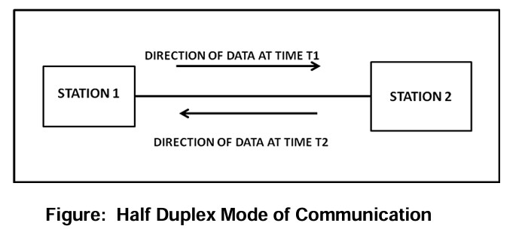
2.Half Duplex
In half duplex both the stations can transmit as well as receive but not at the same time. When one device is sending other can only receive and vice versa (as shown in figure above.)
Example: A walkie-talkie.

Slide 29
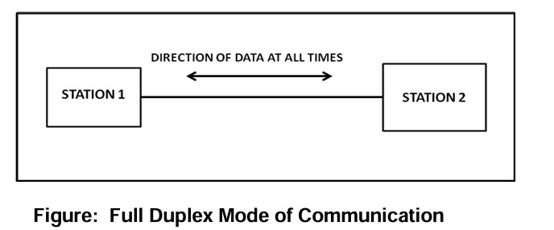
3. Full Duplex
In Full duplex mode, both stations can transmit and receive at the same time.
Example: mobile phones

Slide 30
1.6 IEEE PROTOCOL AND STANDARDS
What is IEEE?
IEEE stands for Institute of Electrical and Electronics Engineers.
It is a professional organization that develops and promotes technical standards for a wide range of industries, especially in electronics, communication, and computer networking.

Slide 31
What are IEEE Standards?
IEEE standards are agreed-upon technical rules and guidelines that ensure devices and systems can interoperate and work reliably.
Standards cover protocols, data formats, hardware, and software specifications.
Why IEEE Standards?
Ensure compatibility and interoperability between devices from different manufacturers.
Promote quality, safety, and efficiency.
Accelerate technology development by providing a common framework.

Slide 32
Common IEEE Protocols and Standards in Networking
1. IEEE 802 Family
A set of standards related to Local Area Networks (LANs) and Metropolitan Area Networks (MANs).
Key IEEE 802 Standards:
IEEE 802.3: Ethernet
  Defines wired LAN communication using Ethernet cables.
  Specifies the physical and data link layer protocols.
IEEE 802.11: Wireless LAN (Wi-Fi)
  Defines wireless communication standards.
  Includes variants like 802.11a/b/g/n/ac/ax with different speeds and frequencies.
IEEE 802.15: Wireless Personal Area Networks (WPANs), e.g., Bluetooth.
IEEE 802.16: Broadband Wireless Access (WiMAX)

Slide 33
2. IEEE 802.1
Focuses on network management and bridging.
Includes standards for VLANs (Virtual LANs), Spanning Tree Protocol (STP), and Quality of Service (QoS).

Slide 34
Layers of IEEE Protocols
Most IEEE protocols apply to the Physical Layer and Data Link Layer of the OSI model.
For example, IEEE 802.3 (Ethernet) defines:
  Physical Layer: how bits are transmitted over cables.
  Data Link Layer: MAC (Media Access Control) addresses and frame formats.

Slide 35
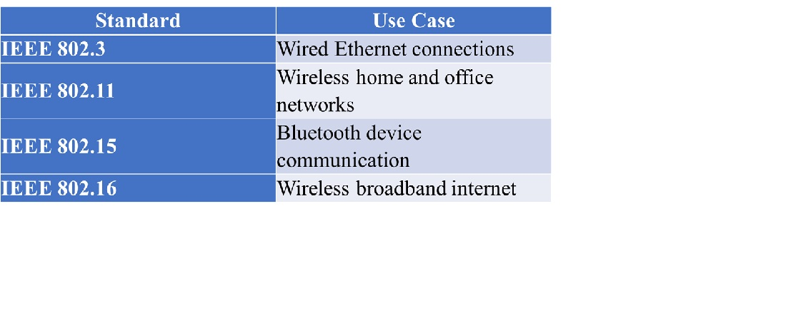
Examples of IEEE Protocol Use Cases

Slide 36
Key Concepts in IEEE Protocols
MAC Address: Unique hardware address for devices on a network (48 bits).
Frames: Data packets defined at the Data Link layer in IEEE protocols.
Collision Detection (CSMA/CD): Used in Ethernet to avoid data collision.
Access Methods: Rules on how devices take turns communicating (e.g., CSMA/CA in Wi-Fi).

Slide 37
1.7 Network classifications
A computer network is a system that connects many independent computers to share information (data) and resources. The integration of computers and other different devices allows users to communicate more easily. It is a collection of two or more computer systems that are linked together. A network connection can be established using either cable or wireless media. Hardware and software are used to connect computers and tools in any network.

Slide 38
Types of Computer Networks
There are mainly five types of Computer Networks
Personal Area Network (PAN)
Local Area Network (LAN)
Campus Area Network (CAN)
Metropolitan Area Network (MAN)
Wide Area Network (WAN)

Slide 39
Personal Area Network (PAN)
PAN is the most basic type of computer network. It is a type of network designed to connect devices within a short range, typically around one person. It allows your personal devices, like smartphones, tablets, laptops, and wearables, to communicate and share data with each other. PAN offers a network range of 1 to 100 meters from person to device providing communication. Its transmission speed is very high with very easy maintenance and very low cost. This uses Bluetooth, IrDA, and Zigbee as technology. Examples of PAN are USB, computer, phone, tablet, printer, PDA, etc.

Slide 40
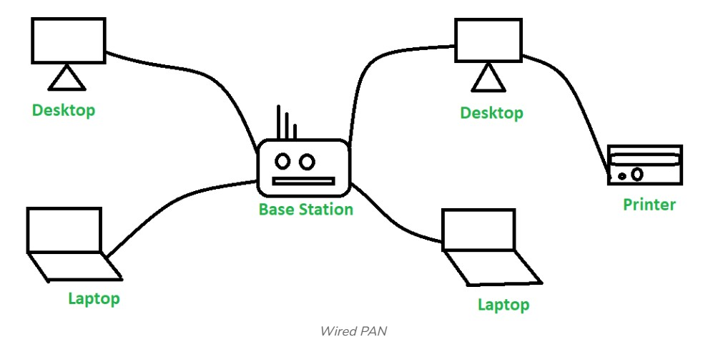
Types of PAN
Wired Personal Area Network: A wired personal area network is constructed using a USB.

Slide 41
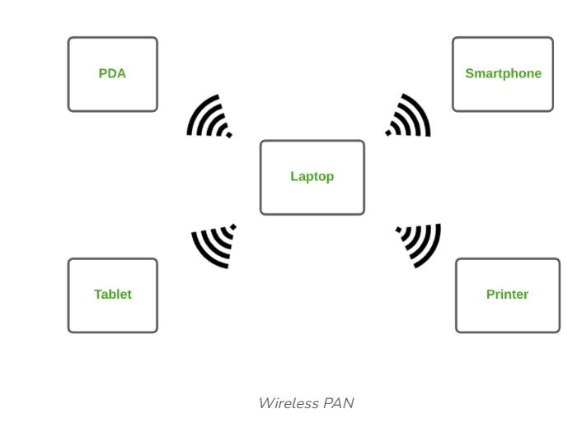
Wireless Personal Area Networks: Wireless Personal Area Networks are created by simply utilising wireless technologies such as WiFi and Bluetooth. It is a low-range network.

Slide 42
Advantages of PAN
PAN is relatively flexible and provides high efficiency for short network ranges.
It needs easy setup and relatively low cost.
It does not require frequent installations and maintenance
It is easy and portable.
Needs fewer technical skills to use.
Disadvantages of PAN
Low network coverage area/range.
Limited to relatively low data rates.
Devices are not compatible with each other.
Inbuilt WPAN devices are a little bit costly.
Applications of PAN
Home and Offices
Organizations and the Business sector
Medical and Hospital
School and College Education
Military and Defense

Slide 43
Local Area Network (LAN)
LAN is the most frequently used network. A LAN is a computer network that connects computers through a common communication path, contained within a limited area, that is, locally. A LAN encompasses two or more computers connected over a server. The two important technologies involved in this network are Ethernet and Wi-fi. It ranges up to 2km & transmission speed is very high with easy maintenance and low cost. Examples of LAN are networking in a home, school, library, laboratory, college, office, etc.

Slide 44
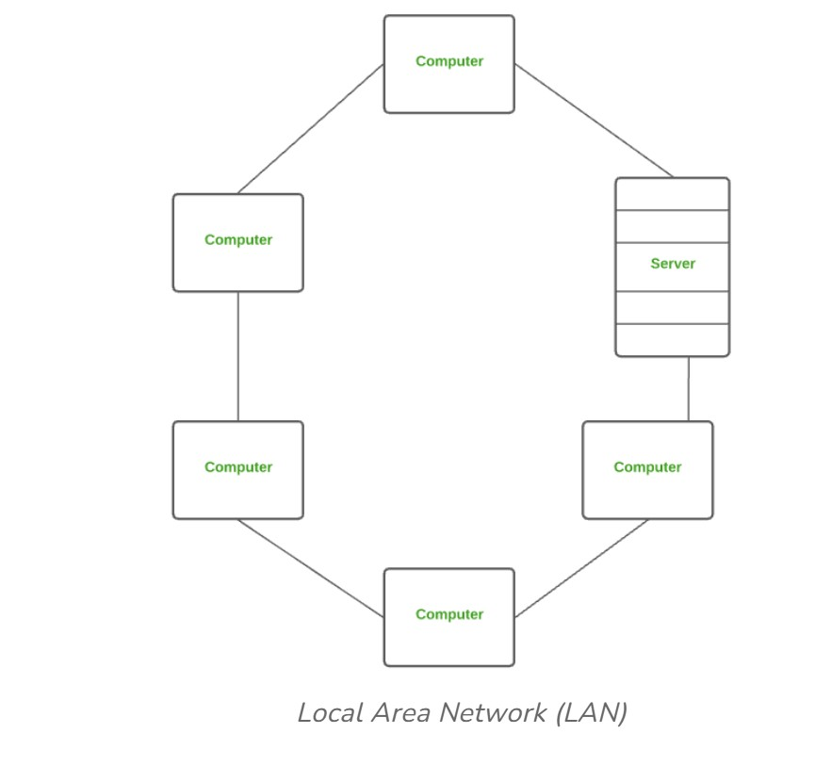

Slide 45
Advantages of a LAN
Privacy: LAN is a private network, thus no outside regulatory body controls it, giving it a privacy.
High Speed: LAN offers a much higher speed(around 100 mbps) and data transfer rate comparatively to WAN.
Supports different transmission mediums: LAN support a variety of communications transmission medium such as an Ethernet cable (thin cable, thick cable, and twisted pair), fiber and wireless transmission.
Inexpensive and Simple: A LAN usually has low cost, installation, expansion and maintenance and LAN installation is relatively easy to use, good scalability.
Disadvantages of LAN
The initial setup costs of installing Local Area Networks is high because there is special software required to make a server.
Communication devices like an ethernet cable, switches, hubs, routers, cables are costly.
LAN administrator can see and check personal data files as well as Internet history of each and every LAN user. Hence, the privacy of the users are violated
LANs are restricted in size and cover only a limited area
Since all the data is stored in a single server computer, if it can be accessed by an unauthorized user, can cause a serious data security threat.

Slide 46
Campus Area Network (CAN)
CAN is bigger than a LAN but smaller than a MAN. This is a type of computer network that is usually used in places like a school or colleges. This network covers a limited geographical area that is, it spreads across several buildings within the campus. CAN mainly use Ethernet technology with a range from 1km to 5km. Its transmission speed is very high with a moderate maintenance cost and moderate cost. Examples of CAN are networks that cover schools, colleges, buildings, etc.

Slide 47
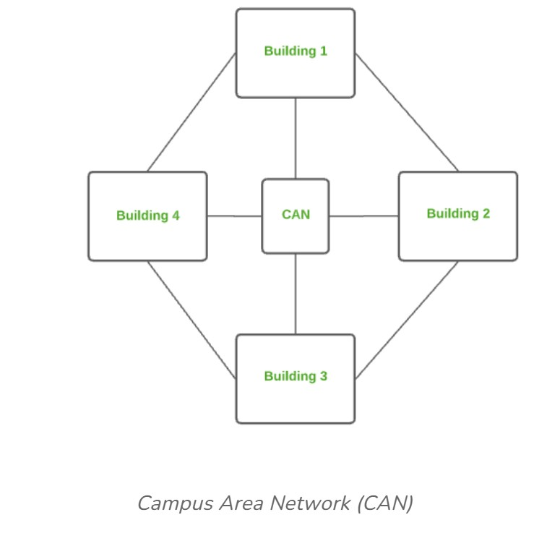

Slide 48
Advantages of CAN
Speed: Communication within a CAN takes place over Local Area Network (LAN) so data transfer rate between systems is little bit fast than Internet.
Security: Network administrators of campus take care of network by continuous monitoring, tracking and limiting access. To protect network from unauthorized access firewall is placed between network and internet.
Cost effective: With a little effort and maintenance, network works well by providing fast data transfer rate with multi-departmental network access. It can be enabled wirelessly, where wiring and cabling costs can be managed. So to work with in a campus using CAN is cost-effective in view of performance

Slide 49
Metropolitan Area Network (MAN)
A MAN is larger than a LAN but smaller than a WAN. This is the type of computer network that connects computers over a geographical distance through a shared communication path over a city, town, or metropolitan area. This network mainly uses FDDI, CDDI, and ATM as the technology with a range from 5km to 50km. Its transmission speed is average. It is difficult to maintain and it comes with a high cost. Examples of MAN are networking in towns, cities, a single large city, a large area within multiple buildings, etc.

Slide 50
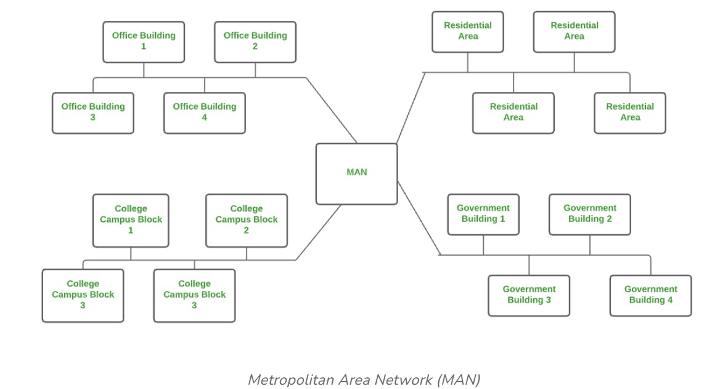

Slide 51
Advantages of MAN
MAN offers high-speed connectivity in which the speed ranges from 10-100 Mbps.
The security level in MAN is high and strict as compared to WAN.
It support to transmit data in both directions concurrently because of dual bus architecture.
MAN can serve multiple users at a time with the same high-speed internet to all the users.
MAN allows for centralized management and control of the network, making it easier to monitor and manage network resources and security.
Disadvantages of MAN
The architecture of MAN is quite complicated hence, it is hard to design and maintain.
This network is highly expensive because it required the high cost to set up fiber optics.
It provides less fault tolerance.
The Data transfer rate in MAN is low when compare to LANs.

Slide 52
Wide Area Network (WAN)
WAN is a type of computer network that connects computers over a large geographical distance through a shared communication path. It is not restrained to a single location but extends over many locations. WAN can also be defined as a group of local area networks that communicate with each other with a range above 50km. Here we use Leased-Line & Dial-up technology. Its transmission speed is very low and it comes with very high maintenance and very high cost. The most common example of WAN is the Internet.

Slide 53
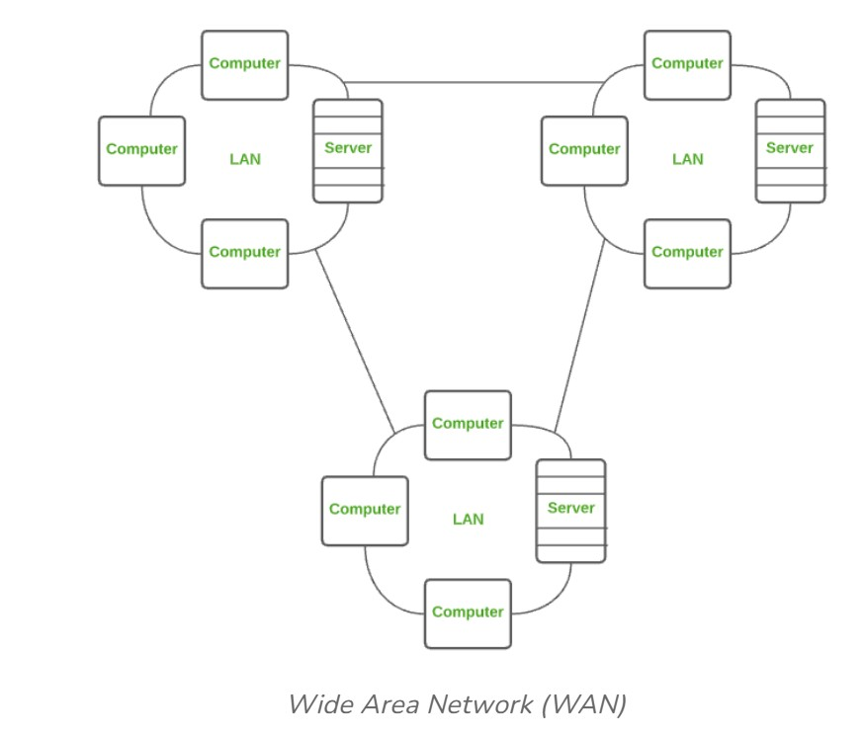

Slide 54
Advantages of WAN
It covers large geographical area which enhances the reach of organisation to transmit data quickly and cheaply.
The data can be stored in centralised manner because of remote access to data provided by WAN.
The travel charges that are needed to cover the geographical area of work can be minimised.
WAN enables a user or organisation to connect with the world very easily and allows to exchange data and do business at global level.
Disadvantages of WAN
Traffic congestion in Wide Area Network is very high.
The fault tolerance ability of WAN is very less.
Noise and error are present in large amount due to multiple connection point.
The data transfer rate is slow in comparison to LAN because of large distances and high number of connected system within the network.

Slide 55
Comparison between Different Computer Networks
Parameters | PAN | LAN | CAN | MAN | WAN
Full Name | Personal Area Network | Local Area Network | Campus Area Network | Metropolitan Area Network | Wide Area Network
Technology | Bluetooth, Zigbee | Ethernet & Wifi | Ethernet | FDDI, CDDi. ATM | Leased Line, Dial-Up
Range | 1-100 m | Upto 2km | 1 - 5 km | 5-50 km | Above 50 km
Transmission Speed | Very High | Very High | High | Average | Low
Ownership | Private | Private | Private | Private or Public | Private or Public
Maintenance | Very Easy | Easy | Moderate | Difficult | Very Difficult
Cost | Very Low | Low | Moderate | High | Very High

Slide 56
1.8 Rudiments of networks topologies
Network topology refers to the manner in which the links and nodes of a network are arranged to relate to each other. Topologies are categorized as either physical network topology, which is the physical signal transmission medium, or logical network topology, which refers to the manner in which data travels through the network between devices, independent of physical connection of the devices. Logical network topology examples include twisted pair Ethernet, which is categorized as a logical bus topology, and token ring, which is categorized as a logical ring topology.
Physical network topology examples include star, mesh, tree, ring, point-to-point, circular, hybrid, and bus topology networks, each consisting of different configurations of nodes and links. The ideal network topology depends on each business’s size, scale, goals, and budget. A network topology diagram helps visualize the communicating devices, which are modeled as nodes, and the connections between the devices, which are modeled as links between the nodes.

Slide 57
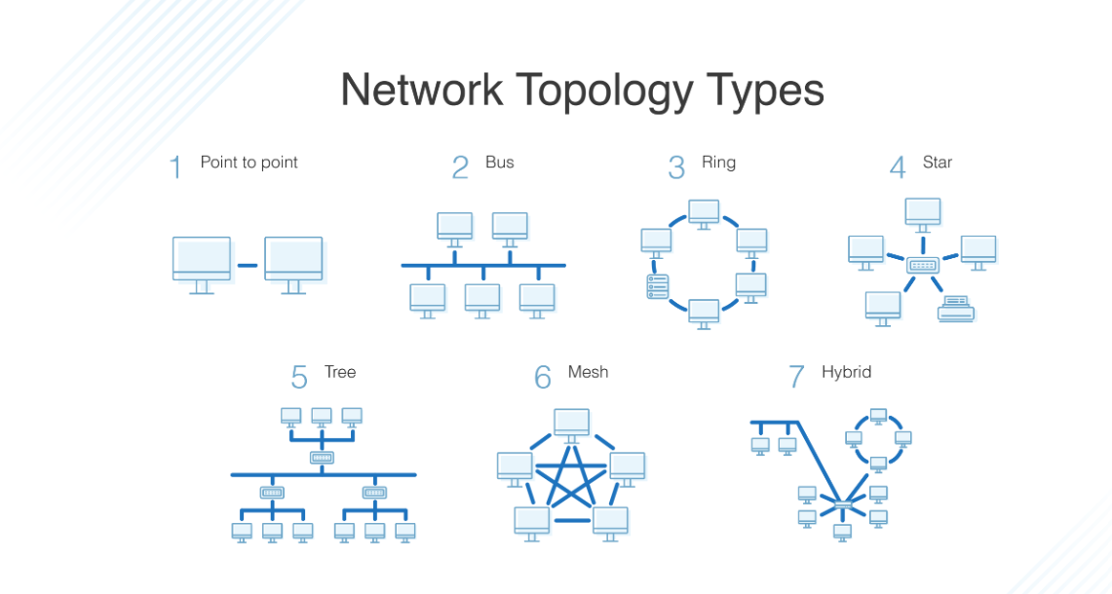

Slide 58
Types of Network Topology
There are several different logical and physical network topologies from which administrators can choose to build a secure, robust, and easily maintainable topology. The most popular configurations include:
Bus network topology -- Also known as backbone network topology, this configuration connects all devices to a main cable via drop lines. The advantages of bus network topology lie in its simplicity, as there is less cable required than in alternative topologies, which makes for easy installation.
Mesh network topology -- A dedicated point-to-point link connects each device on the network to another device on the network, only carrying data between two devices.
Ring network topology -- Two dedicated point-to-point links connect a device to the two devices located on either side of it, creating a ring of devices through which data is forwarded via repeaters until it reaches the target device.
Star network topology -- The most common network topology, star topology connects each device in the network to a central hub. Devices can only communicate with each other indirectly through the central hub.
Hybrid network topology -- Any combination of two or more topologies is a hybrid topology.
Tree network topology -- This topology consists of a parent-child hierarchy in which star networks are interconnected via bus networks. Nodes branch out linearly from one root node, and two connected nodes only share one mutual connection.

Slide 59
Multi-access network topology, also known as a non-broadcast multiple access network (NBMA), consists of multiple linked hosts in which data is transferred directly from one computer to another single host across a switched fabric or over a virtual circuit.
Smart grid network topology refers to the network configurations that are necessary to facilitate system operations in a smart grid. A smart grid is an electrical network of smart meters, smart appliances, renewable energy resources, and energy efficient resources that condition and control the production and distribution of electricity.
Edge computing is a type of decentralized computing that is conducted at or in close proximity to remote sources of generated data, reducing travel time from client to server and time to insight. Edge network topology consists of the cloud or a data center, which connects to edge gateway servers or edge nodes, which then connect to the sensors and controls in IoT devices, such as connected wind turbines and connected oil platforms.

Slide 60
1.9 Client Server and Peer to Peer Network Architecture.
Client Server
This model are broadly used network model. In the Client-Server Network, Clients and servers are differentiated, and Specific servers and clients are present. In Client-Server Network, a Centralized server is used to store the data because its management is centralized. In Client-Server Network, the Server responds to the services which is requested by the Client.

Slide 61
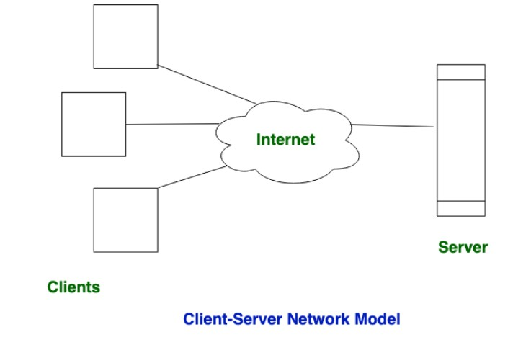

Slide 62
Peer to Peer Network
This model does not differentiate the clients and the servers, In this each and every node is itself client and server. In Peer-to-Peer Network, Each and every node can do both request and respond for the services.
Peer-to-peer networks are often created by collections of 12 or fewer machines. All of these computers use unique security to keep their data, but they also share data with every other node.
In peer-to-peer networks, the nodes both consume and produce resources. Therefore, as the number of nodes grows, so does the peer-to-peer network's capability for resource sharing. This is distinct from client-server networks where an increase in nodes causes the server to become overloaded.
It is challenging to give nodes in peer-to-peer networks proper security because they function as both clients and servers. A denial of service attack may result from this.
The majority of contemporary operating systems, including Windows and Mac OS, come with software to implement peer

Slide 63
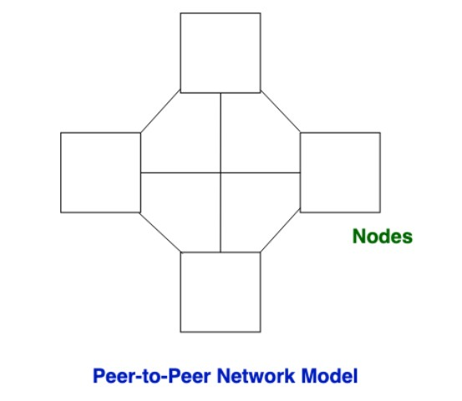

Slide 64
Difference Between Client-Server and Peer-to-Peer Network
Client-Server Network | Peer-to-Peer Network
In Client-Server Network, Clients and server are differentiated, Specific server and clients are present. | In Peer-to-Peer Network, Clients and server are not differentiated.
Client-Server Network focuses on information sharing. | While Peer-to-Peer Network focuses on connectivity.
In Client-Server Network, Centralized server is used to store the data. | While in Peer-to-Peer Network, Each peer has its own data.
In Client-Server Network, Server respond the services which is request by Client. | While in Peer-to-Peer Network, Each and every node can do both request and respond for the services.
Client-Server Network are costlier than Peer-to-Peer Network. | While Peer-to-Peer Network are less costlier than Client-Server Network.
Client-Server Network are more stable than Peer-to-Peer Network. | While Peer-to-Peer Network are less stable if number of peer is increase.
Client-Server Network is used for both small and large networks. | While Peer-to-Peer Network is generally suited for small networks with fewer than 10 computers.

