Slide 1
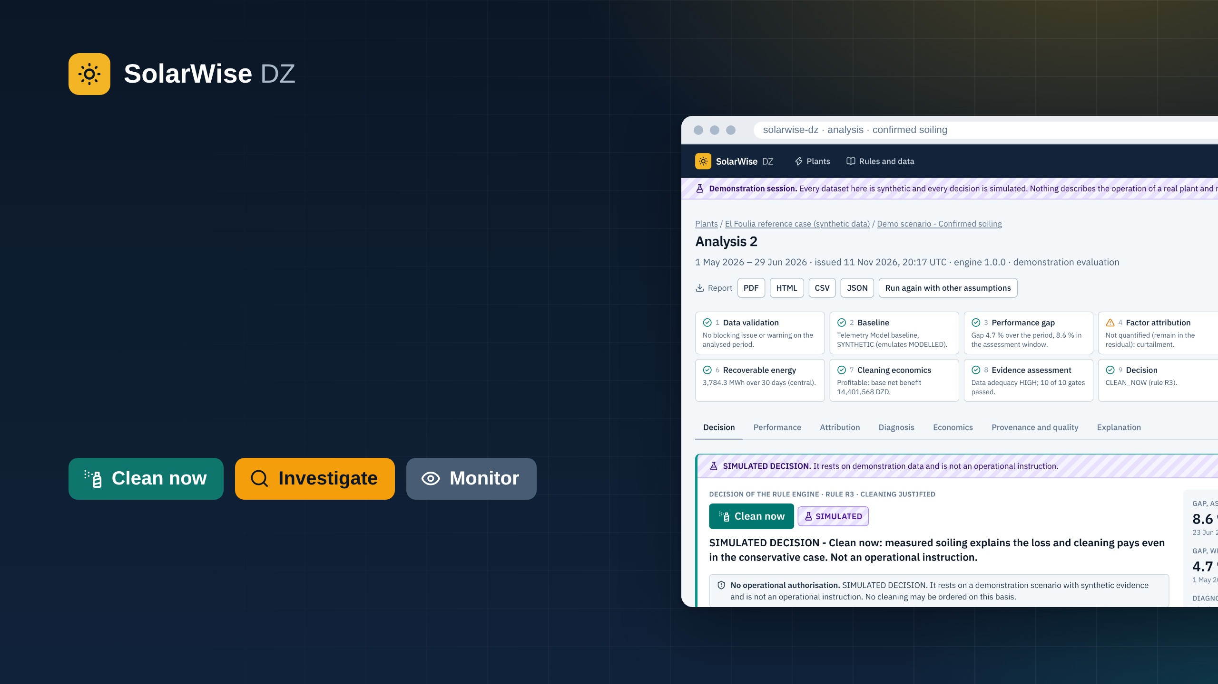
Know why a solar plant
under-performs before
deciding to clean it.
Decision support for photovoltaic plants in the Algerian south. It explains the production gap, then tells whether a cleaning is justified.
Reference case: El Foulia, 300 MWp, Guemar (El Oued), Algeria.
Every figure shown from the demonstration is synthetic.
Notes:
Slide 1 of 11 - Title - 15 s (from 0:00 to 0:15)
[Introduce yourself in one sentence, then:]
This is SolarWise DZ. It tells the operator of a solar plant why the plant is producing less than expected, before anyone decides to send the cleaning crews.

Slide 2
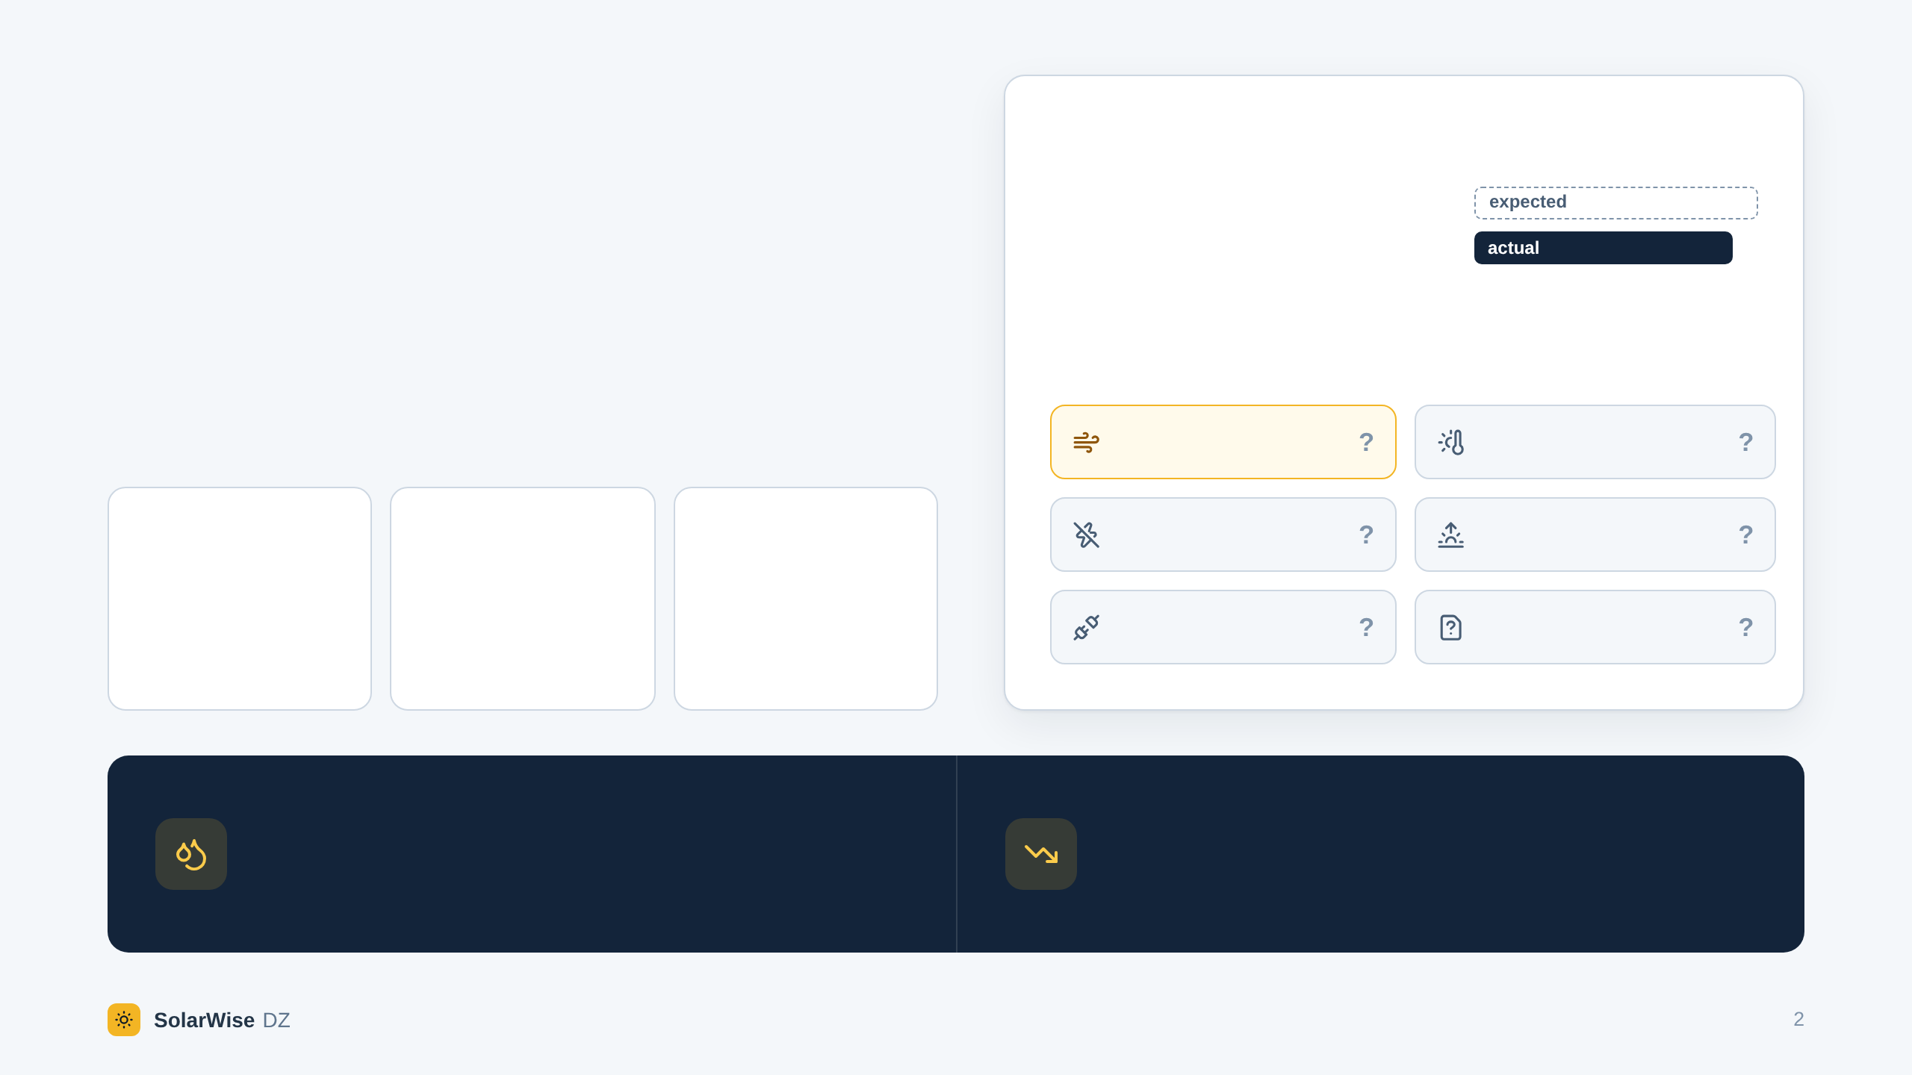
THE PROBLEM
Production is down 9 %.
Is it dust?
ACTUAL AGAINST EXPECTED ENERGY · LAST 7 DAYS
−9 %
In the Sahara, dust really does cut output. But heat, a fault, shading, curtailment or bad data give the same picture on the meter.
Six possible causes. One meter reading.
Dust on the modules
Heat
−8.4 %
300 MWp
15,000 MW
Inverter fault
Shading
power after 8 weeks without cleaning, measured at Ouargla ¹
El Foulia (El Oued), Algeria's largest solar plant, inaugurated in October 2026 ²
of solar capacity planned by Algeria for 2035 ²
Grid curtailment
Missing or wrong data
Clean for the wrong reason: water, labour and money are spent, and nothing is recovered.
Wait when it really is dust: energy is lost every day.
¹ Dida et al., Renewable and Sustainable Energy Reviews 124 (2020), field measurements at Ouargla. ² pv magazine France, 28 October 2026.
Notes:
Slide 2 of 11 - The problem - 35 s (from 0:15 to 0:50)
On the 26th of October, Algeria inaugurated El Foulia, its largest solar plant: 300 megawatts in El Oued. And in the Sahara, dust is real. At Ouargla, researchers measured 8 percent less power after only eight weeks without cleaning.
Now picture the control room. Production is 9 percent below expected. Is it dust? Maybe. But heat, an inverter fault, shading, grid curtailment or bad data look exactly the same on the meter.
Clean for the wrong reason, and you spend water and money for nothing. Wait when it really is dust, and you lose energy every day.

Slide 3
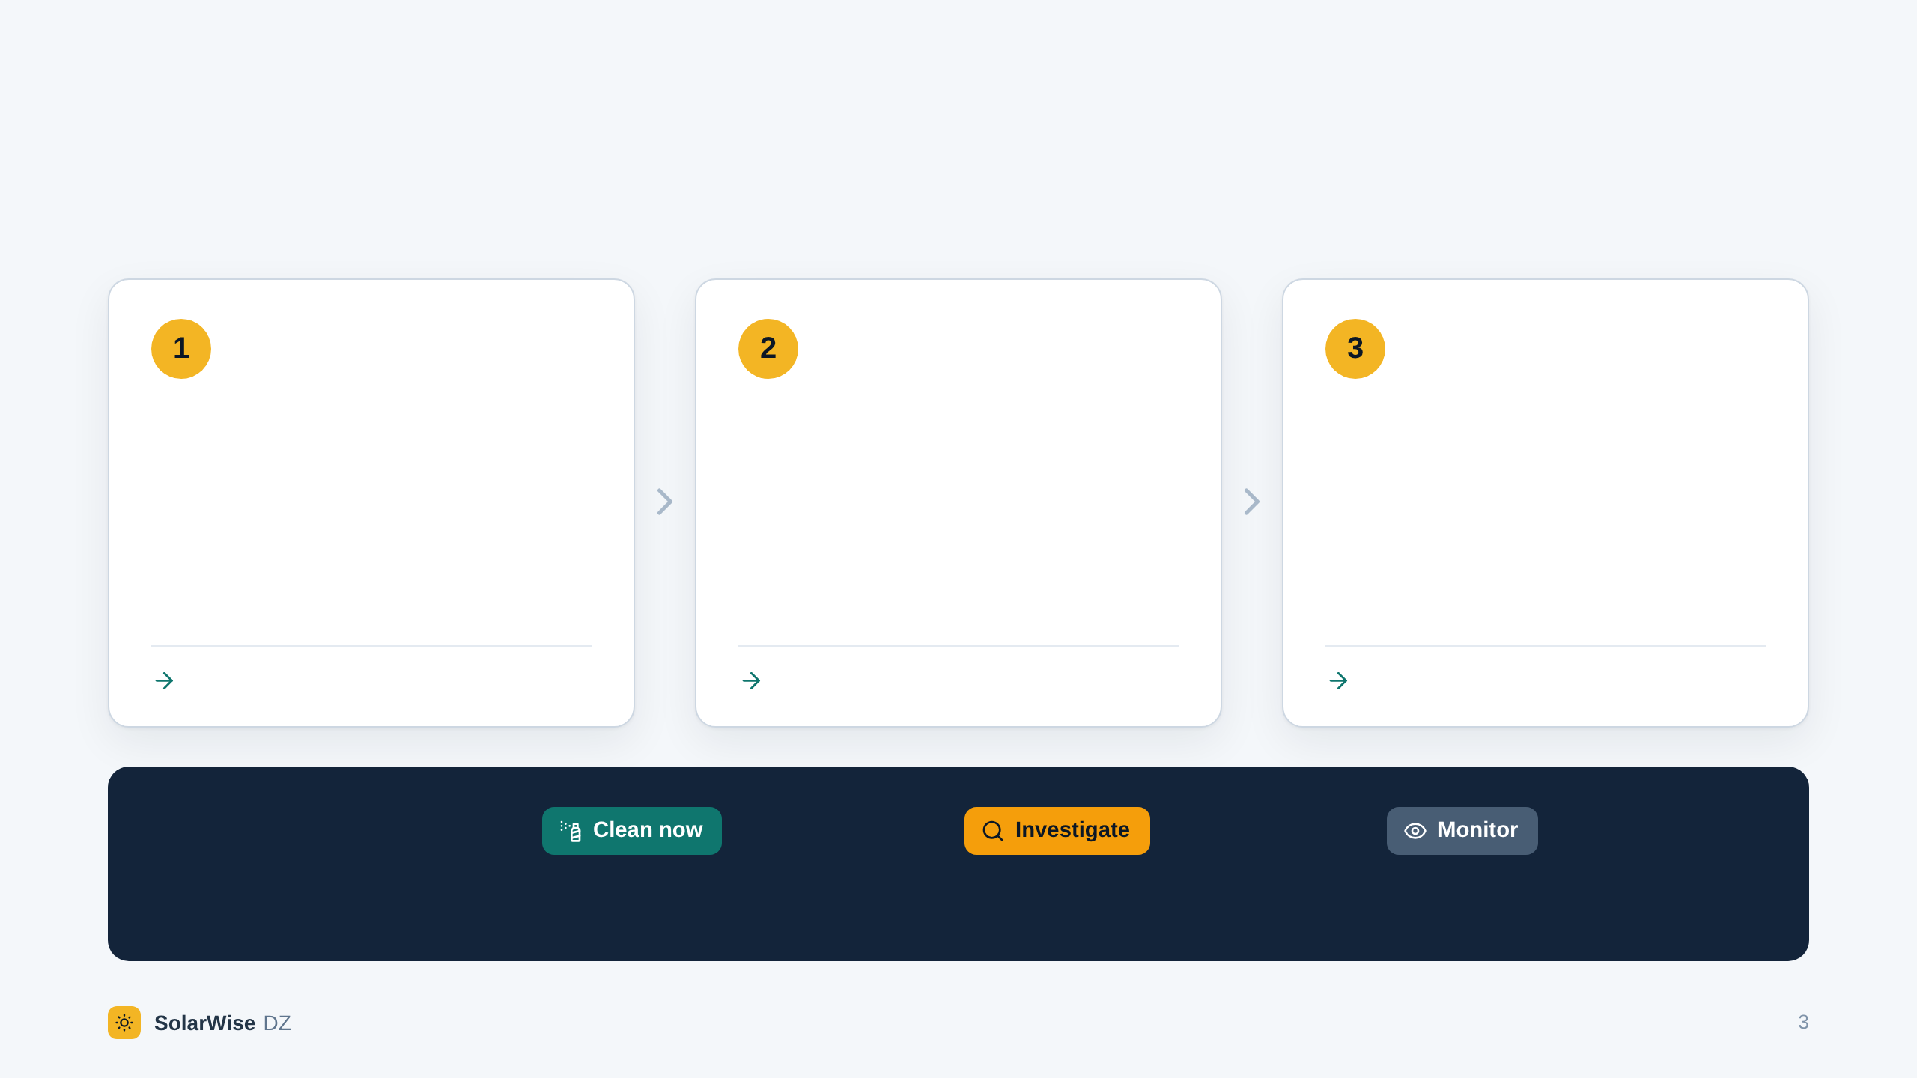
OUR SOLUTION
SolarWise DZ answers three questions, in order.
It reads production data, soiling measurements, maintenance logs, inspections and your own costs, each with its declared origin.
How much is missing?
Why?
Does cleaning pay?
Actual energy against a documented baseline. The gap counts only when it exceeds the measurement uncertainty.
Each cause is quantified only from data that measure it: downtime, equipment, curtailment, soiling sensor. The rest stays “unexplained”.
The energy a cleaning would recover, at its value, against the full cost of cleaning. It must pay even in the conservative case.
The gap, with its uncertainty
The causes, with their evidence
The net benefit, from low to high
One answer,
with its reasons
Every gate is passed: the cleaning is justified and it pays.
Something is unknown, open or contradictory. Find out first.
Nothing to act on now. The analysis is repeated later.
Notes:
Slide 3 of 11 - The solution - 35 s (from 0:50 to 1:25)
SolarWise DZ answers three questions, in order.
One: how much is really missing, against a documented baseline and beyond the measurement uncertainty.
Two: why. Each cause is quantified only from data that actually measure it. What we cannot explain stays “unexplained”.
Three: does cleaning pay. The energy we would recover, against the full cost of cleaning.
The result is one of three answers: clean now, investigate, or monitor. Always with its reasons.

Slide 4
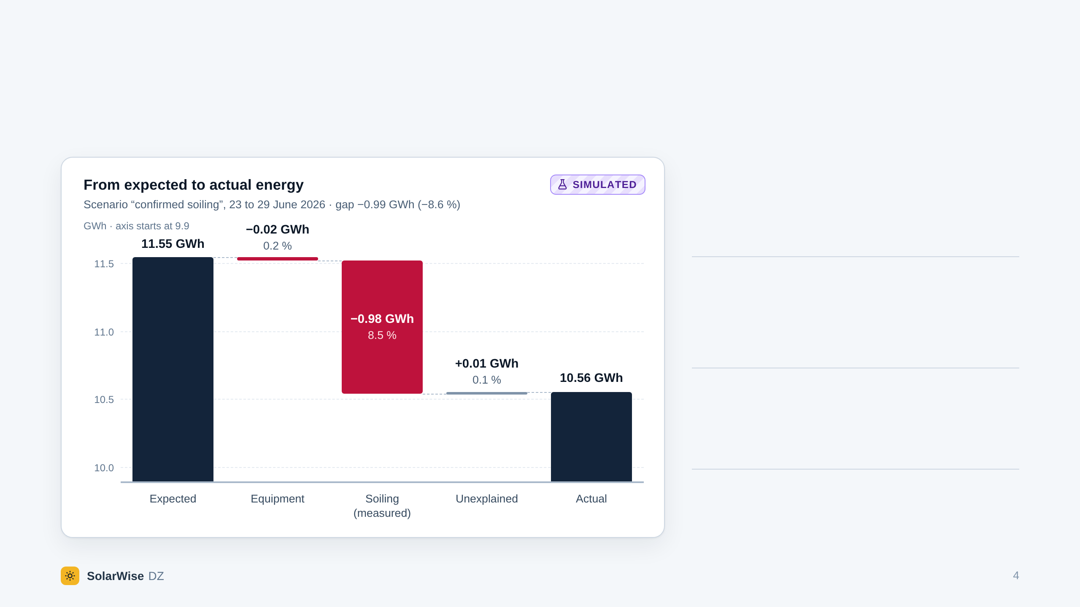
QUESTION 2 · WHY?
Every kilowatt-hour of the gap is accounted for,
or declared unexplained.
8.5 %
Measured by the soiling sensor. It is not deduced from the gap.
8.4 %
Left for soiling to explain once the equipment losses are removed. The two agree.
0.1 %
Unexplained. Nothing is hidden inside “soiling”.
Sunshine and temperature are already inside the expected energy. Performance metrics follow IEC 61724-1.
Synthetic demonstration scenario on the El Foulia reference case. It contains no measurement from any real plant.
Notes:
Slide 4 of 11 - Why: the bridge - 30 s (from 1:25 to 1:55)
Here is the second question, on a simulated case. Expected energy on the left, actual energy on the right.
The soiling sensor reads eight and a half percent. The loss left to explain, once equipment is removed, is eight point four. They agree. And only a tenth of a percent stays unexplained.
The key point: soiling is measured. It is never guessed from the gap.

Slide 5
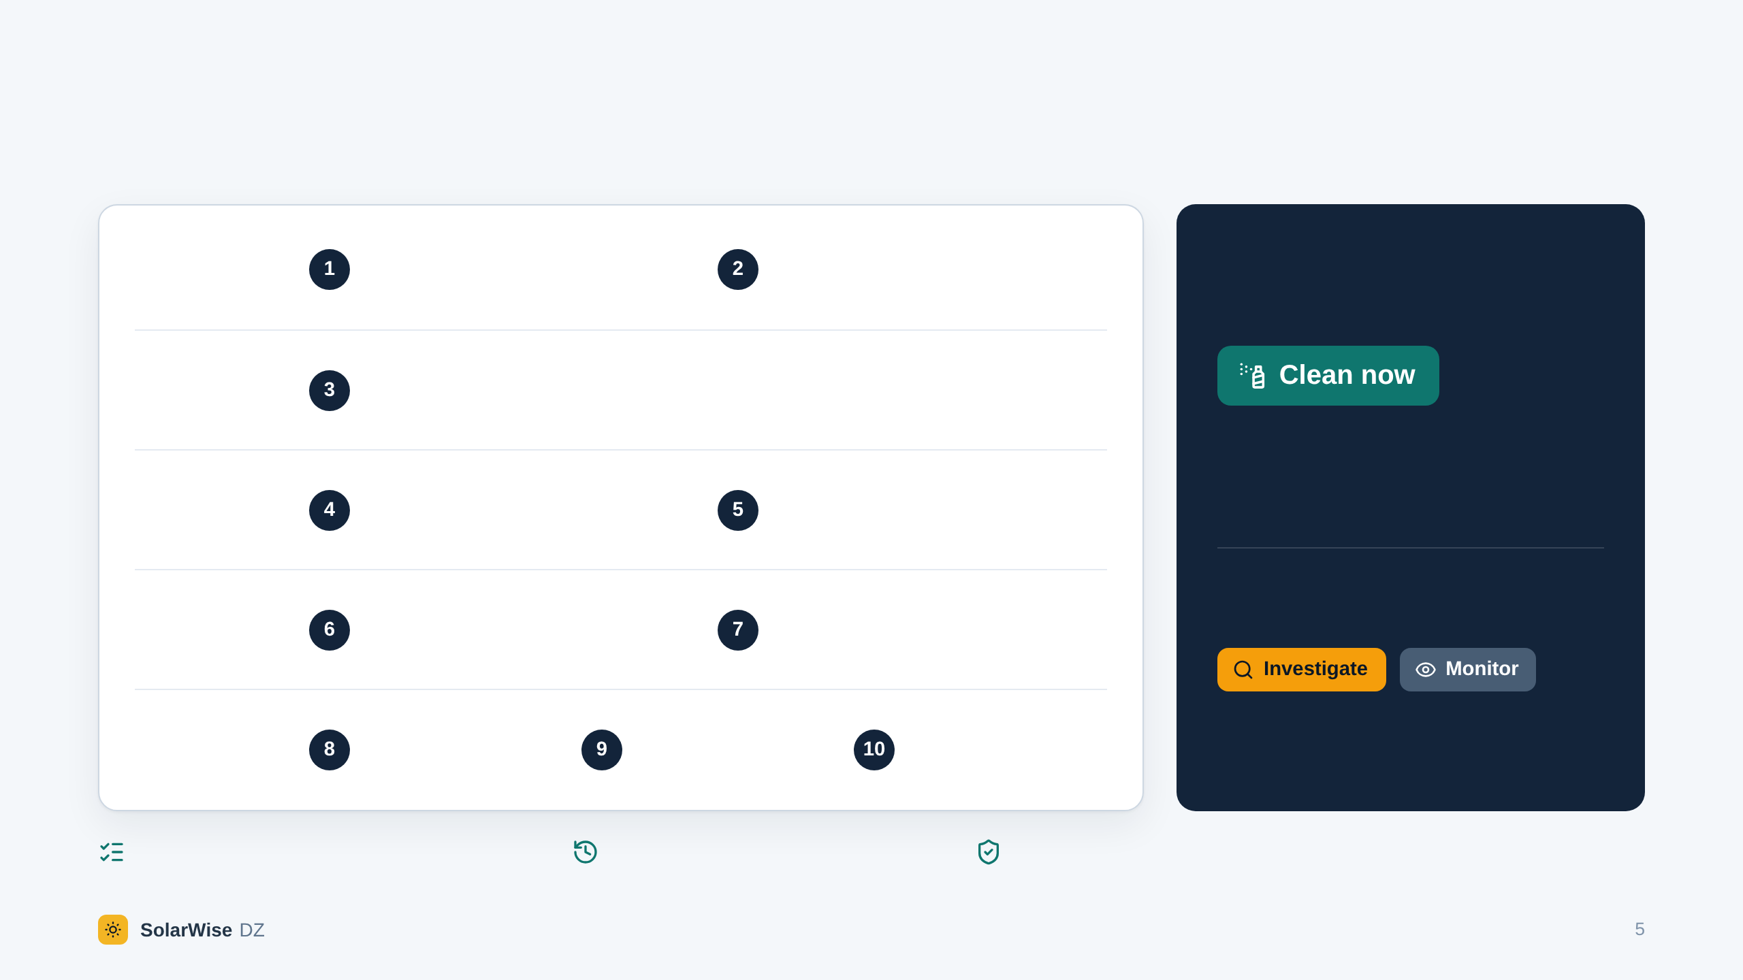
QUESTION 3 · THE DECISION
A cleaning order has to pass ten gates.
THE DATA
Reliable measured production data
Baseline of documented origin
10 of 10
THE LOSS
Significant under-performance now, beyond the uncertainty
Measured loss, explained by measured soiling, nothing else open, and a cleaning that pays.
THE SOILING
Credible measured soiling evidence
Soiling consistent with the production gap
No critical contradiction in the evidence
Anything less
NOTHING ELSE
No unresolved technical issue
Recoverable energy estimated
Complete economic inputs
Profitable in the conservative case
A gate that cannot be evaluated counts as not passed.
THE MONEY
Explicit rules: same data, same answer.
Every result is stored as issued.
An independent interlock re-checks every “Clean now”.
Notes:
Slide 5 of 11 - Ten gates - 35 s (from 1:55 to 2:30)
Then comes the decision. A cleaning order has to pass ten gates: reliable measured data, a real loss, credible soiling evidence that matches this loss, nothing else open, and economics that hold in the conservative case.
Ten out of ten: clean now. Anything less: investigate, or monitor.
These are explicit rules, not a black box. Same data, same answer. And an independent check verifies every cleaning order a second time.

Slide 6
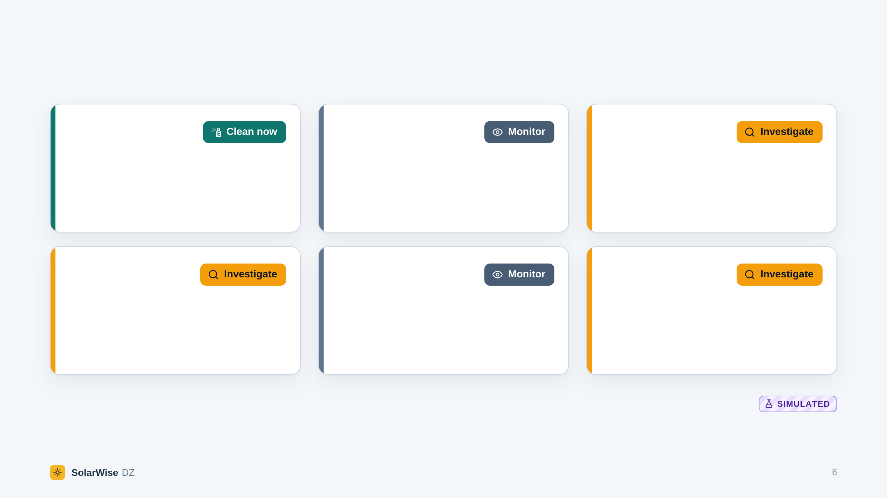
WHAT IT CHANGES
Six cases with the same 9 % drop. One cleaning order.
−8.6 %
−8.9 %
−10.6 %
Dust, measured
Heat
Inverter fault
The soiling sensor reads 8.5 %. It matches the gap, and the cleaning pays.
Module temperature explains 91 % of the gap. Cleaning would change nothing.
Part of the plant is not producing. Repair first: cleaning would not recover it.
−9.2 %
−10.1 %
−8.6 %
Morning shading
Grid curtailment
Conflicting evidence
The sensor shows a clean array and 8.7 % stays unexplained. Check on site.
The grid limited the output. Cleaning would not bring that energy back.
An inspection reports heavy soiling, the sensor reads 1 %. Resolve it first.
A rule of thumb, “gap above 5 %: clean”,
would have sent the cleaning crews six times.
Gap over the last 7 days of each scenario
Synthetic demonstration scenarios on the El Foulia reference case. They contain no measurement from any real plant.
Notes:
Slide 6 of 11 - Same symptom, different answers - 40 s (from 2:30 to 3:10)
So what does it change? Here are six simulated cases, all with about nine percent less production. A simple threshold would clean six times.
SolarWise DZ says clean once: when the dust is measured and the cleaning pays.
Heat, or curtailment: cleaning changes nothing, so we monitor. An inverter fault: repair it first. Shading, or evidence that contradicts itself: investigate.
Five needless cleanings avoided. And each time, the operator knows what to do instead.

Slide 7
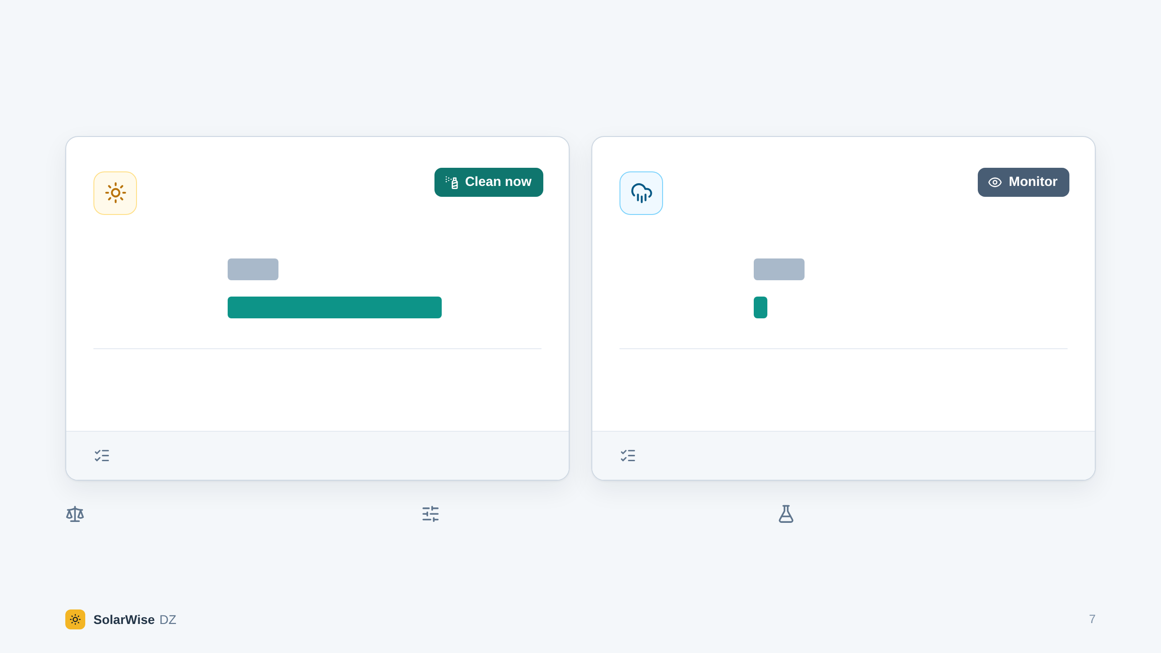
DOES CLEANING PAY?
Same cleaning cost. Opposite answers.
Dry weeks ahead
Rain expected within days
Soiling measured at 8.5 %.
Benefit counted over 30 days.
Soiling measured at 5.4 %.
Benefit counted over 3 days.
Cost of the cleaning
4.5 M DZD
Cost of the cleaning
4.5 M DZD
Energy recovered
18.9 M DZD
Energy recovered
1.2 M DZD
+14.4 M DZD
Net benefit. Still +5.0 M DZD in the conservative case.
−3.3 M DZD
Net loss. Still −1.1 M DZD in the optimistic case.
10 gates of 10 passed. The cleaning is justified.
9 gates of 10 passed. Gate 10 fails: the cleaning does not pay.
The test is conservative: low recoverable energy against high cost. The net benefit must stay positive.
No price is built in. The operator enters water, labour, equipment, downtime and the value of a kWh.
Simulated scenarios with illustrative assumptions (5 DZD per kWh). These are not market prices.
Synthetic demonstration scenarios on the El Foulia reference case. Benefit and cost in the base case, in Algerian dinars.
Notes:
Slide 7 of 11 - Does cleaning pay? - 30 s (from 3:10 to 3:40)
And even real dust does not always justify a cleaning. The cleaning cost is the same in both cases.
On the left, dry weeks ahead: the cleaning recovers about four times its cost. Clean now.
On the right, rain is expected within days: the cleaning would lose money. So we wait.
The prices are the operator's own: nothing is built in. The figures here are illustrative.

Slide 8
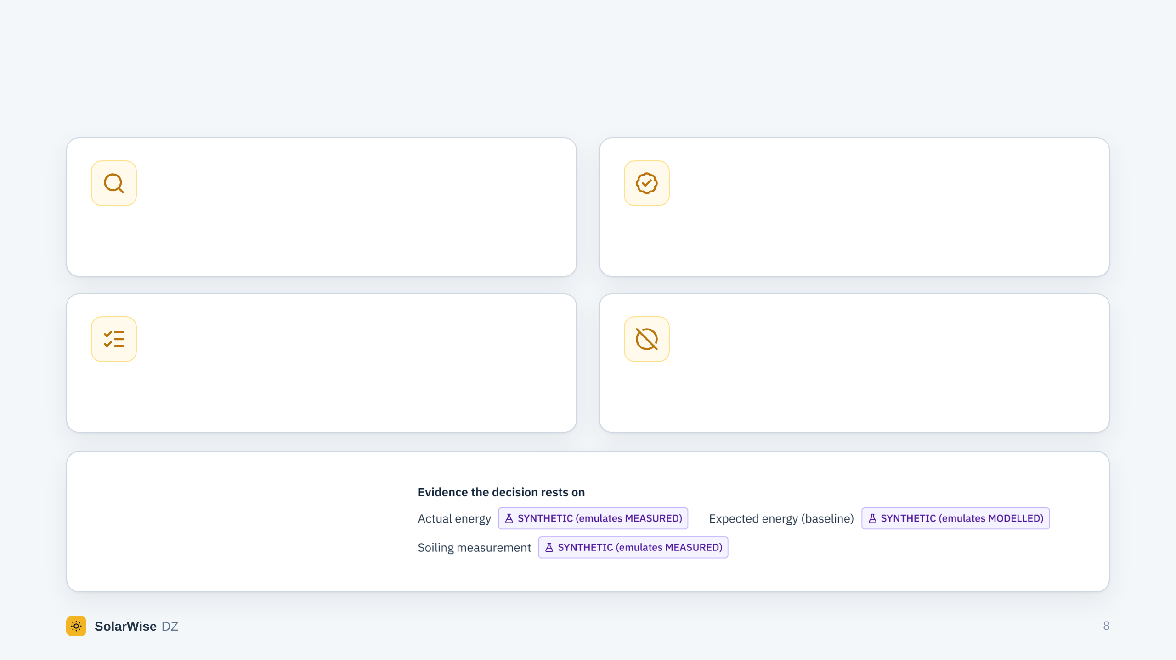
WHY YOU CAN TRUST THE ANSWER
Four rules the software never breaks.
A gap is not a diagnosis
Every value has an origin
Lower production is an observation. It never proves soiling by itself.
Measured, modelled, synthetic or unknown: declared with the data and shown with every figure. Only measured data can justify a cleaning.
Rules decide. AI only explains.
Missing stays missing
A deterministic rule engine decides. An optional language model may only interpret its findings, and its text is checked against the engine's result.
A value that was not observed is never replaced by zero and never interpolated.
IN THE APPLICATION
Every decision shows the origin of the evidence it rests on.
Notes:
Slide 8 of 11 - Four rules - 25 s (from 3:40 to 4:05)
Why trust the answer? Because of four rules the software never breaks.
A gap is not a diagnosis. Every value carries its origin, and only measured data can justify a cleaning. Rules decide: an AI model may only interpret and explain what the engine found. And a missing value stays missing: it is never replaced by zero.
[If you are short of time, this is the slide to shorten: read the four titles only.]

Slide 9
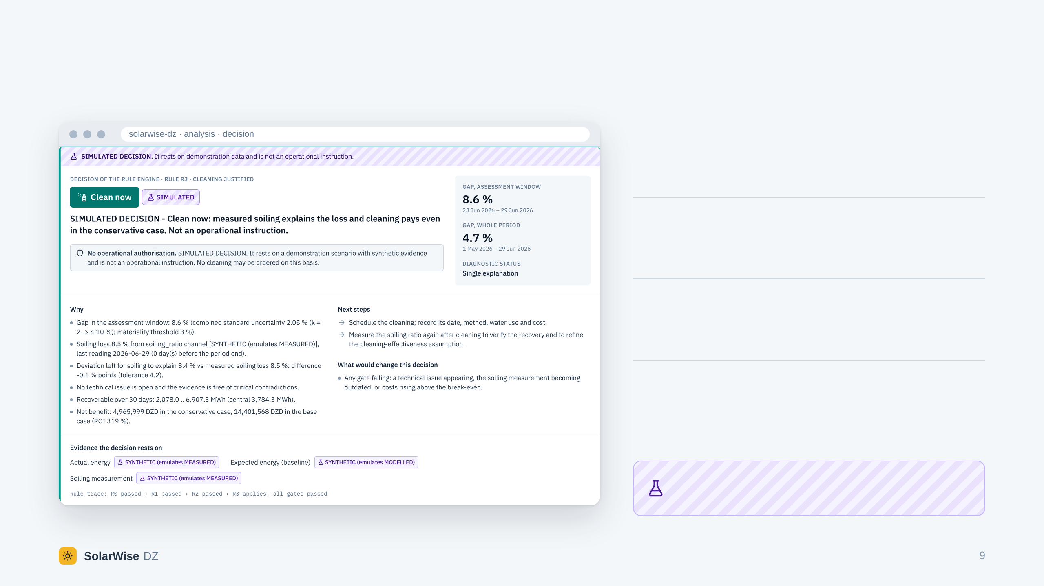
WHERE WE ARE
A working application, not a mock-up.
10
demonstration scenarios, each one giving the decision it should
1,257
automated tests: 1,135 on the engine and the API, 122 on the interface
54
API operations behind a web interface, with accounts and roles
4
report formats: PDF, HTML, CSV and JSON. Every result is stored as issued
Validated on synthetic scenarios. It has not yet been run on the data of a real plant.
Notes:
Slide 9 of 11 - Where we are - 25 s (from 4:05 to 4:30)
And this is a working application, not a mock-up. A web interface and an API. Ten demonstration scenarios. More than twelve hundred automated tests. Reports in four formats.
We are also clear about its limit: so far, it has been validated on synthetic data only.
[If you may show the live demonstration, do it here: open the demonstration, then the plant, then the analysis “Confirmed soiling”.]

Slide 10
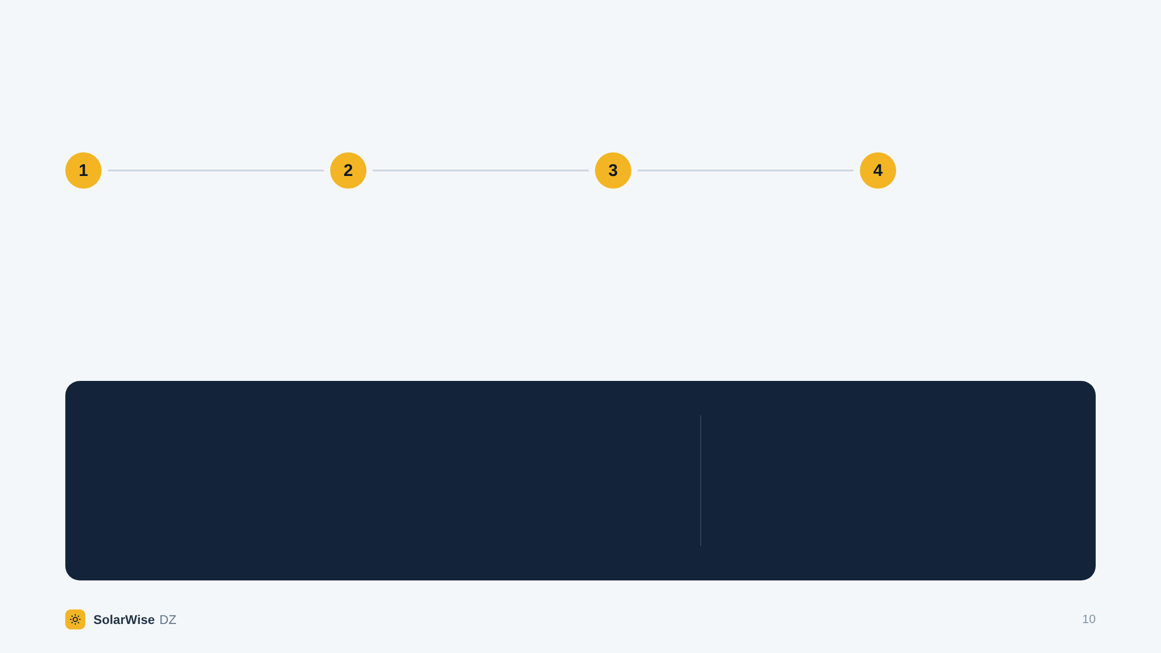
NEXT STEPS
From demonstration to a pilot plant.
Pilot
Calibrate
Connect
Scale
Run on the real production exports of one plant.
Tune thresholds and uncertainties with the operator's engineers.
Soiling stations and weather feeds. The PVGIS and NASA POWER connectors are already built.
More plants, an interface in Arabic and French, planning of cleaning campaigns.
WHAT WE ARE LOOKING FOR
WHAT THE OPERATOR GETS
One plant's historical data, and an operator ready to test it with us.
An evidence file for every cleaning decision: what was measured, what was assumed, and whether the cleaning pays.
Notes:
Slide 10 of 11 - Next steps and what we ask - 25 s (from 4:30 to 4:55)
So the next step is a pilot. One plant's historical data, to calibrate the thresholds with its engineers. Then soiling stations, weather feeds, and more plants.
That is what we are looking for today: an operator ready to test it with us.

Slide 11
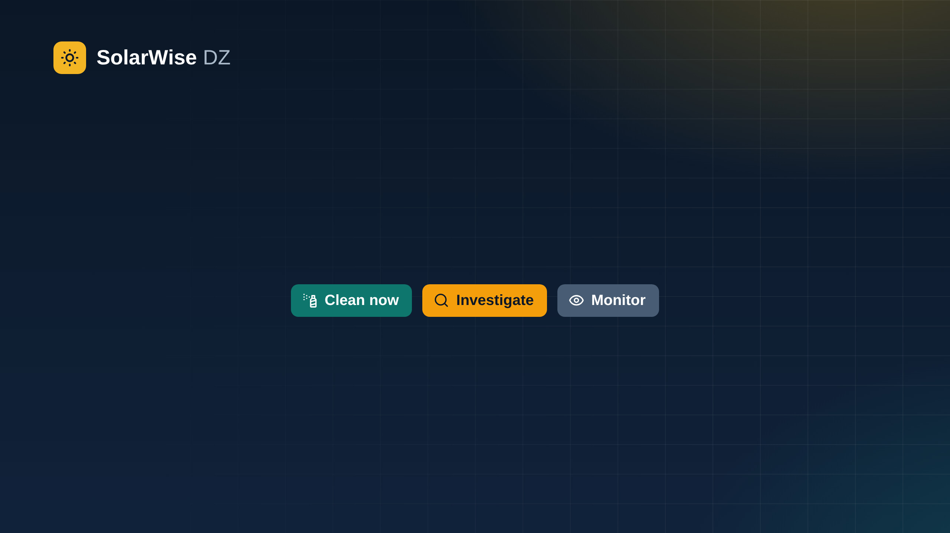
Clean when the evidence says so.
How much is missing. Why. Whether cleaning pays.
Thank you.
Demonstration on synthetic data · El Foulia reference case, 300 MWp, El Oued
Notes:
Slide 11 of 11 - Close - 5 s (from 4:55 to 5:00)
SolarWise DZ. Clean when the evidence says so. Thank you.
[Leave this slide on the screen during the questions. The slides after it are backups.]

Slide 12
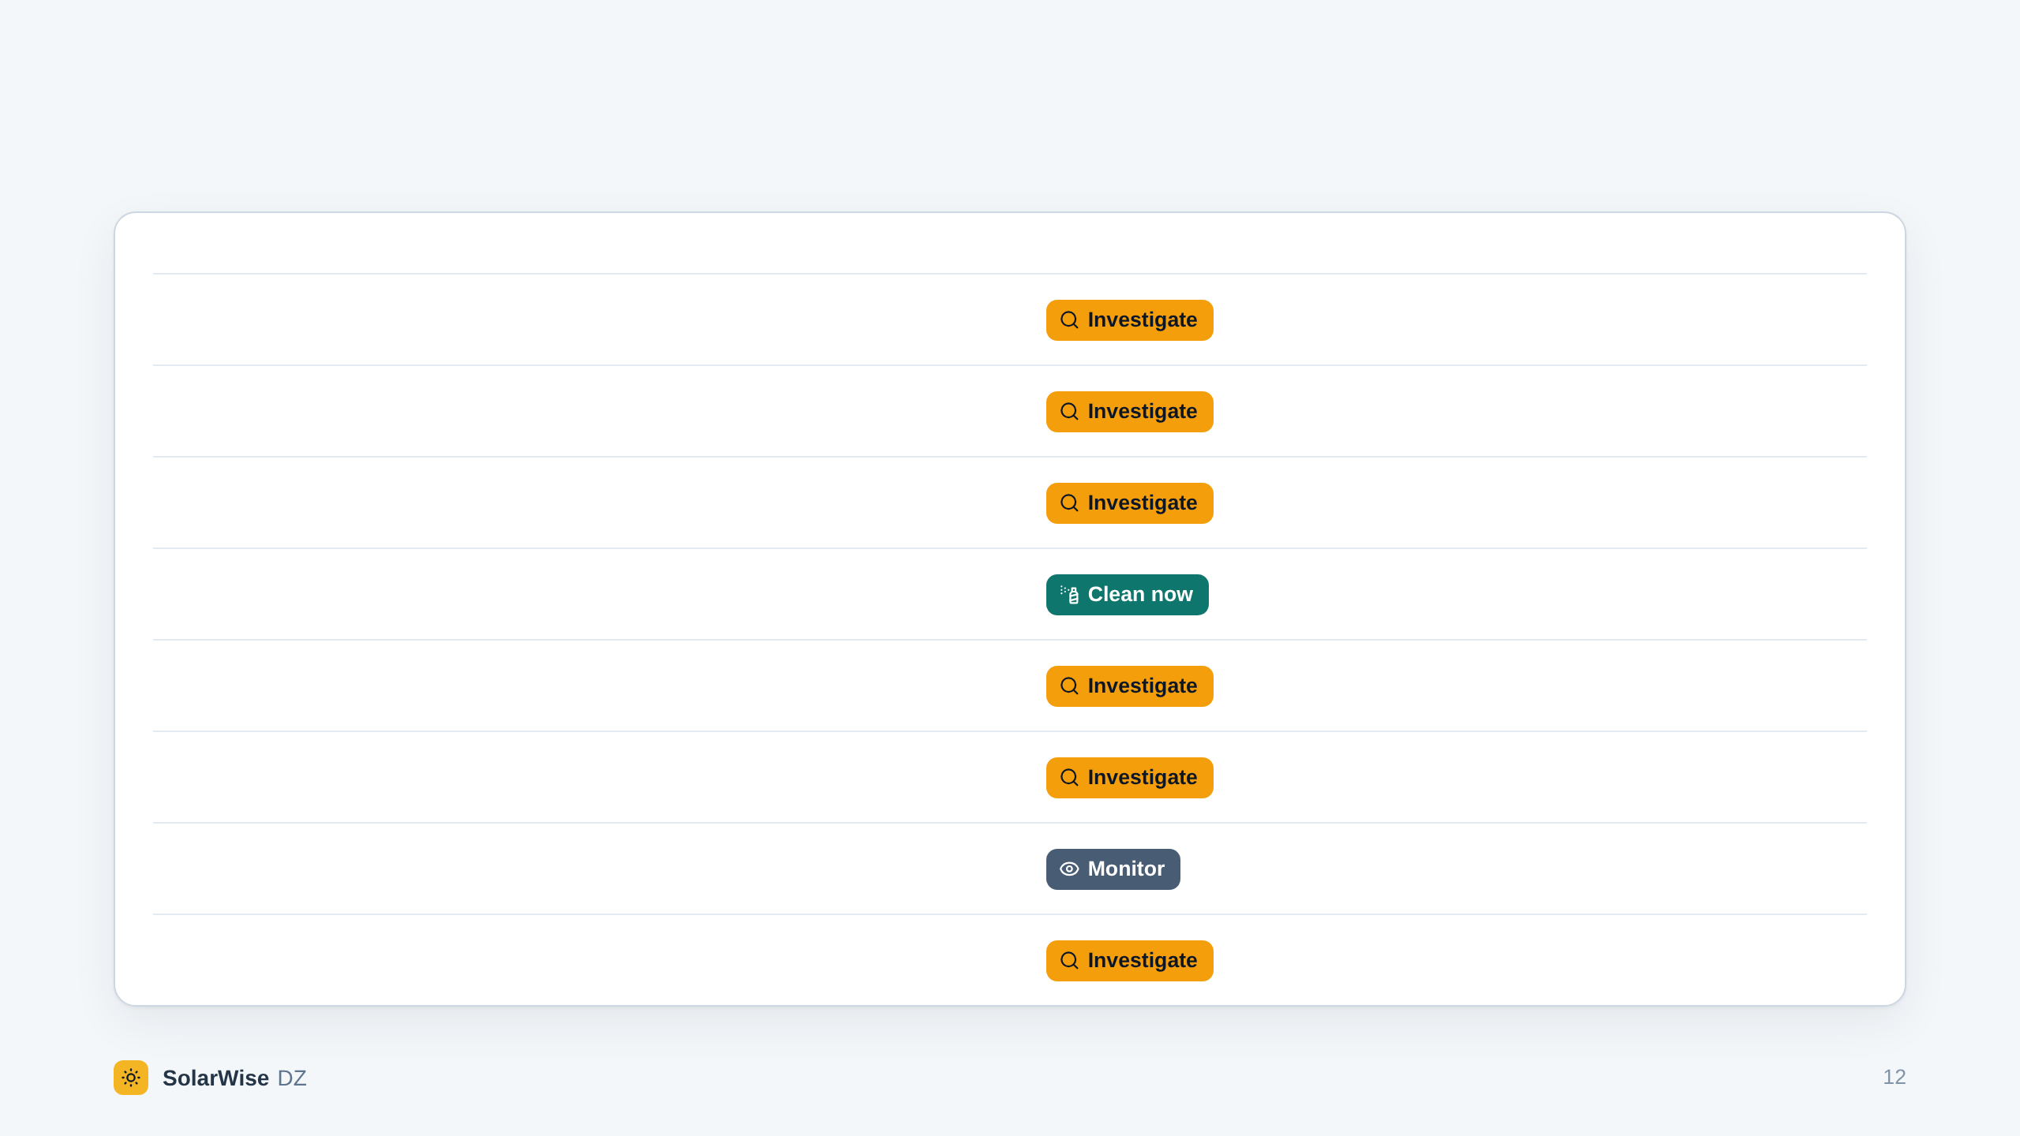
BACKUP · THE DECISION RULES
The rules are applied in this order. The first that applies decides.
RULE
APPLIES WHEN
OUTCOME
WHY
R0
Production data are not reliable measured data, or the baseline is not documented.
Without trustworthy production and a known reference there is no gap to reason about.
R1
A technical issue is open in the assessment window.
Its losses cannot be separated from soiling, and cleaning would not recover them.
R2
The evidence contains a critical contradiction.
A decision resting on one of two contradicting sources would be arbitrary.
R3
Every one of the ten gates is passed.
Measured loss, explained by measured soiling, nothing else open, and a cleaning that pays.
R4
The deviation is significant and largely unexplained, and soiling is not credibly measured.
A production gap alone does not prove soiling.
R5
Soiling is measured and matches the deviation, but the economic inputs are not decision-grade.
It cannot yet be shown that cleaning pays.
R6
None of the above: no significant deviation, a cause that cleaning does not change, or a cleaning that would not pay.
Nothing to act on now. The analysis is repeated after the review interval.
Interlock
A “Clean now” is checked a second time, independently, against the gates and the origin of its evidence, and the check fails.
A programming error in the rules must not be able to issue a cleaning order.
Rule engine version 1.0.0. The same table is published by the application under “Rules and data”.
Notes:
BACKUP SLIDE - Backup: the rules, in order (not part of the five minutes)
[Use it when someone asks “how exactly is the decision taken?” or “why not machine learning?”.]
The rules are checked in this order, and the first that applies decides. Only rule R3 can order a cleaning, and it needs all ten gates. A second, independent check must agree before the order goes out.

Slide 13
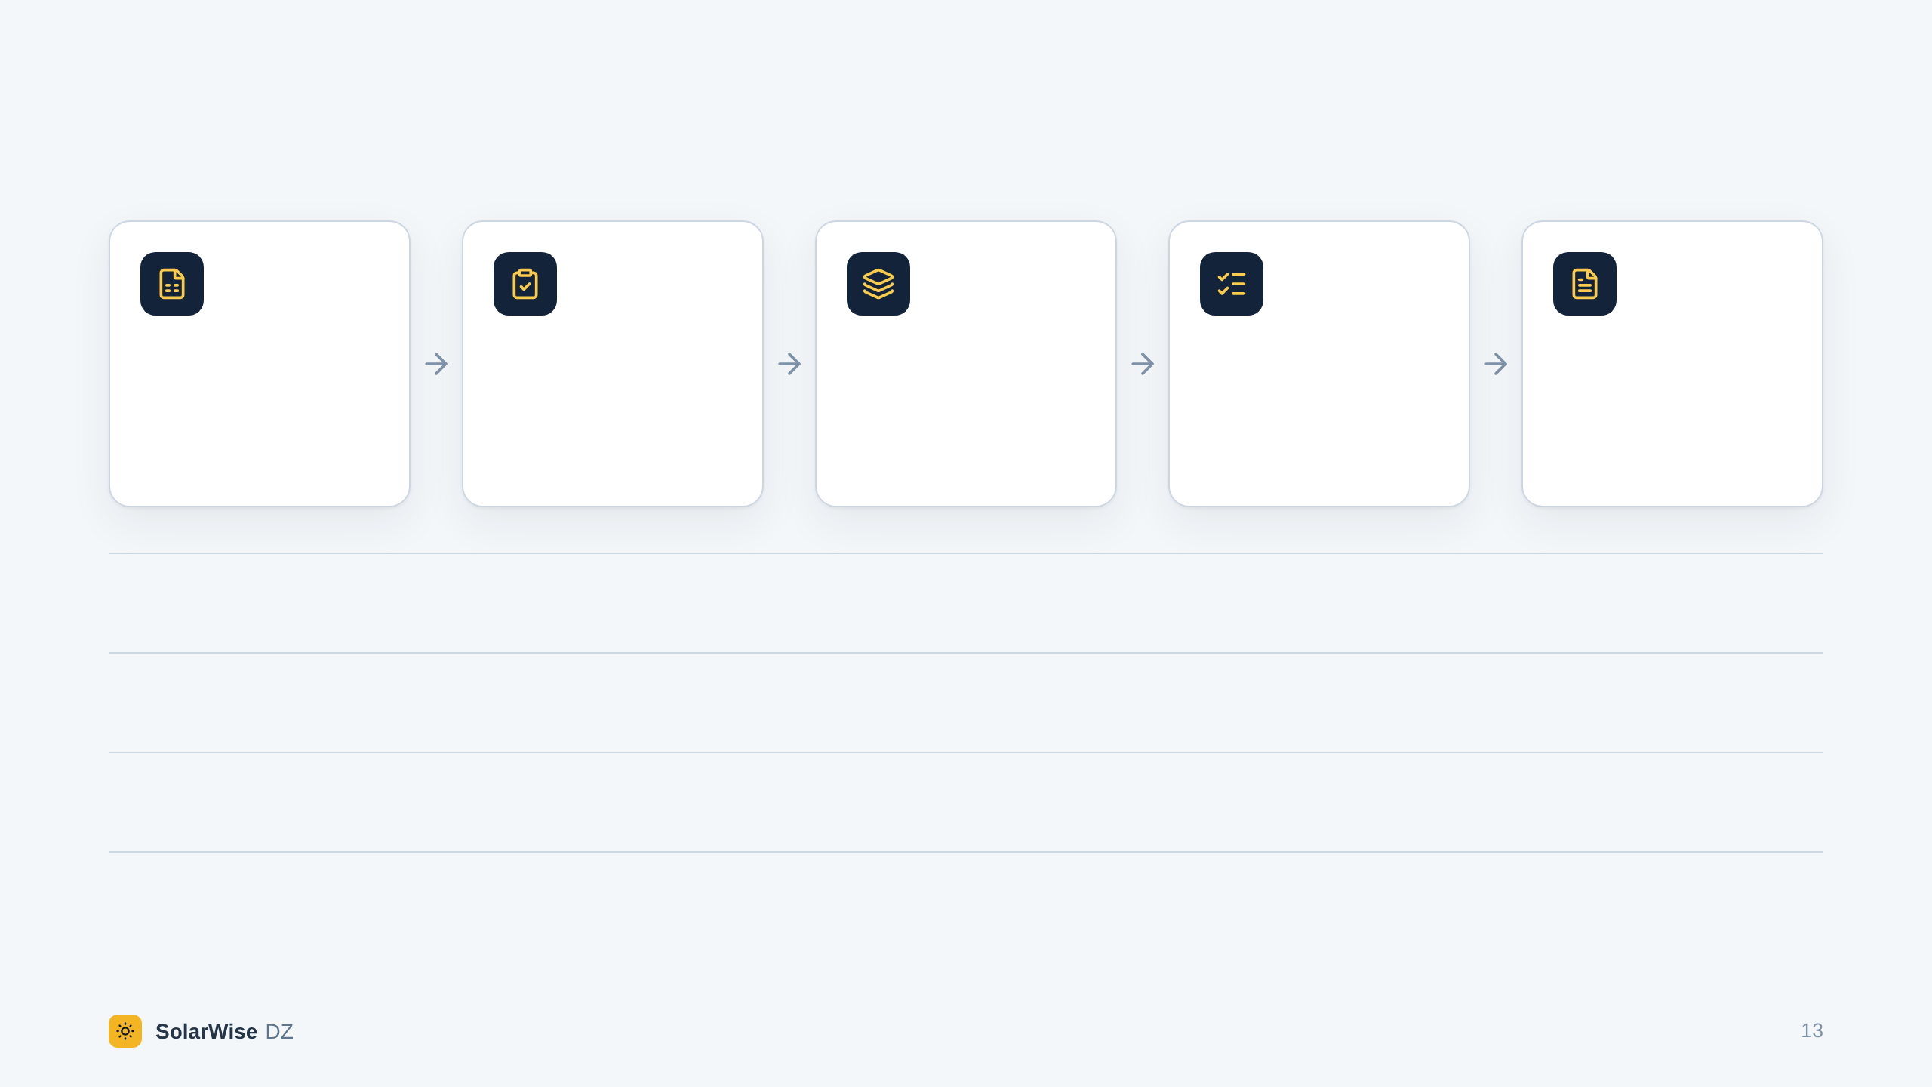
BACKUP · ARCHITECTURE
From a file to a decision, in five steps.
Data in
Validation
Engines
Rule engine
Results
Plant exports in CSV or JSON. Each column: unit, origin, source.
Units, gaps, duplicates, completeness. Missing stays missing.
Gap, attribution, diagnosis, recoverable energy, economics.
Ten gates, rules R0 to R6, and the safety interlock.
Decision, explanation, reports in PDF, HTML, CSV and JSON.
BUILT WITH
Python, FastAPI, SQLAlchemy, PostgreSQL or SQLite · React, TypeScript, ECharts
OPTIONAL CONNECTIONS
PVGIS typical year, NASA POWER weather, a language model that interprets the findings. All can stay switched off.
ACCESS
Sign-up, which can be switched off. Roles for each plant: owner, editor, viewer. Sign-ins and changes are recorded.
VERIFIED BY
1,135 tests on the engine and the API, 122 on the interface, static typing and linting on both sides.
Notes:
BACKUP SLIDE - Backup: how it is built (not part of the five minutes)
[Use it for technical questions: stack, deployment, security.]
The operator uploads the plant's own export. Its columns are recognised, and the operator declares where each one comes from. It is validated, then five engines compute the gap, the causes, the diagnosis, the recoverable energy and the economics. The rule engine decides. The result is stored as issued and can be exported as a report.

Slide 14
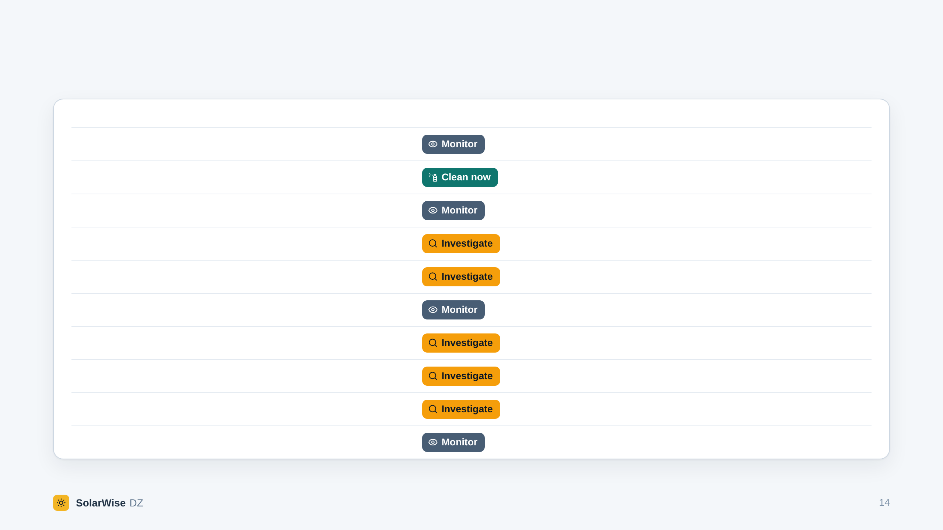
BACKUP · DEMONSTRATION
The ten demonstration scenarios and what the engine answers.
#
SCENARIO
GAP, LAST 7 DAYS
DECISION
RULE AND REASON
1
Normal operation
0.5 %
R6 · production is in line with the baseline
2
Confirmed soiling
8.6 %
R3 · every gate is passed
3
Temperature effect
8.9 %
R6 · explained by a cause that cleaning does not address
4
Inverter fault
10.6 %
R1 · a technical issue is open
5
Morning shading
9.2 %
R4 · a significant loss is not explained
6
Grid curtailment
10.1 %
R6 · explained by a cause that cleaning does not address
7
Missing data
6.5 %
R0 · the data are not sufficient to support a decision
8
Conflicting evidence
8.6 %
R2 · the evidence contradicts itself
9
Synthetic data, no role declared
8.6 %
R0 · the production data are not measured data
10
Unprofitable cleaning
5.8 %
R6 · soiling is measured, but cleaning now would cost more than it recovers
Synthetic scenarios, 1 May to 29 June 2026, generated from a fixed seed. Every decision is marked simulated in the application.
Notes:
BACKUP SLIDE - Backup: the ten demonstration scenarios (not part of the five minutes)
[Use it when someone asks what the demonstration contains, or wants to see a case you did not show.]
Scenario 9 uses the same numbers as scenario 2, but the file does not say that they stand for measurements. The answer changes from “clean now” to “investigate”: data of unknown origin can never justify a cleaning.

Slide 15
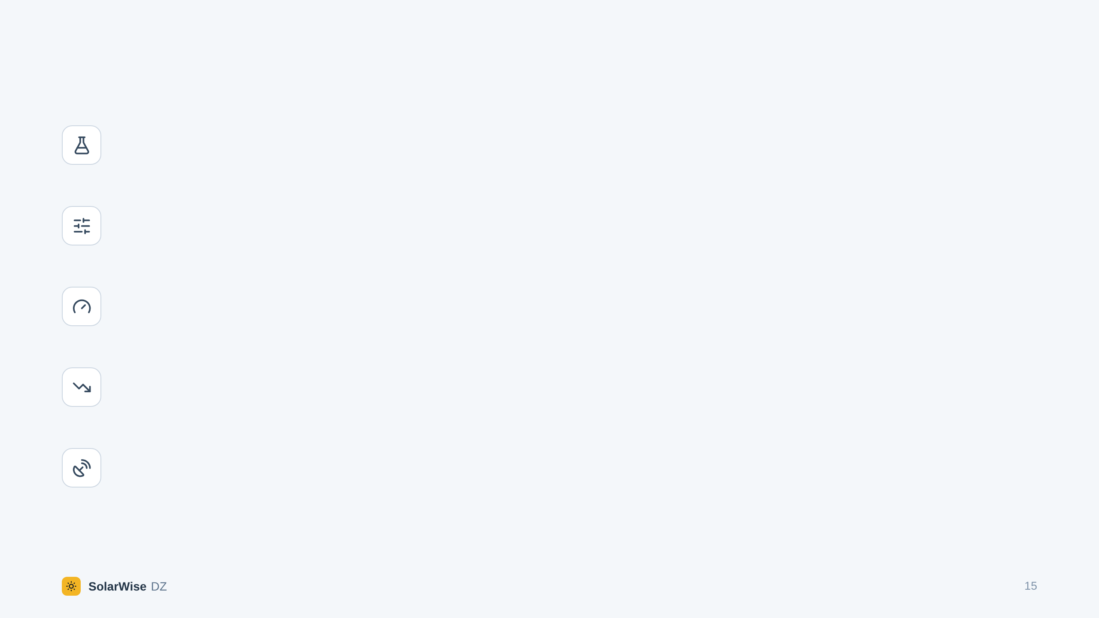
BACKUP · LIMITS
What the solution does not do yet, stated plainly.
Tested on synthetic scenarios only
No measurement from El Foulia or from any other plant has been used. The name, the location and the nominal capacity are public information; everything else is an illustrative assumption.
Thresholds are documented defaults
The 7-day window, the 2 % floor for a credible soiling reading and the other thresholds must be calibrated with each operator.
No direct soiling measurement, no cleaning order
Without a soiling station, a clean reference module or an equivalent measurement, the answer is “Investigate”. This is by design.
The projections are not a validated forecast
The application shows simple reference projections for orientation. They never enter a decision.
Weather services are context, not evidence
PVGIS and NASA POWER data help to build a baseline. They do not measure the dust on the modules.
Notes:
BACKUP SLIDE - Backup: limits, stated plainly (not part of the five minutes)
[Use it when someone asks about real data, accuracy or validation. Saying these limits yourself is stronger than being asked.]
We have not used real plant data yet: that is exactly what the pilot is for. And the software will never order a cleaning without a direct soiling measurement.

