Slide 1




InterviewGenie
Team ID - 8386
Madhav Bhalodiya
Jay kalsariya

Slide 2

Project Objectives
Problem Statement
Project Overview – Introduction
End Users
Wow Factor in Project
Modelling/Block Diagram/Flow of Project
Result/outcomes
Conclusion
Future Perspective

Slide 3
Problem Statement
Traditional interviews are time-consuming and require manual effort. 🔹 Evaluation is subjective and varies between interviewers. 🔹 Candidates lack immediate feedback on their communication skills. 🔹 There is a need for an AI-driven, automated interview system that ensures objective evaluation and real-time feedback.

Slide 4
Project overview - Introduction
This project is an AI-based platform that conducts automated mock interviews and provides feedback on: ✔ Response Quality – AI evaluates the correctness and relevance of answers. ✔ Body Language Analysis – Detects confidence, eye contact, and engagement. ✔ Scoring & Feedback – Gives a detailed performance report.
How it Works? 1️⃣ User selects topic, industry, difficulty, experience level. 2️⃣ AI generates 5 questions accordingly. 3️⃣ Candidate records answers via video. 4️⃣ AI analyzes speech & body language for feedback. 5️⃣ A detailed result page shows scores and improvement areas.

Slide 5
End User
👨‍🎓 Students & Job Seekers – To prepare for real interviews. 🏢 HR & Recruiters – To automate screening processes. 🏫 Coaching Institutes – To train candidates effectively. 💼 Freelancers & Professionals – To practice communication skills.

Slide 6
Wow Factor in Solution
✨AI-powered Question Generation – Questions are dynamically generated based on user inputs. 🎥 Video-Based Confidence & Body Language Analysis – Uses OpenCV to detect eye contact, facial expressions, and engagement. 💡 AI-Based Answer Evaluation – Evaluates content accuracy, clarity, and structure using OpenAI Whisper. 📊 Automated Scoring System – Unbiased evaluation, reducing the need for human intervention.

Slide 7
Modelling
Project Flow:
User Input: Selects topic, difficulty, experience level.
Question Generation: Uses LangChain + Groq AI to generate 5 interview questions.
Interview Process: Candidate records responses via webcam.
Audio Analysis : Extract audio from video using FFmpeg. Transcribe using OpenAI Whisper. Evaluate answer quality using AI.
Video Analysis : OpenCV detects confidence, eye contact, engagement. Custom metric calculates body language score.
Scoring & Feedback: AI generates performance reports, scores out of 10, and final interview rating.

Slide 8
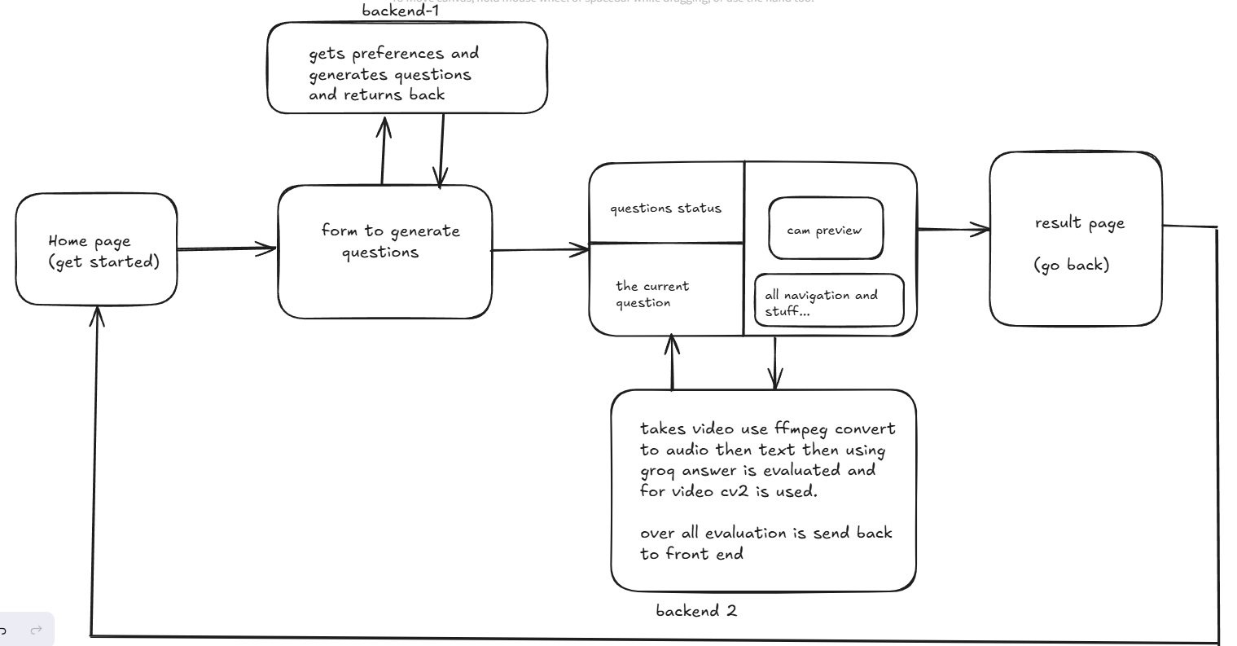
Flow Diagram:

Slide 9
Result / Outcomes
🎯 Successfully implemented an AI-driven interview platform. 🎯 Dynamic question generation tailored to users’ inputs. 🎯 Speech-to-text conversion & answer evaluation using AI. 🎯 Body language analysis through OpenCV for confidence & engagement detection. 🎯 Automated feedback & scoring system for better preparation.

Slide 10
Conclusion
✅ This AI-based interview system enhances interview preparation by providing an automated, unbiased evaluation. ✅ Saves time for recruiters and offers candidates actionable feedback. ✅ Helps individuals improve communication, confidence, and overall interview performance.

Slide 11
Future Perspective
🚀 Real-time AI coaching – Give feedback while answering. 🌎 Multi-language support – Expand accessibility. 📱 Mobile App Integration – Allow users to practice interviews anywhere. 🤖 Facial Expression Analysis – Detect stress levels, emotions, and engagement. 🔗 Integration with Job Portals – Directly connect with recruiters.

Slide 12
Thank you...!
Notes:
12

