Slide 1

OOPs
By –
Raj Nandani Vaishali Ahirwar
Jayshree

Slide 2

Object Oriented Programming in C++
Object-oriented programming – As the name suggests uses objects in programming. Object-oriented programming aims to implement real-world entities like inheritance, hiding, polymorphism, etc. in programming. The main aim of OOP is to bind together the data and the functions that operate on them so that no other part of the code can access this data except that function.

Slide 3

Class
Class in C++ is the building block that leads to Object-Oriented programming. It is a user-defined data type, which holds its own data members and member functions, which can be accessed and used by creating an instance of that class.
A C++ class is like a blueprint for an object. For Example: Consider the Class of Cars. There may be many cars with different names and brands but all of them will share some common properties like all of them will have 4 wheels, Speed Limit, Mileage range, etc.
SYNTAX:-
class ClassName {
// some data
// some functions
};

Slide 4
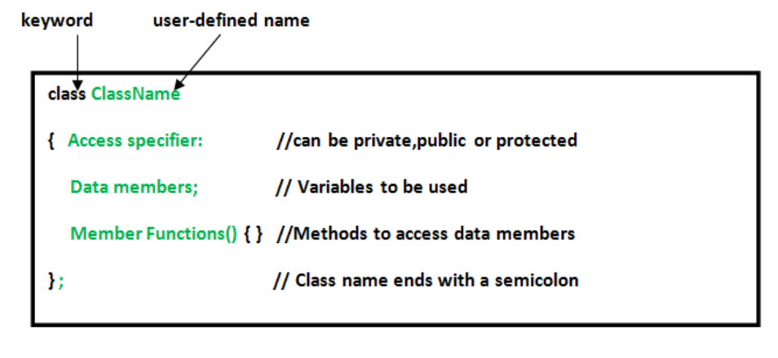

Slide 5
Object
When a class is defined, only the specification for the object is defined; no memory or storage is allocated.
To use the data and access functions defined in the class, we need to create objects.
SYNTAX:-
ClassName object_name;
// sample function
void sample_function() {
// create objects
Room room1, room2;
}
int main(){
// create objects
Room room3, room4;
}

Slide 6
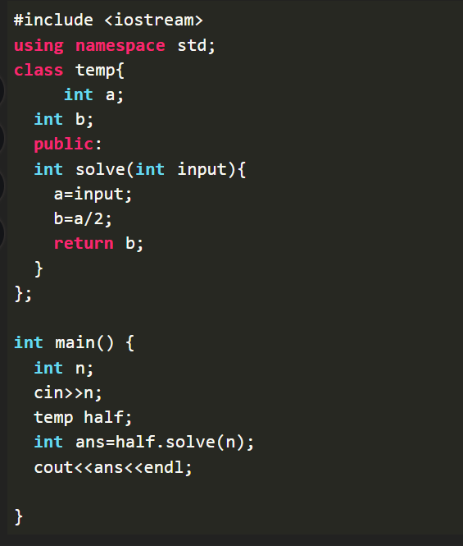
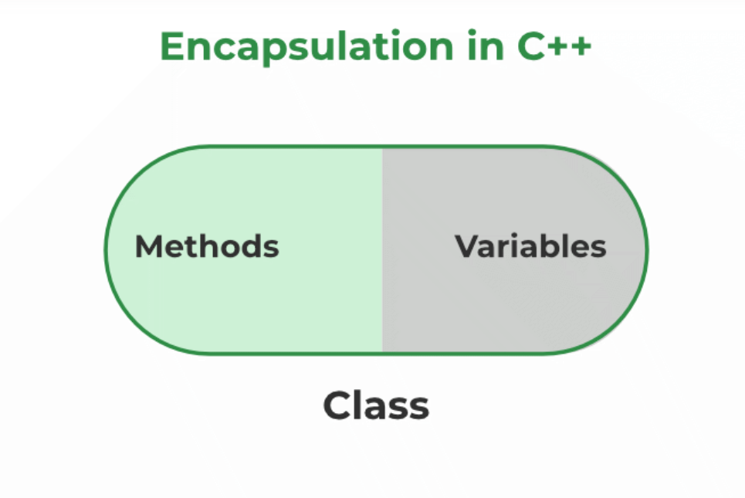
Encapsulation
Encapsulation in C++ is defined as the wrapping up of data and information in a single unit. In Object Oriented Programming, Encapsulation is defined as binding together the data and the functions that manipulate them.

Slide 7
COnstructor
Constructor in C++ is a special method that is invoked automatically at the time of object creation. It is used to initialize the data members of new objects generally. The constructor in C++ has the same name as the class or structure. It constructs the values i.e. provides data for the object which is why it is known as a constructor.
Syntax of Constructors in C++
class-name> (list-of-parameters);
<class-name> (list-of-parameters)
{
// constructor definition
}

Slide 8
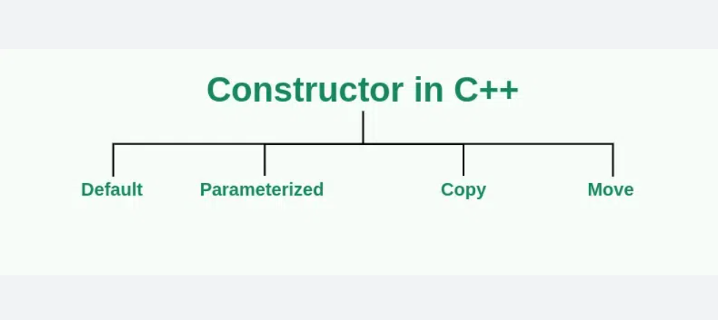
Types of Constructor in C++
Constructors can be classified based on in which situations they are being used. There are 4 types of constructors in C++:
Default Constructor
Parameterized Constructor
Copy Constructor
Move Constructor

Slide 9
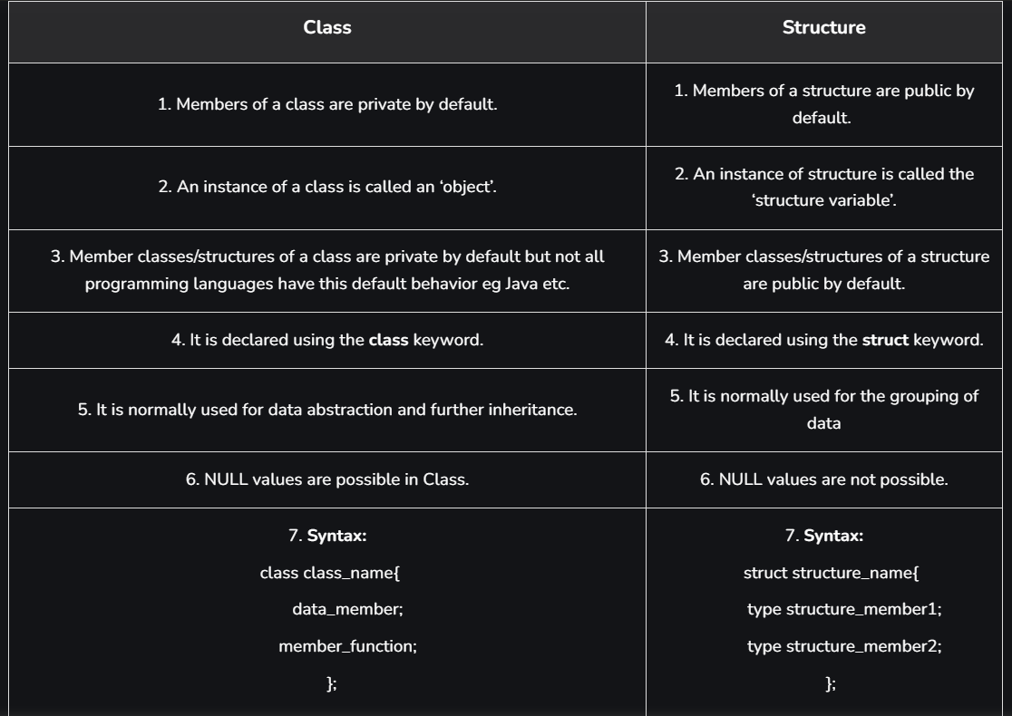
Difference Between Class And Structure

Slide 10
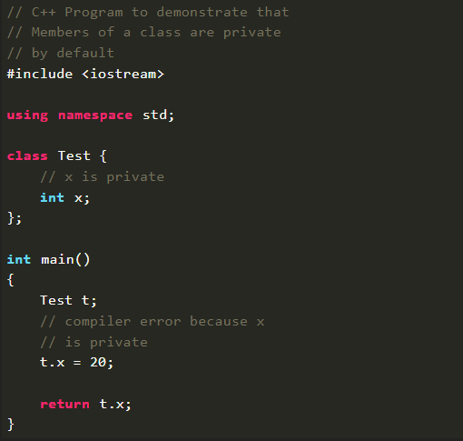
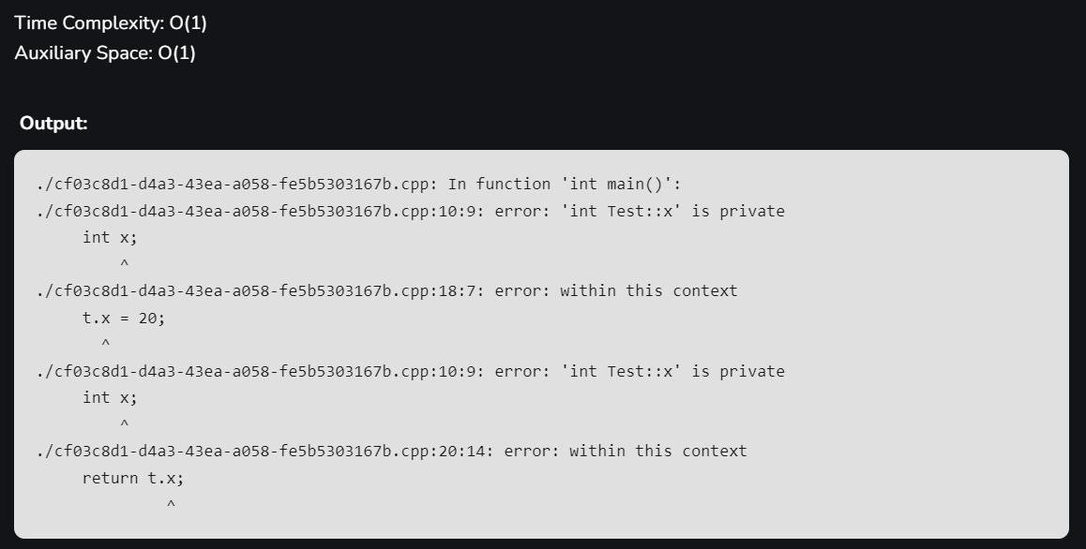
EXAMPLE
Members of a class are private by default and members of a structure are public by default.
For example, program 1 fails in compilation but program 2 works fine,

Slide 11
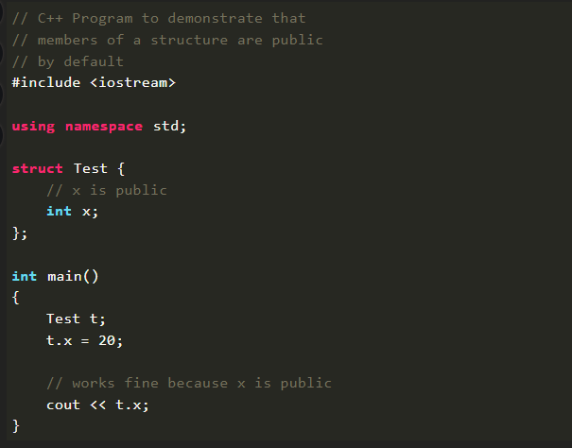

Program 2:

Slide 12

THANK YOU

