Slide 1
CMPS 339 PROJECT
You must exactly follow this template.
Do not change the order and the format.
No background coloring or formatting.
ENTER TEAM NAME HERE

Slide 2
Requirements
Develop a database system with the requirements listed below.
At least, 6 tables, at least 20 attributes in total
The total number of records must be no less than 100. The data must have diversity for analysis
ER diagram must specify structural constraints (min, max)
Analyze your data as instructed in the template PPT file
All drawing must be done professionally
Submit
Presentation file. Use the template PPT file Project.pptx.
Data in an Excel file. The Excel file must have single table per sheet. The first line must have attributes. Use the template Excel file Tables.xlsx.
The SQL-query file Queries.sql. Use the template file.
Backup of your database as CMPS339_<team name> and submit as "CMPS339_< team name>.zip" file.

Slide 3
TEAM MEMBERS & ROLES
Joshua Cantu - Developer
Jacob Dillon - Developer
Nicholas Tate - Developer

Slide 4
DESCRIPTION OF BUSINESS
Business operations:
Users write reviews
Game will Keep a Review Count
Allow Friends
Business requirements:
Handle User Accounts
Be able to add games
Manage Friends

Slide 5
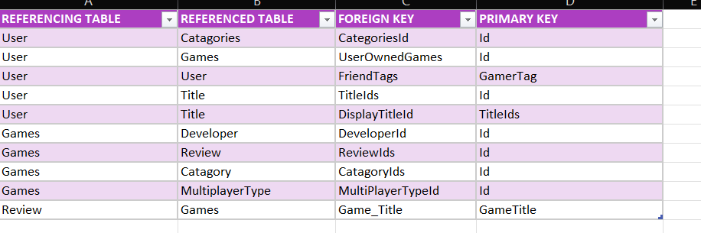
REFERENTIAL-RELATIONS
<Be sure that FK must match PK as instructed in the class.>

Slide 6
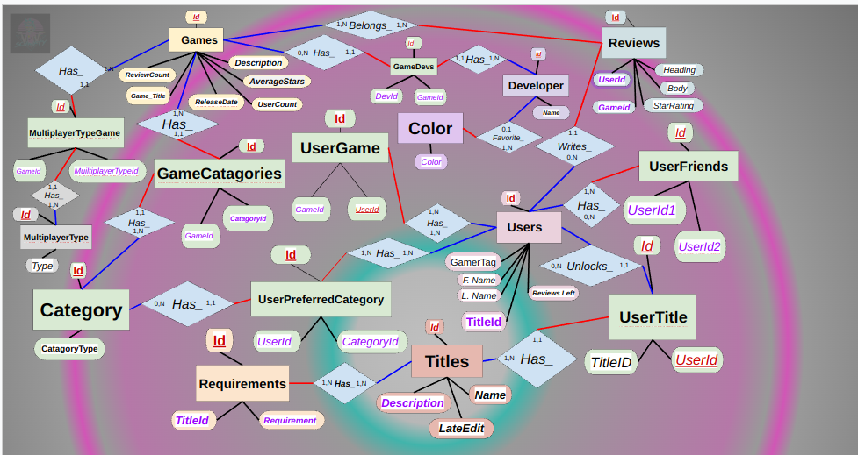
ER-Diagram
<must include structural constraints, cardinalities, relationship names, etc. Use drawing format given in the class.>

Slide 7
DDL QUERIES
Instructions:
- must include ALL queries listed in Queries.sql
- must follow the exact format provided in the template slide

Slide 8
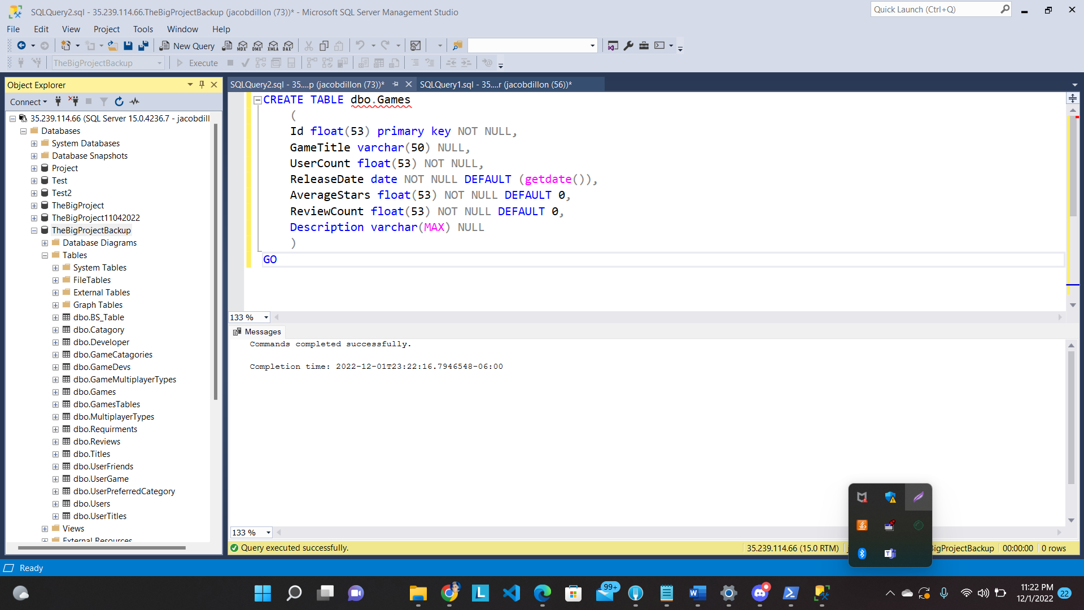
QD1: Create Table
Snapshot of the query output:
Description:
Creates Table to hold all of the games
SQL Query:
CREATE TABLE dbo.Game
(
Id float(53) primary key NOT NULL DEFAULT 0,
GateTitle varchar(50) NULL,
UserCount float(53) NOT NULL,
ReleaseDate date NULL,
AverageStars float(53) NOT NULL DEFAULT 0,
ReviewStars float(53) NOT NULL DEFAULT 0,
Description varchar(MAX) NULL
)
GO

Slide 9
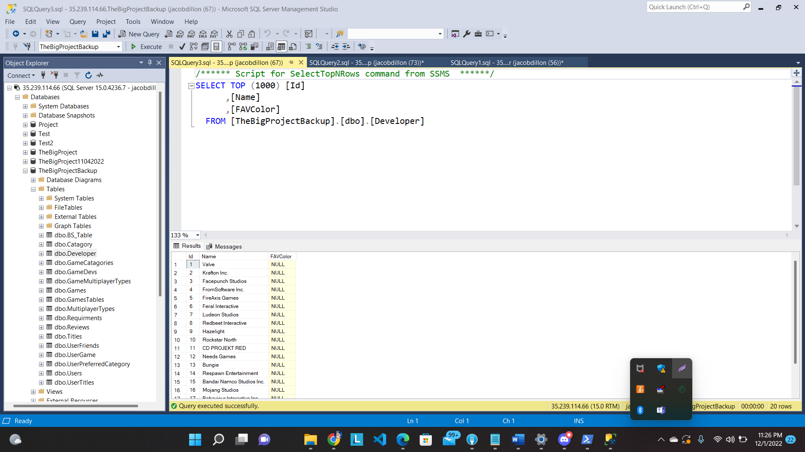
QD2: ALTER TABLE
Snapshot of the query output:
Description:
Alters the Developer table to add favorite color column
SQL Query:
ALTER TABLE dbo.[Developer]
ADD FAVColor varchar(20);

Slide 10
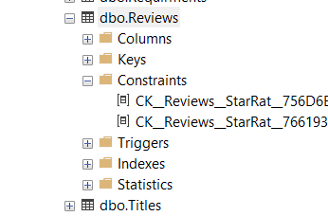
QD3: ADD "CHECK" CONSTRAINT
Snapshot of the query output:
Description:
Makes sure Average Stars has a value, if value entered is less than or equal to 5
SQL Query:
ALTER TABLE Reviews
ADD CHECK (StarRating <= 5)

Slide 11
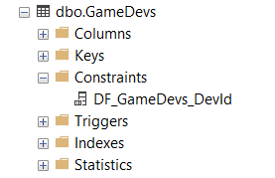
QD4: ADD FK CONSTRAINT(S)
Snapshot of the query output:
Description:
Added Forein key and default value
ALTER TABLE dbo.GameDevs
ADD Developer_id float NOT NULL
CONSTRAINT DK_GameDevs_DevId DEFAULT (20)
CONSTRAINT FK_GameDevs_Games FOREIGN KEY (GameId)
REFERENCES dbo.Games
(
Id
) ON UPDATE NO ACTION
ON DELETE NO ACTION
GO

Slide 12
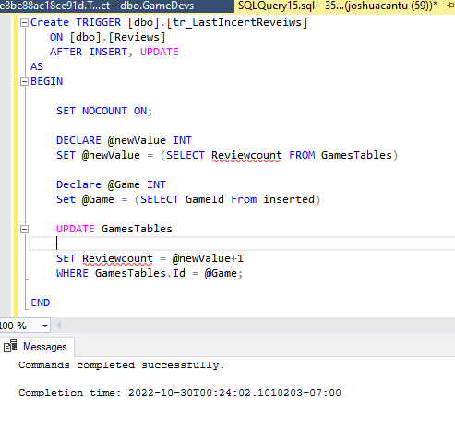
QD5: ADD TRIGGER
Snapshot of the query output:
Description:
Updates Review Count on game when Review is left
Create TRIGGER [dbo].[tr_LastIncertReveiws]
ON [dbo].[Reviews]
AFTER INSERT, UPDATE
AS
BEGIN
SET NOCOUNT ON;
Declare @Game INT
Set @Game = (SELECT GameId From inserted)
DECLARE @newValue INT
SET @newValue = (SELECT ReviewCount FROM Games WHERE Games.Id = @Game)
UPDATE Games
SET ReviewCount = @newValue+1
WHERE Games.Id = @Game;
END

Slide 13
DML QUERIES
Instructions:
- must include ALL queries listed in Queries.sql
- must follow the exact format provided in the template slide

Slide 14
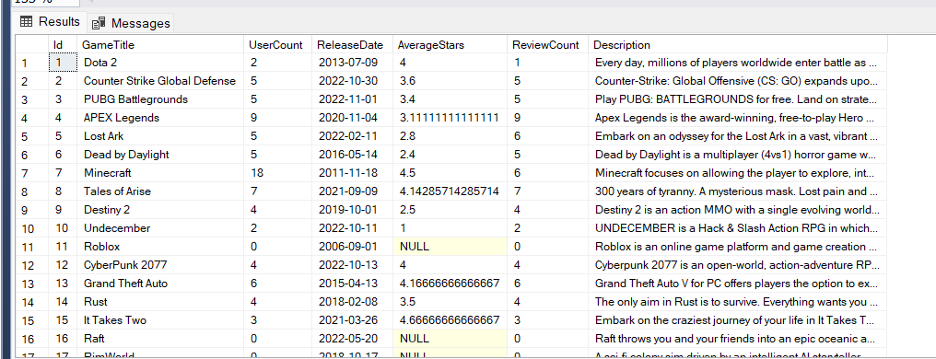
QM1.1: A TEST QUERY FOR THE TRIGGER CREATED in QA5:
Snapshot of the query output:
Description:
when user makes a review, it INCREMENTs ReviewCount
SQL Query:
INSERT INTO dbo.Reviews
(Id, GameId, [User ID], Heading, StarRating, Body)
VALUES (1, 1, 1, N'good job', 3, N'words')

Slide 15
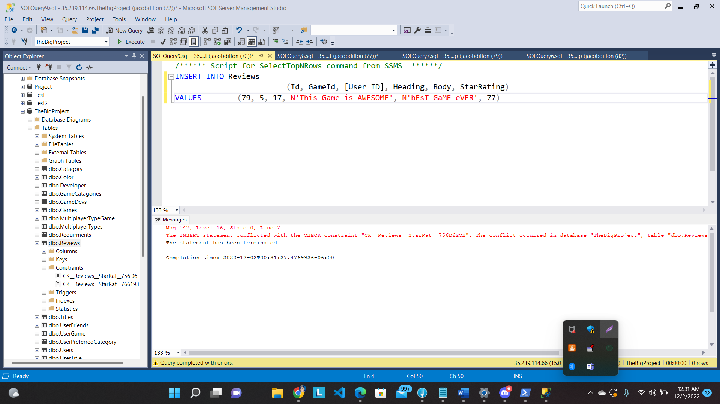
QM1.2: A TEST QUERY FOR THE "CHECK" CONSTRAINT DEFINED in QA3:
Snapshot of the query output:
Description:
Tests that QD3 adds default number as zero for average stars in GameTable
INSERT INTO Reviews
(Id, GameId, [User ID], Heading, Body, StarRating)
VALUES (79, 5, 17, N'This Game is AWESOME', N'bEsT GaME eVER', 77)

Slide 16
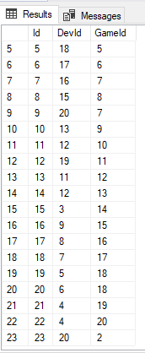
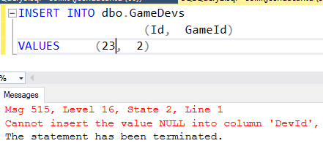
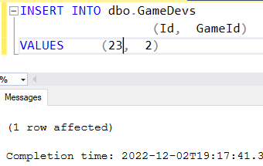
QM1.3: A TEST QUERY FOR THE FK CONSTRAINT DEFINED in QA4
Snapshot of the query output:
Description:
Adds a GamesDev which links the Game "Counter Strike Global Defense" to a placeholder Developer
SQL Query:
INSERT INTO dbo.GameDevs
(Id, GameId)
VALUES (2, 2)

Slide 17

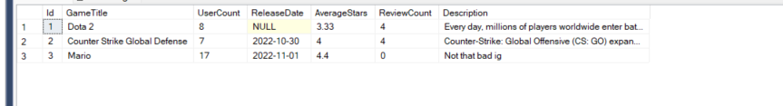
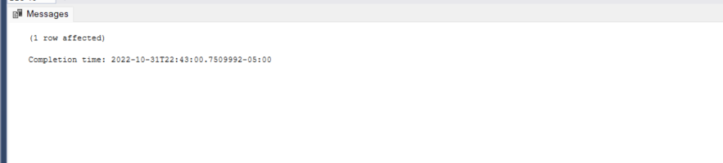
QM2: INSERT DATA:
Snapshot of the query output:
Description:
Adds a New Game to GameTable
SQL Query:
INSERT INTO dbo.GamesTables ( Id, GameTitle, UserCount, AverageStars, ReviewCount, Description)
VALUES (3, 'Mario', 17, 4.4, 0, 'Not that bad ig')

Slide 18


QM3: UPDATE DATA:
Snapshot of the query output:
Description:
Updates the Title of the User with the User Id 2 to 13
SQL Query:
UPDATE dbo.Users
SET Title = 13
WHERE (Id = 2)

Slide 19


QM4: DELETE DATA:
Snapshot of the query output:
Description:
Deletes Review with the Id of 1
SQL Query:
DELETE FROM dbo.Reviews
WHERE (Id = 1)

Slide 20

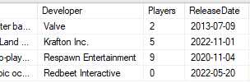

QM5: QUERY DATA WITH WHERE CLAUSE:
Snapshot of the query output:
Description:
Finds any game that either has the Word "battle"
in the Description OR has both of the words
"hero" and "adventure" then Returns the Title of the Game, the Description, the Developer, How many Players the Game has, Realse Date, the Rating, and how many reviews were left.
SQL Query:
SELECT Games.GameTitle AS Title, Games.Description, Developer.Name AS Developer, Games.UserCount AS Players, Games.ReleaseDate, Games.AverageStars AS Rating, Games.ReviewCount
FROM Games INNER JOIN
GameDevs ON Games.Id = GameDevs.GameId INNER JOIN
Developer ON GameDevs.DevId = Developer.Id
WHERE (Games.Description LIKE '%battle%') OR
(
(Games.Description LIKE '%hero%')
AND
(Games.Description LIKE %adventure%')
)

Slide 21
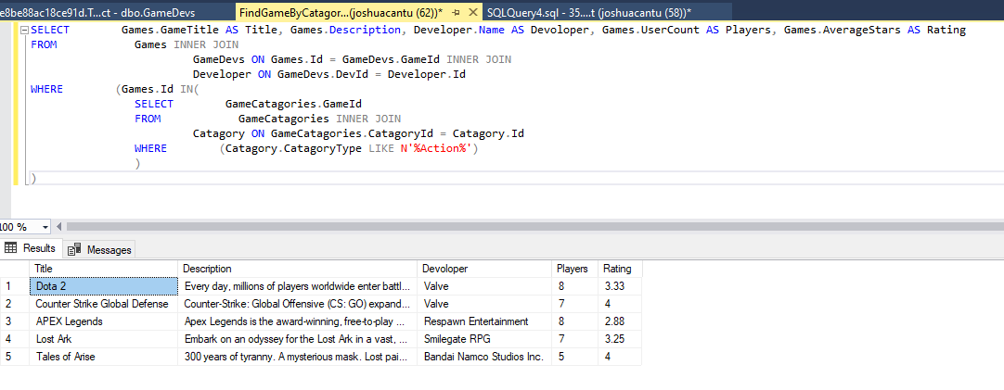
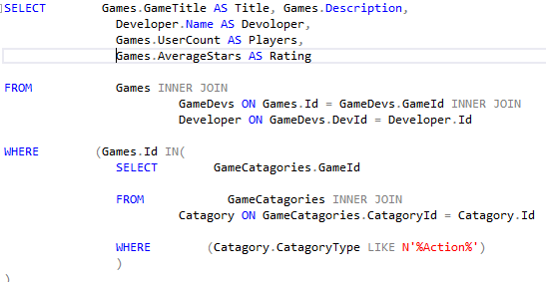
QM6.1: QUERY DATA WITH SUB-QUERY IN WHERE CLAUSE:
Snapshot of the query output:
Description:
Returns all Games of a category using key words,
example “Action”
SQL Query:
SELECT Games.GameTitle AS Title, Games.Description, Developer.Name AS Devoloper, Games.UserCount AS Players, Games.AverageStars AS Rating
FROM Games INNER JOIN
GameDevs ON Games.Id = GameDevs.GameId INNER JOIN
Developer ON GameDevs.DevId = Developer.Id
WHERE (Games.Id IN(
SELECT GameCatagories.GameId
FROM GameCatagories INNER JOIN
Catagory ON GameCatagories.CatagoryId = Catagory.Id
WHERE (Catagory.CatagoryType LIKE N'%Action%')
)
)

Slide 22
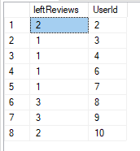
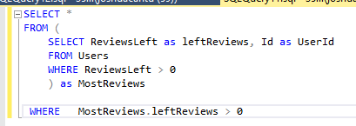
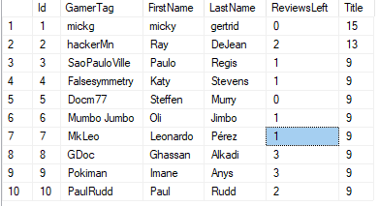
QM6.2: QUERY DATA WITH SUB-QUERY IN FROM CLAUSE:
Snapshot of the query output:
Description: List all the Users That have left more then 1 review
SQL Query:

Slide 23
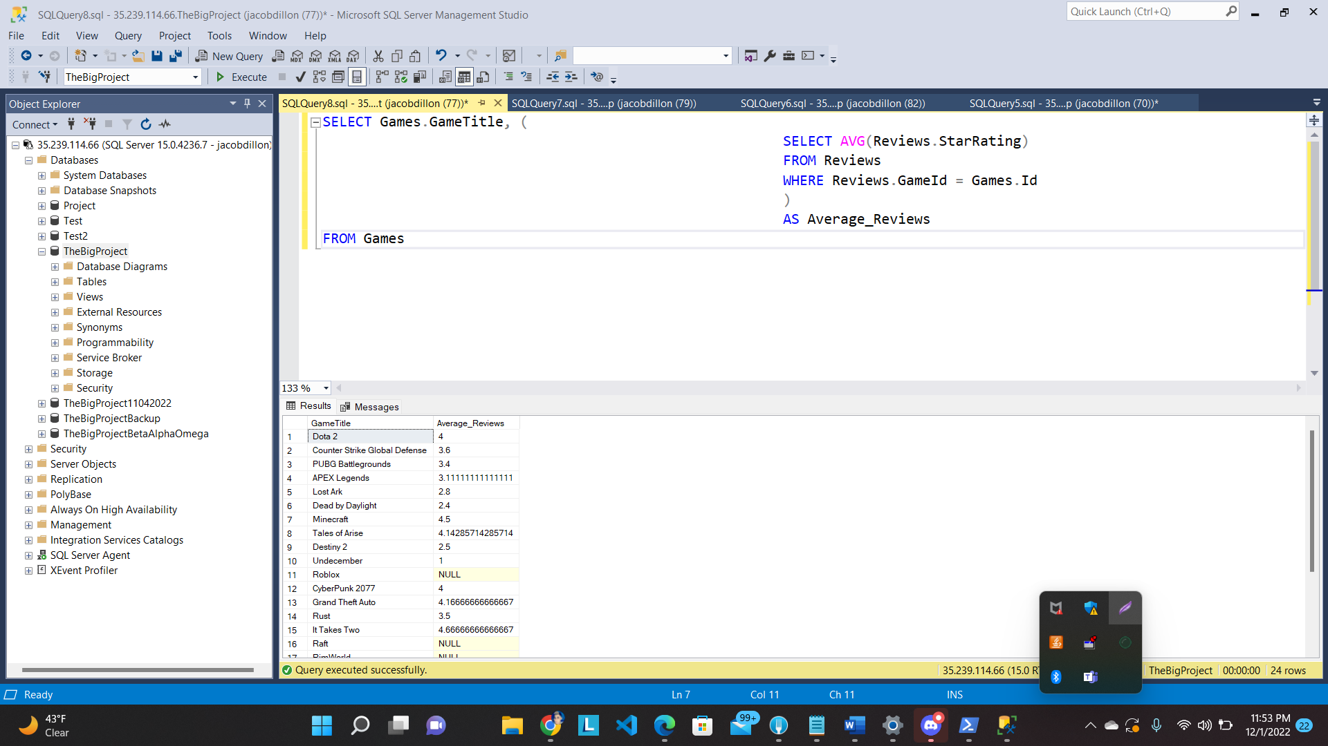
QM6.3: QUERY DATA WITH SUB-QUERY IN SELECT CLAUSE:
Snapshot of the query output:
Description:
Gets all the games and there Average Star rating based on the reviews “as Average_Reviews”
SQL Query:
SELECT Games.GameTitle, (
SELECT AVG(Reviews.StarRating)
FROM Reviews
WHERE Reviews.GameId = Games.Id
)
AS Average_Reviews
FROM Games

Slide 24
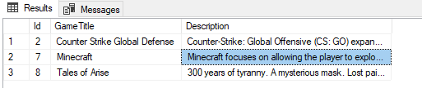
QM7: QUERY DATA WITH EXCEPT:
Snapshot of the query output:
Description:
Returns all games that are not in the mature category (30)
SQL Query:
SELECT Id, GameTitle, Description
FROM Games
WHERE Games.Id IN (
SELECT Id
FROM Games
EXCEPT
SELECT GameId
FROM GameCatagories
WHERE (CatagoryId = 30)
)

Slide 25
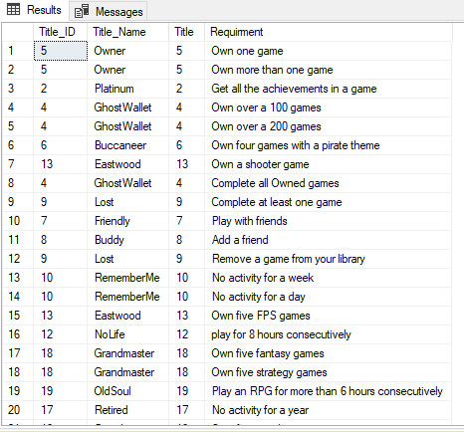
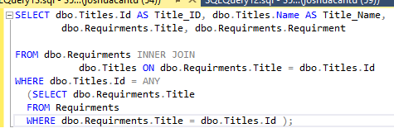
QM8: QUERY DATA WITH ANY/SOME/ALL:
Snapshot of the query output:
Description:
List all the Possible Titles, as well as the Requirements that must be met in order to achieve the Titles
SQL Query:

Slide 26
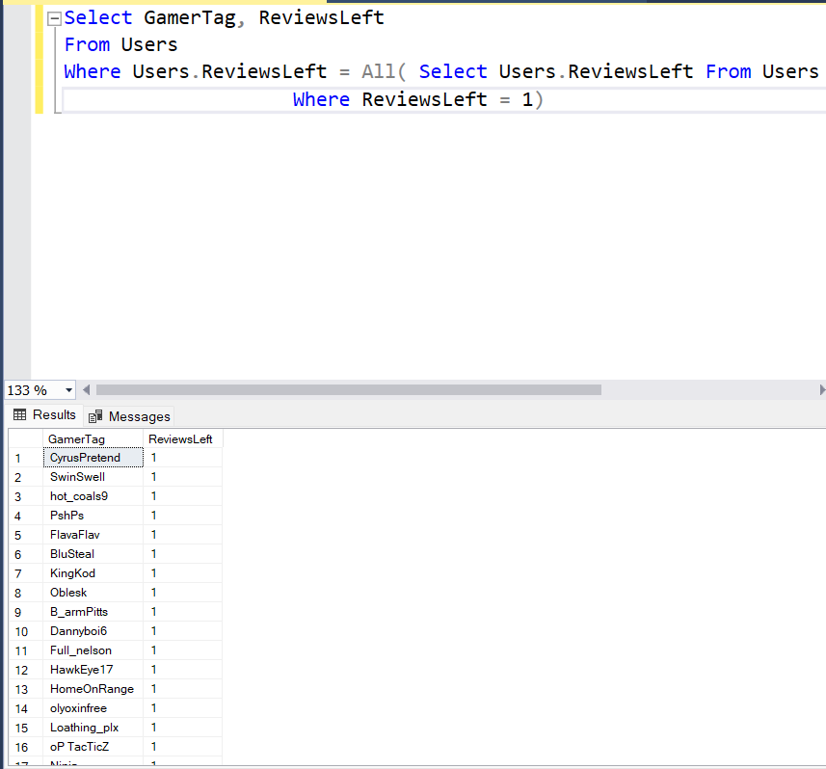
QM8: QUERY DATA WITH ANY/SOME/ALL:
Snapshot of the query output:
Description:
Select GamerTag and ReviewsLeft where there has only been one review left.
SQL Query:
Select GamerTag, ReviewsLeft
From Users
Where Users.ReviewsLeft = All( Select Users.ReviewsLeft From Users
Where ReviewsLeft = 1)

Slide 27
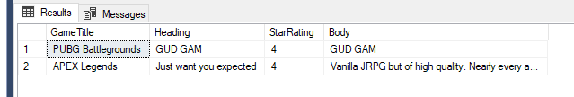
QM9.1: INNER-JOIN-QUERY WITH WHERE CLAUSE:
Snapshot of the query output:
Description:
Returns all reviews left by the User with the Gamertag GDoc. Returns the review with Game’s Title, and review info
SQL Query:
SELECT Games.GameTitle, Reviews.Heading, Reviews.StarRating, Reviews.Body
FROM Reviews INNER JOIN
Games ON Reviews.Id = Games.Id INNER JOIN
Users ON Reviews.[User ID] = Users.Id
WHERE (Users.GamerTag = 'GDoc')

Slide 28
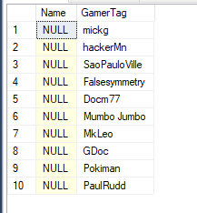
QM9.2: LEFT-OUTER-JOIN-QUERY WITH WHERE CLAUSE:
Snapshot of the query output:
Instruction: The query must return NULL due to the outer join
Description: Query returns all users’ GamerTags, with a left outer join returning null for the names of the user.
SQL Query:
SELECT Name, GamerTag
FROM Users AS E LEFT OUTER JOIN Titles AS S
ON E.GamerTag = S.Name

Slide 29
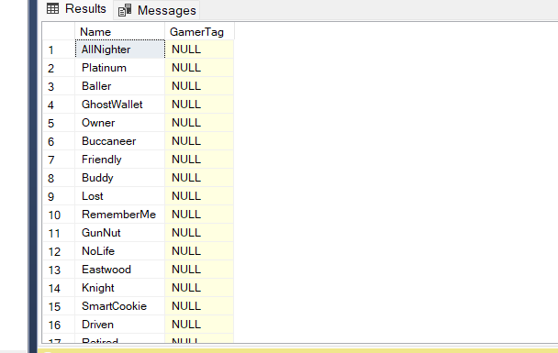
QM9.3: RIGHT-OUTER-JOIN-QUERY WITH WHERE CLAUSE:
Snapshot of the query output:
Instruction: The query must return NULL due to the outer join
Description: Query returns all users’ Names, where the Name contains AllNighter with a right outer join returning null for the GamerTags of the user.
SQL Query:
SELECT Name, GamerTag
FROM Users AS E RIGHT OUTER JOIN Titles AS S
ON E.GamerTag = S.Name
WHERE Name LIKE ('ALLNighter')

Slide 30
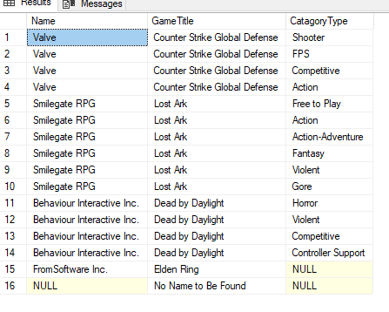
QM9.4: FULL-OUTER-JOIN-QUERY WITH WHERE CLAUSE:
Snapshot of the query output:
Finds all Games with a Rating Below 2 Stars, and returns Developer and Category
SQL Query:
SELECT Developer.Name, Games.GameTitle, Catagory.CatagoryType
FROM GameCatagories2 FULL OUTER JOIN
Games ON GameCatagories2.GameId = Games.Id FULL OUTER JOIN
GameDevs ON Games.Id = GameDevs.GameId FULL OUTER JOIN
Catagory ON GameCatagories2.CatagoryId = Catagory.Id FULL OUTER JOIN
Developer ON GameDevs.DevId = Developer.Id
WHERE (Games.AverageStars <= 2)

Slide 31

QM10.1: AGGREGATION-JOIN-QUERY WITH GROUP BY & HAVING:
Snapshot of the query output:
Description:
query returns all games with AverageStars rating greater than 4 using values assigned in the Games Table
SQL Query:
SELECT Games.UserCount, GameTitle, AverageStars
FROM Games LEFT OUTER JOIN Catagory AS C ON ( Games.Id = C.CatagoryType )
WHERE ( Games.AverageStars > 4 )
GROUP BY GameTitle, UserCount, AverageStars
HAVING ( AverageStars > 2 )

Slide 32
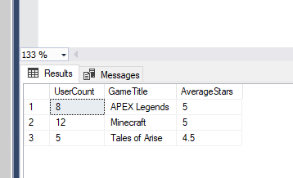
QM10.2: AGGREGATION-JOIN-QUERY WITH SUB-QUERY:
Snapshot of the query output:
Description:
query returns all games, with AverageStars rating greater than 4. Using value assigned by taking the average of StarRatings from Reviews Table as AverageStars.
SQL Query:
SELECT Games.UserCount, GameTitle, ( SELECT AVG(Reviews.StarRating)
FROM Reviews
WHERE Reviews.GameId = Games.Id
) AS AverageStars
FROM Games inner join Reviews as R on Games.Id = R.GameId
WHERE AverageStars > 3
GROUP BY GameTitle, UserCount, AverageStars, GameId, Games.Id
HAVING AverageStars > 4

Slide 33
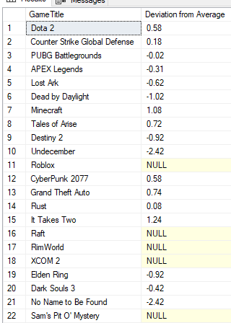
QM11: WITH-QUERY:
Snapshot of the query output:
Description: Calculates the Deviation of each games Average Rating, from the Average of all Reviews left (3.42).
SQL Query:
WITH tempDistanceFromAverage AS (
SELECT Games.Id,
ROUND(
(Games.AverageStars -
(SELECT AVG(Reviews.StarRating)
FROM Reviews
)
),2)
AS Distance
FROM Games
)
SELECT Games.GameTitle,
tempDistanceFromAverage.Distance AS
"Deviation from Average"
FROM Games INNER JOIN
tempDistanceFromAverage ON
tempDistanceFromAverage.Id = Games.Id

Slide 34
Credits and References
Microsoft
Schwifties
Google Cloud

