Slide 1
SEAL Systems
PowerPoint Master
With examples of use

Slide 2
Content
This is a table of contents.
This is where you list the individual points that you address in your presentation.
If you want to show the content again at different places in the presentation, you can change the color of the current point to Peach.
It will look like this.
You just have to select the current point and adjust the text color.

Slide 3
Dos and Don‘ts
Use only the preset colors
Use the provided icons only
Use these slides as a guideline
2022 SEAL Systems has adopted a new corporate design - learn more at
https://brandpad.io/seal-systems/
→ there are no more honeycombs, no Elvis, no hand-drawn icons, new colors, fonts etc. - if you are missing material, please contact marketing at marketing@sealsystems.de

Slide 4
Colors
Pay attention to good contrasts
Use these colors for
  positive accentuation (#1CC671)
  negative accentuation (#DA593F)
Midnight
HEX #222b50
RGB 34, 43, 80
Ivory
HEX #fbfdf6
RGB 251, 253, 246
Azure
HEX #003e7d
RGB 0, 62, 125
Linen
HEX #ccc6c2
RGB 204, 198, 194
Cobalt
HEX #00609e
RGB 0, 96, 158
Marble
HEX #efebe4
RGB 239, 235, 228
Sky
HEX #0080ff
RGB 0, 128, 255
Pepper
HEX #999592
RGB 153, 149, 146
Steel
HEX #7C8993
RGB 124, 137, 147
Peach
HEX #f78d6d
RGB 247, 141, 109
Alternative for Midnight
Alternative for Ivory
Black
HEX #000000
RGB 0, 0, 0
White
HEX #ffffff
RGB 255, 255, 255

Slide 5
Large images

Slide 6
Presenting screenshots …
If possible, use our monitor, tablet or smartphone to place and prominently display your screenshots …

Slide 7
Presenting screenshots …
... Pay attention to a suitable aspect ratio ...

Slide 8
Presenting screenshots …
... if necessary, choose a design without monitor or smartphone, if the aspect ratio does not fit: avoid distorting the screenshots.

Slide 9
Text with images
A selection of slides with images are also available
If the stored images are not suitable for your theme, you can select more here:
F:\PUBLIC\Marketingunterlagen\Bilder-Fotos
(we are currently working on a solution to share images internationally and stop using local file systems)

Slide 10
Presentation of tables
Header | Header | Header | Header
Line one | Line one | Line one | Line one
Row one | Row two | Row three | Row four
Line three | Line three | Line three | Line three

Slide 11




































Selection of the most important icons (1/3)
Mobile Printing
Web Printing
Group of printers
Printer-management
Printer check
Printer MFP
Printer Update
Fax machine
Plotter
Labelprinting
Printer connected
Output Management
Document Word
Document CAD
Document CAO
Document PDF
Data SAP
Document TIFF
PDF Document security
PDF Security PC
PDF/A
Conversion Word
Conversion CAD
Conversion CAO
Conversion PDF
Conversion SAP
SAP Document security
Desktop
Desktop
Smartphone
Tablet
Mobile Devices
Devices
Devices
Terminal Server
Terminal Cloud

Slide 12




































Selection of the most important icons (2/3)
EOS
Windows
SAP
Arrow left
Arrow top
Arrow right
Arrow down
Security
Security lock
PC Security
Firewall
Server check
Server
Server data transfer
Server secured
Integration
User
Rights & Roles
Increase efficiency
Time
Saving time and money
Efficiency & Safety
Sustainability
Manufacturing
Company
Web
Settings
Email
Mail
Email Security
Email Encrypted
Download
Cloud Security
Cloud Server
Cloud Connection
Cloud Update

Slide 13

























Selection of the most important icons (3/3)
Folder / Storage
Download document
Document batch
Document upload download
Document seal
Document security
Signature
ZIP folder
Stamp
Control Center
Paperless Production
PLOSSYS® Output Engine
PLOSSYS® Output
PLOSSYS® 4
DPF
Direct Publishing
Web Portal
PLOSSYS® Conversion
PLOSSYS® Distribution Engine
PLOSSYS® Distribution
PLOSSYS®
Client
PLOSSYS® Configuration
PLOSSYS® Monitor
SEAL General
Couldn't find the right icon? Here you can find more icons!

Slide 14


Creating process graphics using icons
MS Office
MS Visio
MS Project
PDF
PDF/A
XPS
TIFF
JPEG
(Thumbnails)
CorelDraw
OpenOffice
Office-Conversion

Slide 15
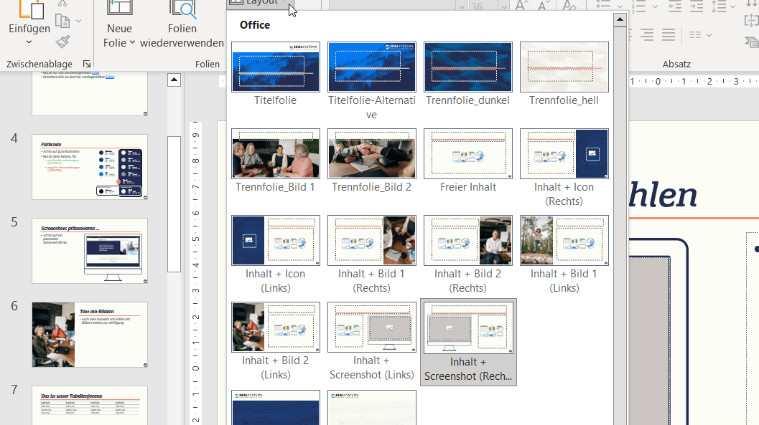
Select slide layout
Select "Start" menu item (top left)
Then click on the text-button "New slide" …
… or click on "Layout "
Select the template you want

Slide 16
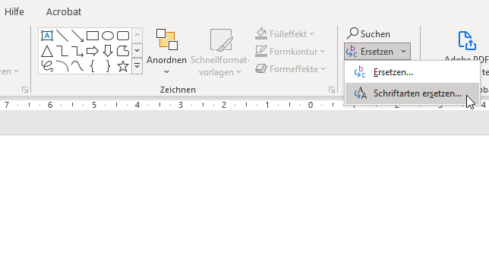
You copied slides from old presentations and have problems with fonts?
In case of problems with missing fonts:
On "Start" menu
Right on the arrow next to "Replace"
"Replace font“
Here you can replace the wrong font with the correct one.
If you have any questions: contact the Marketing Department!

Slide 17
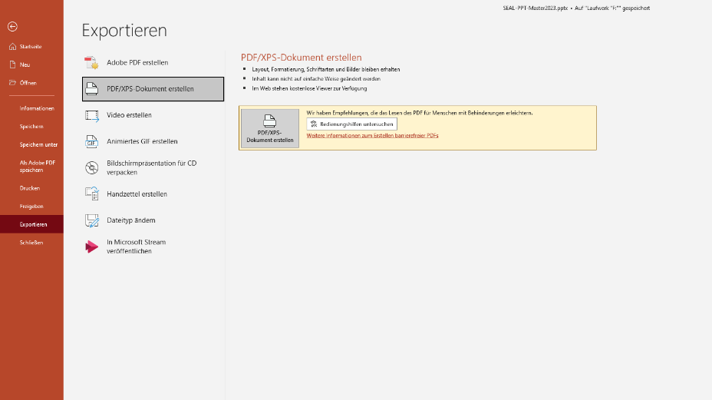
Export slides as PDF
To export your slide set as PDF select: File → Export → Create PDF/XPS document
Save the PDF to a location of your choice
Other functions like "Create Adobe PDF" or "Print → Microsoft Print to PDF" may cause display errors

Slide 19
Sample slides …
… on the following slides

Slide 20
SEAL Systems AG
Our company - Our solutions

Slide 21


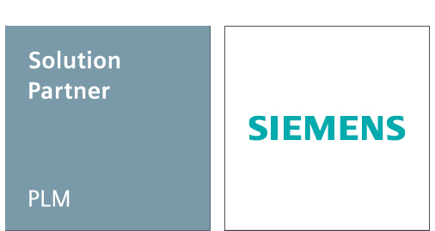
SEAL Systems
Short profile
Solution overview
Over 130 employees in Germany
18.5 million euros turnover in 2022
Subsidiaries in France and the USA
Business Development Scandinavia in Denmark
1,500 installations in 30 countries
1,000 SAP integrations
Over 40 years of experience and expertise
International partner network in Benelux, Italy, England, Switzerland, Scandinavia and Eastern Europe
Enterprise Output Management
Enterprise Conversion Solutions
SAP
Solutions

Slide 22
SEAL Systems: Solutions in detail
Enterprise
Output Management
Enterprise
Conversion Solutions
SAP Solutions
We offer middleware that optimally connects your applications with your printer and output infrastructure. Our Enterprise Output Management ensures smooth, perfectly controlled output on all output channels. Flexible, hardware-independent, transparent.
Working with your documents is simplified while increasing their security. For example, we automatically combine your documents, convert them to many different formats, stamp or sign them, file them, print them, or distribute them electronically - or even all at once.
Our Solutions help to provide documents managed in SAP ad-hoc or business process related, digitally or analogously or to prepare them before document display. We support all SAP DMS components as well as external management systems - up to the realization of a digital signature process in your SAP environment.

Slide 23




















Our customers

Slide 24
Enterprise Output Management –
What makes it stand out?

Slide 25
Enterprise Output Management – Definition
Application level
Multi-Channel-Output
SAP
Printer / Multi-function printer
Engineering
Email / Fax
Windows / Citrix
File / Portal
Mobile Devices
Mobile Devices / Display / Terminal

Slide 26
Enterprise Output Management – Definition
Application level
Middleware
Multi-Channel-Output
Output Management
Generic data preparation - conversion - spooling - output control and monitoring
SAP
Printer / Multi-function printer
Additional functions
Administration + Monitoring
Security + High Availability
Accounting + Controlling
Document preparation
Secure + Pull Printing
Rule-based job distribution
Printermanagement
Publishing
Formsmanagement
Engineering
Email / Fax
Windows / Citrix
File / Portal
Mobile Devices
Mobile Devices / Display / Terminal

Slide 27



Solutions for SAP: SEAL Process Printing
SAP Form
Document attachments
Order-correct output at the push of a button
Invoice
Production order
Sales order
Purchase order
Delivery bill
…
Open Text
SharePoint
cFolders
DMS
ArchiveLink
Services to the object
Folders Management
…

Slide 28
Enterprise Output Management – the key topics
Transparency
Monitoring
Accounting
Reliability
Failover
Loadbalancing
Security
Encryption
Loadbalancing
Document security

Slide 29
Enterprise Output Management – the key topics
Single Point of Administration
Devicemanagement
Jobmanagement
Neutrality
At device level
At application level
Costs
Standardization
Centralization
Independence

Slide 30

Enterprise Output Management – What sets us apart
Cloud native architecture
  Technology
    Microservices
    Containerizable (Docker)
    Kubernetes and Openshift
  Benefits
    Zero Downtime
    Automatically scalable solution
    Highest reliability
    Future-oriented

Slide 31

Enterprise Output Management – What sets us apart
Serverless and Driverless Printing
  Technology
    Solution Architecture
    Master Driver
    Printservice
  Benefits
    No driver conflicts on the workstations or the Citrix/terminal servers
    Enables drastic reduction of the server infrastructure in use

Slide 32

Enterprise Output Management – What sets us apart
SAP Process printing
  Technology
    Own solution modules in SAP
    Forms and documents for a business process in one operation
  Benefits
    Process optimization through automation
      Faster
      Safer
      More cost effective

Slide 33
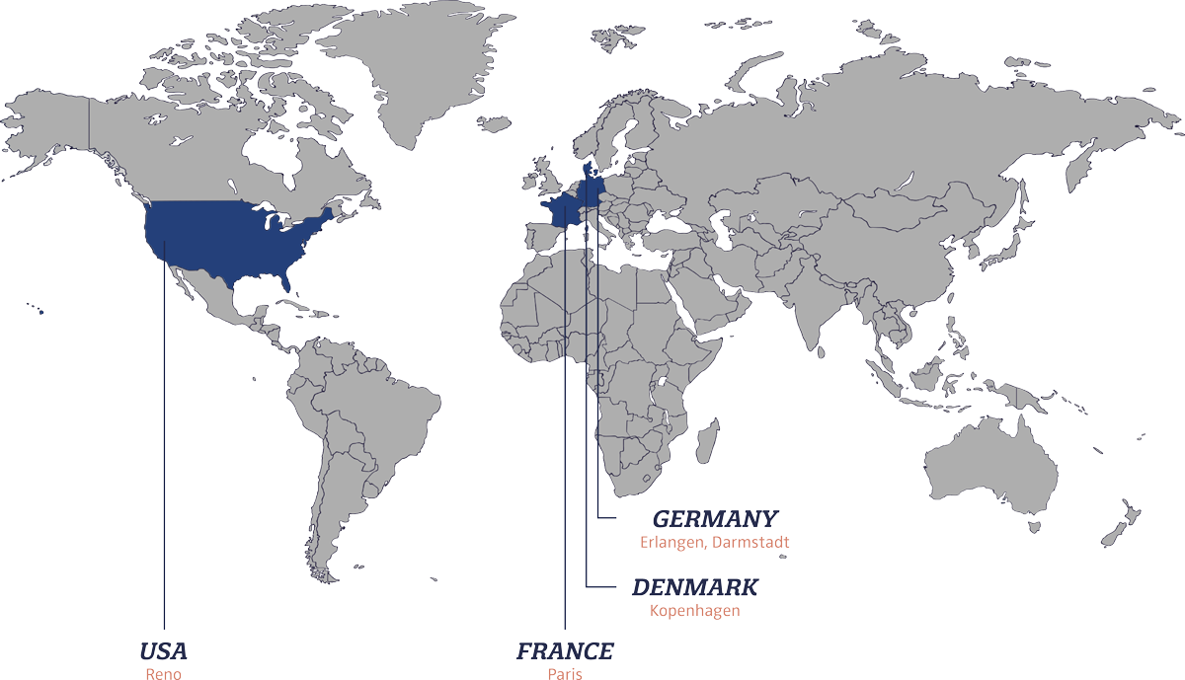
SEAL Systems in numbers
Over 130 employees in Germany
Subsidiaries in France and the USA
Business Development Scandinavia in Denmark
International partner network
1,500 customers worldwide
1.000 installations with SAP integrations
Over 40 years of experience
Our sites

Slide 34
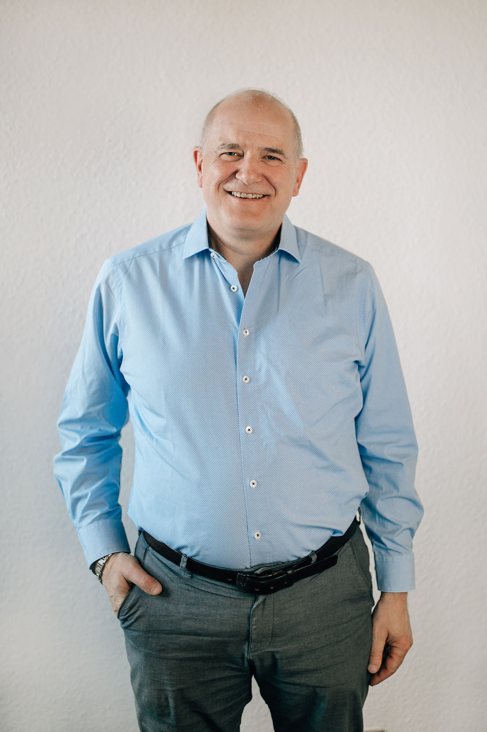




Thank you!
SEAL Systems AG
Lohmühlweg 4
91341 Röttenbach
GERMANY
Tel.: +49 9195 926 0
Email: info@sealsystems.de
Web: www.sealsystems.de
Johannes Hesel
+49 6154 637 371
johannes.hesel@sealsystems.de
Matthias Müller
+49 9195 926 102
matthias.mueller@sealsystems.de

Slide 35
Matthias Müller
Johannes Hesel
+49 9195 926 102
matthias.mueller@sealsystems.de
+49 6154 637 371
johannes.hesel@sealsystems.de

