Slide 1
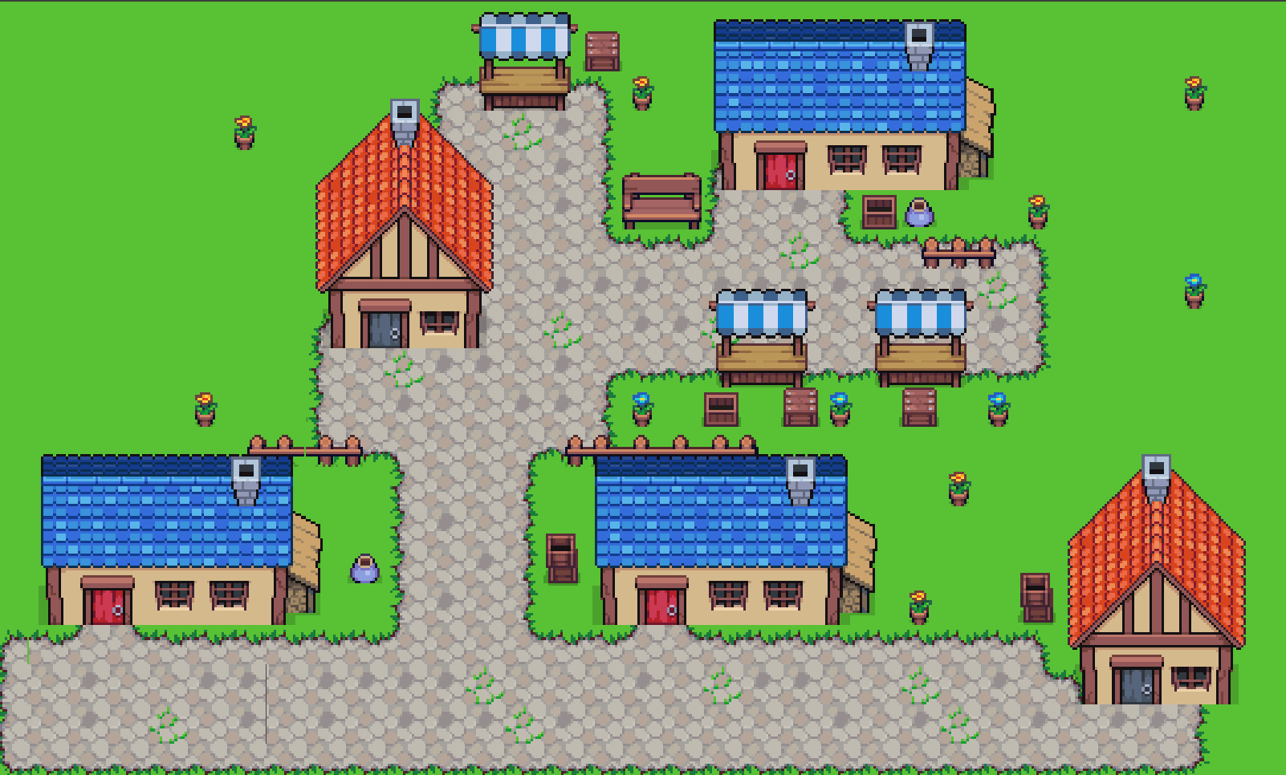

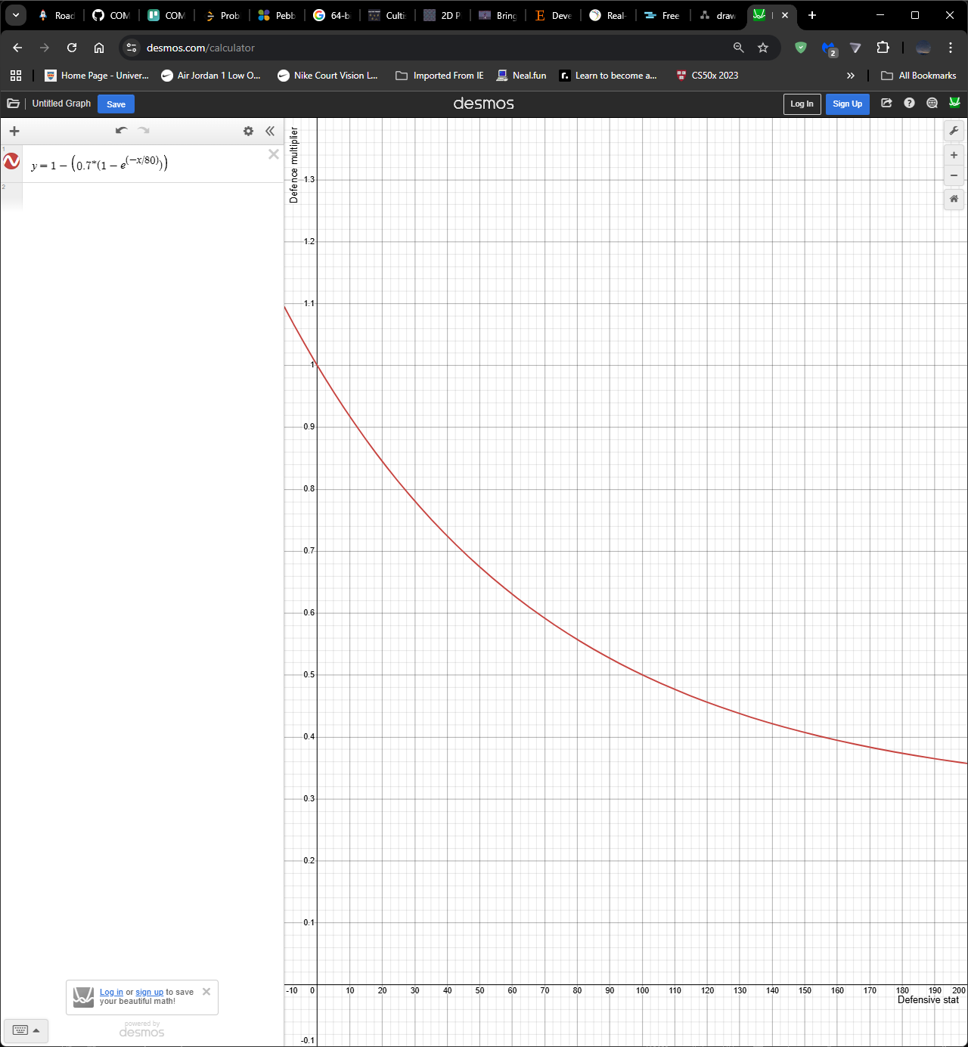
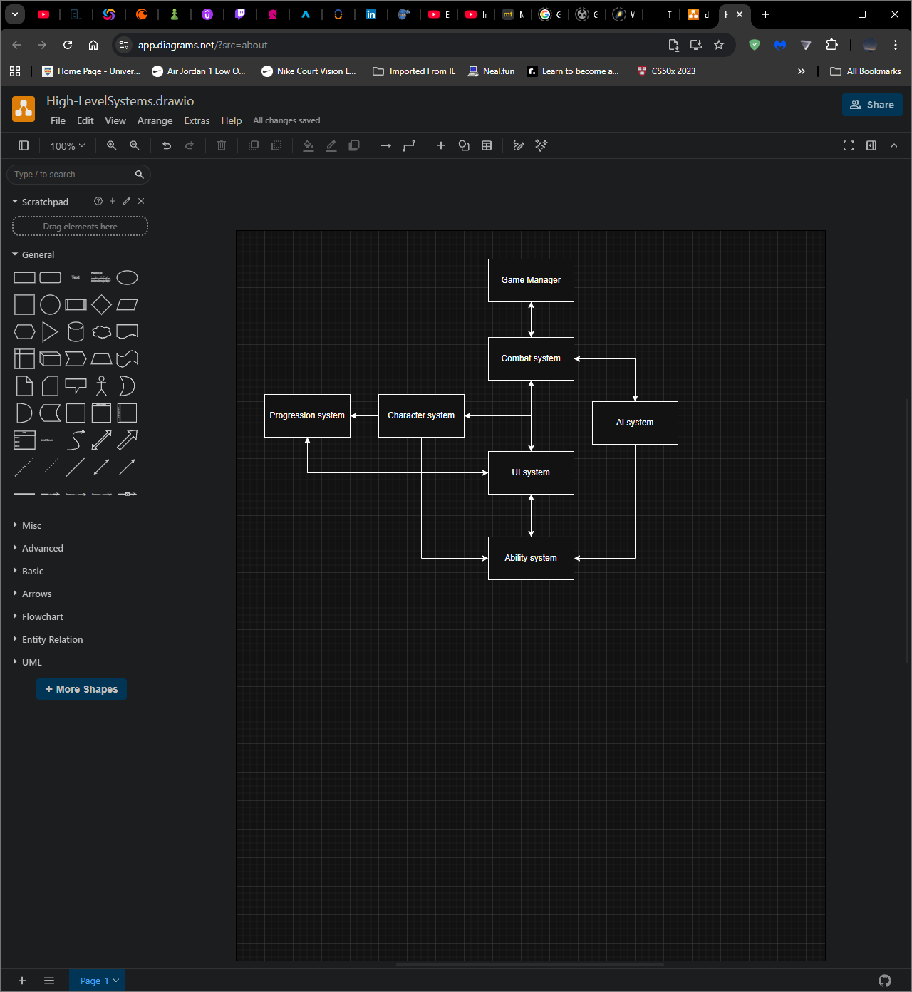


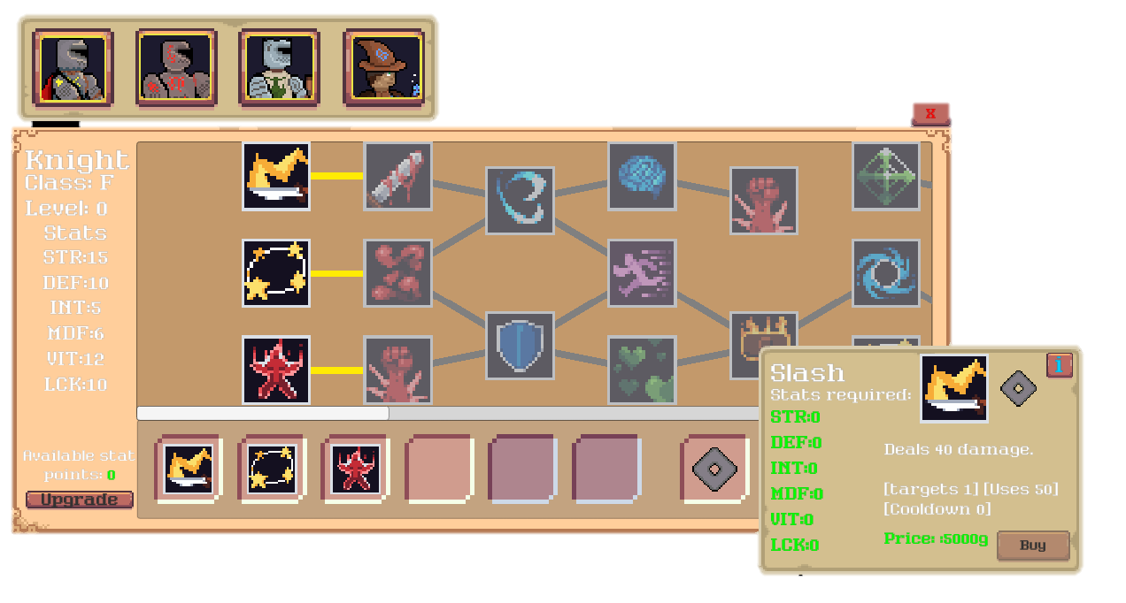


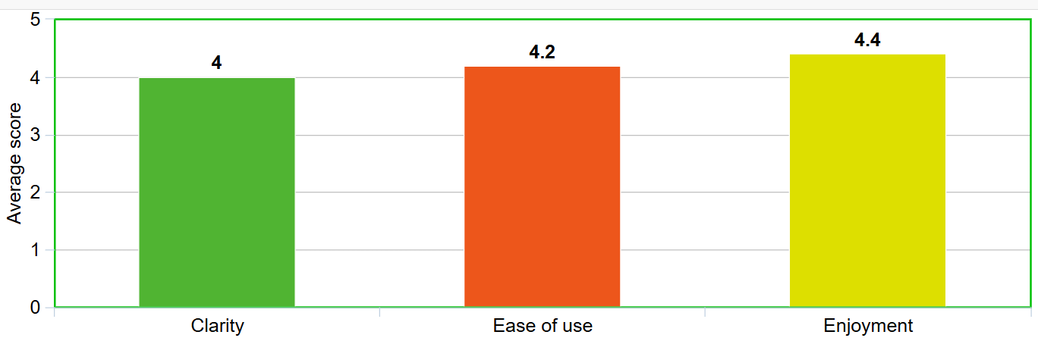
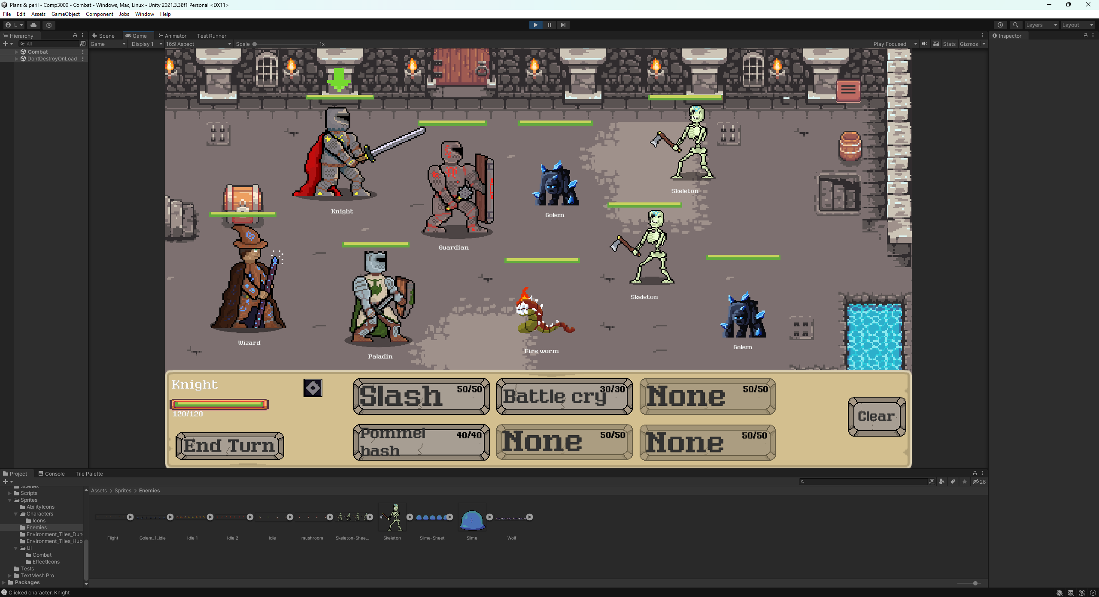
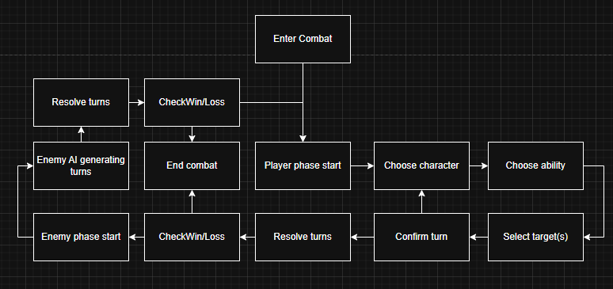





Plans & Perils :
Developing a Turn-Based Combat Game as a Tool for Strategic Skill Acquisition
Jonathan Andrews
BSc: Computer science (games development)
Supervisor: Rory Hopcraft
Background and rationale
Strategic skills are essential in multiple aspects of life, however there are few places to develop them.
Aim: to develop and evaluate a high-quality modular combat system architecture that supports learning in an enjoyable environment.
Objectives:
Make a functional and robust game with minimal to no major bugs or crashes
Have the game’s core function be based on strategic thinking and actions
Have players learn core team management skills
Make the theme of the game suitable and enjoyable for 10–14-year-olds by following industry standards
Core combat loop
Development and technical highlights
Development timeline:
Combat and ability systems
Progression system
Character ability trees
Enemy AI expansion
Technical highlights
Dynamic damage calculation formula
Status effect stacking system
Modular ability framework using scriptable objects
Automated unit testing of combat logic using unity testing framework
Data-driven architecture to support scalability and maintainability
Equation for damage scaling for stat differences
maxDR: maximum percentage (0.7)
D: defensive stat
Kd: scaling constant (80)
AttackMultiplier = 1 + (Attack / 100)
FinalDamage = BaseDamage × AttackMultiplier × DefenceMultiplier
1−maxDR×(1−e^{−D/kd})
General systems overview
Results
Testing results:
Method: 5 participants with no prior exposure to system completed tutorial and 5 minutes of gameplay
Key findings:
Players could understand core combat mechanics quickly
Ability usage was generally intuitive
Some confusion observed in sections of tutorial
Conclusions:
This system demonstrated good usability and clarity to new players, although further work was needed and carried out to improve tutorial. Evaluation with a larger sample size is needed.
Character selection
Enemy selection
Character info
End/Skip turn
Ability selection buttons
Clear current selection
Made with:

