Slide 1
What can redis do for you?
An intro to redis

Slide 2
What is redis?
A very fast in-memory data structure store
Used as a database, cache, or message broker
Essentially a very fast key-value store
Supported in most widely-used languages (C, C#, C++, Java, Python, Node.js, Scala, etc.)
Supports many basic types and sets as values

Slide 3
Why do I care?
Caching of queries
Performance improvements
5-10x Faster GraphQL queries
One server/cluster can cache multiple types of information
Easy to use
Can theoretically store anything, not just query results

Slide 4
Limitations
Larger keys = Larger lookup times
Memory-intensive on the server: All data held in memory
Keys must be strings
String can be binary sequences
Keys and values are limited to 512MB each
Less persistence than fully-fledged RDBMS

Slide 5
How do I use it?
Essentially a giant HashMap
Insert, remove, edit key-value pairs
Clients offer easy API methods
Most methods can be asynchronous or synchronous
Use query as key, string representation of result as value
Can group operations as transactions
// C# example code
// db is connection to Redis
string key = “Any string”;
string value = “Basic data type or set”;
db.StringSet(key, value);
string retVal = db.StringGet(key);
bool isSame = retVal.Equals(value); // True

Slide 6
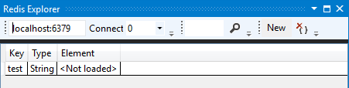
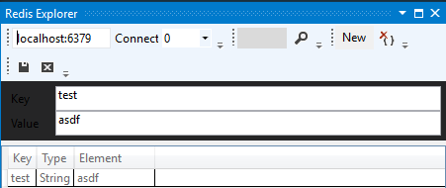
Redis explorer
Visual Studio extension for viewing Redis
Lists ‘rows’ of key-value pairs
Does not automatically load values
View -> Other Windows - > Redis Explorer

Slide 7
When to not use Redis
Very large queries
Major limiting factor will be network bandwidth/latency
SQL Server Queries (Specifically the results) for performance improvements
Must be parsed into compatible format
SQL Server 2016 supports JSON return, we don’t have that
Redis performs at about the same speed
Only reason would be to remove load from SQL Server

Slide 8
Cloning the repo
We have provided some starter code
git clone https://github.com/zoldham/Redis-Intro Redis
The starter code will be in Redis/Attendees

